Slide 1
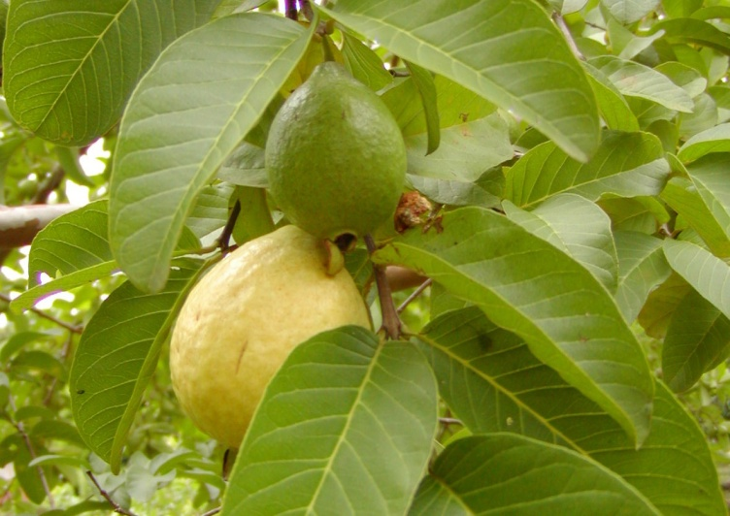
Centurion
UNIVERSITY
INSECT PESTS OF GUAVA
Centurion University of Technology and Management
Shaping Lives...Empowering Communities...

Slide 2
TEA MOSQUITO BUG Helopeltis antonii Miridae: Hemiptera
DISRIBUTION
It is a major insect pest distributed in AP, Kerala, Karnataka, Goa, Maharastra and TN.
NATURE OF DAMAGE
Nymphs and adults pierce the guava fruits of all sizes, tender twigs and leaves for sucking sap.
Each tab (probe) on the fruit results in a brownish spot which develops into a raised pustule known as scab (gajji).
A bug may tab in about 50 places on a single fruit.
On tender fruits, the spots may coalesce and fina lly crack.
Such tender fruits drop down.

Slide 3
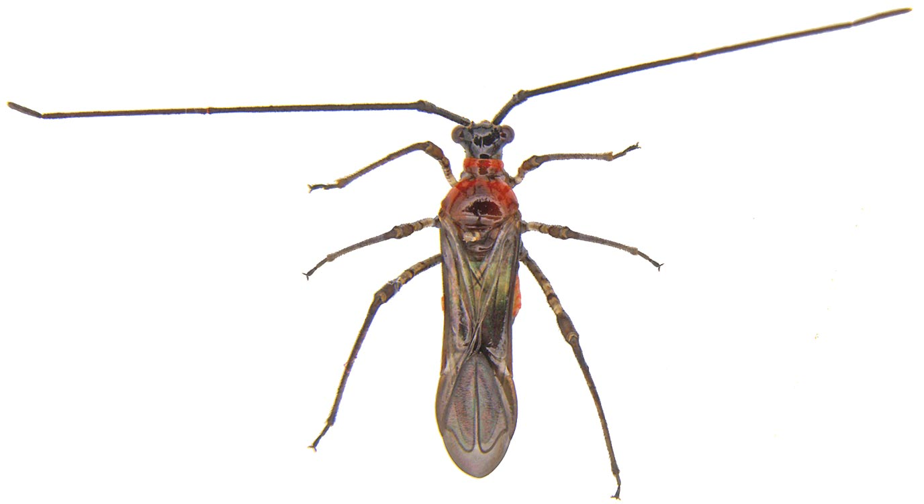

Slide 4
If the bug pierces into the twig, black, linear scars will form.
If tender leaves are pierced there may be small reddish streaks and will curl up.
SYMPTOMS OF DAMAGE
Scab on fruit surface
Black linear scars on twigs
Reddish streaks on leaves

Slide 5
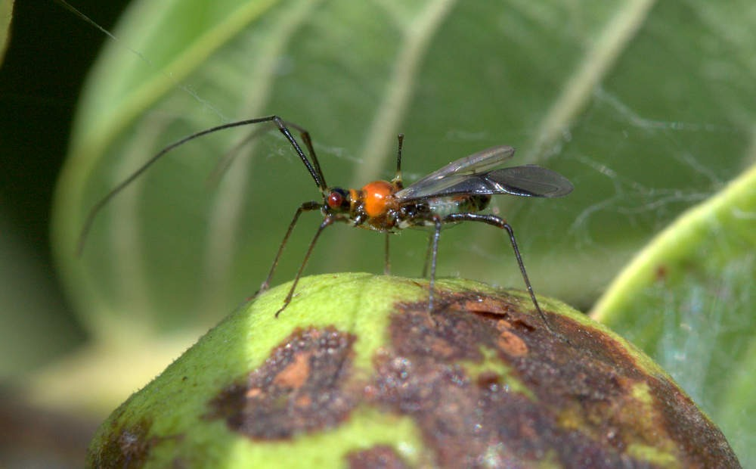

Slide 6
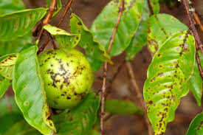

Slide 7
MANAGEMENT
Nymphs are parasitized by the mermithid, Agamermis paradecaudata
Application of recommended dose of fertilizers.
Spray application of monocrotophos 1.6ml/l or dimethoate 2ml/l at fortnightly interval during the fruit development will manage the pest.

Slide 8
GUAVA MEALY BUG Ferrisia virgata Pseudococcidae: Hemiptera
DISTRIBUTION
It is otherwise called white tailed mealy bug /striped mealy bug. It is a widely distributed species in tropical and subtropical countries.
APPEARANCE
Female bug is apterous with two long prominent waxy filaments at the posterior end and a number of waxy hairs over the body covered with waxy powder.
In the posterior end of the body, the dorsum has a prominent blackish patch.
It has the habit of encircling itself by secreting thin glassy threads of wax specially when its population is less.

Slide 9
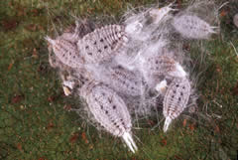

Slide 10
LIFE HISTORY
Reproduction takes place both sexually and parthenogenitically, the latter being more common.
Mating takes place only once and lasts for about 12-23 minutes.
The female lays the eggs in groups which lie under its body. Fecundity ranges from 109 to 185 during aoviposition period of 20-29 days. Incubation period is about 3-4 hours
Male and female nymphs moult 3 - 4 times respectively and their development period varies from 26 to 47 and 31 to 57 days.

Slide 11
Longevity of female is 36-53 days and that of male is only 1-3 days
NATURE OF DAMAGE
Nymphs and adults remain clustering upon the terminal shoots, leaves and fruits and suck the sap which results in
SYMPTOMS OF DAMAGE
Yellowing, withering and drying of plants or shedding of fruits etc.
Formation of sooty mould due to honey dew excretion.
In dry weather they may move down below ground and inhabit the roots

Slide 12
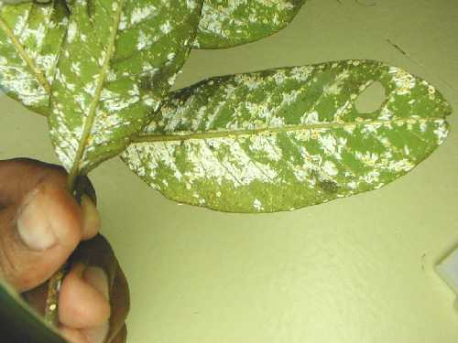

Slide 13
MANAGEMENT
Pruning and destruction of the infested twigs.
The branches that are touching the ground to be cut and destroyed
Periodical raking of basins and application of balanced dose of fertilizers especially N.
Arranging the polythene sheet around the stem.
Predators Chrysoperla carnea, Cryptolaemus montrouzieri, Pullus sp. suppress the natural population.
Spray dichlorvos1.0 ml/l or acephate 1.5 g/l.

Slide 14
FRUIT FLY Bactrocera dorsalis, B. diversus, B. zonatus, B. cucurbitae Tephritidae: Diptera
Bactrocera, B. dorsalis is the most common causes considerable loss to fruit yield
Flylays the eggs on developing fruits.
Maggots enter into the fruit and feed on the pulp.
The damage leads to the formation of soft patches on the fruit and premature drop of fruits.
The mature maggots come out of the fruit and fall to the ground and pupate in soil.
Premature fruit drop, fruits with exit holes and soft patches are the symptoms of damage.

Slide 15
Collection and destruction of fruits, periodical raking of the plant basins
Incorporation of carbaryl 10D @ 50-100 g / tree manages the pupa.
Poison baiting with a mixture of molasses / sugar @ 200 g and malathion 50 ml in 2litres of water kept in small earthen pots in the field attracts and kills the adults

Slide 16
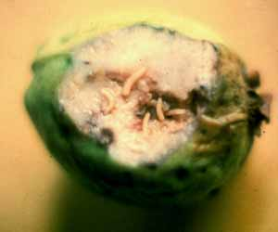

Slide 17
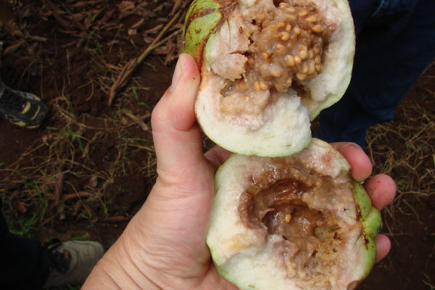

Slide 18
SPIRALLING WHITE FLY Aleurodicus dispersus Aleurodidae: Hemiptera
DISTRIBUTION
The pest is a native of America and distributed all over the world.
In India this pest is mostly distributed in Kerala, Karnataka, Tamil Nadu and Andhra Pradesh
APPEARANCE
Adult spiralling whitefly is bigger than the other aleurodids.
LIFE HISTORY
Eggs are laid in groups of 15-25 on the undersurface of the leaf in circular fashion, hence spiralling whitefly.
Fecundity is 200 eggs.

Slide 19
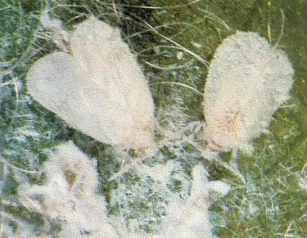

Slide 20
Nymphs are covered with white cottony mass and suck sap from leaves
SYMPTOMS OF DAMAGE
The leaves crinkle and turn to red colour.
The honeydew excretion leads to formation of sooty mould that hinders the photosynthetic activity.
The vigour of the plant and fruit yields are reduced.
Timely pruning of plants and balanced nutrition

Slide 21
MANAGEMENT
Aphelinid, Encarsia sp. Are the most important in reducing the population.
Cryptolaemus montrouzieri and Mallada sp. are the other natural enemies associated with this pest.
Arranging yellow sticky traps in the gardens especially during night times for the flying adults
Spray application of neem oil 0.5 ml /l or neem based product also reduce the damage

Slide 22
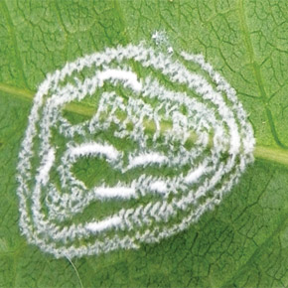

Slide 23
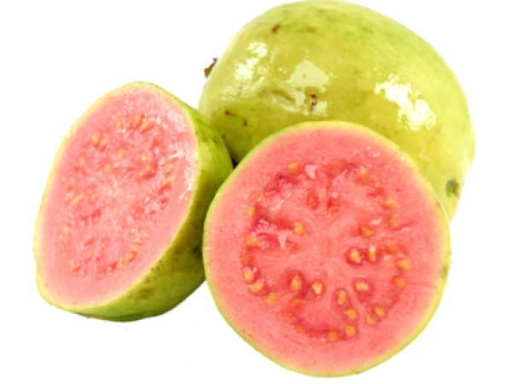
THANK U…….

