Slide 1
Centurion
UNIVERSITY
PESTS OF VEGETABLE CROPS AND
THEIR MANAGEMENT
Centurion University of Technology and Management
Shaping Lives...Empowering Communities...

Slide 2
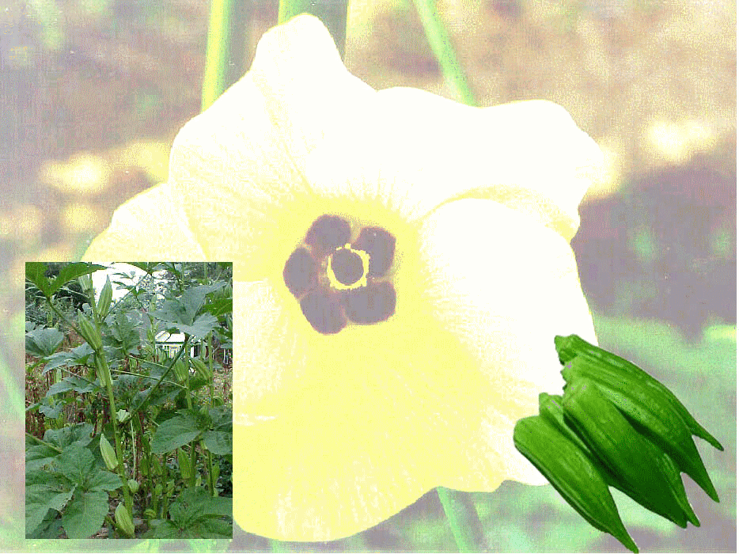
INSECT PESTS OF BHENDI

Slide 3
Common name | Scientific name | Family | Order
1. Bhendi shoot and fruit borer/ spotted fruit borer | Earias vitella, E. insulana | Noctuidae | Lepidoptera
2. Leaf hoppers | Amrasca biguttula biguttula, Cestius phycitis | Cidadellidae | Hemiptera
3. Whitefly | Bemesia tabaci | Aleurodidae | Hemiptera
4. Red spider mites | Tetranychus telarius | Tetranychidae | Acarina

Slide 4
BHENDI SHOOT & FRUIT BORER / SPOTTED FRUIT BORER Earias vitella, E. insulana Noctuidae: Lepidoptera
DISTRIBUTION:
It is one of the important pests of bhendi throughout the country. It also infests cotton, mesta, Abutilon etc.,
APPEARANCE:
Adult of E. vitella has pale whitish forewings with a broad greenish band in the middle while E. insulana has completely green forewings.
The adult body length is about one cm while the wing span is about 2.5 cm.

Slide 5
Shoot and fruit borer
Earias vitella & E. insulana

Slide 6
Life cycle:
The female moth lays spherical, sculptured bluish eggs singly or in groups on tender leaves, fresh squares (flower buds) and flowers.
On an average each female lays 60-80 eggs. Egg period is about 2-10 days.
The caterpillars of both the species have a number of black and brown spots on the body and hence the name spotted fruit borer.
Full grown larva measures 14 mm in length.
The larval stage lasts for about 9-25 days.
Pupation takes place generally in fallen material, outside the boll, on plant surfaces and in cracks and crevices of the soil.
Before pupation however, the larva spins a dirty, white boat shaped silken cocoon.
Pupal period is about 6-25 days. Total life cycle takes 20-22 days.

Slide 7
SYMPTOMS OF DAMAGE:
In the early stage of the crop, the caterpillars bore into growing shoots of plants.
When the fruits appear they also bore into the fruits which show holes plugged with excreta.
The infested fruits are mostly shed in early stage of fruiting.
Drooping of tender shoots
Holes on the infested fruit and filled with excreta
Fruits distorted and rendered unfit for human consumption.

Slide 8
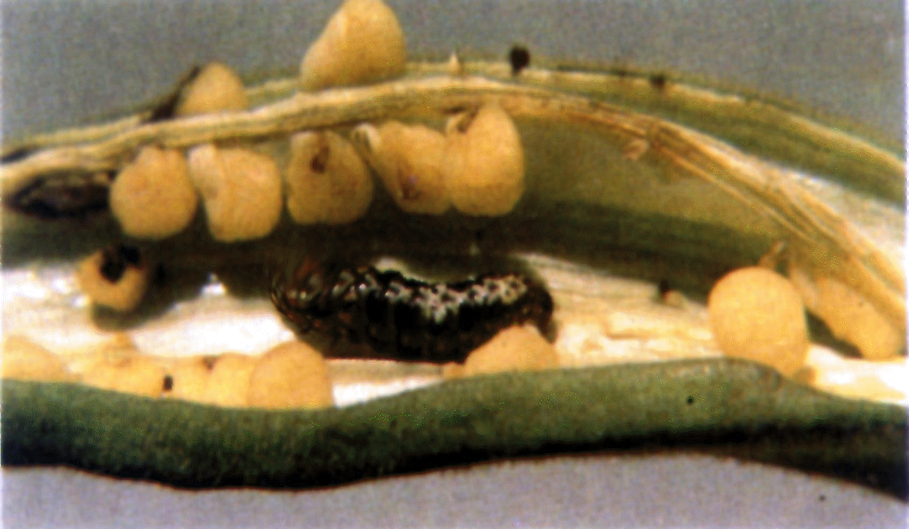
Earias larva damaging fruit

Slide 9
Earias Damage to shoots

Slide 10
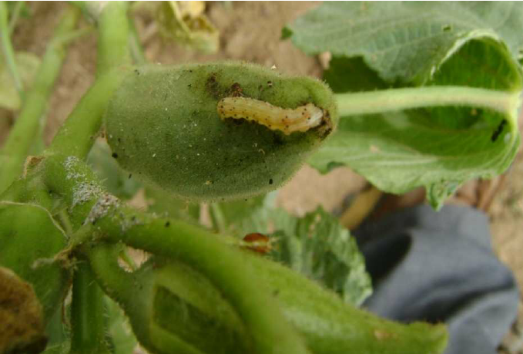
Earias Damage to Fruit

Slide 11
MANAGEMENT
Avoiding bhendi or cotton during off season which will serve as alternate hosts.
Removal and destruction of affected shoots, fruits in early season help in keeping the pest under check.
Natural enemies:
Trichogramma evanescens which parasitises the eggs
Bracon lefroyi which parasitise the larval stage and
Chelonus and Chalcis species that parasitise pupal stages.
Foliar spray with thiodicarb 1 g/l during vegetative and at fruiting stages or carbaryl 3g/l or quinalphos 2 ml/l or profenophos 2 ml/l or endosulfan 2 ml/l twice at 10 day interval after harvest of fruits.

Slide 12
LEAF HOPPERS Amrasca biguttula biguttula Cidadellidae: Hemiptera
Both nymphs and adults suck the sap from underside of leaves injecting toxic saliva. The damage results in
Characteristic hopper burn symptom.
Infested leaves crinkle and show characteristic browning
Attacked plants stunted, fail to bear fruits.
MANAGEMENT
Removal of affected parts.
A spider Distina albina and a chrysopid, Chrysopa cymbela are predaceous on leafhoppers. Lymaenon empoascae parasitizes the eggs.
Foliar sprays with dimethoate 2ml/l or methyl demeton 2 ml/l or fipronil 2 ml/l are effective.

Slide 13
NYMPH OF LEAF HOPPERS

Slide 14
Nymphs and adults sucks sap from underside of leaves

Slide 15
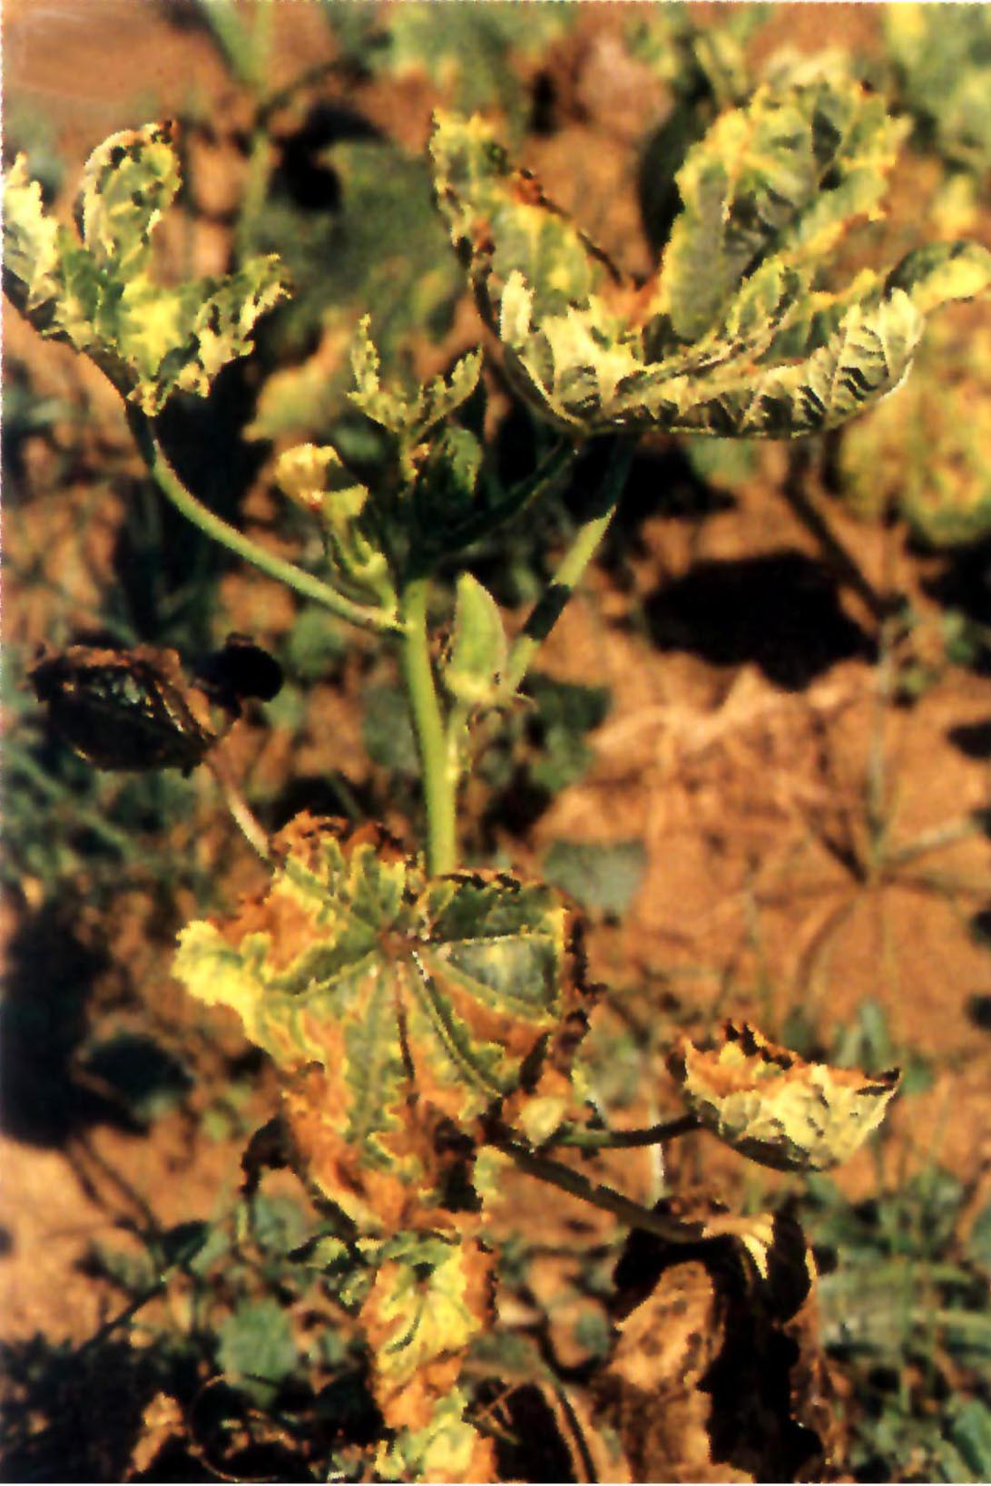
Damage symptom on leaves

Slide 16
WHITEFLY Bemesia tabaci: Aleurodidae: Hemiptera
Both nymphs and adults suck the sap from underside of leaves.
As a result, the plant loses its luster.
The adult acts as a vector for yellow vein mosaic virus disease.
MANAGEMENT:
Removal of affected plants, erecting yellow sticky traps, spraying with acetamiprid 0.4g/l or thiamethoxam 0.4g/l or profenophos 2ml/l were found effective

Slide 17
Whitefly Bemisia tabaci
NYMPHS
ADULT

Slide 18
Yellowing of entire network of veins.

Slide 19
Stunted Plants and YVMV symptoms

Slide 20
RED SPIDER MITE Tetranychus telarius Tetranychidae: Acarina
Red spider mites are found in large colonies on underside of leaves protected by the silk webbing constructed by the female.
They are polyphagous infesting brinjal, bhendi and bean.
Leaves present a characteristic blotches which become whitish then brown patches appear. Later the entire affected leaf become discoloured and dried up.
MANAGEMENT
Spraying with wettable sulphur 3-5 gm/l or dicofol 2.7 ml/l or spiromecyferan 3 ml/l or propargite 3 ml/l twice at 10 day interval are effective.

Slide 21
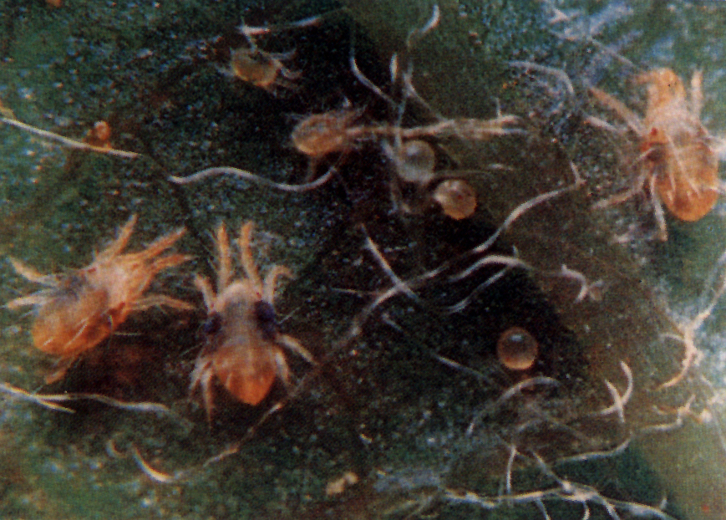
RED SPIDER MITES Tetranychus urticae

