Slide 1
Types of green house on the basis of utility

Slide 2
Greenhouses for active heating
During the night time, air temperature inside greenhouse decreases. To avoid the cold bite to plants due to freezing, some amount of heat has to be supplied.
The requirements for heating greenhouse depend on the rate at which the heat is lost to the outside environment.

Slide 3
Greenhouses for active cooling
During summer season, it is desirable to reduce the temperatures of greenhouse than the ambient temperatures, for effective crop growth.
Hence suitable modifications are made in the green house so that large volumes of cooled air is drawn into greenhouse, This type of greenhouse either consists of evaporative cooling pad with fan or fog cooling.

Slide 4
Greenhouse type based on construction
The type of construction is predominantly influenced by the structural material, though the covering material also influences the type.
Span of the house inurn dictates the selection of structural members and their construction.

Slide 5
Wooden framed structures
In general, for the greenhouses with span less than 6 m, only wooden framed structures are used.
Side posts and columns are constructed of wood without the use of a truss.
Pine wood is commonly used as it is inexpensive and possesses the required strength.
Timber locally available, with good strength, durability and machinability also can be used for the construction

Slide 6
Pipe framed structures
Pipes are used for construction of greenhouses, when the clear span is around 12m .
In general, the side posts, columns, cross ties and purlins are constructed using pipes.
In this type, the trusses are not used.

Slide 7
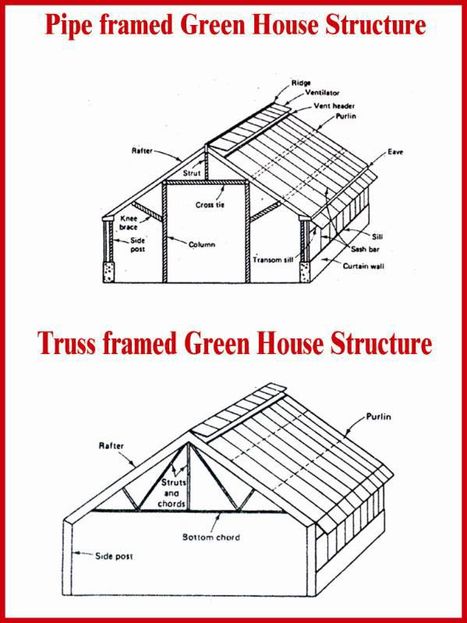
Truss framed structures

Slide 8
Greenhouse type based on covering materials
Covering materials are the major and important component of the greenhouse structure.
Covering materials have direct influence on the greenhouse effect inside the structure and they alter the air temperature inside the house.

Slide 9
Glass greenhouses
Plastic film greenhouses
Rigid panel greenhouses
Shading nets

