Slide 1
Industrial IoT and Automation

Slide 2
IoT vs. Industrial IoT
IoT is the proliferation of Smart Devices.
The benefit of using Smart Devices at home would be reducing electric bills and time savings etc.
Managing Heavily Electric Consuming usage of electric appliances to be used at the time of when electric rate is cheapest, based on Sensors to operate.
IoT devices are commonly used by the hobbyist or another consumer usage, and even in industry.
In a home network, loss of the generated data would be trivial.
IIoT is designed for heavy-duty tasks such as manufacturing, monitoring, etc.
IIoT uses more precise and durable (heat/cold resistant) devices, actuators, sensors, etc.
IIoT is scalable and the volume of generated data and how data has been handled.
IIoT devices generate massive amount of data.
In IIoT loss of the data is vital, as this may generate huge amont of financial loss.

Slide 3
IoT vs. Industrial IoT
Both IoT and IIoT have the same core principles such as Data Management, Network, Security, Cloud, etc.

Slide 4
Seven Principles
According to a keynote speech delivered by Tom Bradicich, the Seven Principles of the IIoT are provided as follows:
Big amount of analog data
Perpetual connectivity
Real-time data streaming
Data insights
Time-to vs. depth-of-insight trade-off
Visibility from Big Data
Edge computing

Slide 5
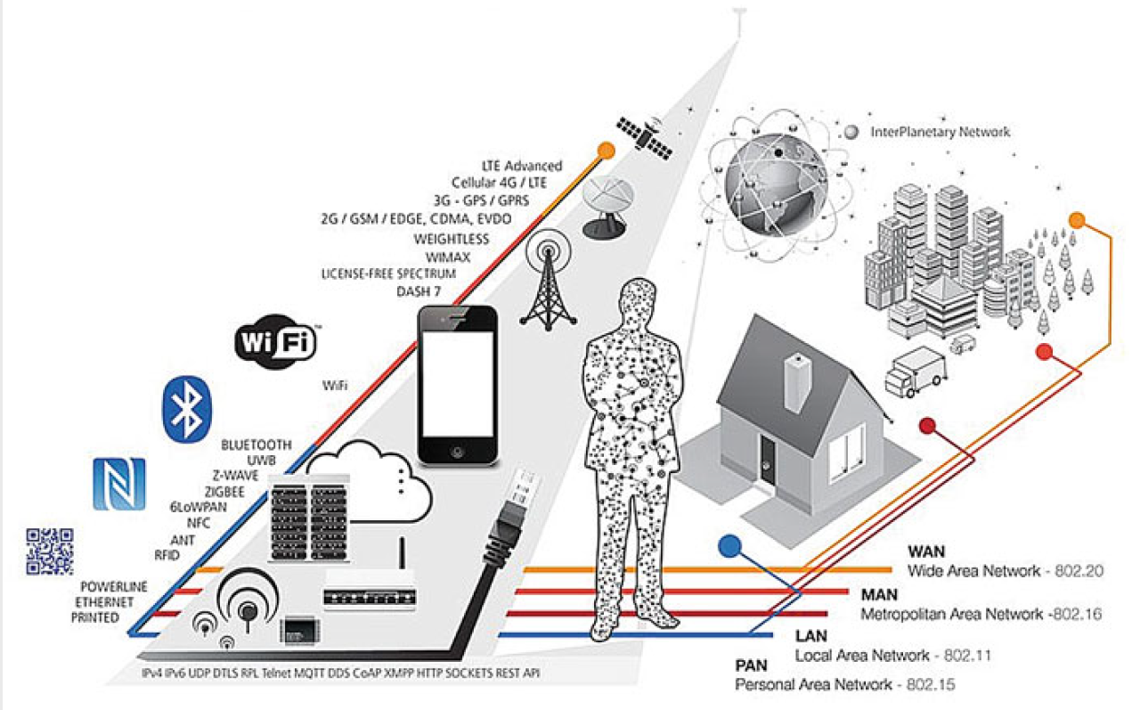
IoT connectivity diagram
Multi-agent systems (coordination and collaboration—distributed resolution of problems, decision and reasoning, learning, planning, simulation)
Human interactions (learning, chat-bots, expert systems)
Computer vision
Robotics
Neuroscience and cognitive science (comprehension and simulation of the brain and nervous system)
Fig. 1: IoT connectivity diagram.

