Slide 1
DAM Site selection and types

Slide 2
Dam
A dam may be defined as a solid barrier constructed at suitable location across river valley with a view of impounding water flowing through that river.
Dams are created for the following objectives: Generation of hydropower energy
Providing water for irrigation facilities Fish farming
Fighting droughts Controlling of floods
Water supply for domestic consumption Providing navigational facilities
•
•
•
•
•
•
•
•
•

Slide 3
Dams
A watertight seal placed in a river in order to create a lake or reservoir by impounding the stream flow
Must be stable under all loading conditions
must resist
  hydrostatic pressures on its upstream face
  destructive influences of water perculation and possible uplift due to it

Slide 4
Investigation for Dams
Factors to be considered include:
Geological conditions
– effect the location and construction of the foundations, abutments, dam itself, and spillways
long and short term stream flow
rainfall and storage reservoir characteristics of the proposed dam catchment
access road

Slide 5
Investigation for Dams
Factors to be considered continued:
local availability of earth and rock materials and their suitability for dam construction
– or as concrete aggregates
degree of permeability of the rock formation on which the dam is to be placed
– may affect hydrostatic uplift pressures and the degree of grouting necessary to control it

Slide 6
Investigation for Dams
Factors to be considered continued:
planning for river diversion to occur while the dam is being constructed
  cutting a temporary channel which by-passes the dam itself
  installation of large pipes under the dam

Slide 7
Investigation for Dams
Factors to be considered continued:
provision of sites for:
  water intake structures and pumping stations for water supply dam
  Penstocks ( inlet tower )
  power station in the case of hydro-electric facilities

Slide 8
Investigation for Dams
Factors to be considered continued:
an Environmental Impact Study
  short and long term effects of of the proposed reservoir and the construction operations on the region
  aesthetics, plant and animal, ecology, fish preservation and public amenity of the reservoir and downstream reaches
  noise and dust hazards in construction
  effects of the dam on the regional micro-climate

Slide 9
Types of Dams
Dams are classified by the materials of which they are constructed:
earth
earth and rock
rock
concrete

Slide 10
Types of Dams
The first three can be subgrouped as embankment dams whilst there are also several different types of concrete dams:
Embankment
earth
rock
concrete
  solid gravity
  arch-gravity
- earth and rock
concrete arch
hollow gravity
– prestressed concrete

Slide 11
Embankment Dams
One constructed of naturally excavated materials
Two sub groups
  earthfill
  rockfill

Slide 12
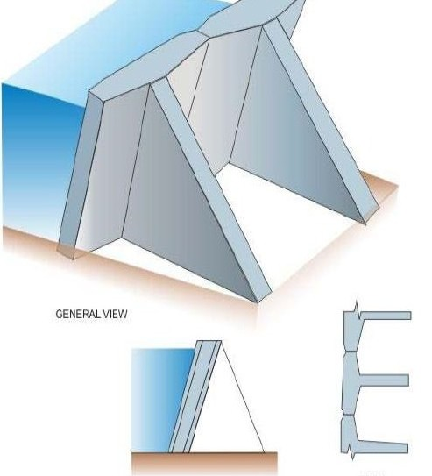
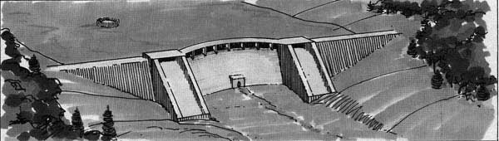
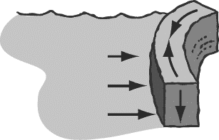
Types of Dams
1. ARC OR BUTTERRESS DAM:
FORCES ACTING ON ARC DAM:
Butress dams are derived from gravity
dams. This type of dams are supported uses thin concrete slab which is supported from downstream side by butresses.
It uses multiple reinforced columns to support the dams. Since it has relatively thin structure so there is considerable amount of saving of concrete material.

Slide 13
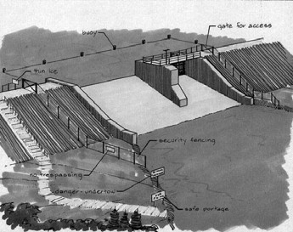
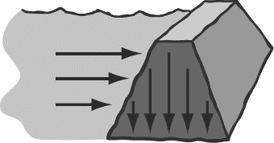
2. GRAVITY DAM:
A gravity is a solid concrete structure, generally having a triangular profile, which is so designed that it can safely stand against the precalculated volume of water by virtue of its weight.
Forces in the dam : thrust of impounded water in x-axis and weight of the dam in y-axis.
FORCES ACTING ON GRAVITY DAM:

Slide 14
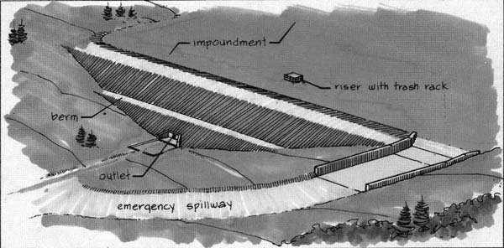
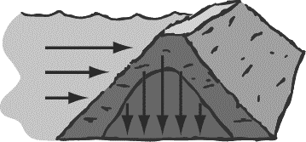
FORCES ACTING ON EMBANKMENT DAM:
3. EMBANKMENT DAM:
These are non rigid structures which are build over wide valleys with varying foundations. These are trapezoidal in shape and are build of single type of material(such as earth fill or rock fill) or combination of more than one material.
The main advantage of these dams is that it can be constructed on weak foundation.
Impervious core is placed in the middle of the embankment body.
Generally riprap is used to control erosion.

Slide 15
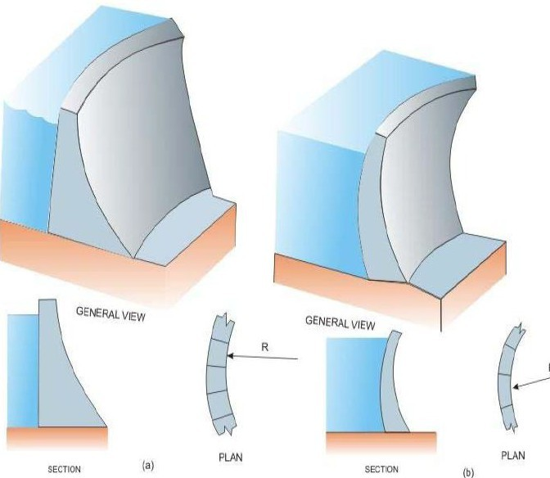
4. Arch dam
It is an arch – shaped solid structure made up of concrete which is designed in such a way that a major part of the thrust forces acting on the dam are transmitted to arch. There are mainly two types of ach dams :
Constant radius arch dams : radius of curvature throughout the structure is constant and upstream face is vertical.
Variable radius dams : curvatures are different on upstream and downstream sides.
➢These types of dames are best suited for narrow valleys.
➢An arch dam having a curvature both in horizontal and vertical alignment is often called a CUPOLA dam.

Slide 16
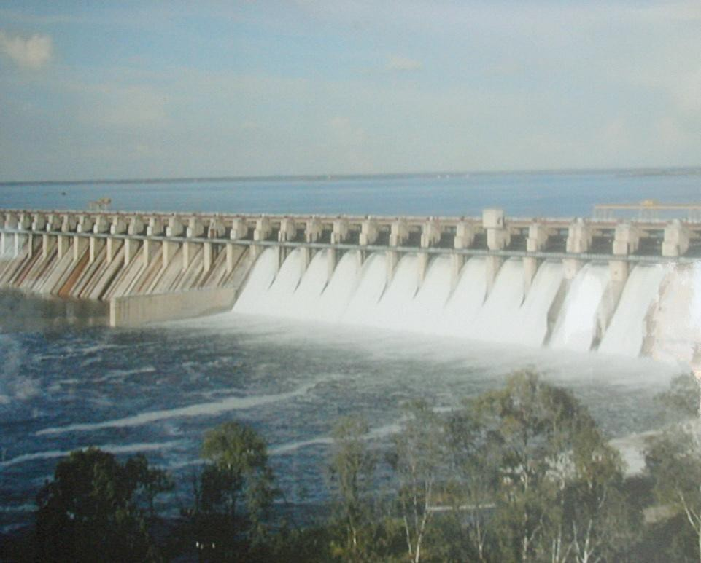
5.Composite dam
Composite dams are combinations of one or more dam types.
Most often a large section of a dam will be either an embankment or gravity dam, with the section responsible for power generation being a buttress or arch.

Slide 17
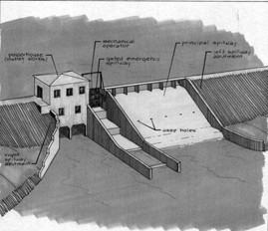

Slide 18
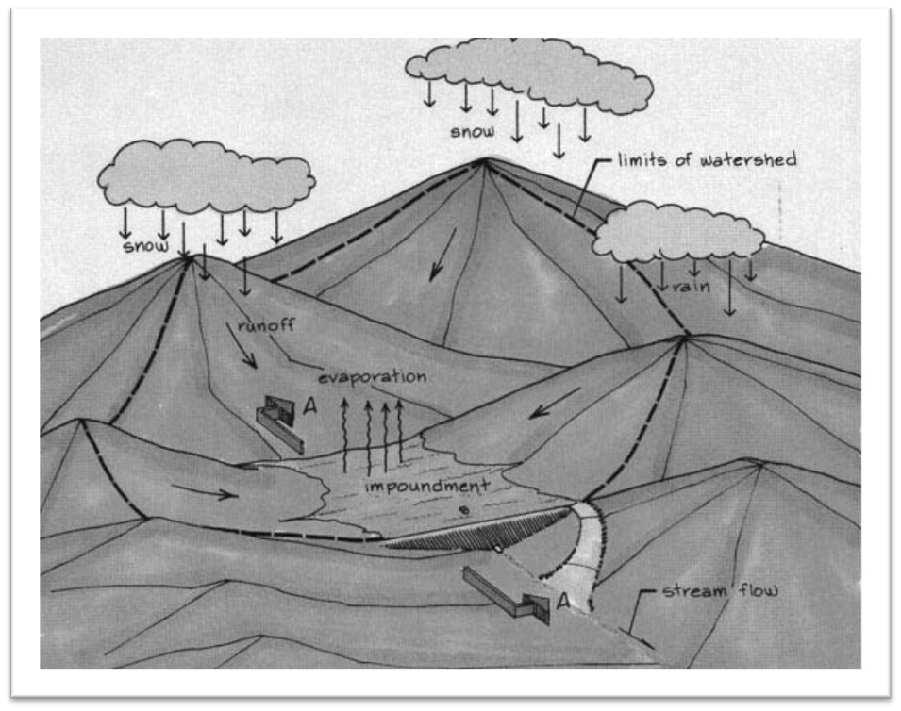
Dam Location Issues
Catchment
Reservoir
Slope Stability
Foundation Rock
Silting

Slide 19
What Geological Input is required for the engineering of a large dam?
The stability and safety of the dam on its foundations;
The water-tightness of the reservoir basin;
The slope stability of the reservoir perimeter
The availability of suitable local materials for its construction.

Slide 20
Preliminary Geological Investigations of Dam Construction:
1.Topographical Studies. 2.Reservoir Location.
3.Petrology studies. 4.Mineralogy Studies 5.Structural Geological Studies.
6.Geological Factors Like Conditions, Water tightness of
Foundation reservoir,
availability of construction material. 7.General examination of rocks.
Indirect study methods for subsurface investigations.
Preliminary Drill Hole Study.

Slide 21
Detailed Geological Investigations for Dams Site Selection:
Study of Geological Toposheet.
Study of the Area with reference to Geology.
Study of Rock Types.
Study of Structural Geology of the Area.
History of the Area with reference to Rainfall Data.
Study of Stream Channels with Diff. Order.
Study of Seismic Data of the Area.
Geomorphological Study.
Preparation of Geological Map of the area in detail.
Study of Core Drill Data and its interpretation.
Detailed Engg. Geological Properties of the area.

Slide 22
Selection of sites
Selection of sites is based on following basis:
Topographically: most suitable place must be chosen for construction. Ideally it must be a narrow gorge or a small valley with enough catchment area available behind so that calculated amount of water can be easily stored in the reservoir created upstream.
Location of spillway: All dam should have an adequate spillway for passing flood flows. If a river gorge is narrow, then there may not be sufficient spillway width available and a suitable location on the periphery of the reservoir has to be found to locate a spillway.
Possibility of river diversion during construction : The way, river can be diverted at a particular site for making way for construction of the dam may affect the design of the dam and also the construction schedule.
Sedimentation possibilities :The average quantity of sediment
carried by the river has to be known, as precisely as possible, which would give an idea of the rate at which a proposed reservoir way get filled up.

Slide 23
Technically: the site must be sound as possible: strong, impermeable and stable. Strong rocks make the job of designer easy. Impermeable sites ensure better storage inventories. Site must be stable with respect to seismic shocks slope failures around dam.
Constructionally: the site should be far from the materials which will be used for the construction. Their non-availability will make the cost of project high.
Human welfare: site selection should be done in such a way that it must cause minimum damage to public in the of destruction or failure.
Economically: the creation of the dam must not create ecological disorder. Fish culture is the first sector that suffers the major shock due to dam construction. It indirectly affects the other population. The dam should become an acceptable element of the ecological set up of the area.

Slide 24
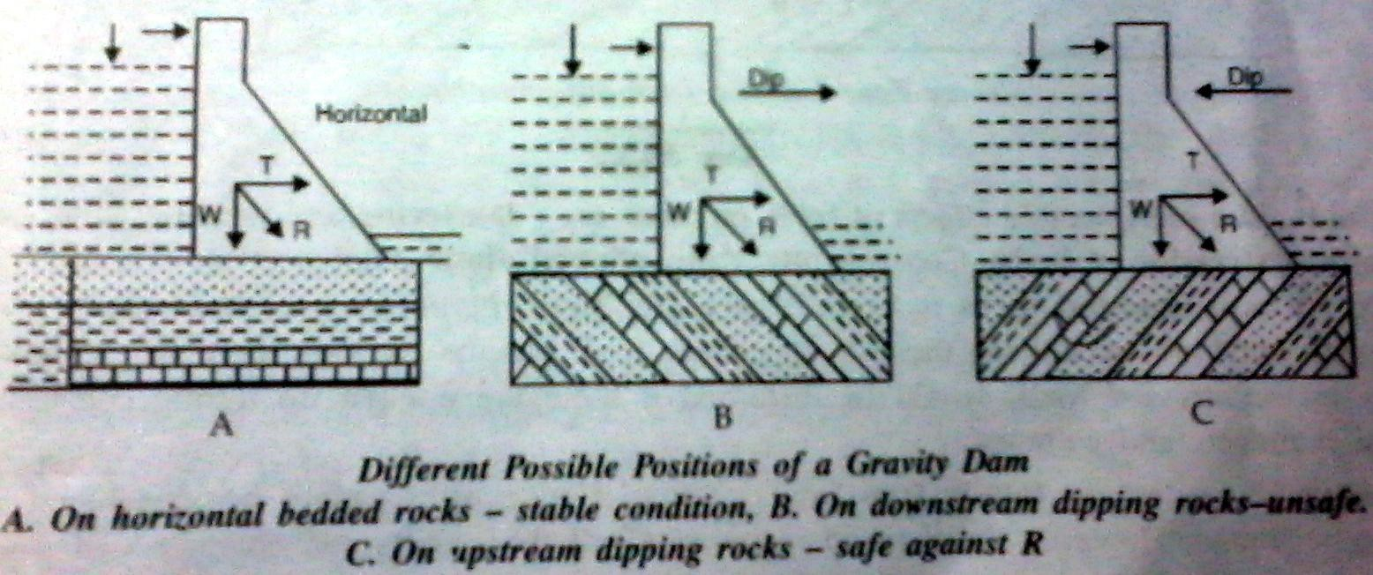
Geological characters for investigation
Geology of the site
a.Lithology : surface and subsurface studies must be carried out. These studies reveal the type, the composition and texture of the rocks along the valley floor.
b.Structures:
1.Dip and strike: the resultant force due to weight of the dam and the up thrust of the impounded water is always inclined the downstream as shown in the figure.
So, gently upstream dipping layers offer best resistance to the resultant force of the dam.
So most unfavorable strike direction is the one in which the bed strike is parallel to the axis of the dam and the slip is downward

Slide 25
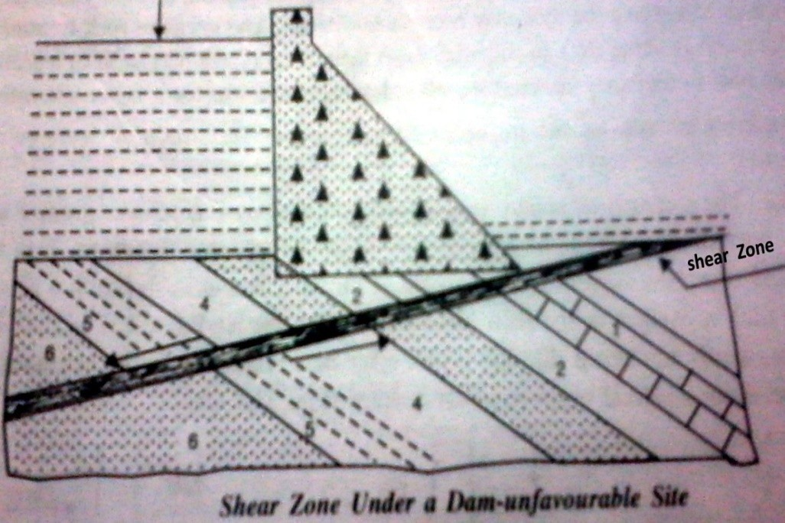
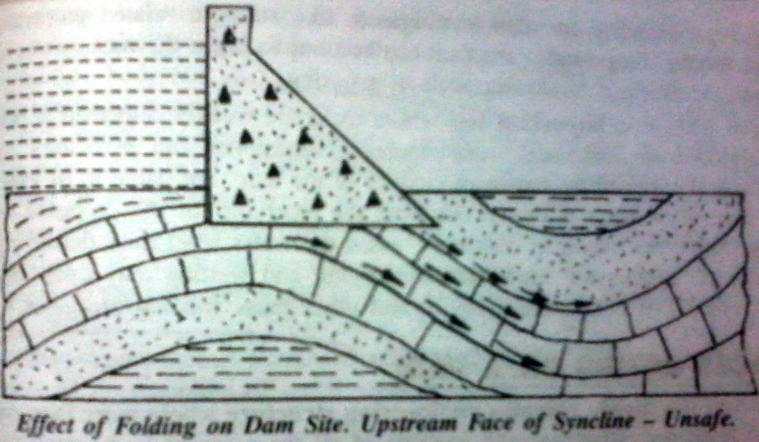
Faults: Dams founded on the fault zones are most liable to the shocks during an earthquake. Generally the small scale fault zones can be treated effectively by grouting.
Folds: the effects on of fold on rock are shattering and jointing along the axial planes and stressing of limbs. In the synclinal region dams placed on the upstream limbs have the risk of leakage from beneath the dam.

Slide 26
Engineering properties of rocks:
a. Strength parameter: it consist of three investigations – laboratory, in-situ static and dynamic.
The compressive and shearing strength of the rocks are estimated by laboratory test.
These tests are complimented with in-situ studies using static and dynamic studies.
Static study: by this test settlements and strains are recorded with different loadings which is used to estimate the bearing strength, modulus of elasticity and Poisson's ratio.
The dynamic method involve creating seismic waves artificially at selected locations and recording the velocity of the shock waves through the rocks of the sites. The shock wave velocity relates to the density, rigidity, porosity and permeability of the rocks at the site.

Slide 27
Porosity and permeability: a dam is a water impounding structure. So water must not find easy avenues to escape other than provided in design such as spillways. So porosity and permeability of the rocks are tested both in laboratory and in-situ. Artificial treatment is given to the critical zones such as grouting to make the rocks water tight
Selection of dam type
Material availability: If the cost of transportation of construction material is excessively high, then an alternate design with locally available materials, have to be considered.
Seismicity : It is very important to analyse the behaviour of the dam under earth quake vibrations thereby making it possible for the designer to check if a particular section of the dam is suitable or not.

Slide 28
Geology and foundation strength- The existence of joint patterns in the abutments (their orientation, inclination and infilling) may indicate the possibility of instability under loading from an arch dam and reservoir water. Such a site would be more satisfactory for an embankment dam or an adequately dimensioned gravity dam.
Where the possibility exists of differential deformation of the foundation along the axis of a dam, a gravity or arch dam would not be a suitable choice because of their inherent rigidity due to their construction in concrete. Instead, an embankment dam may be proposed, which is more flexible.
Further, it may be noted that the stresses expected at the base of a dam may have to be checked with the bearing capacity of the foundation material.
Embankment dams produce the least formation stress, Followed by gravity, buttress and arch, in that order.

Slide 29
Hydrology- If, during the construction season, there are possibilities of the partially constructed dam being overtopped by the floods of the river water, then a concrete dam section would be preferred then an embankment dam section.
If an embankment dam section is still proposed to be built, then adequate diversion works have to be provided for diverting the river flood water.
Unavailability of skilled workers- In case of sophisticated dam section, skilled workers are an absolute necessity. Unavailability of such workers at proposed dam construction site may have to force the designer to adopt a more easy to construct a type of dam.

Slide 30
Valley shape and overburden- The shape of the river valley and the overburden also influences the type of dam that may be proposed to be constructed.
In case of a wide valley with deep deposits of fine-grained soil overburden favours earth fill embankment dams (Figure a) .
A river valley that has much less over-burden (Figure b), would be suitable for embankment, gravity or buttress dams.
A narrow valley with steep sides (Figure c) and with sound rock in the valley floor and sides may be suited to an arch or cupola dams.
In case of a wide valley separated in two parts (Figure d) may suggest a combination of two types of dams. An earth fill embankment may be constructed where the overburden depth is considerable and a concrete gravity dam on the site where the overburden is less. The spillway portion can then be located on the concrete gravity section.

Slide 31
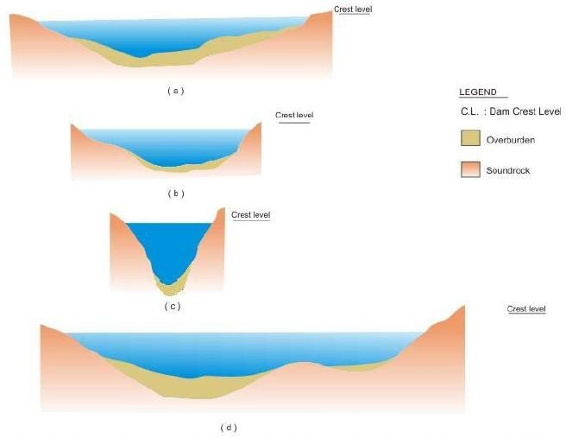

Slide 32



