Slide 1
GEOMETRIC MODELING
Auto CAD & Revit Architecture

Slide 2
MODULE 1 2D SKETCHES AND DIMENSIONING
INTRODUCTION ABOUT AUTOCAD
The word Auto CAD is made up of two words “Auto” (Logo of Company) and “CAD” (Computer Aided Design).
Auto CAD is 2D and 3D modeling software.
It is developed by U.S.A based Autodesk company.

Slide 3
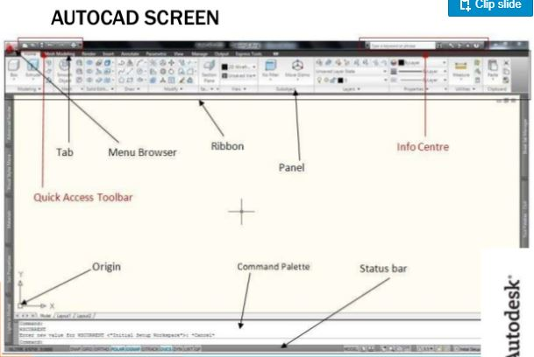
Auto cad screen

Slide 4
Step:01
All Auto CAD commands can be typed at the command line.
Many commands also have one (or) two letters, that can be typed as shortcuts to the commands.

Slide 5
Commands used for drafting
Line - L + Enter Key
Circle - C + Enter Key
Offset - O + Enter Key
Line Extension - Ex + Enter Key + Enter Key
Rectangle - Rec + Enter Key
Trim/Erase - Tr + Enter Key + Enter Key
Zoom - Z + Enter Key
Zoom Out - Z + Enter Key + A + Enter Key
Undo - Ctrl Key + Z
Redo - Ctrl Key + Y
Dimension - Dim + Enter Key
Dimension Modify - D + Enter Key

Slide 6
CoNTD.,
12. Unit - Un + Enter Key
13. Limit - Lim + Enter Key
14. Arc - Arc + Enter Key
15. Text - Tx + Enter Key
16. Colour - Col + Enter Key
17. Mirror - Mir + Enter Key
18. Rotate - Rot + Enter Key
19. Save Project - Ctrl + S
Note: 1. To exit from the command click Esc (or) Enter Key.
2.Replace to command click Space bar.

Slide 7
Step - 02
To learn how to set sheet setting and drawing using commands.
Open Auto CAD application.
Click “Start Drawing” for new drawing sheet.
Set Unit : Click “Un + Enter Key” it will show the new “Unit Setting popup window.”
Set (or) Change Units :
(i) Click “type” down bar [Decimal] select Engineeering.
(ii) Precision : Select “0.0”
(iii) Unit to scale inserted control select need unit “inches”
(iv) Click OK.

Slide 8
Set limit for sheet
Type “Lim + Enter Key”
Type “0 (Zero), 0 (Zero) + Enter Key” – for XY plane.
Type give the value for your drawing overall dimension (Example: 20’, 10’ + Enter Key).
Type ‘Z’ + Enter Key.
Type ‘A’+ Enter Key.
Now the sheet is ready for drawing.

Slide 9
Step-03 practices
1. Creating Line
L + Enter Key – Now we can draw using mouse left click for starting point and use again mouse left click for line ending. (or) Click the starting point using left click and give any value for the end point.
2. Creating continuous line and Join Line
Using same process with change (or) move cursor x,y direction, then give next end value and then same process to continue drawing and click “Esc” to exit command.
Follow the same process for multiple shape of commands.

Slide 10
Contd.,
3. Create Extra Line (or) Offset Line
Click “o + Enter Key + Enter Key”
Give the required offset value and enter (Ex: 2” + Enter Key).
Now touch the line using cursor and then click required side to the line by pasting or offsetting.
4. Erasing or Trimming extra Line
Type “Tr” + Enter Key + Enter Key
Click on the extra line or erasing line using cursor.
Now we can erase the unwanted lines.

Slide 11
UNIT CONVERSION
Inch | Feet | c.M | m.m | m
1 | 0.0833 | 2.54 | 25.4 | 0.0254
2 | 0.1667 | 5.08 | 50.8 | 0.0508
3 | 0.25 | 7.62 | 76.2 | 0.0762
4 | 0.33 | 10.16 | 101.6 | 0.1016
5 | 0.416 | 12.7 | 127 | 0.127
6 | 0.5 | 15.24 | 152.4 | 0.1524
7 | 0.583 | 17.78 | 177.8 | 0.1778
8 | 0.66 | 20.32 | 203.2 | 0.2038
9 | 0.75 | 22.86 | 228.6 | 0.2286
10 | 0.833 | 25.4 | 254 | 0.254
11 | 0.916 | 27.94 | 279.4 | 0.2794
12 | 1 | 30.48 | 304.8 | 0.3048

Slide 12
reference
https://www.slideshare.net/Vgroksoo7/presentation-on-auto-cad
To be continued…

