Slide 1
CENTURION UNIVERSITY OF TECHNOLOGY AND MANAGEMENT
HYPROPIA

Slide 2
AMETROPIA
Ametropia is defined as a state of refraction wherein parallel rays of light coming from infinity ( with accommodation is at rest) are focused either infront or behind the sensitive layer of retina , in one or both the meridian.
Ametropia includes the following-
Myopia
Hypermetropia
Astigmatism

Slide 3
Components of ametropia
The overall refractive state of the eye is determined by four component:
Corneal power ( ranges from 40 to 45 D , mean 43.0 D )
Anterior chamber depth ( mean 3.4 mm )
Crystalline lens power ( ranges from 15 to 20D in its nonaccomodative state ) and
Axial length ( mean 24 mm )

Slide 4
HYPEROPIA

Slide 5
The term hyermetropia is derived from hyper meaning “in excess” met meaning “measure” and opia meaning “of the eye”.
Also called hyperopia/ long sightedness
First suggested in 1755 by KASTNER

Slide 6
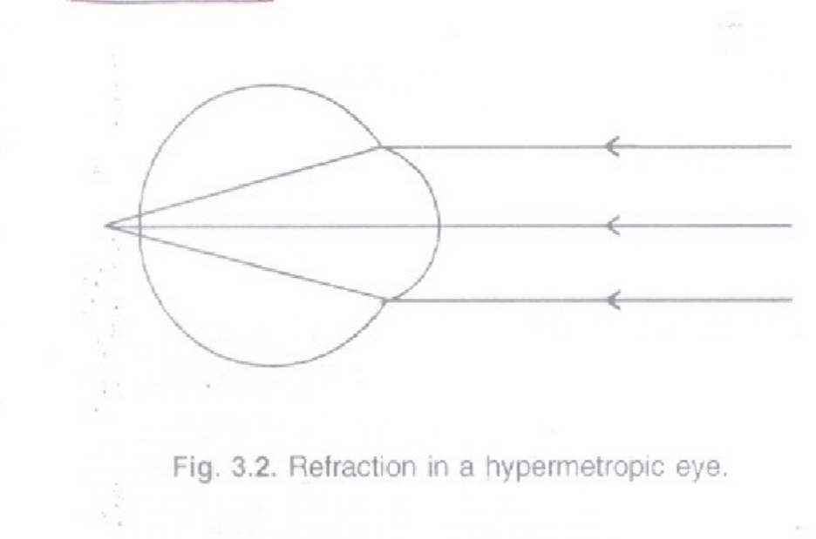
DEFINITION
It is the refractive state of eye where in parallal rays of light coming from infinity are focused behind the retina with the accommodation at rest
The posterior focal point is behind the retina which receive a blurred image.

Slide 7
ETIOLOGY
AXIAL
Most common
Total refractive power of eye is normal
Axial shortning of eyeball
1mm short – 3D of HM
Physiologically more than 6D HM are uncommon.

Slide 8
CURVATURAL
Flattening of cornia,lens or both
1mm increase in redius of curvature result in 6D of HM
Never exceed 6D HM physiological
Congenitally flattened (cornial plana)
Result (truma and disease)
INDEX
Change in refractive index with age
Physiological in old age

Slide 9
POSITIONALY
Posteriorly placed crystalline lens
Occurs as congenital anomaly
Result of trauma or disease
ABSENCE OF LENS
Seen in aphakia

Slide 10
CLINICAL TYPES
Simple hypermetropia
Pathological
Functional hypropia

Slide 11
SIMPLE HYPERMETROPIA
Commonest form
Result from normal biological variations in the development of eye ball
Include axial and curvatural HM
May be hereditary

Slide 12
PATHOLOGICAL HYPERMETROPIA
Anomalies lie outside the limits of biological variation
Acquired hypermetropia
Decrease curvature of outer lens fibers in old age
Cortical sclerosis
Positional hypermetropia
Aphakia
Consecutive hypermetropia

Slide 13
FUNCTIONAL HYRERMETROPIA
Result from paralysis of accommodation
Seen in patients with 3rd never paralysis and internal ophlthalmoplegia

Slide 14
NOMENCLATURE
Total hypermetropia =latent +manifest
(facultative +absolute)

Slide 15
TOTAL HYPERMERTOPIA
It is total amount of refractive error estimated after complete cycloplegia with atropine
Divided into latent and manifest

Slide 16
LATENT HYPERMETROPIA
Corrected by inherent tone of ciliary muscle
Usually about 1D
High in children
Decreases with age
Revealed after abolishing tone of ciliary muscle with atropine

Slide 17
MENIFEST HYPERMETROPIA
Remaining part of total hypermetropia
Correct by accommodation and convex lens
Measure by add strongest lens with max.vision
FACULTATIVE HYPERMETROPIA
Corrected by patients accommodation effort
ABSOLUTE HYPERMERTOPIA
Residual part not corrected by patients accommodation

Slide 18
Absolute hypermetropia can be measured by the weakest convex lens with which maximum visual acuity
Manifest HM-absolute HM =facultative HM (strongest lens )-(weakest lens)
Total HM manifest HM=latent HM

Slide 19
SYMPTOM
Principal symptom is blurring of vision for close work
Symptom vary depending upon age of patient and degree of refractive error
ASYMPTOMATIC
Small error produces no symptom
Corrected by accommodation of patient

Slide 20
ASTHENOPIA
Refractive error are fully corrected by accommodation effort
Thus vision is normal
Sustained accommodation produces symptoms
Asthenopia increases as day prograsses
Increased after prolonged near work

Slide 21
DEFECTIVE VISION ONLY
Refractive vision more than 4D
Adults usually do not accommodation
Marked defective vision for near and distance

Slide 22
SIGNS
Visual acuity :defective
Eye ball : small or normal in size
Cornea : may be smaller then normal .There can be cornial plana
Anterior chamber : may be shallow
Lens : could be dislocated backwords
A scan ultrasonography (biometry) reveal short axial length

Slide 23
COMPLICATION
Recurrent styes m blepharitis or chalazia
Accommodative convergent squint
Amblyopia
Predisposition to develop primary narrow angle glaucomas

Slide 24
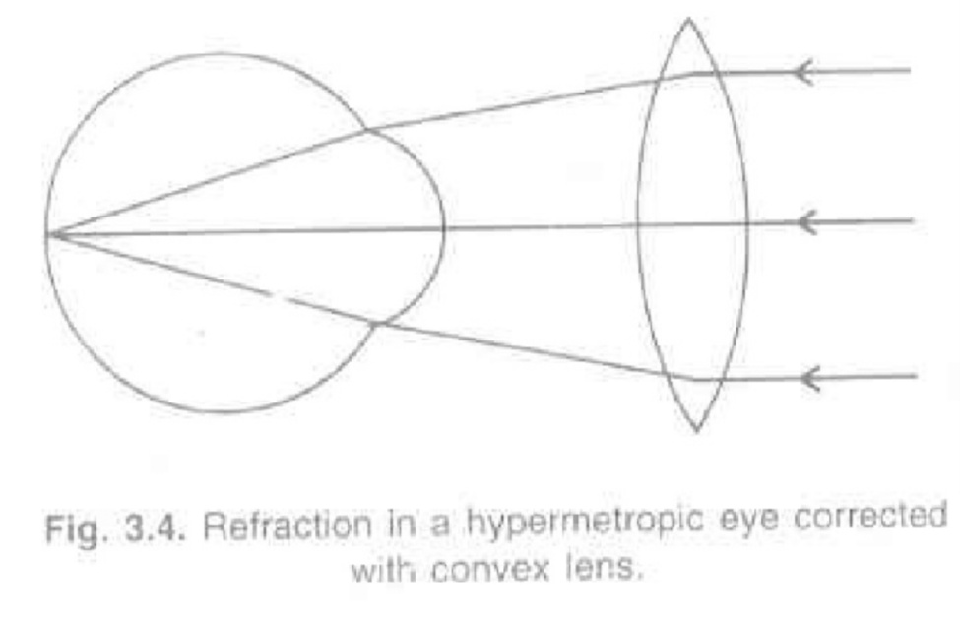
MADE OF TREATMENT
Spectacles
Contact lens
surgical

Slide 25
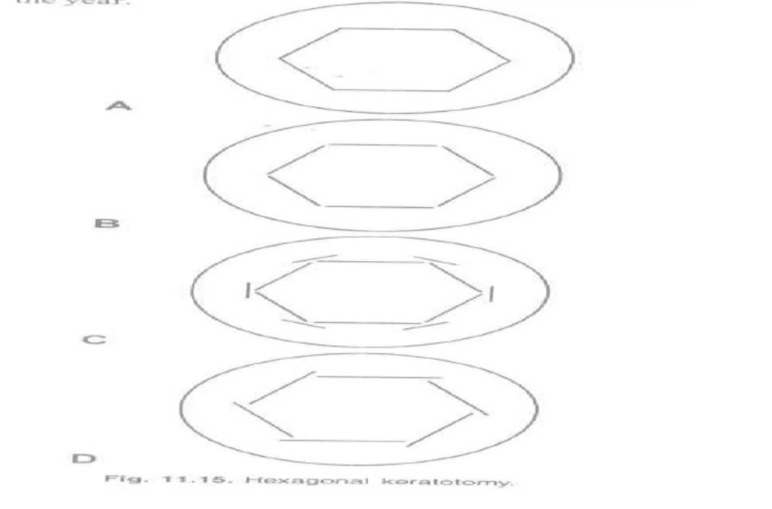
REFRACTIVE SURGERY
Refractive surgery is not as effective as in myopia
TYPES
Hexagonal keratotomy (HK)
Laser thermal keretoplasty (LTK)
Photorefractive keratectomy (PRK)

