Slide 1
Intellectual Property Rights (IPR)

Slide 2
Acknowledgements
I have drawn materials from
Mr. P.R.
Chandrashekaran’s (ppt) presentation, IPR Guide India, WIPO- 2012 publications, different authors’ books, magazines, Journals and Mr. R. Saha’s workshop paper on ‘Management of IPRs in India’ to write this presentation.
I sincerely acknowledge them and extend my courtesy to use their knowledge for the sustainable development of society on non-profit basis.

Slide 3
Chapter Questions
What is Intellectual Property Right and types?
How do organisations develop and protect them?
What is the role of Government(s) and Intl. Orgns?
Are there any cases to discuss?
What is the future and how to overcome obstacles?

Slide 4
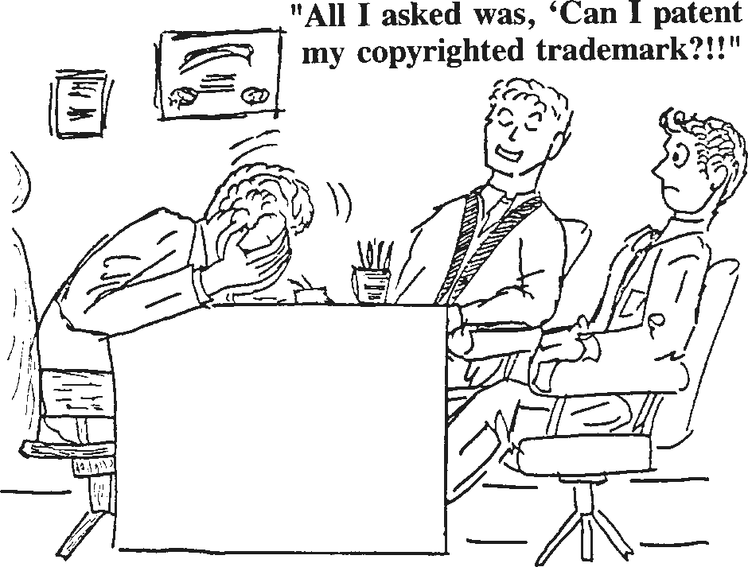
If you don’t see a problem with this question, you need this class!

Slide 5
What is meant by IPRs?
Intellectual Property (IP) is any creations of human mind. Like tangible property, their creation has a value and, as with all property, it needs to be protected.
Intellectual Property Rights (IPR) gives them this protection,
as well as helping them exploit and control their IP.
“The exclusive right granted by State, to prevent others from using, manufacturing, distributing - inventions, processes, applications, new and original designs, trademarks, new plant varieties, data bases and artistic and literary works”. Such a person is known as ‘rights owner’ or ‘rights holder’.

Slide 6
Nature of Intellectual Property Rights
IPRs has become an issue of wide and serious discussion with the formation of the General Agreement on Trade Related Aspects of Intellectual Property Rights (TRIPS) under Uruguay Round agreement of he GATT (now the World Trade Organisation).
India is in ‘priority watch list’ of USA under Special 301 system.
Intellectual property insists on some amount of novelty or originality
to gain protection.
Intellectual property system is duration specific.
It does not provide perpetual and absolute monopoly over the property.
What is protected with respect to intellectual property is the use or value of ideas/expressed ideas. However, the bundle of rights constituting intellectual property is not over abstract ideas but rather over physical, concrete or tangible manifestations of these ideas.
For e.g., rights under patent law include the right to manufacture, distribute etc. while rights under copyright law extend to the right of distribution, publication etc. all of which deal with concrete embodiments of ideas and not the abstract ideas themselves.

Slide 7
Constitutional aspects of IP
The Constitution plays an important part in helping courts and legislature arrive at and justify a balance between conflicting rights.
The US Constitution specifically protects the intellectual property [Article 1(8)] by specifically providing “To promote the progress of science and arts, by securing for limited times to authors and inventors the exclusive right to their respective writings and discoveries”.
Though there is no such intellectual property clause in the Indian Constitution, there are no constitutional restrictions on the power to make laws on intellectual property.
The Constitution (44th Amendment) Act, 1978, struck off the right to property from the fundamental rights. However, property was made a legal right and was put under Article 300A in the ‘Right to Property’, which says “no person shall be deprived of his property save by authority of law”.

Slide 8
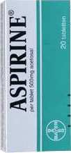
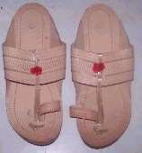
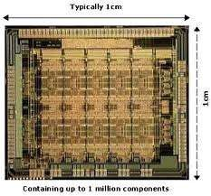
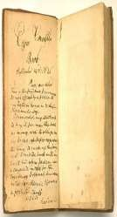
Types of IPRs
Intellectual Property
Industrial Property
Copyrights and related rights
Industrial | Patents Trademarks Trade Secrets | Geographical | Layout Designs of | Plant varieties &
Designs | Service marks | Indications | Semi Conductor ICs | Farmer’s rights
®
©
™

Slide 9
IPR in brief
Industrial Designs: Design deals with features, shapes, patterns, etc., applied to an article by an industrial process, manual or mechanical. Eg., chair is a utility item. However, chair itself does not qualify for IPR, but its special carvings, embossing etc., is done which increases the value of chair though it’s utility remains same, it becomes eligible for IPR under Designs Act. Designs can be registered based on its originality, henceforth they can use ® or registered, with registration number.
Patents: Is a monopoly right granted to a person, who invented a new product or process of making an article, for 20years under the Indian Patens Act, 1970, and can be renewed after expiration of period. The inventor has to file for patent first, and then make his/ her invention to public. A patent has to be applied in each country by the inventor, to claim his rights in that country. Eg: A group of scientists working on new drug development in Himalaya Drugs for some salary. The patent of the drug developed is given to Himalaya Drugs, but not to the scientists. The drug may have many patents like composition, process, and product etc.
Trademarks: Trademark can be a word, name, brand, symbol, label etc., used by a company to create a unique identity for their product. Trademark can be registered, and then use ™ ®. The registration validity is for 7 years and renewable after expiry. In India, it is governed by the Trade and Merchandise Marks Act, 1958, which came into force on 25th Nov., 1959.
•

Slide 10
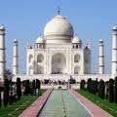
IPR in brief..
Trade Secrets: Trade secret is any intellectual work or product used for a business purpose that can be classified as belonging to that business provided it is not based on information in public domain.
Geographical Indication: This is an indication, that originates from a definite geographical area, which is used to identify natural or manufactured product. For eg., Gadwal/ Pochampally Sarees, Nirmal paintings, Kolhapuri Chappals, Solapur Chaddar etc., qualify for registration under this category. It is valid for 10 years. The application for registration can be an association of persons, organization or by producers.
Copyright: It is a negative right which prevents the appropriation of the fruits of man’s work, labour or skill by another person. Copyright is an exclusive legal right to reproduce an original work of authorship fixed in any tangible medium of expression, to prepare derivative works based on original work, and to perform or display the work in the case of dramatic, music, choreographic and sculptural works. Copyright prevents copying of only the expression. Eg: Bhagwat Geeta, Pathanjali Yoga sutras, Narada Neeti, Vatsayana Kamasutras etc.,

Slide 11
IP RIGHTS
REGISTERED
Patents
Trade Marks
Design rights
UNREGISTERED
Copyright
Unregistered Design rights
Common law trade marks
Database rights
protection for know how under laws dealing with confidential information and trade secrets
Plant varieties
Geographical Indications
Design of Integrated Circuits
‘Passing off’ trade legislation (Domain names)

Slide 12
INDUSTRIAL DESIGNS
The laws governing designs are the Designs Act of 2000 and the Designs Rules of 2001. In India designs are defined as follows:
‘A design refers to the features of shape, configuration, pattern, ornamentation or composition of lines or colors applied to any article, in two or three dimensional (or both) forms’. (Design Office, Kolkata: Guidelines for Registration)
Designs are valid for a maximum of ten years, renewable for a further five years.
The ‘right of priority’ for previous filings of designs overseas requires filing in India within six months of an overseas filing.

Slide 13
INDUSTRIAL DESIGN..
Design rights, as we have seen, consist of both registered and unregistered forms.
The distinctions between what exactly may be protected by each, and the relative levels of protection, are complex. Expert advice is needed to choose which is appropriate.
The more common type is the registered design, covering the appearance (that is, the shape or pattern) of a product or its packaging, as well as typefaces and graphics. To be registered in the UK a design must be distinctive and novel – it should not ‘remind an informed person of an existing design’ – as well as meeting other detailed criteria.
Whilst there are costs involved in obtaining registered design rights (compared with relying on unregistered design rights, which are free) this form of IPR can be treated in the same way as patents – for example, by rights owners exploiting their IP through licensing – and it provides a good level of protection.
A registered design right lasts for up to 25 years in the UK and must be renewed every five years.

Slide 14
PATENTS
Designed by Thomas Jefferson in 1790 to provide a brief legal monopoly to give the inventor an opportunity to get the invention into the market and recoup development costs before competitors entered the market.
Patent is a monopoly right granted by law for the exclusive use of an intellectual property to one or more individuals. The instrument by which such grant is made is known as ‘Patent’. The patent to whom a patent is granted is called the ‘Patentee’.
Section 2(m) of the Indian Patents Act, 1970 defines Patent as – “Patent” means ‘a new product or process involving an inventive step and capable of industrial application’. Act lays down:
a. Grant of revocation of patents, b. Items not patentable, c. Product patent,
d. Patent period, e. Rights and obligations of patentee, f. Working of the patent, g. Compulsory licensing and h. Exceptions (inclu. Rights of Govt.)
After the expiry of the period for which exclusive right is granted to the inventor (20 years in India from the date of application), the invention can be put to use by any person other than the one to whom a patent has been granted.

Slide 15
Patents contd..
In Bishwanath Prasad Radheshyam Vs. Hindusthan Metal Industries, [(1979) 2 SCC 511], the Supreme Court held that “the object of patent law is to encourage scientific research, new technology and industrial progress. Grant of exclusive privilege to own, use or sell the method or the product patented for a limited period, stimulates new inventions of commercial utility. The price of the grant of monopoly is the disclosure of the invention at the Patent Office, which after the expiry of the fixed period of the monopoly, passes into the public domain”.

Slide 16
Types of Patents
Utility Patent: Whoever invents or discovers any new and useful process, machine, manufacture, or composition of matter, or any new and useful improvement thereof, may obtain a patent therefore, subject to the conditions and requirements of this title. (35 U.S.C. §
101) E.g: (functional) toys, coatings, tools, machines, good for 20 years
Plant Patent: Whoever invents or discovers
and asexually
of plant, including
reproduces any distinct and new variety
cultivated spores, mutants, hybrids, and newly found seedlings, other than a tuber propagated plant or a plant found in an uncultivated state. . . (35 U.S.C. § 161)
– No bacteria or similar single-cell organisms need apply!
Design Patent: Whoever invents any new, original, and ornamental design for an article of manufacture may obtain a patent. (35 U.S.C.
§ 171). E.g: (non-functional) a decoration, apparel, jewellery
Can easily be designed around...no functionality to protect

Slide 17
Patents contd..
Under the Indian Patent Law, a “Patentable invention” must be,-
a new product or process;
non-obvious;
useful; and
capable of industrial application.
Novelty: Novelty (newness) in an invention depends upon the state of prior art, i.e., the existing knowledge and similar inventions already known in the particular field. There will be no novelty, if there has been prior publication and prior use of same or an identical invention. In other words, the invention must involve any innovation or technology which has not been anticipated by publication in any document or used in the country or elsewhere in the world before the date of filing of patent application. The subject matter must not have fallen in the public domain.

Slide 18
Patents contd..
Non-obviousness: The invention must be non-obvious to a person skilled in the art to which the invention relates.
Usefulness: The invention, besides being new and non-obvious, must also be useful. If the invention can not be put to any beneficial use of the mankind, it can not be patented.
Exceptions: Some inventions in spite of being new, non-obvious and useful
can not be patented. They include,- [see sec.3]
Inventions which are injurious to public health or violate public morality or public interest or which causes serious prejudice to human, animal or plant life or health, or to the environment;
New method of agriculture or horticulture is non-patentable in order to have widespread benefit of such invention, rather than concentrating the commercial gain of such invention in the hands of inventor alone;
A process of treatment of human beings, animals or plants;

Slide 19
Patents contd...
Exceptions contd…
The mere discovery of a new form of a known substance which does not result in the enhancement of the known efficacy of that substance, or the mere discovery of any new property, or new use for a known substance or of the mere use of a known process, machine, or apparatus unless such known process results in a new product or employs at least one new reactant.
Any process for the medicinal, surgical, curative, prophylactic, diagnostic, therapeutic or other treatment of human beings or any process for a similar treatment of animals to render them free of disease or to increase their economic value or that of their products.
Any invention which in effect is traditional knowledge or which is an aggregation or duplication of known properties of traditionally known component.
The mere discovery of a scientific principle or the formulation of an abstract theory or the discovery of any living thing or non-living substance occurring in nature.
Inventions relating to atomic energy.

Slide 20
Patents contd….
Exceptions contd….
Plants and animals in whole or any part thereof other than micro-organisms but including seeds, varieties and species and essentially biological processes for production or propagation of plants and animals;
A mathematical or business method or a computer program per se or algorithms;
A mere scheme or rule or method of performing mental act or method of
playing games;
A presentation of information;
Topography of integrated circuits;
A literary, dramatic, musical or artistic work or any other aesthetic creation whatsoever includes cinematographic works and television productions;

Slide 21
Patents contd…..
Persons entitled to apply for patent:
Person claiming to be the true and first inventor of the invention.
Any person being the assignee of the true and first inventor of the
invention
By the legal representative of any deceased person who immediately before death was entitled to make such an application.
Full Disclosure of invention:
While the Act grants exclusive right to the inventor to exploit his invention for commercial gain for a specific period of time, it also imposes on him the duty of fully disclosing the invention in the complete specification so as to facilitate anyone from the public working the invention, once the period of protection is over. The full disclosure of the patented invention is mandatory. If this is not done, the patent will not be granted. The validity of such patent, even if granted, can be contested by an opposing party. The patent can be revoked on such contest succeeding.

Slide 22
Patents contd…...
Use by Central Government: Though the patentee has exclusive right of use, the Act provides for the Central Govt. to use any invention even without paying the royalty to the inventor. The Central Govt. can acquire the patent from the patentee or any other person having interest in the patent, by paying the compensation, in public interest.
Restricted use of patented invention:
Such use by a person other than the patentee is permissible. For instance, use of patented invention is permissible for research or experimental purposes or for imparting knowledge or instructions to pupils.

Slide 23
Patents PROTECT Inventions
You need a patent if:
You have invented a product you want to market yourself or sell to a manufacturer.
You believe someone else could sell the product by copying
your inventions.
Patent application must include:
In-depth description of invention.
Drawing of invention.
Completed “Declaration for Patent Application.”
Notarized statement from inventor.
Filing fee to Patent & Trademark Office.

Slide 24
Pathway to a Patent
File a Disclosure Document (Disclosure Statement)
Establishes date of conception of idea (who has the rights?)
Get a two year grace period
File a Provisional Patent Application
Protect your ideas while talking to manufacturers/potential funders
Can use the term “patent pending” on the invention
Only good for 12 months...then must file non-provisional application
File Non-Provisional Patent Application
File complete description with the PTO (Patent & Trademark Office)
“patent applied for” good for two years’ of protection
Denials allow an appeal process

Slide 25
Patents -Infringement
Infringement:
Use by a person other than the patentee or his assignee or licensee would be an infringement of the patent.
Civil remedy is filing of a suit in a court of competent jurisdiction.
The plaintiff on satisfying the court about the infringement would be entitled to the following reliefs –
interlocutory injunction
damages
account of profits
When the subject-matter of a patent is a process for obtaining a product, the onus is on the defendant to prove that the process used by him is different from the patented process.

Slide 26
Patents –Infringement..
A suit as any grievance relating to infringement of patent may be instituted in a court not inferior to a District court. But where a counter claim for revocation of the patent is made by the defendant, the suit along with counter claim, shall be transferred to the High Court.
The reliefs which a court may grant include an injunction and either damages or account of profits. The court may also order that the infringing goods shall be seized, forfeited or destroyed.
Any act of making, constructing, using or selling a patented invention solely for uses reasonably related to the development and submission of information required under any law; and
importation of patented products by any person from a person who is duly
authorised by the patentee to sell or distribute the product;
shall not be construed as an infringement of patent rights.
Principles applicable to working of patented inventions:
Patented inventions are worked in India on a commercial scale and to the fullest extent without undue delay.
The protection and enforcement of patent rights contribute to the promotion of technological innovation and to the transfer and dissemination of technology to the mutual advantage of producers and users and in a manner conducive to social and economic welfare.

Slide 27
Patents –Infringement…
The patent right is not abused by the patentee and the patentee does not resort to practices which unreasonably restrain trade or adversely affect the international transfer of technology.
The benefit of the patented invention is available to the public at
reasonably affordable prices.
They do not impede protection of public health and nutrition and should act as an instrument to promote public interest.
Compulsory Licences:
At any time after the expiration of a period of 3 years from the date of grant of a patent, the Controller of Patents, if he is satisfied that the reasonable requirements of the public with respect to the patented invention have not been satisfied or the patented invention is not worked in the territory of India or the patented invention is not available to the public at a reasonably affordable price, may grant a licence to an applicant upon such terms as he may deem fit. (Sec.84) In such cases, the patentee’s exclusive right to use is limited only to three years.

Slide 28
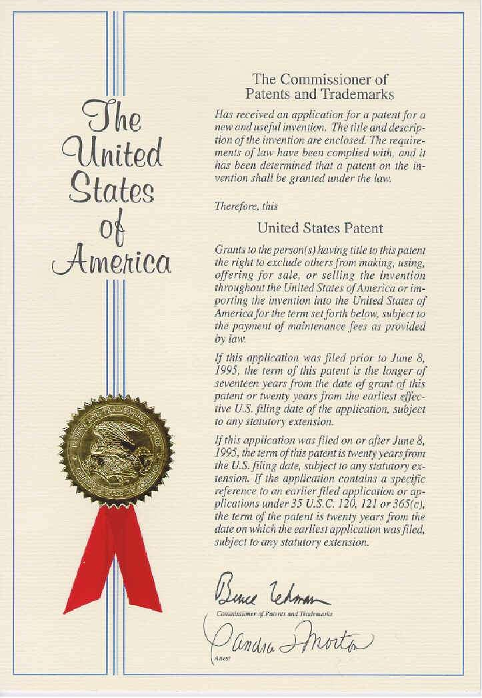
Certificate of PATENT

Slide 29
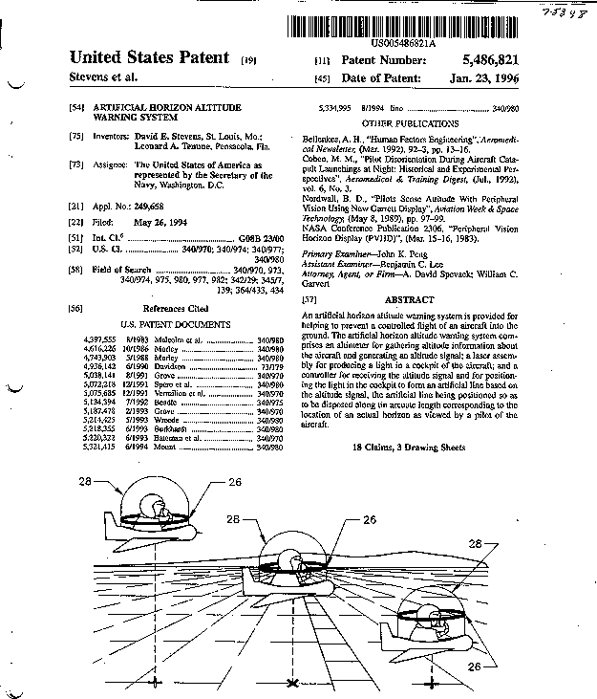

Slide 30
Unit Objectives
Know the difference between trade mark and brand
How do organisations protect trade marks?
How to prevent fraudulent marks?

Slide 31
Trade Marks
Name
Logotype Symbol Slogan
Shape Color

Slide 32
TRADE MARKS
Trade Marks Act, 1999 defines TM as a mark capable of being represented graphically and which is capable of distinguishing the goods or services of one person from those of others and may include shape of goods, their packaging and combination of colours.
Mark includes “Device, brand, heading, label, ticket, name, signature, word, letter, numeral, shape of goods, packaging, combination of colours, and any combination thereof.”
Brand refers to a name, term, sign, symbol, or design, or a combination of them, intended to identify the goods or services of one seller or group of sellers and to differentiate them from those of competitors. E.g. McDonald for restaurants, Cycle brand agarbattis, etc.
Brand Name is that part of a brand which can be vocalized-the utterable.
Brand Mark is that part of a brand which can be recognised but is not a utterable, such as symbol, design or distinctive colouring or lettering.
Device refers to pictorial representations – e.g. animals, birds, landscape
buildings, etc.
Letter as a mark is the identity created out of letterforms and has its inbuilt strength of distinctiveness and individuality – e.g. IBM, GM, ELBEE, 3M etc.

Slide 33
TRADE MARKS TERMS EXPLANATION
Numerals can be registered as trade mark upon evidence of user, e.g. 555, 501
Symbols may take the shape of brand or logos. A logo is a visual depiction of a manufacturer or company and gives an identity to it. E.g. B.M.W., Maruti, Benz etc.
Label and ticket mean a composite mark containing various features incl. devices, words, usually painted on paper and attached to the goods themselves.
Name is the words signifying a name, surname or a personal name or an
abbreviation thereof
Color – a combination of colors can be considered as a trademark-e.g. color combinations used in drug capsules.
Sound – sound or a sequence of sound can be registered as a trade mark –
e.g. ‘the roar of the lion’ sound has been registered by MGM pictures; the ‘Tarzan Yell” has been registered as Edgar Rice Burroughs Inc.
Smell – Registration of smell as a trademark has been permitted as a trade mark. A smell reminiscent of roses applied to tyres was registered for Sumitomo tyres – smell of fresh cut grass for the tennis ball, etc.
Containers fall within the definition of trade mark.

Slide 34
TRADE MARKS TERMS EXPLANATION.
‘Collective mark’ means a trade mark distinguishing the goods or services of members of an association of persons (not being a partnership), who is the proprietor of the mark from those of others.
‘Service’ means service of any description which is made available to potential users and includes the provisions of services in connection with business of any industrial or commercial matters such as banking, communication, education, financing, insurance, chit funds, real estate, transport, storage, material treatment, processing, supply of electrical or other energy, boarding, lodging, entertainment, amusement, construction, repair, conveying of news or information and advertising. A mark identifying such a service is called a service mark.
“Certification trade mark” means a mark capable of distinguishing the goods or services in connection with which it is used in the course of trade which are certified by the proprietor of the mark in respect of origin, material, mode of manufacture of goods or performance of services, quality, accuracy or other characteristics from goods and services not so certified. (e.g. wool mark, ISO 9001 etc.)

Slide 35
TRADE MARKS REGISTRATION
Trademark and Service mark are used before registration.
Registration of a trade mark is not a compulsory requirement of the law. The Controller-General of Patents, Designs and Trade Marks Act, appointed by the central government is the Registrar of Trade Marks. A Register of Trade Marks shall be kept in offices, Regd. Trade Marks details shall be entered into the register.
Once Trade Mark is accepted, allotted should advertise it in prescribed manner.
The registration of a trade mark, if valid, gives its proprietor the exclusive right to the use of the trade mark in relation to the goods or services in respect of which the trade mark is registered and to obtain relief in respect of infringement of the trade mark.
A trademark registration is for 10 years from the date of registration and can be renewed every 10 years consecutively. Failure to renew is removal of the trade mark from register.

Slide 36
REFUSAL GROUNDS FOR REGISTRATION
Grounds for refusal of registration
Marks devoid of distinctive character
Descriptive marks
Generic marks
Marks of such a nature as to deceive or cause confusion
Marks containing any matter which is likely to hurt the religious susceptibilities of any class or section of the Indian citizens
Marks containing scandalous or obscene matter
Marks prohibited under the Emblems and Names (Prevention of Improper use) Act, 1950
Marks consisting exclusively of the shape of the goods which results from the nature of the goods themselves (e.g. apple design for a package of apples, round shape for tennis balls, etc.)
Marks consisting exclusively of the shape of the goods which is necessary to obtain technical results.
If there exists likelihood of confusion with the earlier trade mark by reason of the fact of the trade mark being identical with the earlier trade mark and similarity of goods and services or being similar to earlier trademark and identical or similar goods and services.

Slide 37
TRADEMARK REGISTRATION..
If the earlier trademark being a well-known trademark and the trademark sought to be registered is identical with or similar to an earlier trademark and the goods or services are dissimilar and the use of the mark would take unfair advantage of or be detrimental to the distinctive character or repute of the earlier trade mark.
If the use of trademark in India is liable to be prevented because of any law protecting an unregistered trademark used in the course of trade or because of law of copy right.
Acquisition of Trademark
Trademark may be acquired either by the proprietor of the goods and services for which trademark is sought for registration or by transfer, license, lease, assignment by the proprietor to another entity.
Suit for infringement
Suit for infringement of registered trademark or relating to any right in a registered trademark or for passing off has to be filed in a IP Appellate Board/ District Court. Reliefs can be claimed by way of injunction, damages, account of profits with or without an order for the delivery up of the infringement labels and marks for destruction or erasure.

Slide 38
Trademarks & Service Marks

Slide 39
Trademark Infringement, Counterfeiting and Dilution
Infringement - A mark that is likely to cause confusion with a trademark already existing in the marketplace
Counterfeiting - The deliberate copying of a mark
Dilution - The value of the mark is substantially reduced through competition or through the likelihood of confusion from another mark
Offences include falsifying and falsely applying trademarks,
trade description are punishable by imprisonment and fine.

Slide 40
Trade Secrets
A trade secret consists of
a formula, device, idea, process, pattern, or compilation of information that gives the owner a competitive advantage in the marketplace,
a novel idea that is not common knowledge and is kept in a confidential state.
A trade secret is not protected by federal law
Can only be protected through employment contracts and/or
maintaining tight security
Recipes, ingredients, codes, manufacturing costs

Slide 41
Types of IP: A General Practice Attorney is Likely to Encounter
Variants of Trade Secrets
Limited rights in technical data
Restricted rights in computer software
Government purpose rights
special license rights

Slide 42
GEOGRAPHICAL INDICATIONS
Geographical indication is an indication originating from a definite geographical territory and used to identify agricultural, natural or manufactured goods. The manufactured goods should be produced or processed or prepared in that territory. It should have a special quality or reputation or other characteristics. (e.g. Gadwal / Pochampalli/ Kanchipuram silk sarees, Nirmal paintings, Banginapalli /Alphonso Mango, Darjeeling Tea, Kolhapuri Chappal, Solapur Chaddar, Tirupati Laddu, Nagpur Orange, Bikaneri bhujia).
GIs when registered confers legal protection in India through the Geographical Indications of Goods (Registration & Protection) Act of 1999, prevents unauthorised use of registered GI, promotes the economic prosperity of the producers of goods produced in a geographical territory which in turn boost exports.

Slide 43
GEOGRAPHICAL INDICATIONS..
Any association of persons, producers, organisations or authority established by or under the law, representing the interests of the producers can apply for registration of GI to the Registrar of GI in the prescribed format along with the prescribed fee.
A producer of goods can apply for registration as an authorised user of a registered GI. Producer in the case of agricultural goods means a person engaged in the production, processing, trading or dealing in such goods; in the case of natural goods, a person engaged in exploiting, trading or dealing; in the case of handicrafts or industrial goods, a person engaged in making, manufacturing, trading or dealing in such goods.
An authorised user has the exclusive rights to the use of geographical indication in relation to registered goods. The registration of GI is valid for a period of 10 years and can be renewed from time to time for a further period of 10 years each.
A regd. GI is a public property belonging to the producers of the concerned goods and hence it can not be assigned / transmitted / licenced / pledged or mortgaged.
INFRINGEMENT
When an unauthorised user uses a GI that indicates or suggests that such goods originate in geographical area other than the true place of origin of such goods in a manner which mislead the public as to the geographical origin of such goods; or,
when the use of a GI result in an unfair competition including passing off in respect of registered GI; or When the use of another GI results in false representation to the public that goods originate in a territory in respect of which a registered GI relates, it constitutes infringement.
The registered proprietor or authorised users of a regd. GI can initiate infringement action.

Slide 44
Layout Designs of Semi-conductor ICs
It provides protection for semiconductor IC layout designs. India has now in place Semiconductor Integrated Circuits Layout Design Act, 2000 to give protection to IC layout design. Layout design includes a layout of transistors and other circuitry elements and includes lead wires connecting such elements and expressed in any manner in a semiconductor IC.
Semiconductor IC is a product having transistors and other circuitry elements, which are inseparably formed on a semiconductor material or an insulating material or inside the semiconductor material and designed to perform an electronic circuitry function. The term of the registration is 10 years from the date of filing.
An IC layout design cannot be registered if it is
1.Not original, 2. Commercially exploited anywhere in India or in a convention country; 3.Inherently not distinctive, 4. Inherently not capable of being distinguishable from any other registered layout design.
Note: Design not exploited commercially for more than 2 years from date of registration of application shall be treated as commercially exploited for the purpose of this Act.

Slide 45
Layout Designs of Semi-conductor ICs
Reproducing, importing, selling, distributing the IC
layout design for commercial purposes constitutes infringement. A person when
only creates
another layout design on the basis of scientific evaluation of a registered layout design shall not be causing any infringement.

Slide 46
PLANT VARIETIES
The International Union for the Protection of New Varieties of Plants (UPOV) was established in 1961 by the International Convention for the Protection of New Varieties of Plants (the “UPOV Convention”). UPOV provides and promotes an effective system of plant variety protection, with the aim of encouraging the development of new varieties of plants, for the benefit of society. E.g. Indian Bt. Brinjal
In order to obtain protection, a breeder must file an individual application with each authority entrusted with the granting of breeders’ rights. A breeder’s right is only granted where the variety is new, distinct, uniform, stable and has a suitable denomination.
In the USA, there are two legal frameworks for protecting new plant varieties: the Plant Patent Act (PPA) and the Plant Variety Protection Act (PVPA). According to the PPA, whoever invents or discovers and asexually reproduces any distinct and new variety of plant, including cultivated sports, mutants, hybrids, and newly found seedlings, other than a tuber propagated plant (in practice, Irish potato and Jerusalem artichoke) or a plant found in an uncultivated state, may obtain a patent therefor. Under the PVPA, the US protects all sexually reproduced plant varieties and tuber propagated plant varieties excluding fungi and bacteria.

Slide 47
COPYRIGHT
Copyright is a monopoly right restraining others from exercising that right which has been conferred on the owner of copyright.
It is a negative right meaning thereby that it is prohibitory in nature. It is a right to prevent others from copying or reproducing the work.
The object of copyright is to encourage authors, composers and artists to create original works by rewarding them the exclusive right for a specific period to reproduce the works for publishing and selling them to the public. The moral basis of copyright law rests in the eighth commandment “Thou shall not steal”.
Copyright is not a single right. It is a bundle of rights in the same work. For e,g. in the case of a literary work, copyright consists of reproduction in print media, the right of dramatic and cinematographic versions, the right of translation, adaptation, abridgement and the right of public performance.
Copyright consists not merely of the right of reproduction. It also consists of right to works derived from the original work, rights like the right of public performance, the recording right and the broadcasting right. Such related rights are called “neighbouring rights”.

Slide 48
COPYRIGHT CONTD..
To secure copyright protection, the author must have bestowed upon the work “sufficient judgment, skill and labour or capital”. It is immaterial whether the work is wise or foolish, accurate or inaccurate or whether it has literary merit or not. Copyright protects the skill and labour employed by the author in his work.
The owner of a copyright has no monopoly in the subject-matter. Others are at liberty to produce the same result provided they do so independently and though they are not first in the field, their work is nonetheless ‘original’.
There is no copyright in ideas. Copyright subsists only in the material form to which the ideas are translated. Since there is no copyright in ideas or information, it is no infringement of copyright to adopt the ideas of another or to publish information derived from another, provided there is no copying of the language in which those ideas have or that information has been previously embodied.

Slide 49
COPYRIGHT CONTD…
Copyright subsists in “original literary, dramatic, musical and artistic works; cinematographic films and sound recordings”.
Literary work includes computer programs, tables, compilations inclu. computer data bases. Dramatic work includes any piece for recitation, choreographic work or entertainment in a dumb show, the scenic arrangement or acting form of which is fixed in writing or otherwise but does not include cinematographic film.
Music work means a work consisting of music and includes any graphical notation of such work, but does not include any works or action intended to be sung, spoken or performed with the music.
An artistic work means a painting, a sculpture, a drawing (incl. diagram, map, chart or plan), an engraving or a photograph, whether or not any such work possesses artistic quality; a work of ‘architecture’ means any building or structure having an artistic character or design or any model for such building or structure.
Cinematographic film means any work of usual recording on any medium produced through a process from which a moving image may produced by any means and includes a sound recording accompanying such visual recording and ‘cinematograph’ shall be construed as including any work produced by any process analogous to cinematography including video films.
Sound recording means a recording of sounds from which such sounds may be reproduced regardless of the medium on which such recording is made or method by which the sounds are produced.

Slide 50
COPYRIGHT CONTD….
The word ‘original’ does not mean that the work must be expression of original or inventive thought. It only means the work must not be copied from another work, that is, it should originate from the author.
To qualify for copyright in India, the work should satisfy the
following conditions:-
the work is first published in India;
where the work is first published outside India, the author at the date of publication must be a citizen of India. If the publication was made after the author’s death, the author must have, at the time of death, been a citizen of India.
In the case of unpublished work the author, on the date of making of the work, is a citizen of India or domiciled in India.

Slide 51
COPYRIGHT CONTD..…
Copyright is a bundle of rights consisting of 1) economic rights and 2) moral rights.
ECONOMIC RIGHTS:
In the case of a literary, dramatic or musical work, not being a computer program, the right consists of ,-
to reproduce the work in any material form incl. the storing of in any medium by electronic means;
to issue copies of the work to the public ;
to perform the work in public, or communicate it to the public;
to make any cinematographic film or sound recording in respect of the work;
to make any translation of the work;
to make any adaptation of the work;
to do, in relation to translation or adaptation of the work, any of the acts specified in relation to the work in sub-clauses (1) to (6)
In the case of computer program,-
to do any of the facts specified in clause (a);
to sell or give on hire, or offer for sale or hire any copy of the computer program, regardless of whether such copy has been sold or given on hire on earlier occasions;

Slide 52
COPYRIGHT CONTD…...
in the case of an artistic work,-
to reproduce the work in any material form incl. depiction in two dimensions of a three dimensional work;
to communicate the work in public;
to issue copies of the work to the public;
to include the work in any cinematographic film;
to make adaptation of the work;
to do in relation to an adaptation of the work, any of the acts specified in relation to the work in sub-clauses (1) to (4).
in the case of cinematographic film,-
to make a copy of the film, incl. a photograph of any image forming part thereof;
to sell or give on hire, or offer for sale or hire, any copy of the film, regardless of whether such copy has been sold or given on hire on earlier occasions;
to communicate the film to the public.

Slide 53
COPYRIGHT CONTD……..
in the case of a sound recording,-
to make any other sound recording embodying it;
to sell or give on hire, or offer for sale or hire, any copy of the sound recording regardless of whether such copy has been sold or given on hire on earlier occasions;
to communicate the sound recording to the public.
MORAL RIGHTS:
the right to decide whether to publish or not to publish the work;
the right to claim authorship of a published or exhibited work;
the right to prevent alteration and other actions that may damage the author’s
honour or reputation – the right of integrity;
to restrain or claim damages.
TERM (Period) OF COPYRIGHT
In the case of any literary, dramatic, musical or a artistic work (other than a
photograph), life time of the author + 60 years.
In the case of photograph, cine films, sound recording and Govt. Work, 60 years from the beginning of the calendar year next following the year in which the work is first published.
In the case of broadcasters/performers, reproduction right years from the calendar year next following the broadcast/performance is made.
shall subsist until 25 year in which the

Slide 54
COPYRIGHT - OWNERSHIP
AUTHOR AND OWNERSHIP OF COPYRIGHT: [See Sec. 2(d)]
The author in relation to various categories of works is as follows:-
Literary or dramatic work – author of the work
Musical work – composer
Artistic work – Artist
Photograph – Photographer
Cinematograph film – Film producer
Sound recording – the producer
Literary, dramatic, musical or artistic work which is computer generated –
the person who causes the work to be created.
The owner of copyright:
Normally the author of the work will be the first owner, subject to the following exceptions.

Slide 55
COPYRIGHT – OWNESHIP : EXCEPTIONS
Where a work is made by the author in the course of his employment by the proprietor of a newspaper/magazine/
periodical for publication therein, then such proprietor will be first
owner.
Where a photograph is taken or a painting or a portrait drawn or an engraving or cine film made for a consideration at the instance of any person, then such person shall be the first owner.
When a work is made in the course of the author’s employment under a
contract of service/apprenticeship, the employer will be the first owner.
Where any person has delivered any address or speech in public, that person will be first owner of the copyright.
In the case of Government work, government is the first owner.

Slide 56
INFRINGEMENT OF COPYRIGHT
INFRINGEMENT OF COPYRIGHT:
Copyright in a work is deemed to be infringed –
when any person, without a license granted by the owner of the copyright or the Registrar of copyrights or in contravention of the conditions of a license so granted or of any condition imposed, -
does anything, the exclusive right to do is conferred upon the owner of copyright; or
permits for profit any place to be used for communication , unless he was not aware and had no reasonable ground for believing that such communication to the public would be an infringement of the copyright; or
when any person,-
makes for sale or hire, or sells or lets for hire, or any way of trade displays or offers for sale or hire; or
distributes either for the purpose of trade or to such extent as to prejudicially affect the owner of the copyright; or
by way of trade exhibits in public; or
imports into India, any infringing copies of the work.

Slide 57
INFRINGEMENT OF COPYRIGHT ..
There is no infringement of copyright in copying an idea, theme, plot, historical or legendary fact. Infringement occurs only in the form, manner, arrangement and expression of the idea of author of the original work.
If the theme is the same but it is differently treated or presented by different writers or authors and the subsequent work takes the form of a completely new work, then there would be no infringement.
The better test is to see whether a spectator or viewer after having read or seen both the works is clearly of the opinion with an unmistakable expression that the subsequent work appears to be a copy of the original.
Acts not constituting infringement:
A fair dealing with a literary, dramatic, musical or artistic work,-
for the purpose of private use, incl. research, criticism or review of the work.
for the purpose of reporting current events.
by a teacher or a pupil in the course of instruction or writing answers to a question in an examination.
for the purposes of judicial proceeding or for reporting a judicial proceeding.

Slide 58
INFRINGEMENT OF COPYRIGHT…
Importation of infringing copies:
On application by the owner of the copyright in any work or by his duly authorised agent and on payment of prescribed fee, the Registrar of copyrights, after making necessary enquiries, order that copies made outside India shall not be imported. All copies to which any order so made shall be deemed to be goods prohibited or restricted under section 11 of the Customs Act and all the provisions of that Act shall apply. All such copies confiscated shall be delivered to the owner of the copyright and the property in such copies shall not vest in the Government.
Remedies: There are three types of remedies against infringement of copyright. These are (1) Administrative remedies (before Registrar of Copyrights) (2) Civil Remedies (injunction, compensation, recovery of infringed copies etc.) (before the District Court) and (3) Criminal remedies (before Judicial or Metropolitan Magistrate). All the remedies can be availed simultaneously.

Slide 59
Quiz
Lets Apply the criteria:
Education command wants to reproduce a text book and distribute to all bases and ships at sea. Permissible?
Graphs copied and reproduced in slides will be used in lecture to 150 people. The lecture is going to be video broadcast to all bases and ships at sea. Permissible?

Slide 60
Examples of IPRs Infringement
Example 1
A student of a US university was accused of infringing intellectual property rights after illegally downloading songs from the Internet and sharing them with others. He was found guilty and ordered to pay four businesses hefty damages of US$675,000.
The student was accused of downloading 30 songs from the Internet and sharing them with friends. According to US federal law, the victim may demand damages ranging from US$750 to US$30,000 for each song infringed upon. If the perpetrator is determined to have committed such a crime maliciously, the damages may be as much as US$150,000 per song. In fact, this was not the first time such a case had occurred. Last month, a woman in Minnesota was ruled to have committed a crime of infringement and ordered to pay damages of as much as more than US$1 million. (Accessed on http://english.moe.gov.tw/ct.asp?xItem=11610&ctNode=514&mp=1

Slide 61
Examples of IPRs Infringement
Example 2
A graduate student in a Taiwan University uploaded publications of a domestic publisher onto his website for downloading without authorization or consent. The authorities were soon informed and the student was prosecuted and convicted of copyright infringement.
The verdict was also sent to the student's school and the Ministry. As the student was proved to have committed an infringement and was ordered to pay damages of NT$100,000, the school printed the criminal and civil verdicts in newspapers. The publisher urged the school to propagate the notion of respect for intellectual property rights and properly punish the student to raise awareness.
Since the incident seriously impacted the school's reputation, in addition to expressing concern, the school immediately referred the student to its office of student affairs for punishment and apologized to the publisher.
Intellectual property rights are an issue receiving much global attention. The Ministry urges teachers and students to use the Internet legally and in a reasonable manner.

Slide 62
CASE STUDIES
23-Jan-2013 | Pfizer’s Canadian Patent On Viagra
 | A look at the reasons for the invalidation of Pfizer's Viagra patent by the Supreme Court of Canada, just 18 months before its natural expiry date.
6-Sep-2011 | Interim Injunction For Infringement to be granted very carefully
 | This article discusses the recent pharmaceutical trademark infringement suit where an interim injunction granted by the the Ahmednagar District Court in favour of Sun Pharmaceuticals was reversed by the Appellate Court.
17-Dec-2007 | IPAB to Hear Novartis Case without the Technical Member
 | Discussed in the article are the issues involved as to the role and status of a technical member in the overall constitution of Intellectual Property Appellate Board (IPAB).
25-Sep-2007 | Glivec: Pre-Grant opposition
 | Here we discuss the law suit filed by Novartis in the Chennai High Court, challenging the Indian Patent Office for: Denial of its patent application for Glivec Constitutional validity of section 3(d) of the Indian Patent Law
23-Oct-2000 | Basmati Rice Patent Issue
 | Analysis of the real issues involved in the controversial case of Basmati Rice Patents from various perspectives: commercial, legal and general. Point to point explanation of widely held misconceptions arising out of limited awareness.

Slide 63
Growth in filings in two blocks of four years
x
India has issued 1001 drug patents between April 2010 and March 2013, of which 771
were given to foreign drug makers, mainly from the US and Europe.

Slide 64
Present Indian THINK TANKS on IPR
Justice Prabha Sridevan – Chairman (former Chairman of IP Appellate Board, who had in 2012 figured among the 50 most influential persons in the world in IPR field)
Pratibha Singh & Punita Bhargava – Leading IPR Practitioners and Sr. Advocates
Unnat Pandit – Cadila Pharmaceuticals
Rajeev Srinivasan – Asian School of Business, Thiruvananthapuram, TN
Narendra K Sabharwal – Rtd. DDG of WIPO

Slide 65
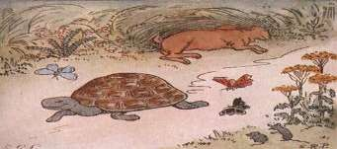
EPILOGUE
Rome was not built in a day.
Any physical process, including development, has to absorb some finite time before taking a shape. We made a good start by keeping in place some very useful systems and policies. (as per need at Global level)
Based on our history we were HARES, but does present Indian local organisations IP registrations prove it? Hope our friendlyfoes doesnot overtake us. Work SMART than hard. Knowledge is Power. We are in Knowledge Economy days. Hence,
AWAKE, ReSearch and IPR (spread) it FAST.

Slide 66
THINGS-TO-DO: IPR
Prepare a new IPR policy and suggest legal means to handle undue pressure exerted by other countries
Develop a pool of Think Tanks and well trained HR on IPRs
Deploy sufficient facilities (hardware and software)
Create environment for generating IPs for growth of trade and industry and well being of the society.
Fix targets and goals by Industry (academic, Industrial)
Show benefits of tax holiday/ incentives or evasions
Register /notify Ancient Indian unregistered IPRs thru local panchayats/ municipalities/ courts/ libraries/ museums

Slide 67
References (Indian IPR)
Organisations:
Central Board of Excise and Customs Competition Commission of India Confederation of Indian Industry (CII)
Controller General of Patents, Designs and Trade Marks
Copyright Office
Indian IPR Foundation (NIPO)
http://www.cbec.gov.in/ http://www.nipo.org.in/iplaws7.htm http://www.ciionline.org/ http://www.patentoffice.nic.in/ http://copyright.gov.in/ http://www.nipo.org.in/
Laws and Procedures:
Domain Name Registration
Draft Manual of Patent Practice and Procedure
http://www.inregistry.in/
http://ipindia.nic.in/ipr/patent/DraftPatent_Manual_2008.pdf
http://www.patentoffice.nic.in/ipr/design/designs_filing.pdf
Guidelines for Design Registration `
IP Environment in India
http://www.iprights.com/cms/templates/articles.aspx?articleid=324&zoneid=2
Texts of India’s IPR Laws :
Patents and Trade Marks: http://www.nipo.org.in/iplaws.htm Industrial Designs, Geographical Indications, Copyright and Unfair Competition:
http://www.nipo.org.in/iplawsmn2.htm
Biological Diversity, Plant Variety Protection, and Semiconductors & Integrated Circuits Layouts Protection:
http://www.nipo.org.in/iplawsmn3.htm

Slide 68
References (General and International)
Collection of Laws for Electronic Access (CLEA) http://www.wipo.int/clea/en/index.jsp
Copyright
Berne Convention
Copyright in the UK
http://www.copyrightservice.co.uk/copyright/p08_berne_convention
http://www.ipo.gov.uk/copy.htm
Copyright Licensing Agency (CLA)
Designs
Designs in the UK
Unregistered Community Designs
http://www.cla.co.uk/
http://www.ipo.gov.uk/design.htm http://www.hindlelowther.com/design11.htm
International IPR Organisations, Systems and Treaties
Community Trade Marks (CTM) http://oami.europa.eu/en/mark/default.htm
Overview by ipr.co.uk: UK-IPO:
http://www.ipr.co.uk/IP_conventions/community_trade_marks.html http://www.ipo.gov.uk/abroad/abroad-tmeurope.htm
European Patent Convention (EPC) http://www.epo.org/patents/law/legal-texts/epc.html
Text of the Convention:
Hague Agreement
http://www.european-patent-office.org/legal/epc/e/contents.html
http://www.wipo.int/hague/en/
International Anti-Counterfeiting Coalition (IACC) International Intellectual Property Institute (IIPI) Madrid Protocol
http://www.iacc.org/contact.php http://iipi.org/ http://www.wipo.int/madrid/en/
TRIPS http://www.wto.org/english/tratop_e/trips_e/trips_e.htm

Slide 69
GRASSE
Positive, developmental Ideas are welcome
THANK YOU

