Slide 1

Industrial Automation

Slide 2
Industrial Automation
Automation is encompassing virtually every
walk of life.
Automation solutions are required right from
agricultural to space technology.
Plant Automation is the necessity for the
manufacturing industry to survive in today’s
globally competitive market

Slide 3
What is Automation ?
Automation is basically the delegation of human control
function to technical equipment for
Increasing Productivity
Increasing Quality
Reducing Cost
Increasing Safety in working conditions

Slide 4
History of Automation
Programmable Logic Controller
Electronic Control using Logic Gates
Hard wired logic Control
Pneumatic Control
Manual Control

Slide 5
Manual Control
All the actions related to process control are taken by the
operators
Drawbacks
Likely human errors and consequently its effect on quality of final product
The production, safety, energy consumption and usage of raw material are all subject to the correctness and accuracy of human action.

Slide 6
Pneumatic Control
Industrial automation, with its machine and process control, had its origin in the 1920s with the advent of "Pneumatic Controllers".
Actions were controlled by a simple manipulation of pneumatic valves, which in turn were controlled by relays and switches.
Drawbacks
Bulky and Complex System
Involves lot of rework to implement control logic
Longer project time

Slide 7
Hard wired logic control
The contactor and Relays together with hardware timers and
counters were used in achieving the desired level of automation
Drawbacks
Bulky panels
Complex wiring
Longer project time
Difficult maintenance and troubleshooting

Slide 8
Electronic Control using Logic Gates
In 1960s with the advent of electronics, the logic gates started
replacing the relays and auxiliary contactors in the control
circuits.
The hardware timers & counters were replaced by electronic
timers
Advantages
Reduced space requirements
Energy saving
Less maintenance & greater reliability
Drawbacks
Changes in control logic not possible
More project time

Slide 9
Programmable Logic Controllers
In 1970s with the coming of microprocessors and associated peripheral chips, the whole process of control and automation underwent a radical change.
Instead of achieving the desired control or automation through physical wiring of control devices, in PLC it is achieved through a program or say software.
The programmable controllers have in recent years experienced an unprecedented growth as universal element in Industrial Automation.
It can be effectively used in applications ranging from simple control like replacing small number of relays to complex automation problems

Slide 10
Advantages of PLCs
MOORE’s LAW
Reduced space
Energy saving
Ease of maintenance
Economical
Greater life & reliability
Tremendous flexibility
Shorter project time
Easier storage, archiving and documentation

Slide 11
Industrial Automation Components …
Field Instruments
Control Hardware
Control Software

Slide 12

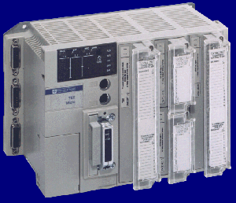


Automation : Typical installation . . . .
SCADA Software
Communication Cable
Control Hardware
Control Panel
Field Cabling
Junction Box
Field Cabling
Sensors Placed in the field

Slide 13
Automation : Advanced Technology . . . .
SCADA Software
Communication Cable
Control Hardware
Control Panel
Field Bus Network
Field Bus Scanners
Field Cabling
Smart Transmitters Placed in the field

Slide 14
Sensors ( Field Instruments )
Sensors with transmitters are the field devices placed in the field who actually sense the parameter and send the analog signal to the control hardware.
The analog signals used are Ohm (RTD), mV (Thermocouple), 4-20 mA, +/-10 V, etc

Slide 15
Widely used Sensors ( Field Instruments )
RTD : Output in Ohms (Temperature)
Thermocouples : Output in mV (Temperature)
Pressure Transmitters : 4-20mA, 0-10 V …..
Flow Transmitter : 4-20mA, 0-10 V …..
Level Transmitter : 4-20mA, 0-10 V …..
Conductivity meter : 4-20mA, 0-10 V …..
Density meter : 4-20mA, 0-10 V …..
pH transmitter : 4-20mA, 0-10 V …..
And Many more

Slide 16
Leading Manufacturers in Sensors
( Field Instruments )
Fisher Rosemount
Yokogawa
Anderson & Housers
Radix
ToshBro

Slide 17
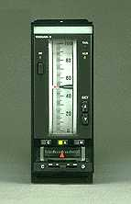
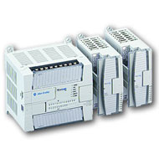
Control hardware
Standalone PID Controllers
Programmable logic controllers (PLC)
Distributed Control System

Slide 18
Standalone PID Controllers
These are the independent small hardware units which caters requirement of closed loop controls in the process.
These hardware can be installed in field or in control room. These hardware can be connected on the network.
Currently the controllers are available with 100s of segment and programming patterns

Slide 19
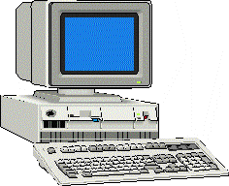

Typical Installations using PID Controllers
Controllers placed in field
RS-232
RS-485 Bus

Slide 20
Leading Manufacturers in PID Controllers
Yokogawa
ABB
Moore
Eurotherm
ASCON
Chino
Bells
Fuji

Slide 21
Programmable Logic Controllers
Now a days PLCs are the most widely used control hardware in control applications. The applications ranges from standalone system for CNC machines to Hot swappable Redundant System for Critical Process Control

Slide 22
What Constitutes A PLC ?
The PLC is programmed interface between the field I/p element like limit switches, sensors, push button and the final control elements like actuator, solenoid/control valves, drives, hooters etc
PLC consist of
Input Module
CPU with Processor and Program memory
Output module
Bus System
Power Supply

Slide 23
Configuration of PLC : Modicon
Built in display for I/O (in-rack, AS-i) and Diag
Programming Terminal PC Connection
8 Analog Inputs 1 Analog Output
I/O Modules
Up/Down Fast Counter
Up Counter
TSX37-22
Unitelway Port for connection of up to 5 Slaves
PCMCIA communications port
PCMCIA memory expansion port

Slide 24
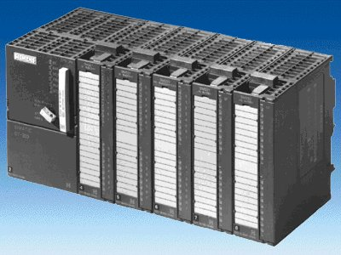
Configuration of PLC : Siemens
CPU
I/O Modules
External Power
Supply

Slide 25

Configuration of PLC : Allen Bradley
CPU
I/O Modules
Power Supply

Slide 26
Distributed I/O Modules
PLC
Distributed I/O scanner
Data Communication Bus
Distributed I/O modules

Slide 27
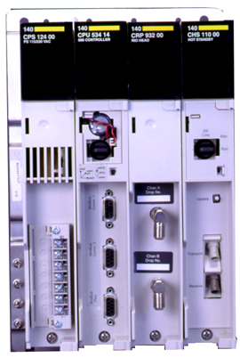
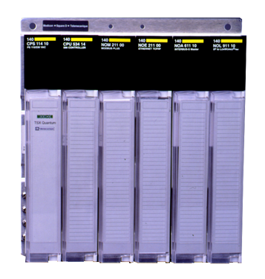
Hot Redundant System Configuration
TAPS
SPLITTERS
Remote
I/O Network
FIBER OPTIC LINK
Remote I/O

Slide 28
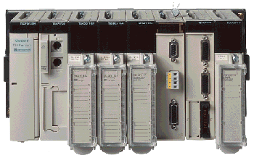
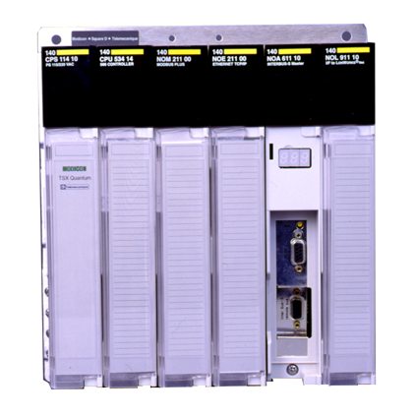
Networking of PLCs
Supervisory HMI
Modicon : Modbus +, Uniteleway, Ethernet
Allen Bradley : DH+, DH485, Ethernet, Control Net, Devicenet
Siemens : Sinec L1/L2/H1, Profibus

Slide 29
Programming Languages in PLCs
Ladder Logic ( LAD/LD )
Structured Text ( ST)
Instruction List ( IL )
Sequential Function Chart ( SFC )
Function Block Diagram ( FBD )

Slide 30
Supervisory Control & Data Acquisition Software
Features of typical SCADA software
Dynamic process graphic
Real-time and Historical trending
Alarms
Recipe Management
Security
Device connectivity
Script for logic development
Database connectivity

Slide 31
Some of the Leading SCADA Software
Wonderware : InTouch
Intellution : Fix DMACS
Merz : Aspic
Allen Bradley : Rsview
Siemens : WinCC
GE Fanuc : Cimplicity
KPIT : ASTRA

Slide 32
Role of Engineers In
Industrial Automation
Designing of the Automation system
Erection and Commissioning
Maintenance and Troubleshooting of existing system

