Slide 1
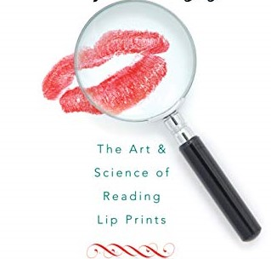
Lip Print
(Nature, location and collection)

Slide 2
Content
Introduction
Why lip print is used for identification
Nature and location
Anatomy
Collection of lip print from crime scene
Collection of specimen
Application
03
04
05
06
07
08-12
13-14
L Limitations
15-16
17
Summary

Slide 3
Introduction
Identification plays a major role in any crime investigation.
Prints are very helpful in identification.
Just like fingerprint, lip print is also used as tool for identification.
LIP PRINT:
Study of lip print is called “Cheiloscopy”.
The term “CHEILOSCOPY” is derived from Greek words “cheilos” meaning lips and “skopein” meaning to see.
It is defined as the study of the characteristic pattern of the wrinkles and grooves present on the labial mucosa (sulci laborium) called as lip print.

Slide 4
Why lip print is used for identification?
Everyone has lips.
They are unique to an individual.
They are permanent throughout the life.
They can be easily recorded.

Slide 5
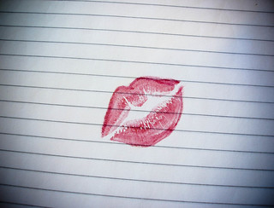
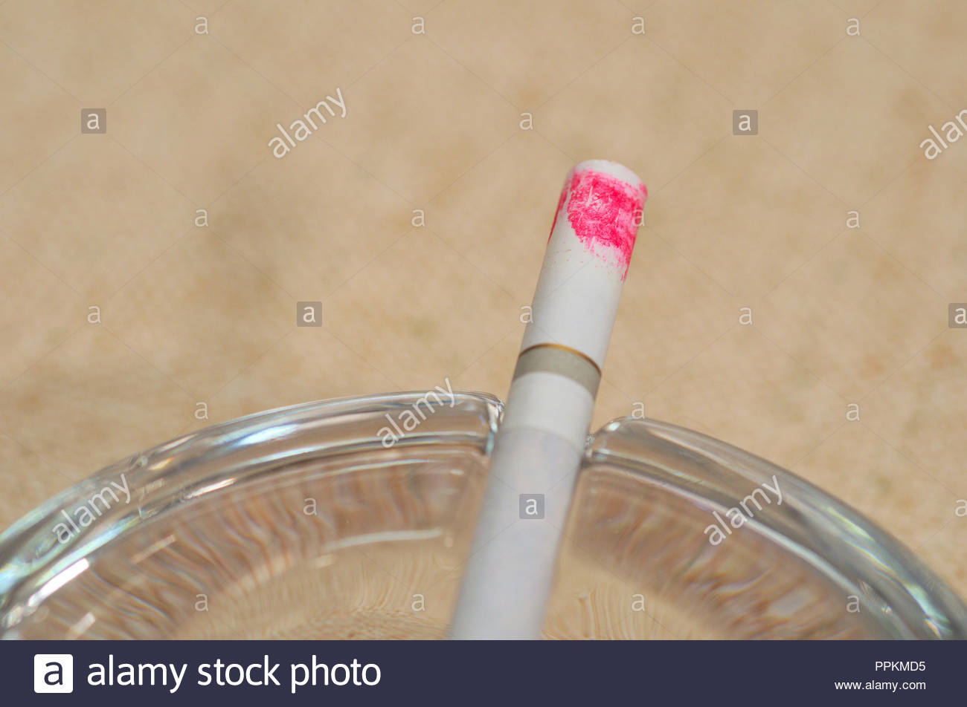
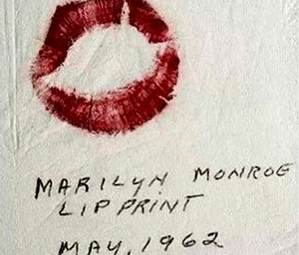
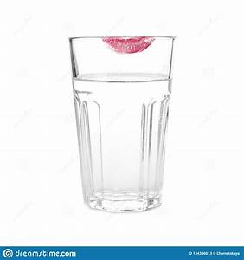
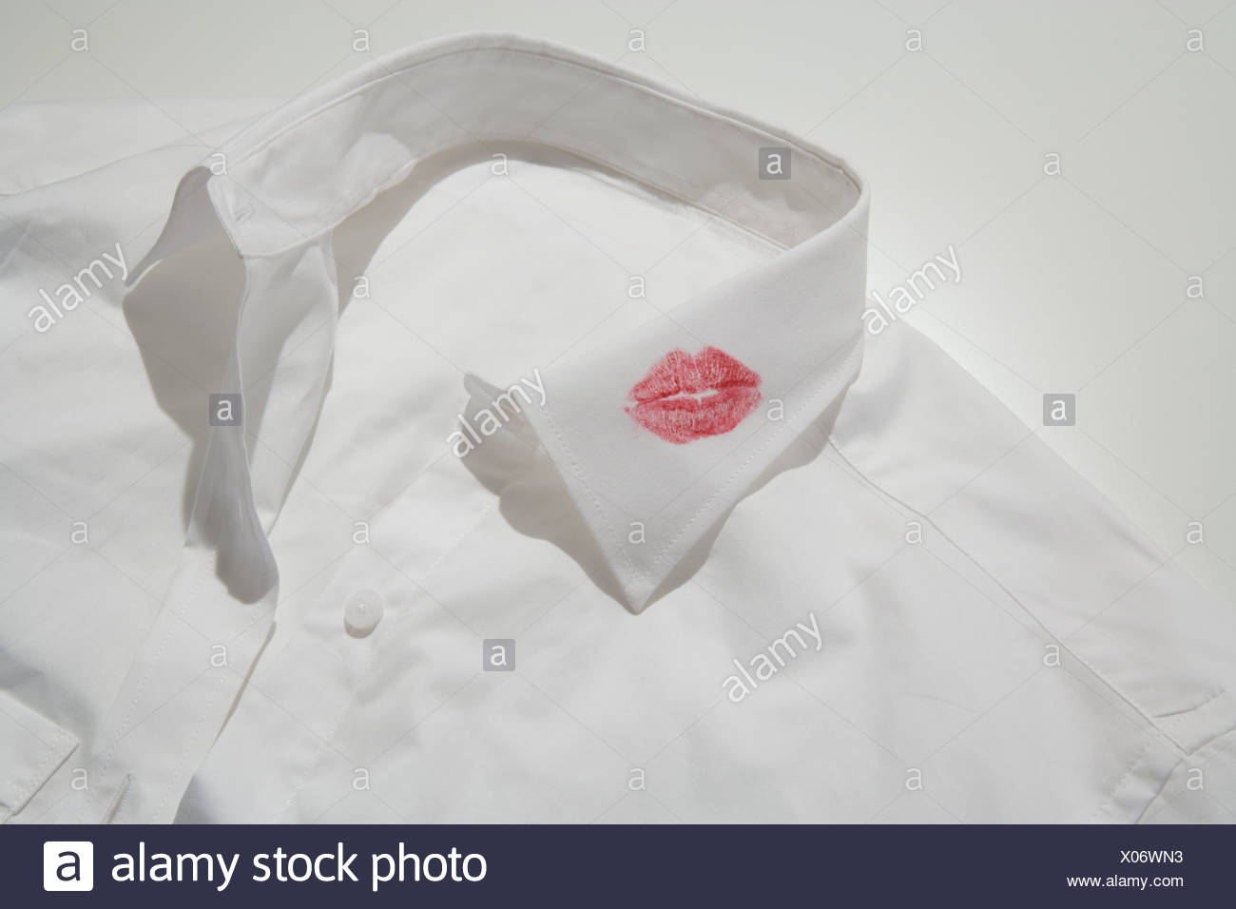
Nature and location
NATURE:
Lip prints are normal lines or fissure in the form of wrinkles and grooves present in the zone of transition of human lip between the inner labial mucous and outer skin.
LOCATION:
Encountered at the scene of the crime of burglary, sexual assault, house trespass, homicide, rape etc.
Depending upon the scenario of crime scene, lip print may be found on various physical evidences at the crime scene such as shirt, handkerchief, tissue paper/ wipes, cups, photograph, letter, glass, window panes, cutlery, fruit skin/ peel, cigarette butts, clothing and even biological materials such as skin.

Slide 6
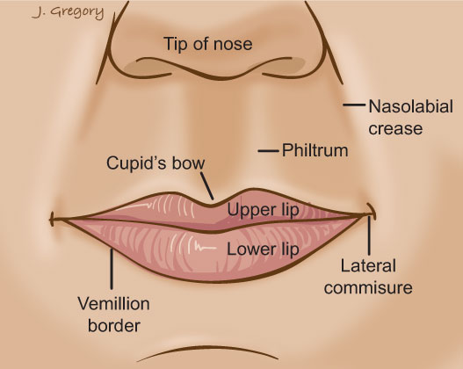
Anatomy
Lips can be described as two highly sensitive mobile folds that surround the oral orifice and form the anterior boundary of the oral cavity.
Each lip is composed of skin muscle, glands and mucous membrane.
Lip area is considered as the surface that forms the oral sphincter irrespective of covering.
Lip can be divided into upper lip and lower lip.
Two lips are joined at the corners of the mouth and separated by the buccal fend.
The meeting point of mucosal and skin covering of the lip is termed labial cord, which is white wavy line called vermillion border.

Slide 7
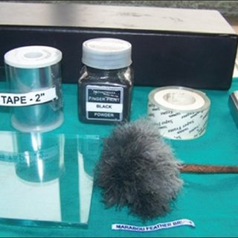
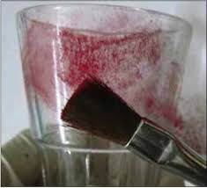
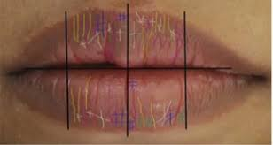
Collection of print from crime scene
Powder method -
Is used to identify latent prints or weak prints in the crime scene.
2. Photography method-
Directly used, when the lip print is clearly visible like a lipstick mark on a non-porous flat surface such as mirror, cups, letters, window panes, etc.
And if latent it can be observed under white light and can be photographed without any further treatment.
Also, can be seen by holding the flashlight at low angles so that the surface is observed under oblique lighting can be photographed.

Slide 8
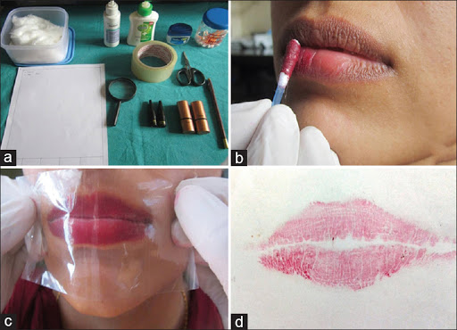
Collection of specimens
1. LIPSTICK METHODS:
The glued portion of cellophane tape strip is placed
and then it is asked to make a lip impression in the normal rest position of the lip.
Then cellophane strip is stuck to the white chart paper for permanent record purpose.
Then it will be visualized by magnifying lens.

Slide 9
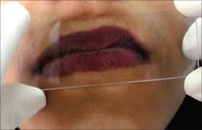
Collection of specimens(continued….)
b) A hinge of folded paper is inserted in a portion between the lips.
it is asked to press his/ her lips against it.
After that the paper is unfolded and analysed under magnifying lens.
c) A clean microscopic glass slides is placed on the lips.
It will result in picking off the lip print.
Which is preserved with cellophane tape and analysed using magnifying lens.

Slide 10
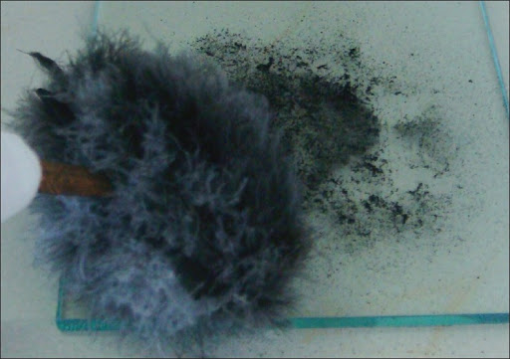
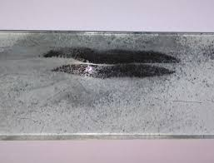
Collection of specimen (continued)….
2. GLASS SLIDE METHODS
Microscopic glass slide is placed over the lips.
It is developed with dusting fine black carbon powder using ostrich brush.
Prints are preserved with a strip of cello tape and then analysed.

Slide 11
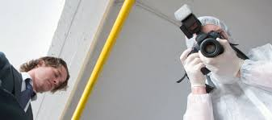
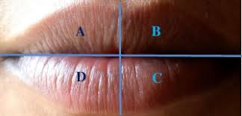
Collection of specimen (continued)….
3. PHOTOGRAPHIC METHOD
It is a modern approach for collecting lip print.
It involves digital camera.
Lip print are recorded by direct photography of the lips using a closeup reflex camera with coloured films.
Or, digital camera from a fixed distance is also used to photograph the lips of the participant in natural condition

Slide 12
video:

Slide 13
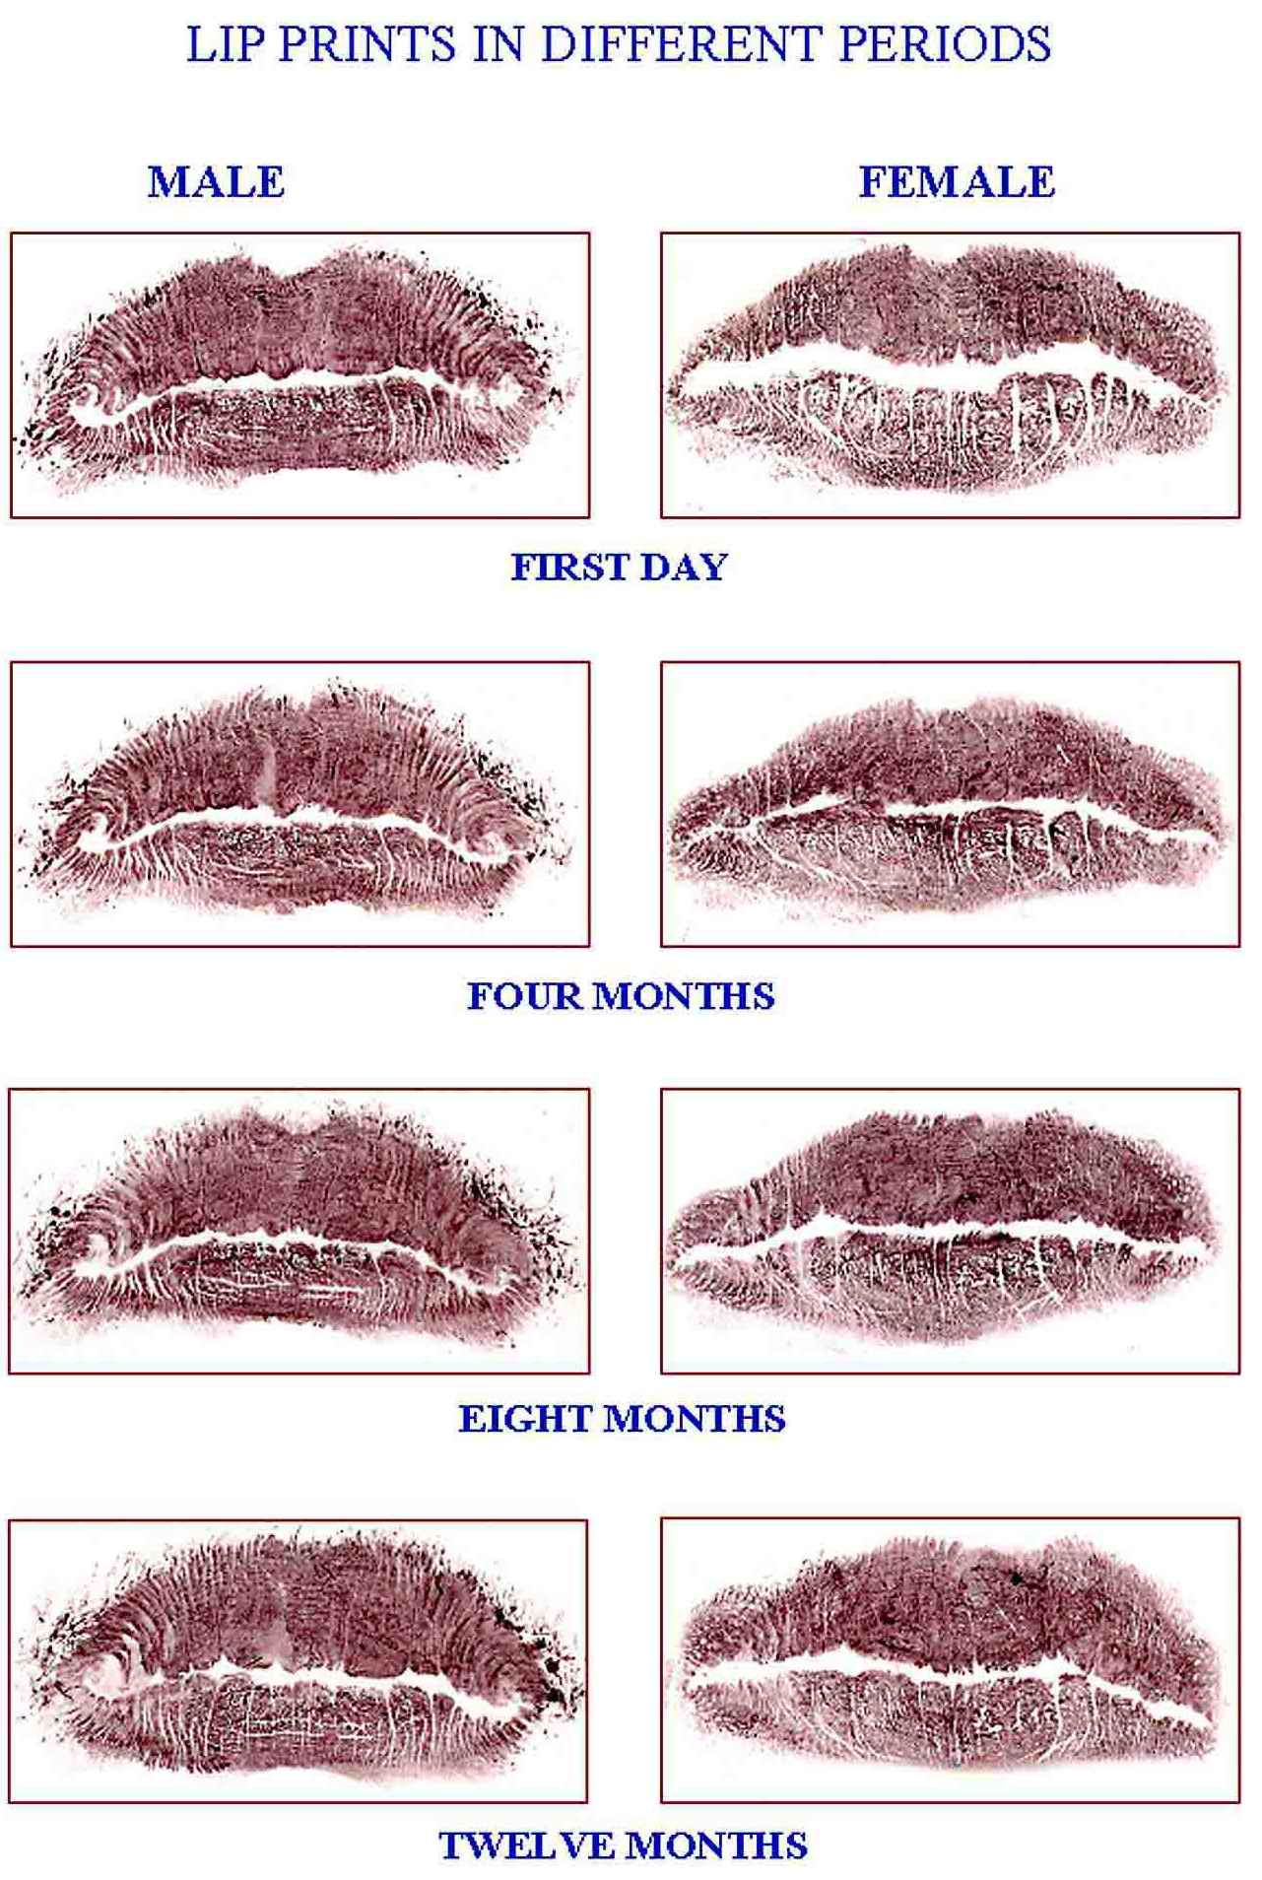
Application
In sex identification-
Lip print was reported to vary with gender, which therefore led to conclusion that lip print is a useful tool in sex discrimination.

Slide 14
Application (continued)
Practical application of lip print:
In 1987 , FBI had successfully identified a male robber who used female disguises.

Slide 15
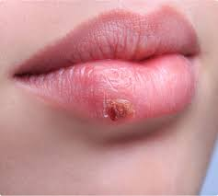
Limitations
Subject associated (intrinsic)
A person can produce different lip print according to pressure and direction.
Lip prints can be influenced by inflammation and abnormalities such as infection, cysts and tumours.
Inflamed lips, abnormal lips may not produce lip prints within the normal pattern.
Any debris on lip surface may alter the lip print recording.
Lip print pattern depends upon whether the mouth is opened or closed.

Slide 16
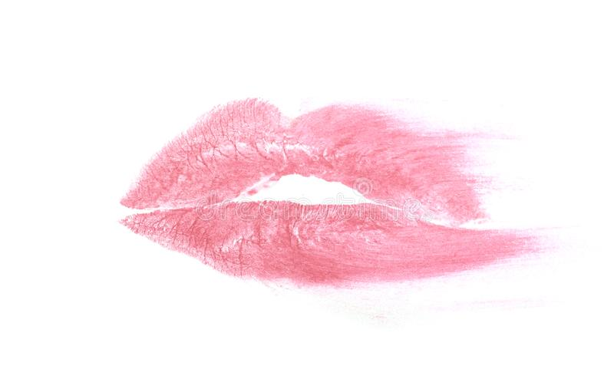
Limitations (continued)
2. Methods associated (extrinsic)
Smudging or spoiling of lip print.
Possible due to presence of prominent facial hair among men.
Application of thick lipstick.
Over stretching of cellophane on the lip surface may alter the recording.

Slide 17
Summary
Term “cheiloscopy” is derived from Greek word “cheilos” meaning lips and “eskopein” meaning to see.
It is the study of characteristics of pattern of wrinkles and groves present on the labial mucosa.
Lip prints are unique and permanent.
They can be found from the crime scene like sexual assault, house trespass, homicide etc.
There are three method used for collection of lip print for specimens:
-> lipstick method
-> glass slide method
-> photographic method
Helps in sex determination.
Collection should be done carefully, or else the print may get disturbed.

