Slide 1


Introduction to Manufacturing Process

Slide 2

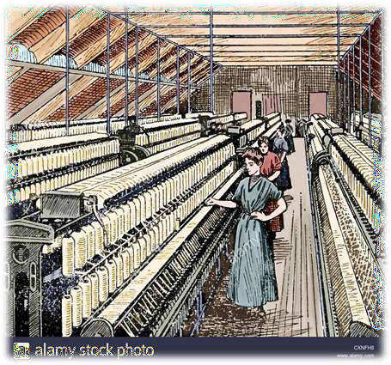








Contents
◆ Definition
◆ Types of Manufacturing
◆ Types of Industries
◆ Types of Manufacturing Operations
◆ What is JIT?
◆ Kanban System

Slide 3




















































Definition
What is “Manufacturing”?
“the process of converting Raw materials into products.”
The word “manufacturing” is delivered from the Latin manu factus, meaning made by hand.
“the conversion of stuff into things” – (by DeGramon, 1998)
“economic terms for making goods and services available to satisfy customer”
– (by T. Black, 1991)

Slide 4













































Types of Manufacturing
Manufacturing can be defined two ways:
Technology – This process to accomplish manufacturing involve a combination of machinery, tools, power and manual labor. Manufacturing also includes the assembly of multiple parts to make products.
Product
Raw Materials
Manufacturing
Process
Profit
Machinery
Tooling
Power Labor

Slide 5



























































Economic – Manufacturing is the transformation of materials into items of
greater value by means one or more processing involve. Therefore,
manufacturing is “added value” to the material.
- “Added Value” – by changing the material’s shape or properties or by combining it with other materials that have been similarly altered.
Manufacturing
Process
Value added
Starting Material
Processed Material
Material in processing

Slide 6



















Types of Industries
SECONDARY
INDUSTRY
TERTIARY INDUSTRY
PRIMARY INDUSTRY
MANUFACTURING INDUSTRIES

Slide 7
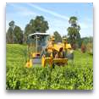
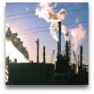







































Agriculture
Forestry
Fishing
Livestock
Mining
Petroleum
SECONDARY INDUSTRY
Aerospace
Automotive
Building
materials
Chemicals
Computers
Electronics
Pharmaceuticals
Textile
Wood & furniture
TERTIARY INDUSTRY
Banking
Communication
Education
Entertainment
Financial services
Government
Hotel
Insurance
Restaurant
Transportation
Tourism
Real estate
PRIMARY INDUSTRY

Slide 8














































Types of Manufacturing Operator
Project – 1 to 10 units
Job shop – 10 to 100 units
Batch – 100 to 10,000 units
Mass – Above 10,000 units
[Low Production]
[Medium Production]
[High Production]
Production Quantity: number of unit produced annually of a particular
product type.
Product Variety: different product designs or types that are produced in the plant.

Slide 9































1. Project
◆ Product position – remains stationary during the manufacturing process – size, weight, location of the product.
◆ Materials, people, machinery are brought to the product or product site.
◆ Based on customer specifications.
◆ Example: bridge, building construction, aircraft, ships, locomotive.

Slide 10








































2. Job Shop
◆ Low volume and production quantities called lot sizes with high product variety.
◆ Satisfies a market for nonstandard or unique product.
◆ Require high skill levels labor – to operate a variety of equipments.
◆ A short duration activities to provide custom goods.
◆ Example: space vehicles, reactor vessels, turbines, aircraft component.

Slide 11















































3. Batch
◆ Batch production produce or process any product in groups which is called “batches”.
◆ Can produce a variety of products – opposed to a continuous production
process, or a one time production.
◆ Useful for industries that makes seasonal items\products for which it is difficult to forecast the demand.
◆ Example: similar standard items made periodically in batches; bakery, paint,
hand tools.

Slide 12




































4. Mass
◆ Also known as flow production, repetitive flow production, series production.
◆ Machinery (e.g.: robots, machine press) that is needed to set up the mass production line is so expensive.
◆ Involved fewer labor cost and a faster rate of production.
◆ Plant and equipments are arranged in a flow line layout.
◆ Example: light bulbs, refrigerator, TV.

Slide 13



































What is Just In Time (JIT)?
◆ Raw materials, parts & components are delivered to the manufacturer just in time to used, parts & components are produced JIT to be made into subassemblies & assemblies, and products are finished JIT to be delivered to the customer.
◆ JIT is also known as “Pull System”.
◆ It tends to simplify and break the whole system into small, autonomous units.

Slide 14





































Benefits of JIT:
◆ Low inventory – carrying cost.
◆ Reduced inspection and reworking of parts.
◆ High quality products made at low cost.
◆ Reduction of:
20% to 40% in product cost.
60% to 80% in inventory.
Up to 90% in rejection rates.
90% in lead times.
50% in scrap & rework.

Slide 15

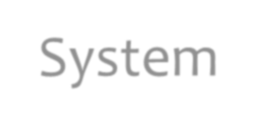




















































Kanban System
◆ Integrated with the implementation of JIT concept.
◆ Kanban – means “visible record”.
◆ Originally consisted of two types of cards:
Production Card: authorizes the production of one container or cart of identical, specified parts at a workstation.
Conveyance\move card: authorizes the transfer of one container or cart of parts from that particular w/station to the w/station where the parts will be used.
The cards contain information on:
  Types of parts.
  Location where issued.
  Part number.
  Number of items in container.

Slide 16

















References
◆ SlideShare
[https://www.slideshare.net/juffrizal/lecture-01-introduction-to-
manufacturing]
◆ Wikipedia [www.wikipedia.net]

Slide 17
THANK YOU

