Slide 1
Money Multiplier
Sit Dolor Amet

Slide 2
Measures of money Supply in India
RBI= C + R+ OD
C= Currency held by the public
R= Cash reserves of the commercial banks
OD= Other Deposits with the RBI
For Practical Purposes H= C+ R

Slide 3
Commercial Banks and Money Creation
The money deposited with the banks- Primary deposits
On the basis of primary deposits, banks create secondary deposits
Households savings
Payment received from RBI for sale of govt. bonds
Payments received from abroad and deposited
Money deposited for convenience

Slide 4
Balance sheet of a Monopoly Bank
Liabilities | Amount | Assets | Amount
A Deposit | 100 | Cash Reserves | 20
 |  | Excess Reserves | 80
Total | 100 | Total | 100

Slide 5
Continued
Liabilities | Amount | Assets | Amount
A Deposit | 100 | Cash Reserves | 36
S Deposit | 80 | S’s Loan | 80
 |  | Excess Reserves | 64
Total | 180 | Total | 180

Slide 6
After the final end
Liabilities | Amount | Assets | Amount
A Deposit | 100.00 | Cash Reserves | 36.00
S Deposit | 80.00 | S’s Loan | 80.00
 |  | Excess Reserves | 0.00
Total | 500.00 | Total | 500.00

Slide 7
Liabilities | Amount | Assets | Amount
Bank 1 | 100.00 | Cash Reserves | 36.00
S Deposit | 80.00 | S’s Loan | 80.00
 |  | Excess Reserves | 0.00
Total | 500.00 | Total | 500.00

Slide 8
Deposit creation in Multiple Bank Model
Bank | Liabilities Deposits | Amount |  | Amount
 |  | Credits | Reserves
Bank 1 | 100.00 | 80.00 | 20.00
 |  |  |  | 100.00
 |  |  |  | 80.00
Bank 2 | 80.00 | 64.00 | 16.00
Bank 3 | 64.00 | 51.80 | 12.80 | 64.00
Bank n
Total | 500.00 | 400.00 | 100.00 | 500.00

Slide 9
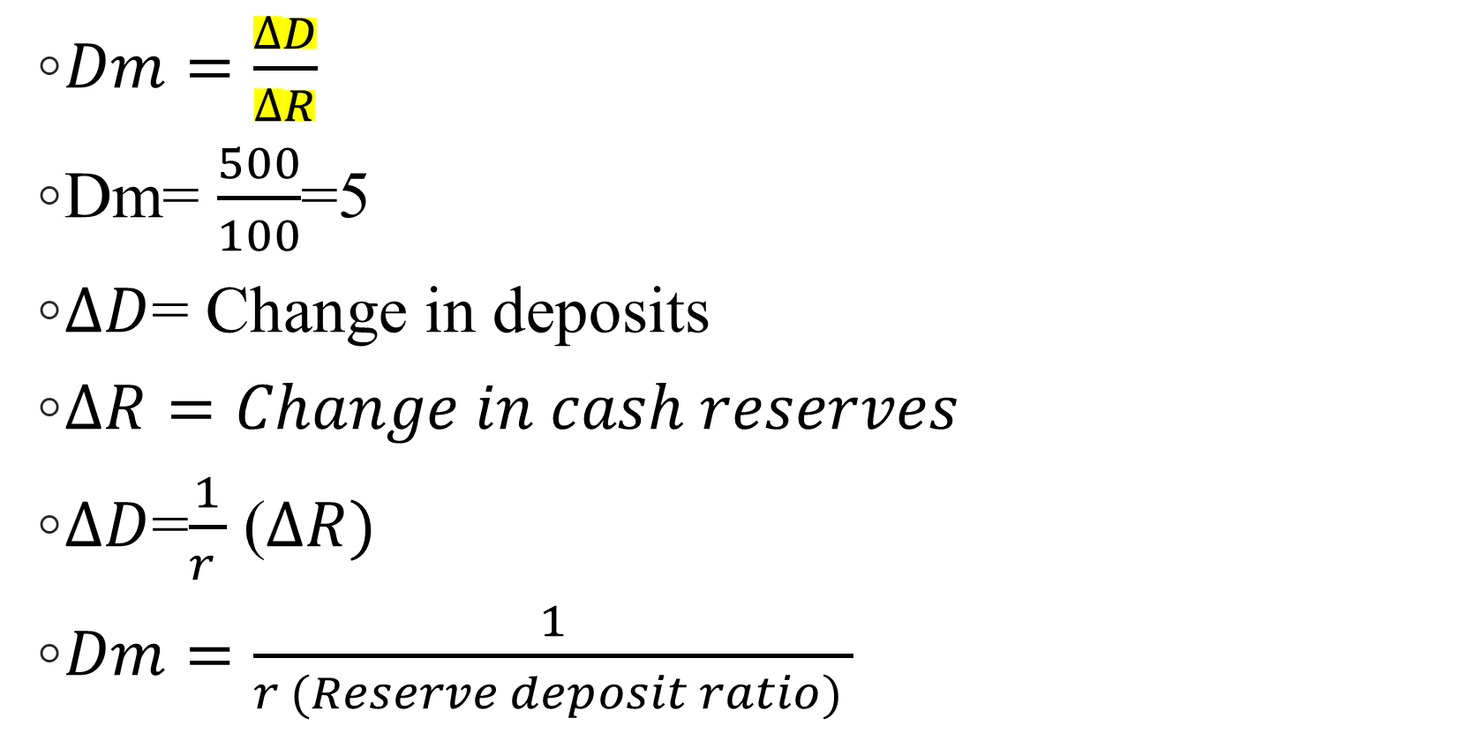
Deposit Multiplier
$Dm=\frac{∆D}{∆R}$
Dm= $\frac{500}{100}$=5
$∆D$= Change in deposits
$∆R=Change in cash reserves$
$∆D$=$\frac{1}{r }$ ($∆R)$
$Dm=$ $\frac{1}{r (Reserve deposit ratio) }$

Slide 10

Credit Multiplier
$Cm=\frac{∆CC}{∆R}$
$Cm=\frac{1−r}{r}$(1-0.2/0.2= 0.8/0.2=4)
400/100= 4

Slide 11
RBI Measures of Money Supply
M1= C +DD +OD
M2=M1 + Savings deposits with post offices
M3=M1 + Net time deposits with commercial banks
M4= M3 + Total deposits with post offices

Slide 12
Money Supply as of 4th June
Item | Outstanding as on
 | 2021 | 2021
 | Mar 31 | Jun 04
1 | 2 | 3
M3 | 18768268 | 19096038
Components (i+ii+iii+iv)
i) Currency with the Public | 2752971 | 2878270
ii) Demand Deposits with Banks | 1984261 | 1854844
iii) Time Deposits with Banks | 13983686 | 14313042
iv) `Other ' Deposits with Reserve Bank | 47351 | 49881
Sources (i+ii+iii+iv-v)
i) Net Bank Credit to Government Sector (a+b) | 5810192 | 5985157
a) Reserve Bank | 1099686 | 1108321
b) Other Banks | 4710506 | 4876836
ii) Bank Credit to Commercial Sector (a+b) | 11610235 | 11494044
a) Reserve Bank | 8709 | 1964
b) Other Banks | 11601526 | 11492081
iii) Net Foreign Exchange Assets of Banking Sector | 4529334 | 4727072
iv) Government's Currency Liabilities to the Public | 26913 | 26973
v) Banking Sector's Net Non-Monetary Liabilities | 3208405 | 3137208
of which : Net Non-Monetary Liabilities of R.B.I. | 1356660 | 1328980

Slide 13
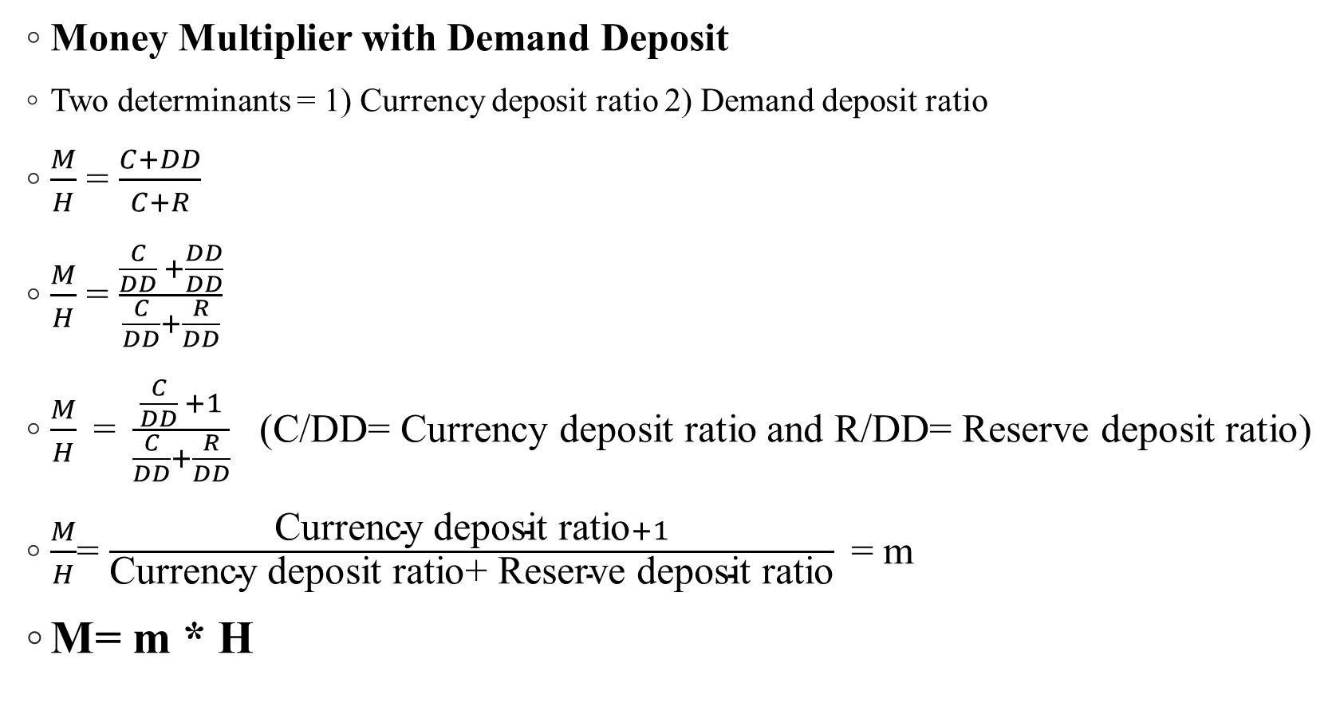
Money Multiplier
Money Multiplier with Demand Deposit
Two determinants = 1) Currency deposit ratio 2) Demand deposit ratio
$\frac{M}{H}$ = $\frac{C+DD}{C+R}$
$\frac{M}{H}$ = $\frac{\frac{C}{DD} +\frac{DD}{DD}}{\frac{C}{DD}+\frac{R}{DD}}$
$\frac{M}{H}\text{ = }\frac{\frac{C}{DD} +1}{\frac{C}{DD}+\frac{R}{DD}}$ (C/DD= Currency deposit ratio and R/DD= Reserve deposit ratio)
$\frac{M}{H}$= $\frac{\text{Currency} \text{deposit} \text{ratio}+1}{\text{Currency} \text{deposit} \text{ratio}\text{+ }\text{Reserve} \text{deposit} \text{ratio}}$= m
M= m * H

Slide 14
Determinants of Money Multiplier
Immediate factors
Currency deposit ratio (c)
Reserve deposit ratio (r)
Time deposit ratio (t)
Ultimate factors
Factors that determine the value of c, r. t
r depends on Monetary policy
c and t depends on the public (Level of income, interest rate, banking system, banking habit of the people, black money etc.)

Slide 15
Thank You

