Slide 1
Industrial Automation SCADA-1

Slide 2
SCADA SUPERVISORY CONTROL AND DATA ACQUISITION

Slide 3
SCADA
Basically consists of data accessing feature from the controller and controlling process remotely.
Conversion of data is possible i.e. analog to digital and vice versa.
Can communicate to any of the protocols available in market.
Completely rely on window based operating systems
Distance as such doesn’t hamper scada operation.
Scada is not dedicated to any one type of application or industry.

Slide 4
Why SCADA?
Previously without a scada a industrial process was entirely controlled by PLC, CNC , PID & microcontrollers having programmed in certain languages or codes.
These codes were either written in assembly language or relay logic without any true animation that would explain the process running.

Slide 5
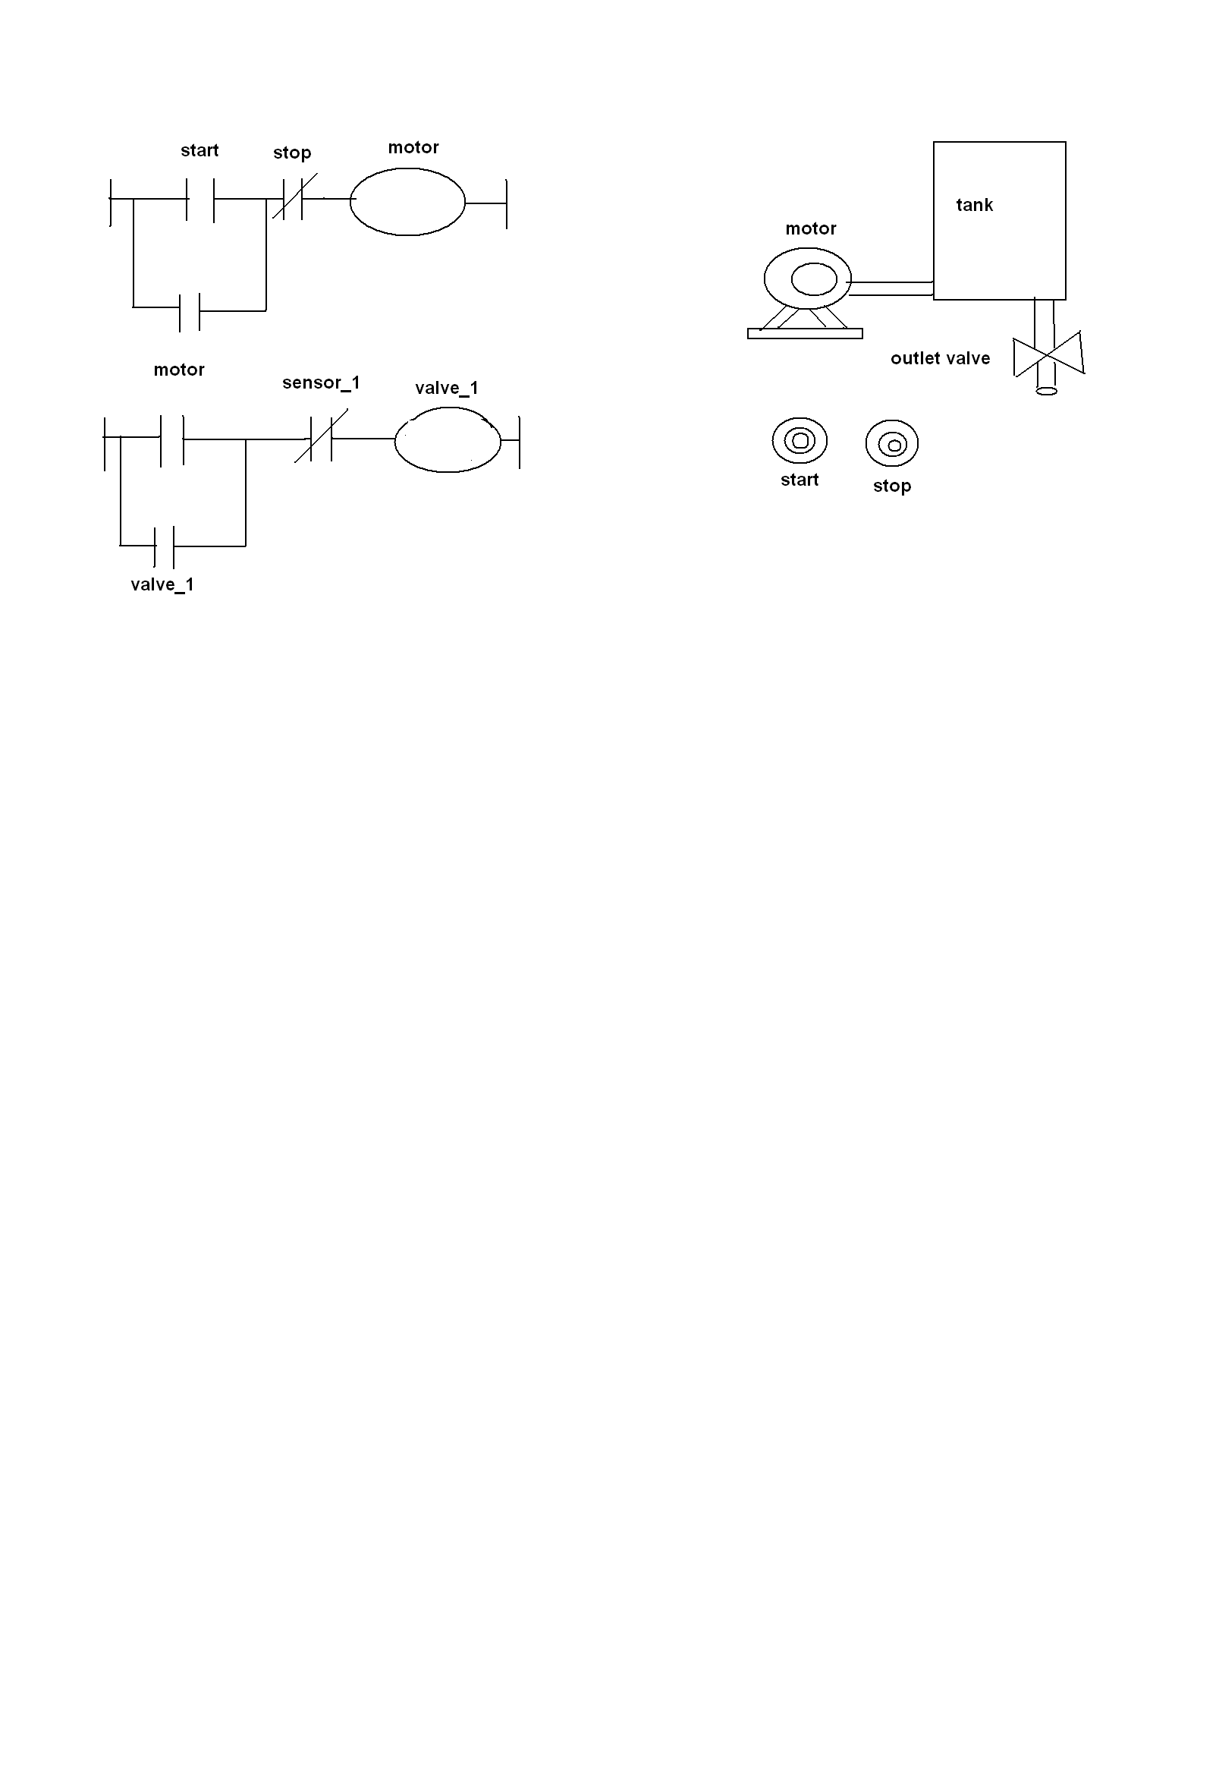
In the left side u see the ladder program which is written for PLC and on the right side is the process for which the logic is written.
Now we can easily understand the process if it is shown with some animations rather then written codes.
Hence Scada came to exist and with him he brought some exclulsive features that amazed the industrial peoples.
SCADA related to industrial process is called industrial scada.

Slide 6
Understanding SCADA
It works like a supervisor who supervises the entire plant area ,if needed it also controls the process as well it converts the data segments for storing process values.i.e. level , pressure , switch positions , density , temperature, messages , etc.
From a distant place if we want to run the process i.e. starting , stopping , opening and closing of field instruments as well logging the various values. Scada can do for you.
Scada is not a 100% controller it is just a software which has to be linked with controllers. ultimately it has to connected to PLC / PID / DCS systems which in turn are connected to field instruments.

Slide 7
How is scada connected
RS232
CONTROLLER
field
instrument
scada
SCADA is installed in the computers and through serial port it is linked to PLC .
All the field devices are connected to PLC and they get signals or commands from PLC.
Whatever applications we want to run can be executed either through PLC or SCADA.

Slide 8
Hazardous areas , unhygienic places , hilly areas and sea beds were a person can’t be send regularly but process has to be watched continuously or it should be controlled then it can be done using SCADA.
Without going to field area if one wants to reset alarms or wants to log a data for a period of time or wants to know status of various units of his company then SCADA is the best option.

Slide 9
Features of SCADA
Dynamic representation
Database connectivity
Device connectivity
Alarms
Trends
Scripts
Security
Recipe Management
Networking

Slide 10
DYNAMIC REPRESENTATION
This feature explains about the representation of various symbols of field instruments which are present in tool library which can be utilized in Scada applications.
Scada is not dedicated to any specific industry hence its library is so large that u can use it for any industries available.

Slide 11
DATABASE CONNECTIVITY
Scada doesn’t has its own database just like microsoft has.Hence for storage it rely on databases available in the market.
It can be connected to VB , SQL ,EXCEL ,
or SAP.

Slide 12
DEVICE CONNECTIVITY
Scada is not a 100% controller.i.e.Scada alone can’t do any controlling .It has to be connected to controllers .
Hence any scada can be connected to any PLC or DCS that are available in the market by using specific driver software.

Slide 13
ALARMS and EVENTS
In the field area alarms are generated for warnings or to keep the process between
certain limits.
Generally these alarms are implemented by
indicating lamps or Hooters in field but Scada represents it with a format.
The format consists of date , time , status ,
priorities , many such elements which can be used for generation of reports.

Slide 14
TRENDS
These are also called as XY plotters or Data loggers. Basically it represents the values in wave formats .It is one of the important feature of Scada
It plots the value with reference to time.
Trend is subdivided into real time and historical
real time trends we can see the present values of the process
historical trends we can see current as well past values and can be stored and records can be maintained for the same.

