Slide 1
Skill course on Poultry Farming
ABC01(0-4-0)
Session: 11
Skills of vaccinating the chicks and growing birds against common diseases. Identifying the diseased birds in poultry farms. Knowing skills of healthy symptoms, Skills of nasal inoculation, feather pricking and administrative of vaccinating material and medication.

Slide 3
Definition
Biosecurity is a defensive health plan and hygienic procedure that can help to keep your farm disease free.

Slide 4
Biosecurity is the key element in the triangle of disease control

Slide 5
1. CONCEPTUAL BIOSECURITY
2. STRUCTURAL BIOSECURITY
3. OPERATIONAL BIOSECURITY

Slide 6
1. CONCEPTUAL BIOSECURITY
build farm in an isolated area, atleast 3 km away from nearest poultry
In the case of breeders, the farm should be away from the major road ways that may be used to transport commercial and backyard poultry.
Maintain distance brooder and layer shed

Slide 7
2. STRUCTURAL BIOSECURITY
Fencing of farm to prevent unwanted visitors.
Test water source for minerals, bacteria, chemical contamination and pathogen load (once in 2-3 months).
Suitable location for storage of bagged feed.
Facilities for safe scientific disposal of dead birds and waste.
Safe housing, with suitable wild birds and rodent proofing.
Feed, litter and equipment should be stored in a section separated from live bird area to prevent contamination.
Proper decontamination and disinfection of equipment, houses

Slide 8
disinfection

Slide 9
3. OPERATIONAL BIOSECURITY
Microbes enter through air and mechanical carriers like human beings, vehicles, predators (vultures, wild birds).
Exchange of infected equipment and material among farms or with traders.
Unauthorized visitors should be completely banned to enter poultry houses.
Out side vehicles should not be allowed to enter farm premises

Slide 10
While entering houses footbath at entrance.

Slide 11
Farm vehicles allowed through disinfectant dips .

Slide 15
In breeder farms, all visitors and workers require to shower and use clean farm clothes to prevent cross contamination between them.

Slide 18
Wild birds control

Slide 20
Maintain record for visitors and their purpose.
In the case of breeders, no vehicles or equipment should be allowed within the farm area from the time of delivery of flock until disposal.
In commercial broiler unit, a minimum inter flock interval of two weeks is recommended.
control pest and rodent through biological, chemical and mechanical means.

Slide 21
disease diagnosis and proper vaccination schedule.
In small scale egg production unit, follow all- in-all-out system. If it is not possible, pullets should be obtained from a source free of vertically transmitted diseases.
Recycling of egg packing materials etc. should be decontaminated at the point of entry of farm.

Slide 22
Routine disease monitoring procedures like postmortem examination and periodic serum antibody assay to determine immune status of the flock.
Regular culling of unhealthy, unproductive and diseased birds
Periodical vaccination and medication.
Supply of quality feed & water.
Educating farmers and farm managers on biosecurity.

Slide 23
MANAGEMENT FACTORS IN DISEASE PREVENTION
It is not advisable to rear birds of different age groups in the same house.
all-in-all-out system.
Litter management
Quality chicks
Proper nutrition
Water quality

Slide 24
Dead bird disposal
DISPOSAL OF POULTRY FARM MANUTE
DISINFECTION
Rodent control
Insect control

Slide 25
Dead bird disposal pit

Slide 27
VACCINATION

Slide 28
TYPES OF VACCINES
Live vaccines
Killed or inactivated vaccines
Recombinant vaccines
Live vaccines contain attenuated organisms. Attenuation is a process by which the pathogenicity, capability of producing a disease, is reduced without altering the immunogenicity. It is usually done by passage in embryos or cell culture.

Slide 29
KILLED OR INACTIVATED
These vaccines contain pathogenic organism(s) that have been chemically inactivated so that they cannot produce disease or spread among the
flock.
However, they can still induce a strong long lasting antibody mediated immunity in the blood.
They must be injected and require an oil or other chemical based adjuvant that slowly releases the antigenic part of the organism, which stimulates the immune system of the animal.

Slide 30
RECOMBINANT VACCINES
Genetically engineered vaccine vectors contain a gene from another organism. The vaccine vector can replicate only the immunogenic part of the inserted organism.
Common recombinant vaccine vectors include HVT, Fowl Pox, E. coli, Salmonella, and NDV. The most common vaccine inserts include IBDV, ILTV, and AIV.
Most are given in the hatchery. HVT and Fowl Pox vectored vaccines are the most common and are given in ovo or by SQ injection, whereas NDV is given by spray at any time during the production cycle. A fowl pox vectored (ILTV +AE vaccine) can be given by wing web injection to pullets in the field. These vaccines are highly effective, but very expensive.

Slide 31
1) Common viral vaccines: MDV, ND, IBV, IBDV, Reovirus, ILTV, etc.
VACCINES ARE ALSO CLASSIFIED BASED ON THEIR CONTENTS
Common bacterial vaccines: MG, MS, Cholera, Coryza, E. coli, Salmonella enteriditis and S. typhimurium, etc.
Only protozoal vaccine: Coccidiosis

Slide 32
COMMON VACCINATION PROGRAMS FOR
YOUNG CHICKENS IN THE US
18 days of incubation in ovo machine or 1 day SQ machine– Marek’s disease (HVT + or – SB1 strains)
1 day Course spray cabinet NDV, IBV, IBDV, Cocci, Salmonella.
Optional-14-18 days –booster dose- NDV, IBV, ILTV, IBD by drinking water or coarse spray.
.

Slide 33
Common Vaccination Programs used for Chickens the US
VACCINATION FOR LAYERS
 | DISEASE | VACCINE | AGE | ROUTE OF VACCINATION
1 | Marek’s disease | HVT+SB1 | hatchery | in ovo or SQ
2 | NDV+IBV | NDV-B1, IBV- Mass, Ark, Ga, Del | 1 | spray cabinet
3 | IBD | intermediate | 14-21 days | water
4 | NDV+IBV | NDV-Lasota IBV-Mass, Ark, Ga | 14-21 days | spray or water
5 | NDV+IBV | Lasota, Mass, Ark, Ga | 6-8 weeks | spray or water
6 | coryza | A/B/C Killed | 12th week | SQ
7 | Fowl Pox | live | 12th week | Wing web
8 | ILTV | live | 12 week | eye drop
10 | NDV, IBV, IBDV | Lasota, Mas, Ark, Ga. Killed | 18th week | SQ

Slide 34
PRE VACCINATION CARE
Vaccinate only healthy birds. If birds are sick
postpone vaccination.
Handle the birds gently.
Vaccinate in cool hours (morning) of the day.
Avoid over crowding
Store vaccines at 4⁰C.
Keep records of all vaccinations, including batch #, brand, manufacturer, etc.
Prepare vaccines in suitable diluents, preferably one supplied by manufacturer.
Use sterile glassware and equipment: syringes, needles,
vaccine guns.

Slide 35
PRE VACCINATION CARE
Provide 1 week interval between vaccinations.
Destroy left over vaccine, empty vials, needles, etc.
Use reconstituted vaccine within 2 hours.
Vaccinate all birds at one time in a house and farm in a day, if possible.
Never mix two unrelated vaccines together to save time and labor.
Use only distilled water for reconstitution of vaccine.
Vaccinate birds early in the morning if possible.

Slide 36
POST VACCINATION CARE
If birds develop a delayed exaggerated response to the live vaccine, that lasts more then seven days post- vaccination, you may need to add vitamins, minerals, and an appropriate broad spectrum antibiotic in the water to reduce stress of vaccination for at least 4 days.
Examples are vitamin and minerals packs, 1% Vinegar, and/or glucose (ex. Gatorade^{R}, Powerade^{R}).

Slide 37
FACTORS THAT GOVERN THE VACCINATION SCHEDULE
1) Follow vaccine manufacturer’s recommendations.
2) Expired vaccines should never be used.
3) Storage and transport: stored at 2-8C. Never store above 8C. and transport in closed insulated container with ice packs.
4) Avoid vaccine exposure to direct sunlight.
5) Do not vaccinate during high temperature. Above 30C may affect vaccine potency.

Slide 38
ADDITIONAL FACTORS THAT GOVERN VACCINATION
SCHEDULE
Generally mass vaccination is followed with commercial companies having large flocks.
Initial vaccination in the hatchery is preferred because the company has control of the entire process.
Vaccines can be administered with an in ovo machine, SQ either manually SQ or with an automated machine, spray cabinet or ingestion of oral gel particles.

Slide 39
METHODS OF ADMINISTRATION
Intraoccular or Intranasal: administered by eye or nose drop. NDV, IBD, IBV, ILTV, Cocci, Salmonella. Can be done manually or with a spray cabinet or handheld machine.
Drinking water: Requires a 1-2 hour period of water withdrawal (depends on ambient temperature of the houses) for birds to consume all the vaccine. A vaccine stabilizer like skimmed milk powder is needed to preserve the live vaccine. Ten liters of water mixed with 60 grams of skimmed milk powder should be used. Birds should be walked and feeders run after vaccination. All vaccine needs to be consumed in 2 hours. Variable farm water quality can be problematic.
.

Slide 40
METHODS OF ADMINISTRATION
Wing Web stab: Fowl pox single or vectored
Subcutaneous: deposited under skin by injection with a needle. Live MDV, or killed NDV, IBV, IBDV, Reovirus, E. coli, Cholera, Coryza, Salmonella,
Aerosal: vaccine is sprayed in the form of a
mist, which is absorbed through nostrils and in their eyes. Can be done manually or with a spray cabinet or handheld machine. NDV, IBV, IBDV, ILTV, Cocci. Spray vaccination is more invasive and may give better results for respiratory viral vaccines than a drinking water vaccination, but can cause a stronger reaction.

Slide 41
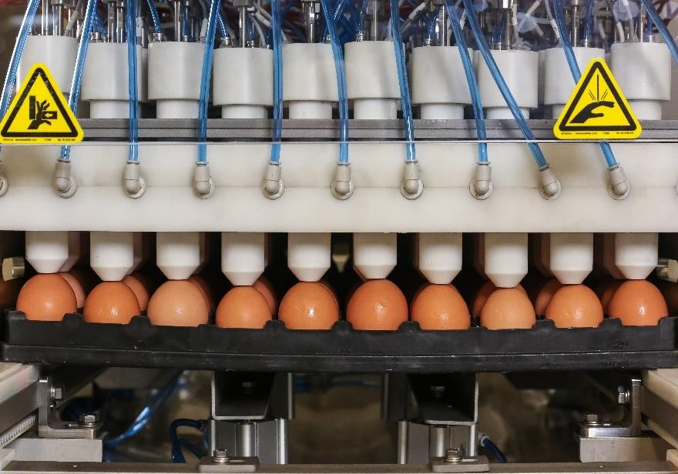
In ovo vaccination

Slide 42
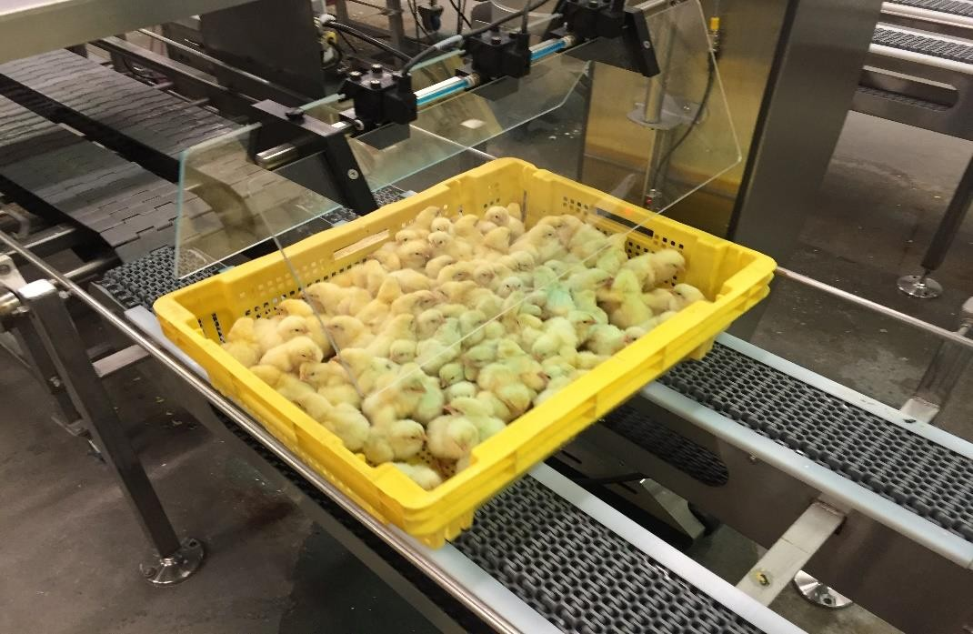
Couse spray machine in the hatchery

Slide 43
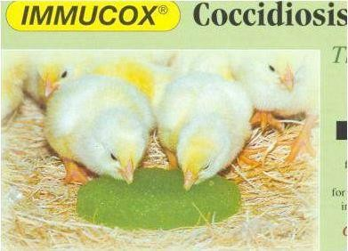
Edible gel containing live coccidia oocytes

Slide 44
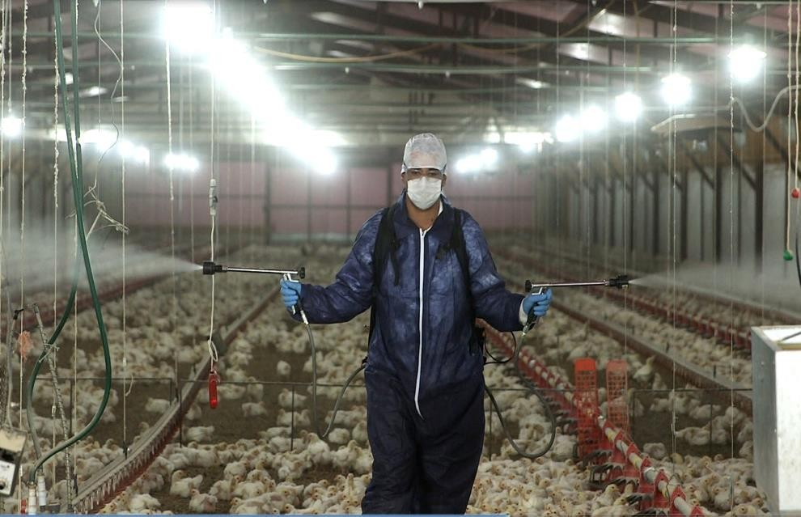
Course spray vaccination in the house

Slide 45
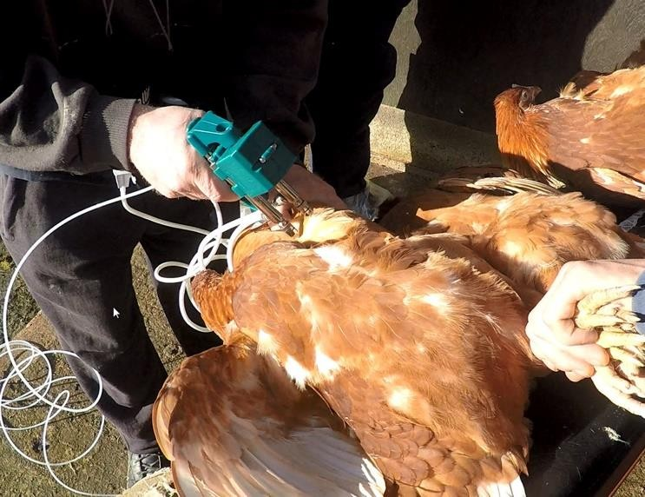
SQ injection of pullets

Slide 46
SUMMARY
There is no universal vaccination program for all poultry.
Programs are only a guide and must be tailored based on the strain, age, and immune status of the birds, prevailing diseases in the area, vaccine availability and costs, and governments regulations.

Slide 47
Thank you

