Slide 1
Livestock & Poultry Management
ASAP2101(2-1-0)
Session: 2
Reproduction in farm animals and poultry

Slide 2

◻ Consists of
proestrus, estrus, metestrus, diestrus and anestrus
1. proestrus- begins after corpus luteum regression, ends at the onset of estrus.
During this period there is rapid development of the follicle which leads to ovulation and the onset of sexual receptivity
estrus- time of sexual receptivity, may be referred to as heat. Ovulation usually, but not always, occurs at the end of estrus. Some species, like cats and ferrets, are induced ovulators
metestrus- the early postovulatory period during which the corpus luteum begins development

Slide 3
4. diestrus- the period of mature luteal activity which begins about 4 days after ovulation end ends with regression of the corpus lutem.
5. Anestrus- without estrus cycles

Slide 4
Hormones
Male
  Testosterone- critical for sperm development
Female
  Estrogen- critical for follicle development
  Progesterone- sustains pregnancy and inhibits new follicle development
  Relaxin- causes ligaments around birth canal to relax
  Oxytocin- causes milk letdown

Slide 5
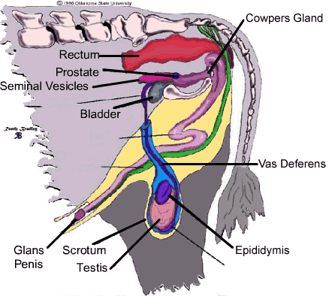
Male Reproductive System
■
Testicles-
■
Site of sperm production and testosterone synthesis
Sperm contain ½ of genetic makeup
■
■
Epididymis-
■
Sperm storage and maturation
■
Scrotum-
■
Protects testes and regulates temperature
http://biotech-adventure.okstate.edu/low/basics/reprod/animal/male/diagram/

Slide 6
Male Reproductive System
Vas Deferans-
  Transports sperm from epididymis to urethra
Urethra-
  tube inside of penis transports sperm or urine exterior
Penis-
  organ of copulation
http://biotech-adventure.okstate.edu/low/basics/reprod/animal/male/diagram/

Slide 7
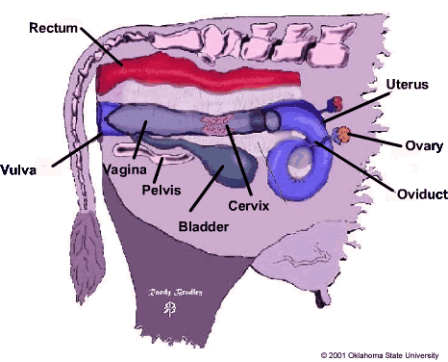
Female Reproductive System
■
Ovaries-
Produce egg
Egg contains ½ of genetic makeup
■
Oviducts-
■
■
Site of fertilization
Transport embryos to uterus
■
Uterus-
■
Site of embryonic development during gestation

Slide 8
Female Reproductive System
■
Cervix-
■
Connects uterus and vagina
Serve as barrier during pregnancy
■
■
Vagina-
■
Female organ of copulation at mating
Opening of bladder
■
■
Vulva-
■
External opening of reproductive system

Slide 9
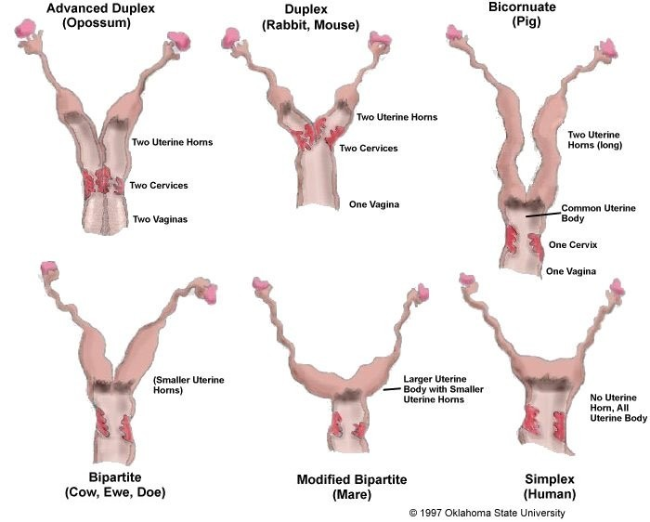
Different Female Reproductive Systems
http://www.ansi.okstate.edu/course/3443/study/Notes/female/tracts.htm

Slide 10
Events of Reproduction
Puberty- Age at which reproductive organs become functional
Female- Reproduction process occurs within
  Estrous cycle- Repetitive cycle occurring when pregnancy does not
  Estrus- “Heat” or receptivity to mating
Fertilization- Egg & Sperm unite
  Only real male contribution is the sperm
Gestation- Length of time of pregnancy
Parturition- Act of giving birth

Slide 11
Age of Puberty
6 to 12 Months
5 to 7 Months
4 to 12 months
4 to 8 Months
12 to 15 Months
9 to 16 YEARS
Cattle:
Sheep:
Goat
Swine:
Horses:
Humans:

Slide 12
Estrous Cycle
Cattle: Polyestrous (cycle throughout year)
Sheep and goat: Seasonal (Decreasing light, Fall)
Swine: Polyestrous (cycle throughout year)
Horses: Seasonal (Increasing daylight, Spring)

Slide 13
Length of Estrus Cycle
Cattle:
Sheep and Goat:
Swine:
Horses:
19 to 23 Days
14 to 19 Days
19 to 23 Days
10 to 37 Days

Slide 14
Duration of Estrus Cycle
Cattle:
Sheep and Goat:
Swine:
Horses:
6 to 27 Hours
24 to 36 Hours
48 to 72 Hours
3 to 8 Days

Slide 15
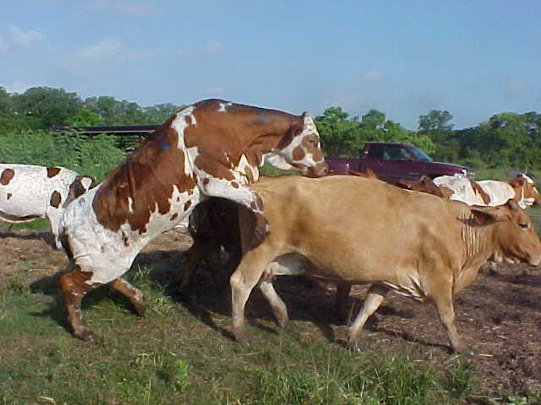
Signs of Estrus
Swollen vulva
Mucous discharge
Restless behavior
Female receptivity to male
http://www.goodecattle.com/spot.htm

Slide 16
Specific Signs of Estrus
Cattle: Visually active mounting
Sheep and Goat: Few external signs
Swine: Brace with pressure to back, vocal grunting
Horses: Tease with Stallion and will go nose to nose

Slide 17
Gestation Length
Cattle:
Sheep and goat:
Swine:
Horses:
285 Days
147 Days
114 Days
336 Days

Slide 18
Partition Names in Species
Cattle:
Sheep and goat:
Swine:
Horses:
Calving Lambing Farrowing Foaling

Slide 19
Signs of Parturition
Distended abdomen
Mammary development & milk secretion
Swollen vulva and relaxed pelvic ligaments
Mucous discharge
Relentlessness and separation from group
Labor and Contractions

Slide 20
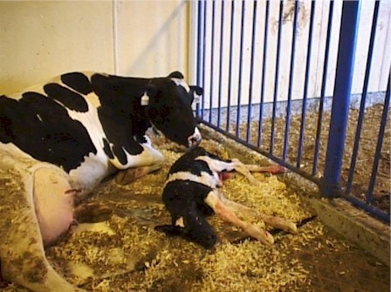
Signs of Parturition
Appearance of placental membrane
Expulsion of fetus
Expulsion of placental membrane
Bonding behavior of offspring and mother (will vary between species)
http://www.ansc.purdue.edu/dairy/4-H/amdairy.htm

Slide 21

◻ Factors affecting risk of dystocia
Abnormal presentation
Multiple births
Heifer vs cow
Pelvic measurement
Nutritional status- obesity/malnutrition

Slide 22

◻ Repulsion then traction
◻ Pubic symphysiotomy- in first calf heifers, if calfs head is larger than the pelvic canal the veterinarian can open and spread the suture between the pubic bones thus enlarging the pelvic canal diameter
◻ Cesarean section
◻ Fetotomy- if fetus is dead, dismembered and delivered in pieces. Note: care must be taken to avoid sharp bone pieces piercing/rupturing uterine wall

Slide 23

◻ Vaginal/uterine prolapse
◻ Obturator paralysis
◻ Milk fever/hypocalcemic tetany
◻ Rejection of offspring

Slide 24
Male Transfer of Sperm
Two different ways
  Let the male and female naturally engage.
    Male seeks out female in Estrus
    All controlled by male and female interaction
  Artificial Insemination (AI)
    Human transfers semen past female cervix
    Human is in control of male product and female interaction
    No contact between male and female

Slide 25
Artificial Insemination (AI) Pros
Conception rate is high
Extends use of superior males
  One ejaculate can fertilize many females
Reduce incidence of venereal diseases
  Individual straw per female
Improves record keeping and mgt.
  Know exactly who the father is
Can accelerate genetic improvements

Slide 26
Artificial Insemination (AI) Cons
Need to know Estrus Cycle of animal
Cost intensive
■ Pay for someone to AI animals

Slide 27
AI Use in Farm Animals
Dairy Cattle: widely used
Beef Cattle: limited use (herds hard to monitor)
Sheep: limited use (need to use microscope)
Swine: intermediate use
Horses: restricted by breed associations

Slide 28
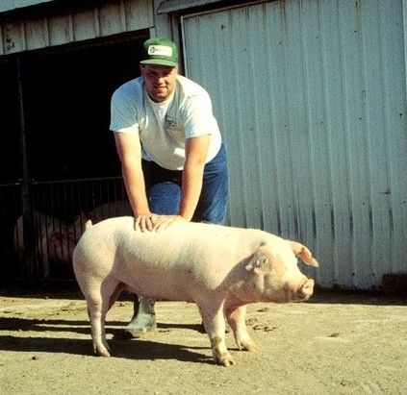
Basic AI Process
■
■
Check for Heat
Have all necessary tools
■
Make sure tools are clean
■
■
Clean her exterior surface
Go through the AI process for the species being bred
Assessment, record important information (date, time, who to… etc)
■
www.ces.purdue.edu/ pork/clipart/reprod.htm

Slide 29
How Animals Differ
Cattle: Follow cervix through anus, guiding the pipette
Sheep: Use microscope to guide pipette
Swine: Out of body guiding of pipette
Horses: Restricted by breed

Slide 30
Swine AI Process
Check for Heat
  Use a teaser bore for receptivity
  Listen to see if vocal
  Swollen vulva with secretion
  Apply back pressure
■
Tight arms Ears flapping
■
www.ces.purdue.edu/ pork/clipart/reprod.htm

Slide 31
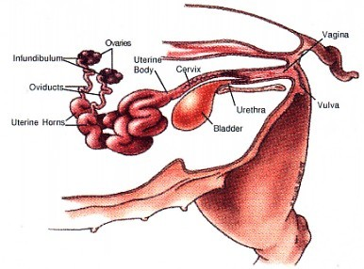
Swine AI Process
Have all necessary tools
  Catheter/pipette
  Lube
  Semen
  Baby wipes
Make sure tools are clean
http://www.ansc.purdue.edu/swine/porkpage/repro/sow2.htm

Slide 32
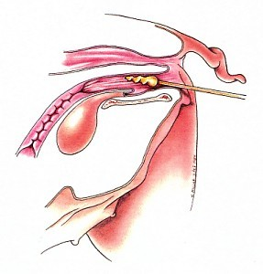
Swine AI Process
Put pressure on back to stimulate mounting
Lubricate catheter
Insert catheter at a 30- 45 degree angle following vulva
Push in about 4-6 inches
http://www.ansc.purdue.edu/swine/porkpage/repro/mngt3.htm

Slide 33
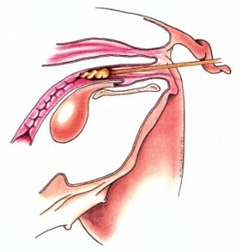
Swine AI Process
■
Move catheter to horizontal position and gently move forward until resistance is felt
Rotate counterclockwise once you have hit resistance
Feel for pressure from cervix (see if holds pipette)
■
■
■
Will pulsate up and down
http://www.ansc.purdue.edu/swine/porkpage/repro/mngt3.htm

Slide 34
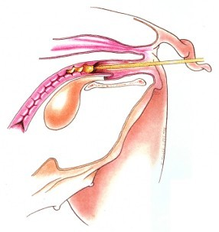
Swine AI Process
■
Connect semen onto catheter
Give small squeeze to initiate flow of semen
■
■
Should suck in herself
■
■
DO NOT RUSH
After semen is gone give a five count
Rotate catheter clockwise
■
and gently pull out
http://www.ansc.purdue.edu/swine/porkpage/repro/mngt3.htm

Slide 35
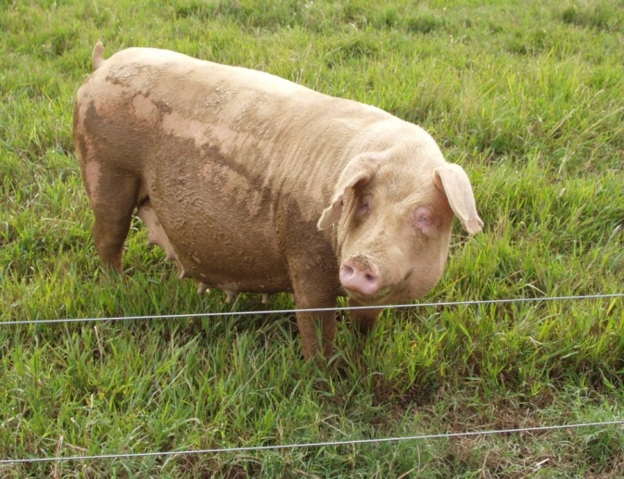
Assessment AI Process
■
Make sure semen took by checking that it didn’t leak out or urinated out.
Record important information
■
■
■
■
■
Date Time Who to
Anything else that you feel is crucial

Slide 36

◻ Colostrum
Requirement – 1 liter per 100 lbs
Colostrum banking- dams will produce more colostrum than needed. After neonate has consumed a sufficient amount, the rest may be milked out and frozen for storage for up to 1 year

Slide 37
- Colostrum quality- (quality = immunoglobulin content)
subjective- stickiness, thickness (Note: color is not a reliable criteria for assessing quality)
Objective- specific gravity > 1.060
- Gut closure- the neonatal intestinal tract has the transient capability to absorb large ( immunoglobulins) molecules intact. That capability is lost after 24 hours or the consumption of 32 ounces of material.
Colostrum consumed after gut closure is of no benefit.
behavior- strong suck reflex
Umbilicus- iodine ( foals apply every 12 hours until navel remains dry)
Meconium- feces that accumulates in the colon during fetal development, can be rock hard and difficult to pass. If straining is observed, administer phosphate enemas until meconium is passed. ( colostrum has laxative)

Slide 38



Slide 39
What the major male and female reproductive organs in poultry and their functions?
III. The reproductive systems of poultry are similar to that found in mammals with a few differences.
The reproductive system of the male poultry includes the testicles, which are held within the body cavity rather than in a scrotum. The testicles produce the sperm and seminal fluid.

Slide 40
Male Poultry Reproductive System
The vas deferens carries the seminal fluid and sperm cells to the cloaca.
The cloaca is the enlarged part where the large intestine joins the end of the alimentary canal.
The alimentary canal is the food-carrying passage that begins at the mouth and ends at the vent.
The papilla is the organ in the wall of the cloaca that puts the sperm cells into the hen’s reproductive tract.

Slide 41
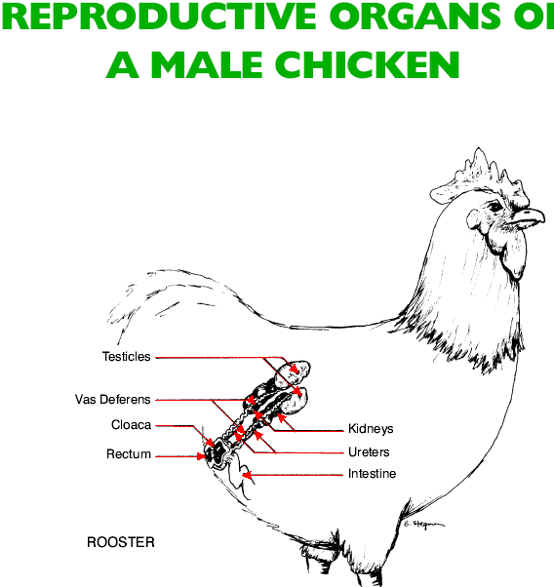

Slide 42
Female Poultry Reproductive system
The reporductive system of female poultry has two ovaries and two oviducts.
The right ovary and oviduct do not function. Only the left ovary and oviduct produce eggs.
The ova produced in the ovary develop into egg yolks.
The oviduct of the chicken has five parts:

Slide 43
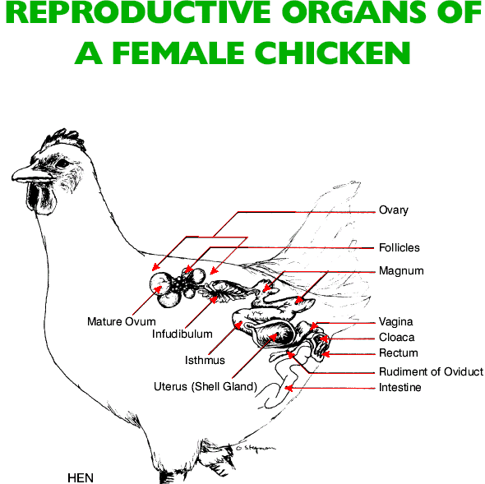

Slide 44
Five Parts of Oviduct
Funnel - receives the yolk from the ovary.
The sperm cells that the chicken receives from the male are stored here.
Magnum - secretes the thick white of the egg.
It takes approximately three hours for the thick white to be placed around the yolk in the magnum.
3. Isthmus - The yolk and thick white move from the magnum into the isthmus, where two shell membranes are placed around the yolk and thick white. This process takes approximately 1¼ hours.

Slide 45
4. Uterus- The developing egg remains in the uterus for 18-20 hours while approximately 40% of the albumen and all of the shell is added. It is for this reason that the organ is often called the shell gland
5. Vagina - From the uterus, the egg moves into the vagina.
The egg stays here only a short time after which it is laid.
It takes about 25 to 27 hours for a chicken to produce one egg

Slide 46
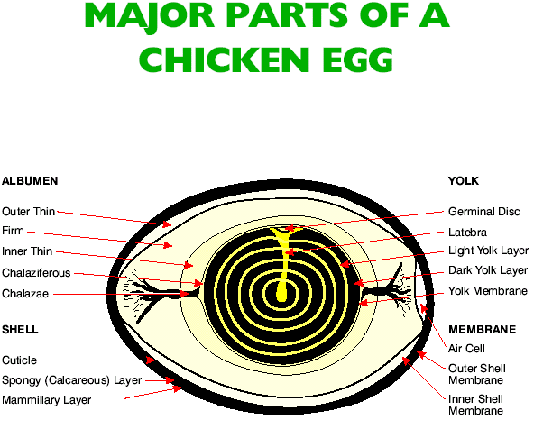

Slide 47
What are the phases of reproductive development in the life of an animal?
Incubation is the development of a new animal in the fertile egg of poultry, fish, and other egg-laying species.
Spawning is the releasing of eggs by a female fish and the subsequent fertilization by the male.

Slide 48
What are the phases of reproductive development in the life of an animal?
A female may lay thousands of eggs at one spawning.
The male fish then fertilizes the eggs by releasing sperm on the mass of eggs.

Slide 49
Four Factors in Incubating Eggs
Temperature should be maintained at 99 to 103°F.
Humidity should be about 60 % during the first 18 days and 70 % during the last 3 days.
Oxygen - Sufficient air exchange to prevent carbon dioxide buildup.
Egg rotation - Eggs should be rotated two to five times daily for the first 18 days.

Slide 50
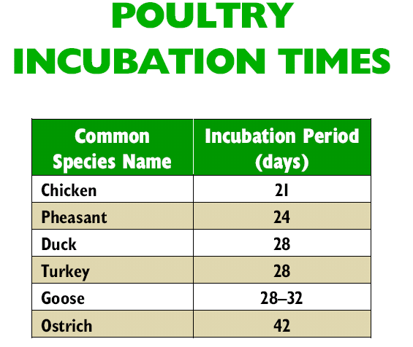

Slide 51
Thank you

