Slide 1
Study of vacuum still, Preparation of Purified Water I. P. And Water for Injection I. P. By Distillation and construction and working of the still used for the same
Ms. Shubhashree Das
Assistant Professor
School of Pharmacy
Centurion University of Technology and Management
Balasore
shubhashree.das@cutm.ac.in

Slide 2
Vacuum Still
The vacuum stills are employed for distilling substances under reduced pressure on a large scale.
A vacuum still is generally made of stainless steel or any other metal which can withstand a high vacuum.
The still is connected to a condenser.
The vacuum is crated by means of a vacuum pump.
The vacuum still is filled by attaching a pipe to a tap in the lower part of the hood and the pump is started.
The other end of the pipe dips into the liquid to be distilled so that it can be drawn into the still.
An observation window in the hood is very helpful to the operator to see the progress of distillation and also the level of the content of the liquid to be distilled.
Notes:
The

Slide 3
Two receivers are generally attached to the condenser in order to collect the distillate without stopping distillation.
However, they may be used alternatively by a suitable arrangement of the cocks.
Applications in pharmacy
Distillation of substances that have a high boiling point at atmospheric pressure.
Distillation of thermolabile substances that get damaged by a high temperature.
Removal of the last traces of a volatile solvent.

Slide 5
Preparation of Purified Water I. P. And Water for Injection I. P. By Distillation:-
The portable water is used for the preparation of purified water. It contains-
(i) Dissolved gases such as carbon-dioxide and ammonia
(ii) Dissolved salts and solids
This can be avoid by taking the following precautions:
1. By heating the feed water. This removes the dissolved gases. The solubility of gases decreases as the temperature is raised. For the purpose of economy the water feeding the boiler should be passed through the condenser jacket for heating the water.

Slide 6
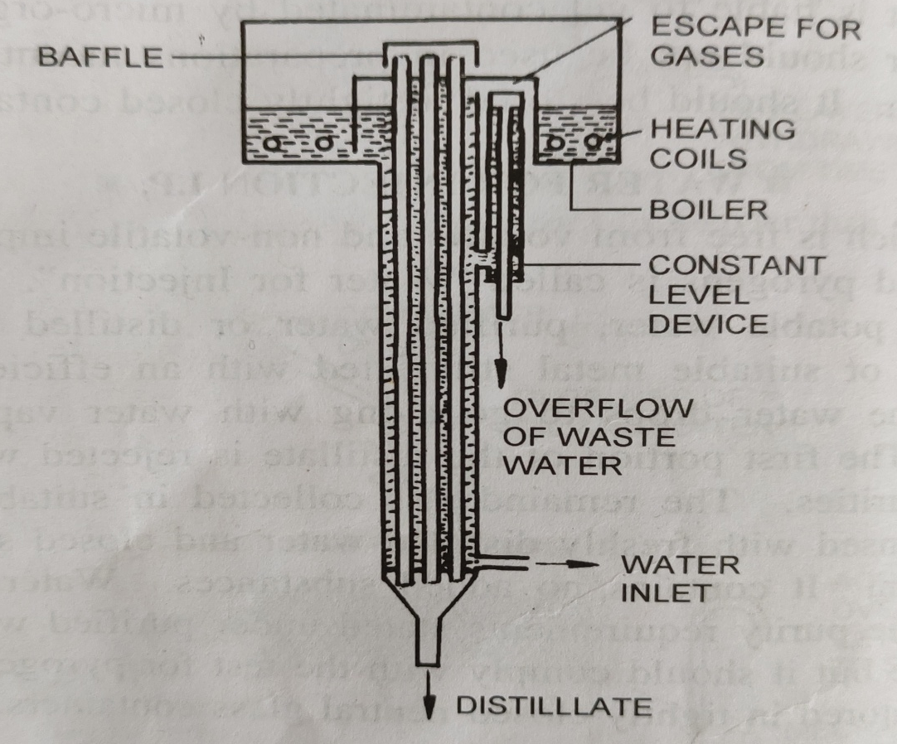
2. A constant level device is attached to the boiler to avoid excessive concentration of salts. Inspite of this, some of the solids will be deposited and it becomes necessary to de-scale the boiler after a certain period.
The distillation unit which is commonly used for the continuous production of purified water is shown below:-

Slide 7
It consists of a boiler which is made of cast iron.
It is connected to the condenser tubes through the baffles.
The condenser tubes and baffles are made of stainless steel.
Baffles are provided over the top of the condenser tubes to avoid water drops getting mixed with the vapours.
It is done to avoid carry-out of pyrogen and other water soluble materials in the droplet.
The cooling water enters at the bottom of the condenser and is heated by the condensing vapours.
The flow rate is adjusted in such a way that water gets heated at 90 ℃ -95℃ before it enters the boiler.
The top of the condenser jacket is open, so that gases from the water can escape into the atmosphere.
A constant level device is fitted in such a way that the heated water free from gases enters the boiler.

Slide 8
THANK YOU ☺

