Slide 1




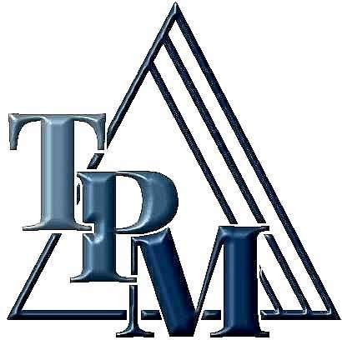

Slide 2

◆ What is maintenance and their types
◆ What is TPM
◆ Why TPM need
◆ TPM History
◆ TPM Objectives
◆ TPM targets
◆ Similarity and difference between TPM and TQM
◆ Pillars of TPM
◆ Why is TPM so popular and important
◆ Company checklist
◆ Benefits of TPM
◆ Losses of TPM
◆ Conclusion

Slide 3
What is Maintenance?
The Management,control,execution and quality assurance of activities which ensure the achievement of optimum availability and performance of a plant in order to meet business objectives.

Slide 4
Types Of Maintenance :
Preventive Maintenance
Predictive Maintenance
Scheduled Maintenance
Breakdown Maintenance

Slide 5





T: TOTAL
Participation of all Employees.
Include all Departments, operation,
equipment and
process.
P: PRODUCTIVE
Pursue the maximization of efficiency of the production
system
by making all loses zero.
Zero accidents Zero defects Zero breakdowns.
M: MAINTENANCE
To improve the efficiency of the equipment.
Maintenance means the entire life cycle of the production system.

Slide 6
It is a Japanese approach for
◆ Creating company culture for maximum efficiency
◆ Striving to prevent losses with minimum cost
◆ Zero breakdowns and failures, Zero accident, and Zero defects etc.
◆ The essence of team work (small group activity) focused on condition and performance of facilities to achieve zero loss for improvement
◆ Involvement of all people from top management to operator

Slide 7


◆ TPM first introduced in Japan 20 years ago and rigorously
been applied in past 10 years
TPM planning & implementation in Japanese factories supported by JIPM (Japan Institute of Plant Maintenance)
Awarded yearly prizes to various industries:
  Automotive
  Metals
  Chemicals
  Rubber
  Food
  Glass etc.

Slide 8
◆ Initially implemented in
high-to-medium volume production areas
◆ Later successfully applied in:
Low-volume production
High-to-low volume assembly
Development areas
Whole range of industry

Slide 9



Avoid wastage in a quickly changing economic environment.
Producing goods without reducing product quality.
Reduce cost.
Goods send to the customers must be non defective.

Slide 10
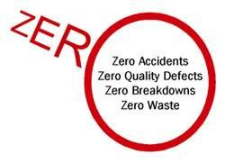


Increase production while, at the same time, increasing employee morale and job satisfaction.
Hold emergency & unscheduled maintenance to a minimum.
To provide the safe and good working environment to the worker.
Achieve Zero Defects, Zero Breakdown and Zero accidents
in all functional areas of the organization.
Involve people in all levels of organization.
Form different teams to reduce defects and Self Maintenance.
To fulfill Regulatory compliances.

Slide 11


To provide the safe and good working environment to the worker.
“If you focus on result you will never change.
If you focus on change you will get Result.”
11

Slide 12


PRODUCTION
I). Obtain Minimum 80% Overall Production Efficiency
1.
Obtain Minimum 90% Overall Equipment Effectiveness
Run the Machine during lunchtime
QUALITY
Operate in a manner, so that there are no customer complaint
COST
Reduce the manufacturing cost as much as possible
DELIVERY
2.
3.
4.
Achieve 100% success in delivering the goods as required by the
customer
5.
SAFETY
Maintain an accident free environment
MULTYTASK
Develop multiskilled & flexible workers.
6.

Slide 13


◆ Employees must be empowered to initiate corrective action.
◆ Total commitment of upper level management.
Category
TQM
Quality ( Output and effects )
TPM
Equipment ( Input and cause )
Employees participation and it is hardware oriented
Elimination of losses
and wastes.
Object
Systematize the management. It is software oriented
Mains of
attaining goal
Target
Quality for PPM

Slide 14
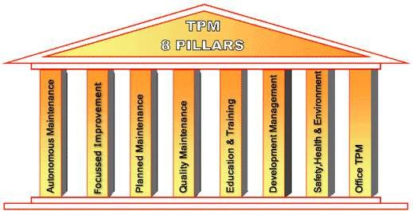
14

Slide 15


◆ PILLAR 1 - Autonomous Maintenance
◆ A collaborative team activity involving production,
maintenance, and engineering
◆ Maintaining Basic conditions on shop floor & in Machines.
◆ All over participation through TPM Circles.
◆ An approach that
◆ Develops operating and maintenance skills
◆ Strengthens communication and cooperation
◆ PILLAR 2 - Focused Improvement
◆ Improvement on every one’s activity.
◆ Improvement is to eliminate Production losses and cost reduction.
◆ Improvement in Reliability, Maintainability, and cost.

Slide 16
PILLAR 3 - Planned Maintenance
Logical analysis “Real causes for real counter measures”.
Focus on Prevention.
It is aimed to have trouble free machines and equipments producing defect free products for total customer satisfaction. Example: Preventive Maintenance, Breakdown
Maintenance, etc.,

Slide 17
PILLAR 4 - Quality Maintenance
Developing perfect machine for perfect Quality.
Eliminating In – Process defects and custom complaints.
Policy :
Defect free conditions and control of equipments.
QM activities to support quality assurance.
Focus of prevention of defects at source
Effective implementation of operator quality assurance

Slide 18
PILLAR 5 - Education & Training
Skills development for uniformity of work practices on machines.
Skills for Zero defects, Zero breakdowns & Zero accidents.
Multi Skilled employees in all departments
Steps in Educating and training activities :
Setting policies and priorities and checking present status of
education and training.
Establish of training system for operation and maintenance skill up gradation.
Training the employees for upgrading the operation and maintenance skills.
Preparation of training calendar.
Evaluation of activities and study of future approach.

Slide 19
PILLAR 6 - Development Management
Developing machines for “high equipment
effectiveness”.
Quick process for developing new products. Example: KAIZEN
Kaizen Policy :
Relentless pursuit to achieve cost reduction targets in all resources.
Relentless pursuit to improve over all plant equipment effectiveness.
Extensive use of PM analysis as a tool for eliminating losses.
Focus of easy handling of operator

Slide 20
PILLAR 7 - Safety, Health & Environment
Zero accidents and Zero hazards at works.
Zero Pollution at Plant and Environment
PILLAR 8 - Office TPM
Office TPM should be started after activating from other pillars of TPM. Office TPM must be flowed to improve productivity, efficiency in the administrative function and identify eliminate losses. This includes analyzing process and procedure towards increased office automation. Office TPM covers twelve major losses. These are:
Processing loss
Cost loss including in areas such as procurement, accounts marketing leading to high inventories.
Communication loss.
Idle loss.
Set-up loss.
Accuracy loss
Office equipment breakdown.
Communication channel breakdown.
20

Slide 21
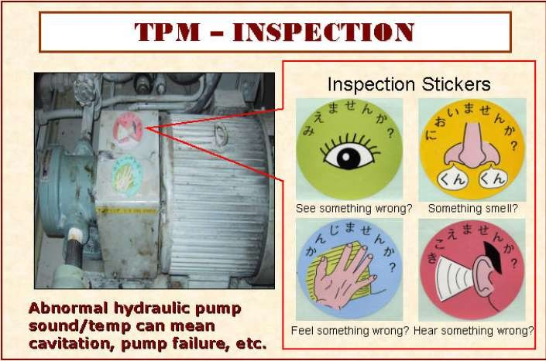

Slide 22

Three main reasons:
1. It guarantees dramatic results (Significant tangible results)
◆ Reduce equipment breakdowns
◆ Minimize idle time and minor stops
◆ Less quality defects and claims
◆ Increase productivity
◆ Reduce manpower and cost
◆ Lower inventory
◆ Reduce accidents

Slide 23
2. Visibly transform the workplace (plant environment)
◆ Through TPM, a filthy, rusty plant covered in oil and grease, leaking fluids and spilt powders can be reborn as a pleasant and safe working environment
◆ Customers and other visitors are impressed by the
change
◆ Confidence on plant’s product increases

Slide 24
3. Raises the level of workers knowledge and skills
As TPM activities begin to yield above concrete results, it helps:
◆ The workers to become motivated
◆ Involvement increases
◆ Improvement suggestions proliferate
◆ People begin to think of TPM as part of the job

Slide 25
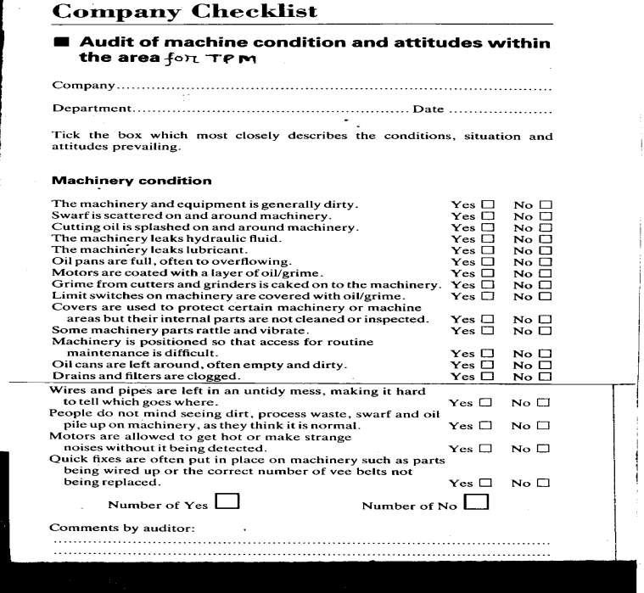

Slide 26
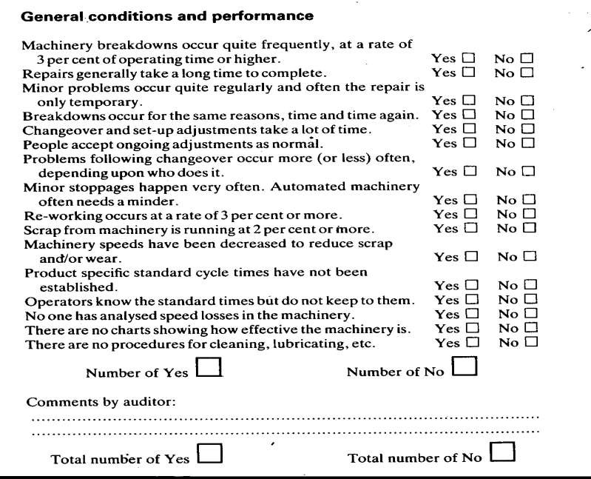

Slide 27
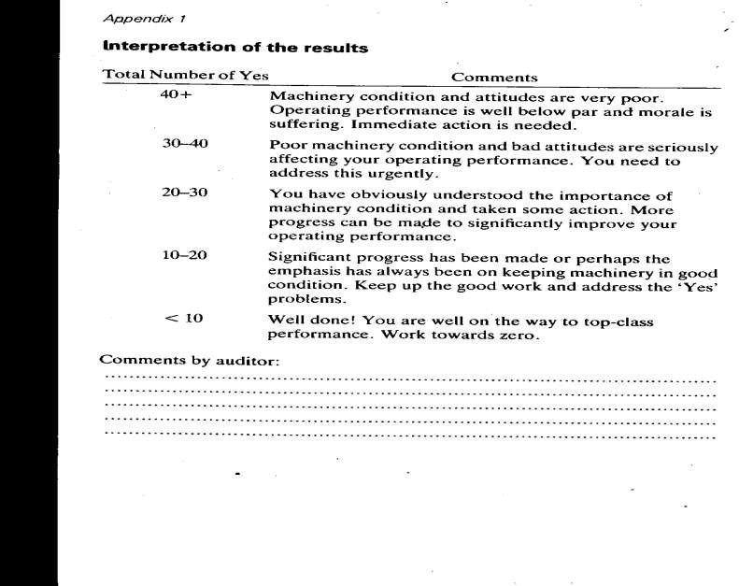

Slide 28

Direct Benefits of TPM
Indirect Benefits of TPM
Increase Productivity and Overall Plant Efficiency by 1.5 to 2 times
Rectify customers complaints
Reduce manufacturing
cost by ….percent
Satisfy the customers needs by 100%
Reduce accidents
Higher confidence level among the workers
Keep the work place clean, neat and attractive
Favorable change in the attitude of the operators
Achieve goals by working
as Team
Share knowledge and experience

Slide 29
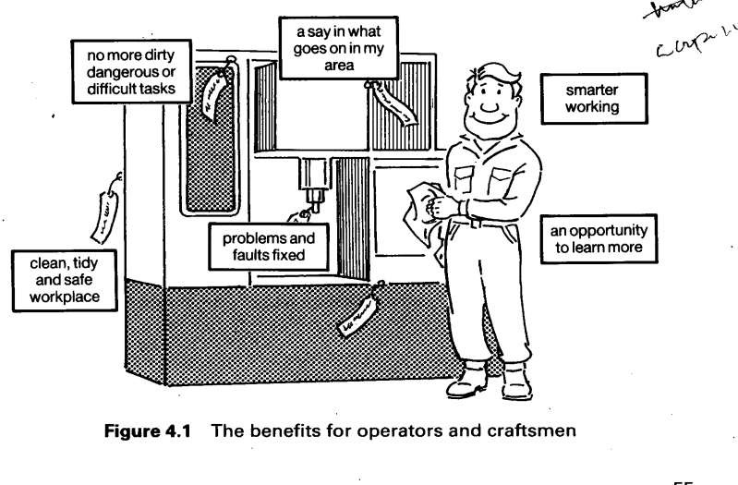

Slide 30

Breakdown losses
Setup and adjustment losses
Idling and minor stoppage losses
Speed losses
Quality defects and rework losses
Start-up/yield losses

Slide 31


TPM is a Lean tool for Quality and Productivity
Today, with competition in industry at an all time high, TPM may be the only thing that stands between success and total failure for some companies. It has been proven to be a program that works. Employees must be educated and convinced that TPM is not just another "program of the month" and that management is totally committed to the program and the extended time frame necessary for full implementation. If everyone involved in a TPM program does his or her part, an unusually high rate of return compared to resources invested may be expected.
TPM may be the only thing that stands between success and total failure for
some companies
It can be adapted to work not only in industrial plants, but in construction, building maintenance, transportation, and in a variety of other situations.
Easy to operation, Improvement the availability and productivity, make operation and area safer.

Slide 32


