Slide 1
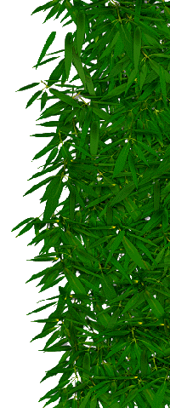

Slide 2
What is
Transpiration?
Transpiration is the evaporation of water from plants. It occurs chiefly at the leaves while their stomata are open for the passage of CO₂ and O₂ during
photosynthesis.

Slide 3
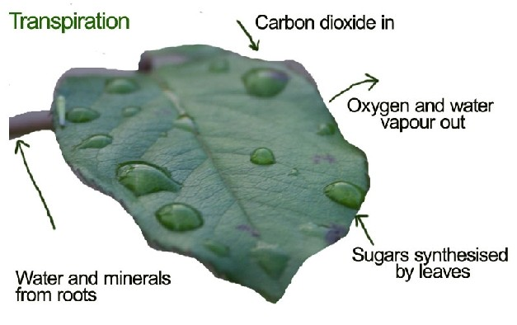

Slide 4
Gas Exchange in Plants
In order to carry on photosynthesis, green plants need a supply of carbon dioxide and a means of disposing of oxygen. In order to carry on cellular respiration, plant cells need oxygen and a means of disposing of carbon dioxide (just as animal cells do).

Slide 5
Unlike animals, plants have no specialized organs for gas exchange (with the few inevitable exceptions!). The are several reasons they can get along without them:
Each part of the plant takes care of its own gas exchange needs.
Roots, stems, and leaves respire at rates much lower than are characteristic of animals.

Slide 6
The only living cells in the stem are organized in thin layers just beneath the bark. The cells in the interior are dead and serve only to provide mechanical support.
Oxygen and carbon dioxide also pass through the cell wall and plasma membrane of the cell by diffusion. The diffusion of carbon dioxide may be aided by aquaporin channels inserted in the plasma membrane.

Slide 7
Leaves
The exchange of oxygen and carbon dioxide in the leaf (as well as the loss of water vapor in transpiration) occurs through pores called stomata (singular = stoma).
Normally stomata open when the light strikes
the leaf in the morning and close during the night.

Slide 8
RATE OF TRANSPIRATION
Time | Osmotic Pressure, lb/in²
7 A.M. | 212
11 A.M. | 456
5 P.M. | 272
12 midnight | 191

Slide 9
Importance
Transpiration is not simply a hazard of plant life. It is the "engine" that pulls water up from the roots to:
supply photosynthesis (1%-2% of the total)
bring minerals from the roots for biosynthesis within the leaf
cool the leaf

Slide 10
Environmental factors that affect
the rate of transpiration
1. Light
Plants transpire more rapidly in the light than in the dark. This is largely because light stimulates the opening of the stomata (mechanism). Light also speeds up transpiration by warming the leaf.

Slide 11
2. Temperature
Plants transpire more rapidly at higher temperatures because water evaporates more rapidly as the temperature rises. At 30°C, a leaf may transpire three times as fast as
it does at 20°C.

Slide 12
3. Humidity
The rate of diffusion of any substance increases as the difference in concentration of the substances in the two regions increases.When the surrounding air is dry, diffusion of water out of the leaf goes on more rapidly.

Slide 13
4. Wind
When there is no breeze, the air surrounding a leaf becomes increasingly humid thus reducing the rate of transpiration. When a breeze is present, the humid air is carried away and replaced by drier air.

Slide 14
5. Soil water
A plant cannot continue to transpire rapidly if its water loss is not made up by replacement from the soil. This immediately reduces the rate of transpiration (as well as of photosynthesis).
The volume of water lost in transpiration can be very high.

Slide 15
Adaptation | How it works | Example
thick cuticle | stops uncontrolled evaporation through leaf cells | most dicots
small leaf surface area | less area for evaporation | conifer needles, cactus spines
low stomata density | fewer gaps in leaves
stomata on lower surface of leaf only | more humid air on lower surface, so less evaporation | most dicots
shedding leaves in dry/cold season | reduce water loss at certain times of year | deciduous plants

Slide 16
sunken stomata | maintains humid air around stomata | marram grass, pine
stomatal hairs | maintains humid air around stomata | marram grass, couch grass
folded leaves | maintains humid air around stomata | marram grass,
succulent leaves and stem | stores water | cacti
extensive roots | maximise water uptake | cacti

Slide 17
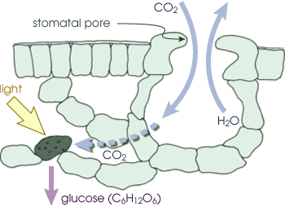

Slide 18
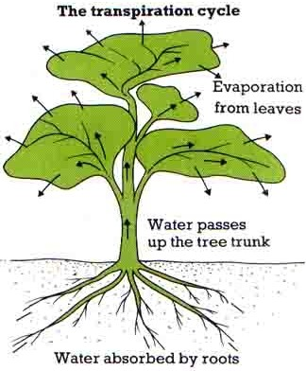

Slide 19
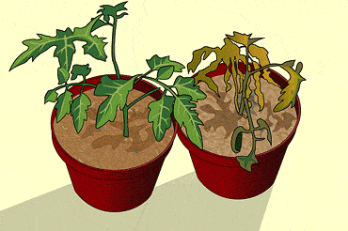

Slide 20
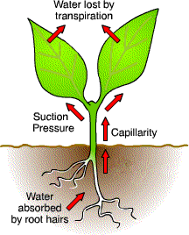

Slide 21
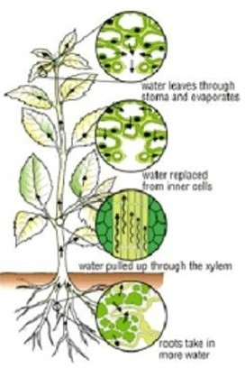

Slide 22
Project prepared by
Jenefa Joanna

