Slide 1








Slide 2


Definition
Objective and goals
Equipment Qualification:
  DQ
  IQ
  OQ
  PQ
  Documentation
  Change control
  revalidation

Slide 3

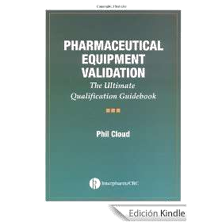
Equipment is the collective analytical measurement instruments, assembled to perform a mechanical process.
Equipment qualification is the action of proving that any equipment works correctly and actually leads to accurate and reliable results

Slide 4


Qualification :Qualification is an act or process to assure something complies with some condition, standard, or specific requirements
It applies on one element of process to be validated.
Validation:proof document that the process will consistently produce a predetermine outcome

Slide 5

The goals for equipment qualification are:
Easy maintenance of equipment and safety
to improve overall production reliability and availability Control of product quality
Reduction of variation in results Fewer interruptions of work Lower repair costs
Identification of high maintenance cost

Slide 6
equipment qualification
Design Qualification
Installation Qualification
Operational Qualification
Performance Qualification
revalidation
User requirment specification
Calibration
Drawings
Vendor quality procedure
Funtion specification

Slide 7
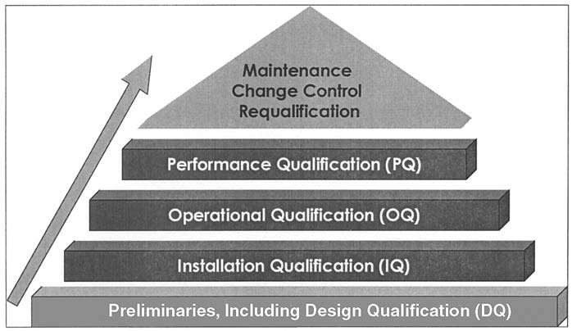

Slide 8
Always written for a technical system
Goal :
To document the needs of the manufacturing department.
To generate a document detailing all the GMP requirements that the technical system has to fulfill
1.Equipment Design, Size and Location
Pharmaceutical companies are not directly involved with the design and the construction of equipment but they can contribute indirectly.
They can provide information on requirements and feedback on existing equipment.

Slide 9
2.Location of equipment
Equipment should be placed in such a manner so that it enables all parts requiring maintenance,
instrumentation calibration to be easily
accessible.
3. Equipment construction
The equipment surface should be inert with regards to the API, critical utilities i.e. water,
compressed gas so on..

Slide 10

"Design qualification (DQ) defines the functional and operational specifications of the instrument and details for the conscious decisions in the selection of the supplier".
Steps that should be considered in a design qualification:
Description of the analysis problem
Description of the intended use of the equipment
Description of the intended environment
Preliminary selection of the functional and
performance specifications
Preliminary selection of the supplier
Instrument tests (if the technique is new)
Final selection of the equipment

Slide 11

Preliminary selection of the functional and performance specifications
Preliminary selection of the supplier
Instrument tests (if the technique is new)
Final selection of the equipment

Slide 12

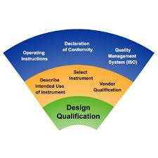

Slide 13

Definition:
  “The performance end documentation of tests to ensure that equipment (such as machines, measuring equipments) used in a manufacturing process are appropriately selected, correctly installed and work in accordance with established specifications.”
Aim:
  To check documentation against reality
  Verifies that the equipments are installed in accordance with design specification, manufacturer recommendation and cGMPs
  Confirms that critical instruments are calibrated

Slide 14

· Pre-shipment inspection of equipment and documentation included as part of IQ
· Pre-shipment inspection can be performed along with vendor audits to address issues such as software development and quality assurance plans, operational reports and specific vendor/purchaser inspection reports.

Slide 15

Equipment management group
Support Groups
Plant Engineering Group

Slide 16


Content of IQ protocol
Description
History
Fundamentals
Purpose
Attachments of IQ
Results of test
Acceptance criteria:
  General
  Specific
Documentation

Slide 17
Specification
Check completeness and current status of documentation
Check delivered equipment from manufacturer
Check if all parts of plant are according to their specification
Check the identity of all parts of the plant
Visual check of complete and craftsmanship
installation of all parts
Material used are within specifications

Slide 18

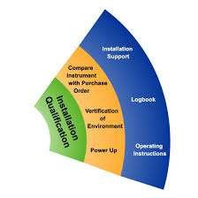

Slide 19

· "Operational qualification (OQ) is the process of demonstrating that an instrument will function
according to its operational specification in the selected
environment within the acceptance
criteria"
The protocol must contain procedures to start up the equipment according to the operating manuals.
Process controls that are part of the equipment i.e. Programmable Logic Controller (PLC) will be
qualified controls
during should
the OQ. [computerized process be qualified in the computer
validation process.

Slide 20
OQ implies that all functions and features included with the system are operational.
SOP for use, maintenance ,calibration and cleaning of the plant must be developed during the OQ process, as well as schedules for maintenance and calibration.
Any failure in this qualification is a deviation and must be corrected.
○ A conclusion is drawn regarding the
test has
operation functions
of equipment after the are checked and all data
been analyzed.

Slide 21

Following are the contents of equipment operation qualification
1.Application S.O.P’s 2.Utilization List
Process Description
Test Instrument Utilized To Conduct Test 5.Test Instrument Calibration
6.Critical Parameters 7.Test Function (List)
8.Test Function Summaries

Slide 22

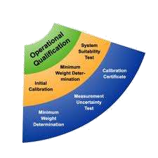

Slide 23

The final section for equipment qualification protocols is the performance qualification (PQ). This is the process of demonstrating that an instrument or piece of equipment consistently performs according to a specification appropriate for its routine use.
PQ implies that factors such as loads, volumes and other capacity and power-related issues are not problematic throughout the specified ranges. In general, test methods shall be executed in the order presented in the protocol.

Slide 24
PQ should always be performed under conditions that are similar to routine sample analysis.
PQ should be performed on a daily basis or whenever the equipment is being used.
In practice, PQ can mean system
suitability testing, where critical key system performance characteristics are measured and compared with documented.

Slide 25

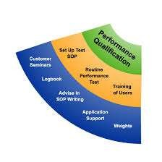

Slide 26
To quickly locate any given document ,it is mandatory to have implemented an appropriate documentation system .
In case of a fault in production inspection
,it become necessary to a find a document within 15 to 20 min.
All companies should test the reliability of their documentation system using internal audits.
One aspect of a working documented using the same document mentation structure.

Slide 27
Change control is define in the document PI 006 as follows “A formal system by which representative of appropriate disciplines review proposed or actual change that might affect a validation status .the intent is to determine the need for action that would ensure and document that the system is maintained in a validated state”

Slide 28


Requalification is Required for:
  significant change in batch size
  change in operating parameters
  component specifications have changed
  new accessories or components are added to previously qualified equipment
  process changes that potentially impact product effectiveness or quality

Slide 29
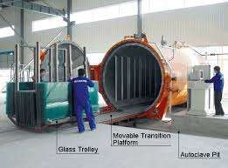

Slide 30

Autoclave is used for stem sterilization
Advantage of steam sterilisation(autoclave)
  More efficiency
  Easy to operate
  Cheap
Disadvantage:
  Not used for thermolabile material
  Excessive pressure may cause explosion
  Leakage affect the stearilisation

Slide 31




· The following pieces of equipment should be calibrated by removing or in situation .
Pressure Gauges
Timing Devices
Temperature Recording Devices
Verification of safety systems and Devices
Power source

Slide 32

· Cycle development :-
Placing Thermocouples
Placing biological indicators and chemical indicators
  Empty cycle
  Minimum load
  Maximum load

Slide 33
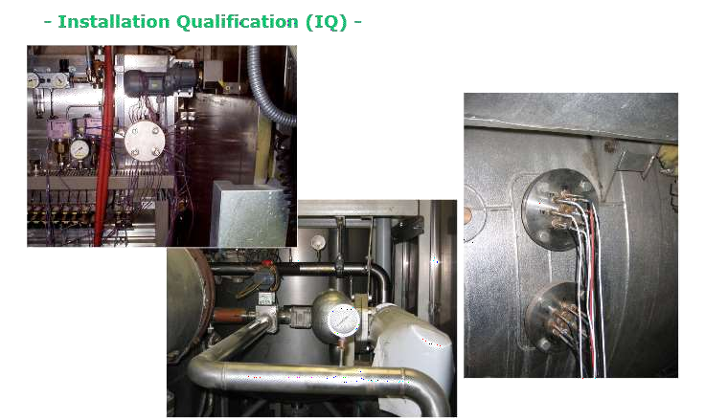

Slide 34




Temperature distribution
Heat penetration
Acceptance criteria of validation
  D value
  Z value

Slide 35

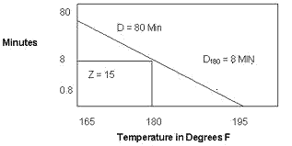
· Time required for 1 log ( or 90%) reuction of microorganism population at base temperature

Slide 36

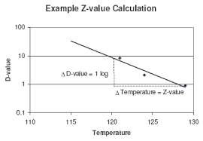
Determine the D value of N organism at minimum 3 different temperature
Construct a thermal death curve by plotting the logarithm of the D value VS temperature

Slide 37
Any change to the sterilization equipment and related utilities should be evaluated by a change control procedure.
Typical changes requiring revalidation:-
Any changes in operating cycle(i.e. temperature ,time ,chamber pressure
Change in load configuration
Change in sterilized materials
Measure maintenance work on critical instrument/elements utilities

Slide 38

Berry I.R., and Nash R.A., “Pharmaceutical Process validation”, second edition, revised and expanded; Marcel Dekker series; 83-110.
Agalloco J.A, Carleton F.A, “Validation of
Pharmaceutical Process”, Third Edition, 175,223.
Willig Sidney H., “Good Manufacturing Practices for
₅th
Pharmaceuticals”, edition, Marcel Dekker
Publication, Page No: 65-80
 Nally Joseph D. “Good Manufacturing Practices for
₆th
Pharmaceuticals”, edition, Infoma Healthcare
Publication, Page No: 51-70
 Sharma P.P. “Validation in Pharmaceutical Industry” Page No. : 119-150

Slide 39

Haider Syed Imtiaz, “ Pharmaceutical Master Validation Plan: The Ultimate Guide to FDA, GMP, and GLP Compliance”
www.fda.gov
Wood, R.T; Journal of Parental drug association; volume 34; 286-294

Slide 40


The journey of a thousand miles begins with a single step…

