Slide 1




FDA Regulation of Promotion & Advertising FDA Enforcement
www.complianceonlie.com
©2010 Copyright
1

Slide 2
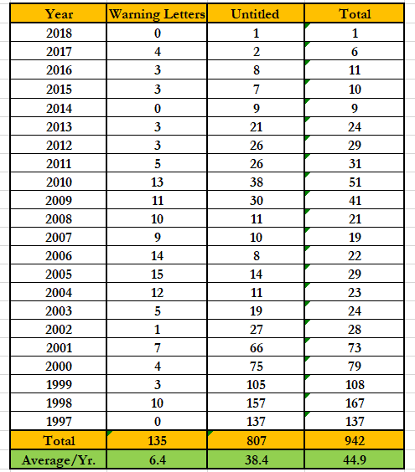
Statistical Record – OPDP/DDMAC
www.complianceonline.com
©2015 Copyright

Slide 3
Most Common Violations –
Omission or minimization or risk information
Misleading efficacy claims
Misleading superiority claims
Promotion of unapproved uses of drugs, including broadening the indication
– Source: Presentation of Thomas Abrams, Director, FDA Office of Prescription Drug Promotion, FDLI, Oct. 2012
www.complianceonline.com
©2015 Copyright

Slide 4
Copaxone Warning Letter
March 14, 2012 – Teva –
  Hot Link – Warning Letter
  Hot Link – Teva promotional materials
2011 AAN Exhibit Panels and “Team Copaxone”
webpages relating to David Kyle and Karen Stewart
General allegations – false or misleading – due to:
  overstate efficacy
  present unsubstantiated claims
  broaden indication of drug
  present unsubstantiated superiority claims
  omit material facts
www.complianceonline.com
©2015 Copyright

Slide 5
Copaxone -- Overstating Efficacy
AAN Panel Claims:
  “20 years of proven safety” … “up to 15 years continuous Copaxone therapy” … “Expanded Disability Status Scale (EDSS) scores remained stable after an average of 15 years on therapy”
  FDA:
    these overstate safety and efficacy by implying long-term data; however, the PI (package insert) only includes data for up to 3 years
    you also cited an open-label extension study – that is not “substantial
evidence”
      only 100/231 patients remained
      need adequate & well-controlled studies
www.complianceonline.com
©2015 Copyright

Slide 6
Copaxone …
Unsupported comparative claim:
  Claim: “No other RRMS therapy can demonstrate the long-
term results like Copaxone”
  FDA: we are unaware of any adequate and well-controlled clinical trials that show that Copaxone is safer, more effective, or otherwise superior
    … continued …
www.complianceonline.com
©2015 Copyright

Slide 7
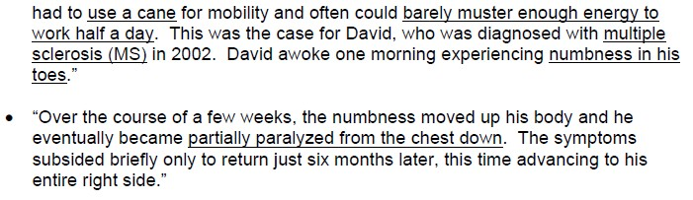
Copaxone – David Kyle and Karen Stewart
Overstating Efficacy/Broadening Indication
Webpage: “Running, Swimming and Biking After Multiple Sclerosis” – Kyle …
www.complianceonline.com
©2015 Copyright

Slide 8
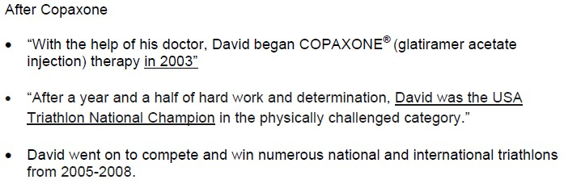
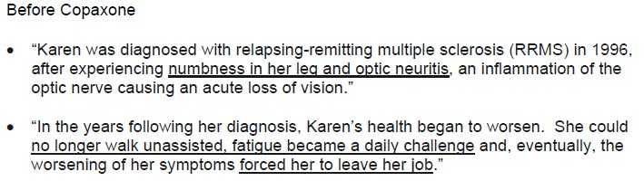
Copaxone – David Kyle and Karen Stewart …
Kyle Website …
Karen Stewart Website …
www.complianceonline.com
©2015 Copyright

Slide 9
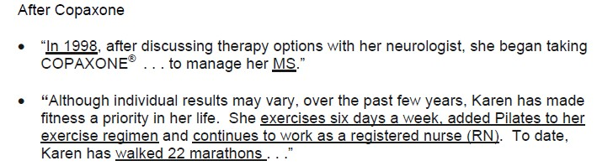
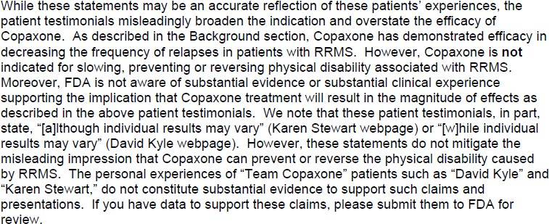
Copaxone – David Kyle and Karen Stewart …
Karen Stewart … after …
FDA:
www.complianceonline.com
©2015 Copyright

Slide 10
Copaxone – David Kyle and Karen Stewart …
Key lessons
  Testimonials – even if accurate, do not equal substantial
evidence or “substantial clinical experience”
    inconsistent with approved labeling, which was:
      decreasing relapses of RRMS
      not indicated for slowing, preventing or reversing physical disability of the
MS sufferer
  Teva – needed data from A&WCCT to make these claims (and, theoretically, would have to submit to FDA as a supplement to approved application before making them)
www.complianceonline.com
©2015 Copyright

Slide 11
Copaxone – David Kyle and Karen Stewart …
Key lessons …
  Broadened indication – type of MS
    FDA – approval is for RRMS
    Webpage claims talk about cycling “after Multiple Sclerosis”, but without
qualification as to RRMS
  Broadened indication – length of therapy
    Kyle and Stewart, on website, are stated to have started Copaxone in 1998 and 2003; suggests long-term usage
    FDA – this implies that Copaxone is effective over a long term, but your
PI data is only for 3 years ..
11
www.complianceonline.com
©2015 Copyright
11

Slide 12
Copaxone – David Kyle and Karen Stewart …
Key lessons
  Omission of Risk Information
    FDA – webpage fails to include any discussion of risk information
      references to approved labeling in website do not cure error
  Implied Superiority (based on alleged less risk)
    FDA -- AAN Panels – listed serious AEs that were not in the Warnings &
Precautions part of Copaxone PI;
      however, these are listed in the Adverse Event list on PI
    FDA – AAN Panels – also failed to list a number of Warnings that are in Copaxone PI such as chest pain, skin necrosis, and potential impact on immune response
www.complianceonline.com
©2015 Copyright

Slide 13
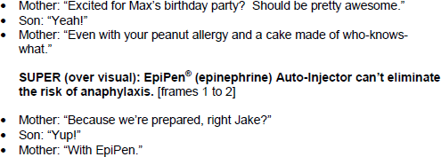
EpiPen WL – DTC Ad – May 2012
Overstatement of Efficacy – Hot Link to Letter
  FDA: “… particularly alarming from a public health perspective because the misleading presentation of the use of the EpiPen may result in serious consequences, including death.”
  TV ad:
www.complianceonline.com
©2015 Copyright

Slide 14
EpiPen WL – DTC Ad – May 2012 …
Overstatement of Efficacy – Hot Link to Promo
  FDA: Overwhelming impression is that the EpiPen alone can provide assurance that a child with history of anaphylaxis does not need to worry or take other precautions
    gives impression don’t have to worry about the cake – “… a cake made
of who-knows-what…”
    FDA -- “The standard of care to prevent a potentially life-threatening anaphylactic reaction is to take precautionary measures to avoid the allergen.”
Logistics – came in via FDA’s “Bad Ad” website
  April 20 – conference call bet. FDA & Pfizer
    agreed to pull materials
www.complianceonline.com
©2015 Copyright

Slide 15

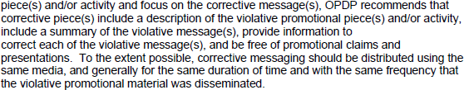
EpiPen WL – DTC Ad – May 2012 …
Corrective Actions requested
“Corrective messages”
  Describe the violative promotional pieces/activity
  Summarize the violative messages
  Provide info to correct each message
  Use same media to correct and same duration of time and frequency as violative promotional mats.
  Be free of promotional material
www.complianceonline.com
©2015 Copyright

Slide 16
Ista – Bromday WL – Omitted Risk Info
July 2011
  Hot Link – Warning Letter
  Hot Link – Promotional Materials
FDA
  first, we sent you a WL on Xibrom last year, before you got approval of a supplement to change the labeling to once/day dosing – omitted risk information also
  Flyer – fails to include any of the Warnings or Precautions, including:
    omitted risk of sulfite anaphylaxis – life threatening
    omitted risk not to use when wearing contacts
www.complianceonline.com
©2015 Copyright

Slide 17
Ista – Bromday WL – Omitted Risk Info
FDA – also omitted material facts on dosage
  Xibrom (first generation) – dosing began 24 hours after surgery
  Bromday – dosing begins 1 day before surgery
  Problem –
    because the flyer suggests that Bromday replaces Xibrom, erroneous conclusions on dosing are possible
    also, the PI for Bromday has a precaution against using a topical NSAID more than 24 hours before surgery (issue: seems to be, but is not clear in WL, 1 day vs. 24 hours)
Full PI – did not cure the defects in the flyer
www.complianceonline.com
©2015 Copyright

Slide 18
Shire – Vyvanese – WL – May 2001
Magnet promo – ADHD drug
  Hot Link to Warning Letter
  Hot Link to Magnet
Bad Ad report – from a pediatric medical office
FDA
  violative because it makes representations regarding use of Vyvanse, but omits the full indication and risks associated with the use of the drug.
    implied the drug was safer and more effective
    Magnet – had a plastic sleeve for inserting the biz card of sales rep –
when inserted, it blocked the risk info
www.complianceonline.com
©2015 Copyright

Slide 19
Shire – Vyvanese – WL – May 2001 …
Omitted risk information
  Product has a Boxed Warning on potential for abuse
  Other serious risks, including some that are fatal
  Contraindications – many – omitted
  FDA -- “Please see accompanying Full Prescribing Information,
including Boxed Warning” – not adequate (also not clear where it was)
Omitted indication information – all said was “First Prodrug Stimulant” – nothing about ADHD
  fails to adequately communicate important information on ADHD indication regarding special diagnostic considerations, need for comprehensive treatment, and long-term use.
www.complianceonline.com
©2015 Copyright

Slide 20
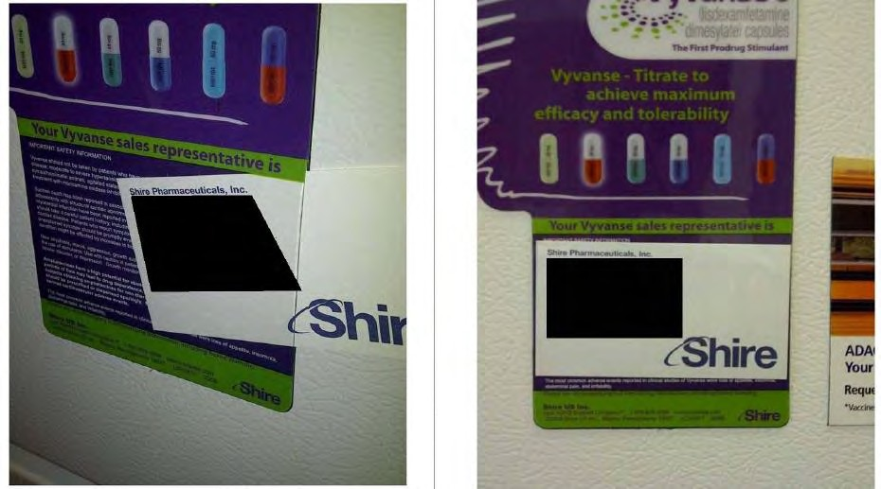
Shire – Vyvanese – WL – May 2001 …
www.complianceonline.com
©2015 Copyright

Slide 21
Gelnique – Untitled Letter – Nov. 2010
“Stall Cling” – not clear what it clung to
  Hot Link -- U-Letter
  Hot Link – Promo
  Viewed at ACOG annual clinical meeting in S.F.
Alleged violations
  minimizes risk
  overstates efficacy
  broadens indication
  omits important risk info
  makes unsubstantiated claims
www.complianceonline.com
©2015 Copyright

Slide 22
Gelnique – Untitled Letter – Nov. 2010 …
Minimized risk
  risk info in very small font at bottom of piece in single-spaced
typed paragraphs
  not reasonably comparable to efficacy claims – which are large and easy to see graphically – as to prominence
  adverse events presented before more serious risks
Overstated Efficacy
  failed to disclose that the big “71%” was compared to a placebo
reduction of 56% (or 2.0 vs. 2.7 episodes per day)
  disclaimer on placebo in very small print in bottom corner –
does not mitigate this overstatement
www.complianceonline.com
©2015 Copyright

Slide 23

www.complianceonline.com
©2015 Copyright
23

Slide 24
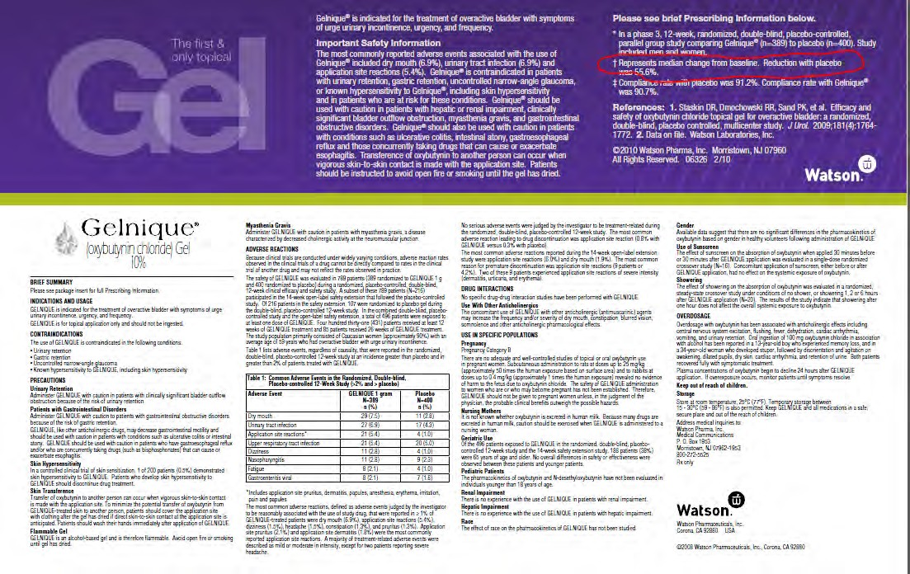
www.complianceonline.com
©2015 Copyright

Slide 25
Gelnique – Untitled Letter – Nov. 2010 …
Broadened indication –
  Significant reduction in “incontinence episodes” – implies drug
is for all types of incontinence
  Approved indication – narrower – “overactive bladder with symptom of urinary incontinence, urgency and frequency”
  FDA – fact that full indication is at bottom in Brief Summary does not cure the violation vs. size/prominence of violative statement
Omitted Risk Info – failed to include Warning in P.I. on hypersensitivity and need to discontinue if develop hypersensitivity to drug -- in Brief Summary, but not in “Important Safety Info” (buried)
www.complianceonline.com
©2015 Copyright

Slide 26
Gelnique – Untitled Letter – Nov. 2010 …
Unsubstantiated claims
  “Fits into a woman’s skin care routine”
    not supported by “substantial evidence”
    inconsistent with skin care warnings
    inconsistent with detailed instructions on how gel is to be applied (e.g.,
keep dry for 1 hour; don’t cover until dry)
  “Smart Gel Technology is her weapon against wetting”
    no evidence suggests their technology is any better than other overactive bladder treatments
    claim implies it is better
www.complianceonline.com
©2015 Copyright

Slide 27
Trisenox – Untitled Letter – June 2011
Hot Link – Untitled Letter
Hot Link – Promotional Materials
Sent in via a 2253
FDA:
  broadens indication
  minimizes and omits risk info
  misleading claims
  unsubstantiated claims
  overstates efficacy
    Result – promotes for broader population than proven by substantial evidence
www.complianceonline.com
©2015 Copyright

Slide 28
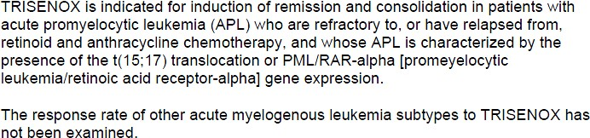

Trisenox – Untitled Letter – June 2011 …
Broaden indication
– indication – very narrow
– web claims – falsely imply good for any type of APL
www.complianceonline.com
©2015 Copyright

Slide 29
Trisenox – Untitled Letter – June 2011 …
Minimized Risk
  info on risk must be given same prominence as those relating to
effectiveness
    effectiveness info – “large, bold, and colorful font and graphics, on the top portion of page”
    risk info -- including on Boxed Warning, appears in small type at bottom
    also, when safety info was nearer to the top on the website, it related to minor safety issues and still downplayed major issues
      … continued …
www.complianceonline.com
©2015 Copyright

Slide 30
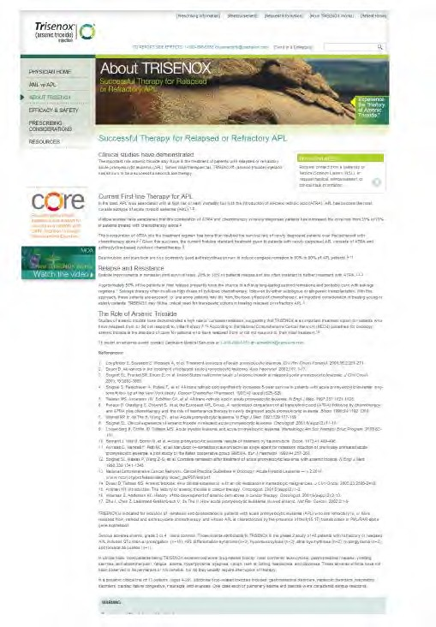
Effectiveness claim
Risk Information
www.complianceonline.com
©2015 Copyright
30

Slide 31
Trisenox – Untitled Letter – June 2011 …
Overstated Efficacy
  used data based on a new definition of “complete remission” (CR) that FDA had not recognized in the approved labeling; was essentially a retrospective re-calculation of response rates based on looser criteria (eliminated a bone marrow confirmation step)
    and because “molecular remission” (MR) was based on CR, the reanalysis
skewed those numbers as well
www.complianceonline.com
©2015 Copyright

Slide 32

Trisenox – Untitled Letter – June 2011 …
Unsubstantiated claims
Contrast:
  PI says that the mechanism of action of drug is not completely
understood
  “Arsenic trioxide also causes damage or degradation of the fusion protein
PML/RAR-alpha.”
www.complianceonline.com
©2015 Copyright

Slide 33

Trisenox – Untitled Letter – June 2011 …
Misleading claims – Dosing
Contrast:
  Infusion – every day for up to 4 hours per day for up to 60 days –
MANAGEABLE?
  Frequent lab and ECG testing required
Omission of Risk – from WARNINGS and PRECAUTIONS section of P.I.
  fetal harm and warning against nursing
  human carcinogen
www.complianceonline.com
©2015 Copyright

Slide 34
Infergen – Warning Letter – March 2011
Three Rivers Pharmaceuticals – “Statgram”
  Hot Link -- Warning Letter
  Hot Link – Promotional Materials
Came in both via 2253 and “Bad Ad” program
FDA allegations
  omits and minimizes important risk information
  broadens and omits material facts about approved indication,
  overstates efficacy
  unsubstantiated claim
  failure to provide adequate directions for use -- labeling
www.complianceonline.com
©2015 Copyright

Slide 35
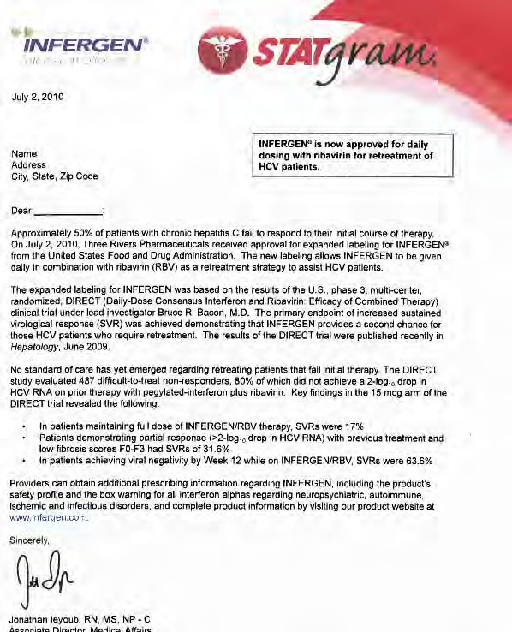
www.complianceonline.com
©2015 Copyright
35

Slide 36
Infergen – Warning Letter – March 2011 …
Omits risk information
  sent without the P.I.; only risk information was:
“Providers can obtain additional prescribing information regarding INFERGEN, including the product’s safety profile and the box warning for all interferon alphas regarding neuropsychiatric, autoimmune, ischemic and infectious disorders, and complete product information by visiting our product website at www.infergen.com¹.”
  Infergen – its labeling is packed full of warnings, precautions, contraindications, etc. – ranging from requiring close monitoring to suicidal and homicidal ideation, etc.
Did not include full P.I. – because FDA regarded
piece as “labeling,” the brief summary rule was n/a
  “Highlights” Labeling – not enough
www.complianceonline.com
©2015 Copyright

Slide 37
Infergen – Warning Letter – March 2011 …
Broadens Indication
  Statgram -- claimed approved for daily dosing with ribavirin for
retreatment of HCV patients
  But –
    Infergen is approved only for patients 18 or older with compensated liver
disease
    omits fact that Infergen has not been proven in naïve patients or those with co-infections involved HIV or HBV
Overstated Efficacy
  number of claims made about sustained virological responses (SVRS), but were based on an underpowered, open label study; thus not substantial evidence
www.complianceonline.com
©2015 Copyright

Slide 38
Colcrys – Untitled Letter – Dec. 2011
Mutual Pharmaceutical – video and “sell sheet”
  Untitled Letter [Hot Link]
  Promotional Material [Hot Link]
FDA Allegations
  omit risk info
  minimize risk info
  overstates efficacy
  unsubstantiated safety superiority claims
www.complianceonline.com
©2015 Copyright

Slide 39
Colcrys – Untitled Letter – Dec. 2011 …
Omitted risk info
  Warning from PI on risk of rhabdomyolysis in patients with
renal dysfunction or elderly
  Sell sheet –
    “Tough but Gentle” – inconsistent with P.I., which includes fatal overdoses, life-threatening and fatal drug interactions, and neuromuscular toxicity
    “Tolerability is comparable to Placebo” – clearly not!
Risk info not comparable to efficacy discussions
  video spent 15 minutes on Colcrys and how it compares to unapproved colchicines; no verbal discussion on risk;
  then goes, without any alert, into a “running telescript format”
for risk info
www.complianceonline.com
©2015 Copyright

Slide 40
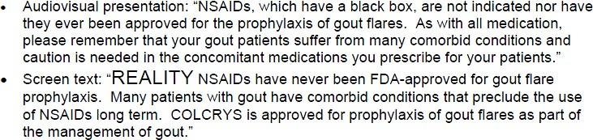
Colcrys – Untitled Letter – Dec. 2011 …
Minimized Risk/Unsubstantiated Safety Superiority
FDA concerns:
  erroneously suggests there are no issues with Colcrys in patients with comorbid conditions
  erroneously suggests that Colcrys is superior (safer) for patients with
concomitant medications and comorbid conditions
  FDA – no A&WCCT on a head-to-head basis to support
www.complianceonline.com
©2015 Copyright

Slide 41

Colcrys – Untitled Letter – Dec. 2011 …
Overstatement of Efficacy – video
FDA – the P.I. states that the efficacy of Colcrys was assessed at 24 hours, not 16
  study was not powered to evaluate outcomes at 16 hours
www.complianceonline.com
©2015 Copyright

Slide 42
Saphris – Untitled Letter – Feb. 2012
Merck – Hot Link to untitled letter
  complaint via “Bad Ad”
  oral statements by Dr. Armando Favazza – at lunch – “on behalf of Merck” – no slides or materials
    “Merck Peer Discussion Group”
    Not a response to a question
FDA – statements promote Saphris for an unapproved use, for which labeling lacks adequate directions for use
  adjunctive therapy for major depressive disorder (MDD) “just as
he might prescribe Abilify” and “it works just as well”
  approved indications – schizophrenia and bipolar, but not MDD
www.complianceonline.com
©2015 Copyright

Slide 43
Testopel – Warning Letter – March 2010
Slate Pharmaceuticals – CIII -- testosterone therapy –
WL is about 14 pages long [Hot Link]
Unapproved uses – by reference to testimonials on:
  Depression; erectile dysfunction, Type 2 diabetes, HIV
  Increased muscle mass and bone strength
Omitted Risk
  video – 2 minutes on efficacy; 10 seconds on risk, none done verbally
Minimized Risk – video – doctor said patient can come
get treated and not have to “think about anything else”
www.complianceonline.com
©2015 Copyright

Slide 44
Testopel – Warning Letter – March 2010 …
Broadened indication – created impression could be used for any testosterone replacement, when there are limits to its approved use
  “only approved implantable testosterone pellet”
Overstating Efficacy – many statements that people “Reclaim their lives” or “feel normal again” – however, FDA:
  no substantial evidence of this
  understates the serious risks associated with the drug
www.complianceonline.com
©2015 Copyright

Slide 45
Testopel – Warning Letter – March 2010 …
Unsupported Superiority
  Slate: claimed greater PD effect on gonadotrophin suppression
and PK features are advantageous compared to other T preps
    study they relied on was not even on their drug
    study was not an A&WCCT done head-to-head; rather open label, single
dose and non-randomized PK study
  Slate – also contended men preferred their pellet product over others – but relied on same flawed study as above
[note – the violations in this letter were lengthy; I pulled some of the highlights]
www.complianceonline.com
©2015 Copyright

Slide 46
Pexeva -- Untitled Letter – May 2011
Noven Pharmaceuticals, Inc. – Flash Card
  Untitled Letter [Hot Link]
  Promotional Material [Hot Link]
Drug – indicated for PD, MDD, OCD and GAD
  boxed warning on suicidality
Broadened indication
  “Broad spectrum therapy” and linked MDD to anxiety
    FDA – implies Pexeva is effective in persons with MDD comorbid to anxiety, but not proven by substantial evidence
– Study cited did not even measure GAD
www.complianceonline.com
©2015 Copyright

Slide 47
Pexeva -- Untitled Letter -- May 2011 …
Overstated Efficacy –
  Flash card – listed numerous individual symptoms that can be
linked to MDD, PD, OCD, and GAD;
  FDA -- claims that the manner in which the clinicals supporting approval were done did not specifically measure those symptoms; thus, these lack substantial evidence
Omission of Risk Info
  omits warning in P.I. about serotonin syndrome, which can be fatal
  fails to state the Pexeva is not approved in pediatric pops.
www.complianceonline.com
©2015 Copyright

Slide 48

www.complianceonline.com
©2015 Copyright

Slide 49
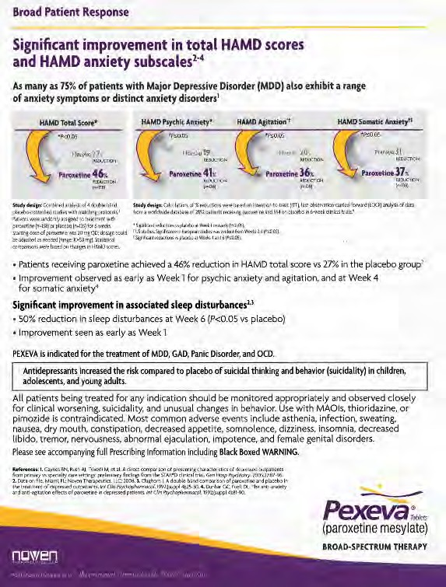
www.complianceonline.com
©2015 Copyright

Slide 50
Pataday – Untitled Letter – Oct. 2011
Alcon Research, Ltd. – Rebate Card – via 2253
  Untitled Letter [Hot Link]
  Promotional Material [Hot Link]
What kind of ad is it supposed to be?
Can you find what’s wrong with the next ad?
www.complianceonline.com
©2015 Copyright
50

Slide 51

www.complianceonline.com
©2015 Copyright
51

Slide 52
Pataday – Untitled Letter – Oct. 2011 …
Suggests indication
– graphic of dandelion and the eye – which FDA says has a plant
allergen superimposed over the iris
Suggests dosage – logo -- “Once Daily”
Superiority – “Most relief ”
Once falls out of reminder labeling, requires full labeling
www.complianceonline.com
©2015 Copyright

Slide 53
Aegerion – Loose CEO Lips Sink Ship?
Warning Letter -- November 8, 2013 [Hot Link]
Facts:
  Juxtapid® -- approved for familial homozygous hypercholest- erolemia (HOFH), but not for reduction of cardiac events.
  CEO – on CNBC – “These patients are going to die of a cardiac event, either a stroke or a heart attack, if we don’t have them on therapy.” [and some other statements]
FDA:
  This creates a new use, for which there are not adequate
directions for use
  No balancing risk information relative to “new” uses – and product has a boxed warnig
www.complianceonline.com
©2015 Copyright

Slide 54
Aegerion – Loose CEO Lips Sink Ship…
Corrective action:
  At FDA’s request
  Aegerion – ran a corrective advertisement on CNBC (among other things)
  FDA – has closed the warning letter
www.complianceonline.com
©2015 Copyright

Slide 55
Concordia – More Loose Lips? Sales Script
Untitled Letter [Hot Link] – on Kapvay
  Promotional Material -- Professional telephone script
Omitted material risk information
  “completely omits the contraindication, all of the warnings and
precautions, and common adverse events…”
  “I can e-mail the full prescribing information … or you can
access it at the Kapvay website ... Which do you prefer?”
    FDA: “… this does not mitigate the omission of important risk
information”
    FDA: by omitting key risk info, “misleadingly suggests that Kapvy is
safer than has been demonstrated.”
www.complianceonline.com
©2015 Copyright

Slide 56
Concordia – Loose Lips? … Sales Script …
Omitted material facts
  Script describes Kapvay as treatment for ADHD, but fails to say
that it is part of a “total treatment program”
  Dosing – wrong – script suggests twice a day, but labeling calls for it to start with single dose at bedtime – then could be titrated from there
Established name – clonidine hydrochloride
  Not in conjunction with Kapvay
  Here – that FDA cited it may reflect fact that clonidine is a drug that has been around for a while and omitting it in running text could lead someone to think product was more innovative (although WL does not say that)
www.complianceonline.com
©2015 Copyright

Slide 57
Device Warning Letters
www.complianceonline.com
©2015 Copyright
57

Slide 58
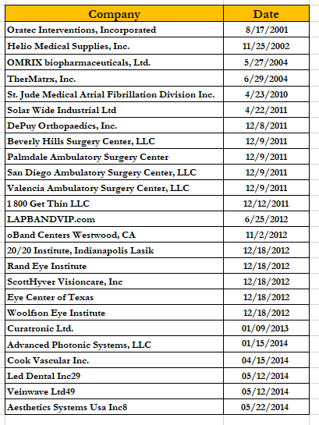
FDA Device Advertising – Warning Letters
n = 25
www.complianceonline.com
©2015 Copyright

Slide 59
Oratec Interventions WL – Aug. 2001
Actually 2nd warning letter (prior in 1999) to Oratec on same product – SpineCath Intradiscal Catheter and an Electrothermal Arthroscopy System
Allegations – unapproved/uncleared uses
  SpineCath – cleared to be intended for the “coagulation and decompression of disc material to treat symptomatic patients with annular disruption of contained herniated discs.”
    Website – promoting for degenerative disk disease
    FDA – not same as herniated disk
      … continued …
www.complianceonline.com
©2015 Copyright

Slide 60
Oratec Interventions WL – Aug. 2001
FDA:
  In Oratec’s May 7, 1999 response to our previous Warning Letter, you indicated that some of the terms used by medical professionals to describe the presence of contained herniations and annular disruptions include phrases such as degenerative disc disease, chronic discogenic syndrome, internal disc disruption, cliscogenic pain, and discopathic syndrome. We disagree with that assessment.
  In addition to annular disruption of contained herniated discs (the cleared intended use), the Office of Device Evaluation has concluded that the claim of degenerative disc disease may also encompass: degenerative arthritis of the facet joints, instability of the motion segment, pain syndromes, and spinal stenosis. The agency considers the claim of degenerative disc disease to be an expansion and broadening of the intended use requiring the submission of a new 510(k).
  Additionally, in our follow up letter to Oratec dated October 4, 1999, we advised that whenever Oratec uses the term "lower back pain" it should be qualified with the modifier "lower back pain associated with herniated discs."
www.complianceonline.com
©2015 Copyright

Slide 61
Oratec Interventions WL – Aug. 2001 …
FDA – Intended use regulation:
– 21 CFR 801.4 -- The intended use is the objective intent of the persons responsible for the labeling of the device. Such objective intent may be shown by the circumstances surrounding the distribution of the product and maybe shown by labeling claims, advertising matter, or oral or written statements by such persons or their representatives. It may be shown by labeling claims that the article is, with the knowledge of such persons or their representatives, offered and used for purposes for which it is neither labeled nor advertised.
www.complianceonline.com
©2015 Copyright

Slide 62
Thermatix WL – Jun. 2004
Off-label promotion
  TMx-2000 BPH Thermotherapy System (TMx-2000) – approved under a PMA in 2001 – a “non-surgical device for the treatment of symptomatic benign prostatic hyperplasia (BPH) in men who have a minimum prostatic urethra length of 30 mm and a total prostate volume between 30 and 100 cc
  Challenged claims
    Treat median lobe enlargement of the prostate
      FDA – no clinical data in your PMA to support
    You can treat other patients during the procedure
      FDA – precautions in PMA labeling say that attention required by a physician during treatment -- to, among other things, make sure rectal temperatures remain correct
www.complianceonline.com
©2015 Copyright

Slide 63
Thermatix WL – Jun. 2004
Unsubstantiated Efficacy Claims
  Claim – durable for 4+ years
    FDA – data in PMA only covers 1 year
  Claim – “permanent tissue necrosis”
    FDA – BPH can come back, so this is misleading because it implies a
permanent cure for BPH
  Claim – “superior peak flow rate improvement”
    FDA – we are not aware of data showing a statistically significant improvement over other therapies
www.complianceonline.com
©2015 Copyright

Slide 64
St. Jude Medical WL -- 2010
Epicor™ LP Cardiac Ablation System – cleared for ablation of cardiac tissue (generally)
Claims:
  "The Epicor LP system is designed specifically to create the critical Cox Maze III lesions entirely epicardially, which helps mitigate risks associated with other cardiac ablation technologies."
  "The Epicor UltraCinch LP Ablation Device ... is designed to safely, effectively and reproducibly create a classic box lesion in a single step."
www.complianceonline.com
©2015 Copyright

Slide 65
St. Jude Medical WL – 2010 …
FDA:
  claims [on your website] to be promotion of these devices for
the treatment of atrial fibrillation.
  Although the box lesion and Maze lesions are ablation lesions performed on cardiac tissue during cardiac surgery, they are specifically intended to disrupt abnormal electrical conduction to isolate the pulmonary veins in an attempt to terminate a patient's atrial fibrillation. Therefore, FDA considers references to the classic box or Maze cardiac lesions to be synonymous with the treatment of atrial fibrillation.
www.complianceonline.com
©2015 Copyright

Slide 66
Solar Wide WL – 2011
GMP problems, plus:
– Your TENS device, the Stimplus Pro, cleared under K913522 was cleared for the following uses: symptomatic relief of chronic, intractable pain and from acute post-surgical and acute post-traumatic pain. However, our inspection revealed that the TENS devices were also labeled for the following uncleared uses: (1) smoking severance, (2) eating disorders, (3) stress and insomnia, and (4) “clinically tested as biologically active.”
Interestingly, company got two WL’s on same day covering (1) same TENS device, but (2) QSR issues at two different plants – Shenzen and Hong Kong
www.complianceonline.com
©2015 Copyright

Slide 67
Abiomed WL – June 2011
Impella Recover LP 2.5 Percutaneous Cardiac Support System
  Clearance:
    “partial circulatory support using an extracorporeal bypass control unit, for periods up to 6 hours. It is also intended to be used to provide partial circulatory support (for periods up to 6 hours) during procedures not requiring cardiopulmonary bypass. The IMPELLA RECOVER LP 2.5 also provides pressure measurements which are useful in determining intravascular pressure.”
  FDA – you’re making claims we said were inappropriate in a Jan. 2010 letter
… continued …
www.complianceonline.com
©2015 Copyright

Slide 68
Abiomed WL – June 2011 …
Claim:
  An advertisement placed in the September, 2010, Cath Lab Digest (vol. 18, no.9). The advertisement shows a hand puncturing a red balloon with a pin. Printed on the balloon is text that reads, “Old ideas about heart recovery.” The caption below the balloon reads in part, “After 40 years, there is something other than the intra-aortic balloon [pump] (IABP) for circulatory support in the Cath lab . . . Cardiac Power Output (CPO) is the #1 correlate to mortality for [acute myocardial infarctions] (AMI) in cardiogenic shock patients . . . In the latest USPELLA registry, the CPO of shock patients was observed to increase 120% from 0.5± 0.2 prior to IMPELLA to 1.1±0.2 on IMPELLA (p=0.02).”
FDA:
  As we stated in our January 28, 2010, letter, “comparative statements can be interpreted as
efficacy statements regarding the superiority of the IMPELLA RECOVER LP 2.5 to
IABP.” When we sent you the January, 2010, letter, ABIOMED had an ongoing investigational device study, G050017, and we advised your firm that the claims violated the regulations at 21 CFR 812.7(d), which prohibit the representation that a device is safe and effective for the purposes being studied. Although the study has since been terminated, the unsupported comparative claims violate 21 CFR 801.6.
www.complianceonline.com
©2015 Copyright

Slide 69
Abiomed WL – June 2011 …
On page 9 of your firm’s presentation to the 2010 Transcatheter Cardiovascular Therapeutics meeting, your firm claimed that use of the IMPELLA RECOVER LP 2.5 in AMI Shock patients improves hemodynamics, and on page 10 your firm states that the use of the IMPELLA RECOVER LP 2.5 improves cardiac output, which is then linked to lower mortality rates.
  FDA: Both of these indications would need to be supported with an appropriately designed
clinical study performed under an Investigational Device Exemption (IDE).
On the ABIOMED website, your logo includes the tag line, “Recovering Hearts, Saving Lives.”
  FDA: This is another claim that would require a randomized clinical study performed under an IDE specifically to evaluate whether the device could salvage heart tissue and muscle.
FDA: Statements such as the ones cited above represent a major change or modification in the intended use of your firm’s device that requires a new premarket notification. 21 CFR 807.81(a)(3)(ii).
www.complianceonline.com
©2015 Copyright

Slide 70
Understanding FDA’s Enforcement Power
www.complianceonline.com
©2015 Copyright
70

Slide 71
How to “Avoid” Enforcement?
The answer is simple – Comply!
But, how? -- Please Teach Vigorous Risk Avoidance Comprehensively & Corporately
  Thus, to ensure you comply, you must have:
    P = Procedures
    T = Training
    V = Validation
    R = Records
    A = Audits
    C = Communications – open channels
    C = Compliance Culture from the Top
www.complianceonline.com
©2015 Copyright
71

Slide 72
Commissioner Hamburg Revives FDA’s
Compliance Culture –
The August 6, 2009 Speech and its Impact
www.complianceonline.com
©2015 Copyright
72

Slide 73
Hamburg: Six New FDA Enforcement Mandates
Impose clear post-inspection deadlines
  Generally –15 business days to respond to 483
  After that, agency can issue warning letter or take other enforcement action
Speed the warning letter process – by limiting review by FDA Office of Chief Counsel to warning letters that present significant legal issues
www.complianceonline.com
©2015 Copyright

Slide 74
Hamburg: Six New FDA
Enforcement Mandates …
Work more closely with FDA’s regulatory partners
  Example: in some cases, such as food safety, state, local, and
international officials can act more quickly than FDA
  When public health is at risk, the agency will coordinate with its regulatory partners to take rapid action
Prioritize follow-up on all warning letters and other enforcement actions
  FDA will work quickly to assess the corrective action taken by industry after a warning letter, a major product recall, or other enforcement action
  Via new inspection or other form of investigation
www.complianceonline.com
©2015 Copyright

Slide 75
Six New Enforcement Mandates …
FDA will be prepared to take immediate action to respond to public health risks
  Actions may occur before a formal warning letter is issued – at any time
  Days of multiple responses to inspections – over
Develop and implement a formal warning letter
“close-out” process
  If FDA determines a firm fully corrected violations in a warning letter, agency will issue an official “close-out” notice and post on FDA Web site
  Seen as an “important motivator” for corrective action
www.complianceonline.com
©2015 Copyright

Slide 76
Enhanced Enforcement In Action –
Timely 483 Responses Policy
Aug. 11 Federal Register notice – Post-inspection 483 responses timing policy published – 15 business days
Timely Responses
  FDA will conduct “detailed review” in deciding any enforcement
action
  If FDA issues a warning letter, letter will address sufficiency of response
www.complianceonline.com
©2015 Copyright

Slide 77
Enhanced Enforcement In Action – Timely 483 Responses Policy …
Late responses
  Response will not be considered by FDA in deciding to take
enforcement action such as a warning letter
  If warning letter issues after a late 483 response, FDA will consider the 483 response in assessing firm’s later reply to warning letter
Purpose of Warning Letter:
  “ensure … seriousness and scope of the violations are understood by top management … and that the appropriate resources are allocated to fully correct the violations and prevent their recurrence”
www.complianceonline.com
©2015 Copyright

Slide 78
FDA Administrative Enforcement Powers
www.complianceonline.com
©2015 Copyright
78

Slide 79
Administrative Enforcement Tools
Inspections
  Planned and conducted pursuant to FDA annual plan or center
compliance program
  Pre-approval
  “For cause” (e.g., public health crisis due to defective or contaminated FDA-regulated product; follow up to 483 response)
  Government-wide Quality Assurance Program
    FDA may inspect at the request of the DoD or VA to determine, for example, whether a company bidding on a government contract is in compliance with GMPs and otherwise in compliance with the FDCA
www.complianceonline.com
©2015 Copyright

Slide 80
Administrative Enforcement Tools …
Inspections (continued)
  Combination or joint inspections (EPA, OSHA, or a state food and drug
regulatory body)
  Consumer, trade, and other complaints
  Adverse product effect reports
  Congressionally inspired
Clinical hold
Withdrawal or suspension of marketing permit
Recall (FDA-requested or “voluntary”)
www.complianceonline.com
©2015 Copyright

Slide 81
FDA Administrative Enforcement Tools …
Import detention or refusal
Civil money penalties
Warning Letters
– addressed to CEOs/other executives; FDA’s effort to get executive buy-in on necessary fixes is often sabotaged by corporate bureaucracy, which sends the letter back down to the person with knowledge of the specifics – but – see prior Slide 77 on purpose of WL
Application Integrity Program (AIP) – discussed in more detail later
www.complianceonline.com
©2015 Copyright

Slide 82
The Pen Is Mightier Than The Sword: Adverse Publicity
FDA Website
Press release
Talk paper
Press conference/television and radio interview
Speeches
Congressional and other testimony
Articles in scientific, professional and lay publications
www.complianceonline.com
©2015 Copyright

Slide 83
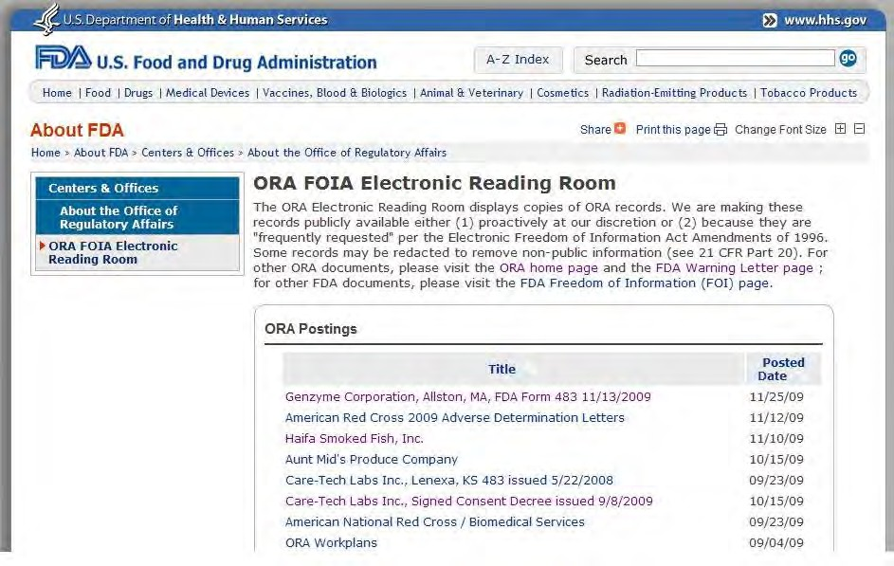
Publicity as an Enforcement Tool?
www.complianceonline.com
©2015 Copyright

Slide 84
Pre-Dissemination Review of TV ads …
Disseminating an ad in violation of 503B – is a
“prohibited act” under § 301(kk) of the Act
  failure to submit at all
  disseminate before end of 45-day period
  failure to incorporate required additions to ad as per Section 503B(e) – such as serious risks in labeling or approval dates
Civil monetary penalties –
  FDAAA revised § 303 so that any person who disseminates or causes another party to disseminate a false or misleading DTC ad shall be liable for a civil penalty of up to $250,000 for the first violation, and up to $500,000 for subsequent violations in a 3 year period.
www.complianceonline.com
©2015 Copyright

Slide 85
DTC Ads – Civil Monetary Penalties
CMP law does not distinguish between TV and print/radio ads
Factors
  whether submitted under §503B or §736A (advisory review)
  whether disseminated before end of 45-day period
  whether they incorporated any comments
  whether they stopped disseminating after getting CMP notice
  whether they had it reviewed by qualified regulatory, medical and legal reviewers before dissemination
  any prior CMPs in last year
  scope and extent of remedial action(s)
www.complianceonline.com
©2015 Copyright

Slide 86
Strict Liability and the “Park Doctrine” –
Criminal Liability for Responsible Corporate Officials
www.complianceonline.com
©2015 Copyright

Slide 87
U.S. v. Park – Strict Criminal Liability in the FDA World
1975 – 421 U.S. 658
http://caselaw.lp.findlaw.com/scripts/getcase.pl?court=us&vol=421&invol=658
Facts:
  John Park – CEO of Acme Markets – based in Phila.
  Warehouse – in Baltimore –multiple FDA inspections found rodent and insect infestation
    1970 – letter to Park re Baltimore warehouse
    1971 – FDA inspection in October and November
    1972 – January letter from FDA
    March 1972 – FDA inspection – still found rodent inspection
www.complianceonline.com
©2015 Copyright
87

Slide 88
U.S. v. Park – Strict Liability …
Supreme Court, quoting Dotterweich (1943):
– observed that the Act is of "a now familiar type" which "dispenses with the conventional requirement for criminal conduct - awareness of some wrongdoing. In the interest of the larger good it puts the burden of acting at hazard upon a person otherwise innocent but standing in responsible relation to a public danger."
“Moreover, the principle had been recognized that a corporate agent, through whose act, default, or omission the corporation committed a crime, was himself guilty individually of that crime. “
www.complianceonline.com
©2015 Copyright
88

Slide 89
U.S v. Park …
The principle had been applied whether or not the crime required "consciousness of wrongdoing," and it had been applied not only to those corporate agents who themselves committed the criminal act, but also to those who by virtue of their managerial positions or other similar relation to the actor could be deemed responsible for its commission.
The liability of managerial officers did not depend on their
knowledge of, or personal participation in, the act made
criminal by the statute.
Rather, where the statute under which
they were prosecuted dispensed with "consciousness of wrongdoing," an omission or failure to act was deemed a sufficient basis for a responsible corporate agent's liability. It was enough in such cases that, by virtue of the relationship he bore to the corporation, the agent had the power to prevent the act complained of.
www.complianceonline.com
©2015 Copyright
89

Slide 90
U.S. v Park …
Duty to seek out and fix violations -- the Act imposes not only a positive duty to seek out and remedy violations when they occur but also, and primarily, a duty to implement measures that will insure that violations will not occur.
– The requirements of foresight and vigilance imposed on responsible corporate agents are beyond question demanding, and perhaps onerous, but they are no more stringent than the public has a right to expect of those who voluntarily assume positions of authority in business enterprises whose services and products affect the health and well-being of the public
But the Act, in its criminal aspect, does not require that which is objectively impossible -- the Act permits a claim that a defendant was "powerless" to prevent or correct the violation to "be raised defensively at a trial on the merits."
www.complianceonline.com
©2015 Copyright
90

Slide 91
U.S. v. Park …
Objective impossibility – not construed by Supreme Court since Park.
  One federal court of appeals – would have to show that you took extraordinary measures, but still the violation occurred
  Delegation is not a defense
March 2010 – Commissioner Hamburg writes Congress -- renewed commitment to use Park
  issued a revision to its Regulatory Procedures Manual (RPM) on factors FDA will use in invoking Park
www.complianceonline.com
©2015 Copyright
91

Slide 92
FDA -- Factors for Park Prosecutions
(FDA RPM § 6-5-3)
Individual’s position in the company and relationship to the violation
Does the violation involve actual or potential harm to public?
Is the violation obvious?
Does the violation reflect a pattern of illegal acts or a failure to heed prior warnings?
Is the violation widespread?
Is the violation serious?
The quality of the legal and factual support for proposed prosecution
Is the proposed prosecution a prudent use of agency resources?
www.complianceonline.com
©2015 Copyright
92

Slide 93
The Park Doctrine – A Recent Example –
OxyContin
May 10, 2007 -- Purdue Frederick Company, Inc. – as a company -- agreed to pay more than $600 million to resolve felony criminal charges and civil liabilities in connection with a long-term illegal scheme to promote, market and sell OxyContin
Purdue trained its sales representatives to falsely represent:
  to health care providers about the difficulty of extracting oxycodone, the active ingredient, from OxyContin
  to health care providers that OxyContin did not cause euphoria and
was less addictive than IR opiates;
  to health care providers the erroneous belief that OxyContin was less addictive than morphine.
www.complianceonline.com
©2015 Copyright
93

Slide 94
The Park Doctrine – A Recent Example – Oxycontin …
As part of the plea, Purdue paid a $600 million settlement, which included:
  a criminal fine
  restitution to government agencies
  over $276 million in forfeiture,
  civil settlement of $100.6 million to the United States.
Purdue's then current and former executive employees, Michael Friedman, Howard Udell and Dr.
Paul Goldenheim, pled guilty to a misdemeanor violation
of misbranding OxyContin as being the responsible corporate officers during the long-term illegal promotion of the drug
www.complianceonline.com
©2015 Copyright
94

Slide 95
Why is Park Being Resurrected?
Congress and Executive Branch – concerned that even huge fines and Corporate Integrity Agreements are “cost of business”
Corporate Executives – being targeted under premise that:
  Organizational misconduct cannot occur without individuals
  What officials could prevent a violation if they tried?
  Answer: the “Responsible Corporate Official” (RCO)
www.complianceonline.com
©2015 Copyright
95

Slide 96
Criminal Prosecution: Misdemeanors
Misdemeanor
  Fines up to $100,000 and $200,000 per misdemeanor offense for
an individual and a corporation respectively ($250,000 and
$500,000 if the misdemeanor offense resulted in death)
  Imprisonment – up to a year in jail per violation
www.complianceonline.com
©2015 Copyright
96

Slide 97
Criminal Prosecution -- Felony
Must prove intent
Fines are greater
More common than misdemeanor prosecutions
Often will combine FDA violations with other federal crimes (e.g., conspiracy, false statements)
www.complianceonline.com
©2015 Copyright
97

Slide 98
Seizure
Civil action
  Technically, is against the goods themselves
  Owner or others with interest must intervene to defend the goods
    If do, then trial on merits of alleged violations
  Lose – goods usually destroyed, but may be reconditioned if possible
  Win – goods go free
www.complianceonline.com
©2015 Copyright
98

Slide 99
Injunction
Action to either:
  Compel compliance
  Prevent future violations
Personal against individuals or corporations
Can result in an order that will involve tremendous allocation of resources over a long period of time to address
www.complianceonline.com
©2015 Copyright
99

Slide 100
Consent Decree
Order of a court
Entered by consent of the parties
Not technically a judicial verdict, but a negotiated contract between the parties under the sanction of the court
Parties represent that it is a just determination of their rights as if the alleged facts of the case had been proven
www.complianceonline.com
©2015 Copyright
100

Slide 101
Consent Decrees …
How do they come about??
Settlement of a court case after FDA has filed for an injunction
  “Voluntary” negotiations with FDA after an adverse inspection
  Most terms/conditions negotiable -- but depends on your leverage point
  companies more often concerned about naming executives as individually responsible: FDA finds this point important as a deterrent and necessary to pursue contempt charges if decree becomes ineffective
www.complianceonline.com
©2015 Copyright
101

Slide 102
Disgorgement
Government (FDA doesn’t get) recovery of company
profits
Can’t profit from sales of an illegal product that is
nonetheless medically necessary
FDA refrains from enjoining production of non- compliant products because it would compromise patient care by causing significant shortages of medically necessary products
In return, firms will pay a fixed % of future sales to ensure that they did not profit from the violative products
www.complianceonline.com
©2015 Copyright
102

Slide 103
Collateral Consequences of Serious Enforcement Actions
www.complianceonline.com
©2015 Copyright
103

Slide 104
Collateral Damage – Worst Case Scenario from FDA Enforcement
This is a picture you do not want to see ….
  in your newspaper ….
  on your local news ….
  on the Internet ….
or
  in an FDA lawyer’s presentation for years to come ….
www.complianceonline.com
©2015 Copyright
104

Slide 105
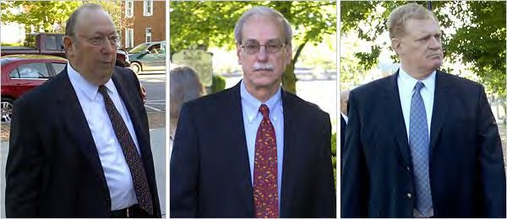
Purdue Pharma Executives Outside Court in Virginia
Udell | Goldenheim | Friedman
www.complianceonline.com
©2015 Copyright
105

Slide 106
HHS Disqualification – The “Death”
Sentence
2008 – HHS Office of Inspector General – proposed to disqualify all three from participating in federal health care programs (e.g., Medicare, Medicaid)
– Did not allege direct involvement, but based on RCO theory
2010 – Twelve year exclusion upheld by federal district court – Friedman v. Sebelius (on appeal to
D.C. Court of Appeals)
July 2012 – Federal Court Appeals – agreed, although remanded to see if length of exclusion was consistent with prior exclusions
www.complianceonline.com
©2015 Copyright
106

Slide 107
HHS Disqualification …
Guidance for Implementing Permissive Exclusion Authority under Section 1128(b)(15)of Social Security Act – http://oig.hhs.giv/fraud/exclusions/asp
Distinguishes between different types of corporate officials as to the “scienter” needed for disqualification
  Owners or control interest – knew or should have known of violation to be disqualified
  Officers/officials – can be strictly liable – “managing employee” – an individual (including a general manager, a business manager, an administrator, or a director) who exercises operational or managerial control or who directly or indirectly conducts the day-to-day operations of the entity.
www.complianceonline.com
©2015 Copyright
107

Slide 108
OIG Disqualification – Factors
Circumstances of the misconduct and the seriousness of the offense
Individual’s role in sanctioned entity
Individual’s actions in response to the misconduct
Information about the entity
Forest/Solomon – OIG threatened to disqualify him even though he had not been convicted; later backed off
www.complianceonline.com
©2015 Copyright
108

Slide 109

Problems For Individuals If Convicted
Lose right to vote
Lose right to run for public office
Damage to reputation
www.complianceonline.com
©2015 Copyright
109

Slide 110
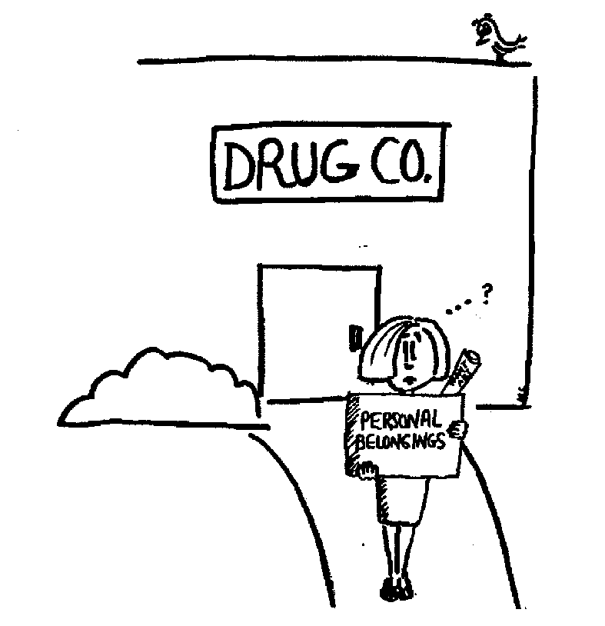
Problems For Individuals If Convicted …
Can be deported if not a U.S. citizen
Financial ruin -- lose your job
May not be able to ever work in industry again:
  Debarment (FDA)
  Disqualification (HHS, Clinical Investigator)
www.complianceonline.com
©2015 Copyright
110

Slide 111
Problems For Companies Caused By
Criminal Convictions …
Shareholders sue the company, its officers and directors
Other companies may sue the company (e.g., Mylan Labs sued Par and others)
Federal government may suspend or “debar” company
from selling to government
“Qui Tam” actions under the False Claims Act -- e.g., GSK (GMP) & Pfizer cases -- “whistle blower” cases -- leading to civil damages and may also spawn a criminal prosecution
www.complianceonline.com
©2015 Copyright
111

Slide 112
Problems For Companies Caused By
Criminal Convictions …
FDA may refuse to approve applications – the AIP Program
May lose state licenses
Customers abandon you
Decreased sales may force lay-offs of employees
www.complianceonline.com
©2015 Copyright
112

Slide 113
Problems For Companies Caused By
Criminal Convictions …
Financing disappears -- banks may refuse to lend money
May violate lending agreements, real estate mortgages or leases
A criminal investigation can cause great disruption to normal business activities
www.complianceonline.com
©2015 Copyright
113

Slide 114
Problems For Companies Caused By
Criminal Convictions …
High financial cost of an investigation:
lost sales
stock price falls
attorney’s fees and costs
costs of complying with requests by government for
documents
www.complianceonline.com
©2015 Copyright
114

Slide 115
Another Picture that You Don’t Want to Star in …
www.complianceonline.com
©2015 Copyright

Slide 116
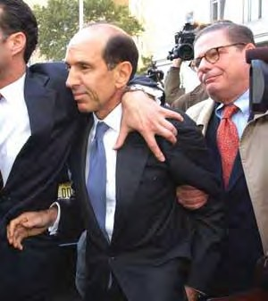
Ex-Imclone CEO exits federal court after
entering guilty plea …
www.complianceonline.com
116
©2015 Copyright

Slide 117
Final Sermon:
Please Teach Vigorous Risk Avoidance Comprehensively and Corporately
P = Procedures
T = Training
V = Validation
R = Records
A = Audit
C = Communications – Open Channels
C = Compliance Culture from the Top
www.complianceonline.com
©2015 Copyright

Slide 118
End of Part 4 – FDA Enforcement
www.complianceonline.com
©2015 Copyright
118

Slide 119
Questions?
Call or e-mail:
Michael A. Swit, Esq.
LAW OFFICES OF MICHAEL A. SWIT
San Diego, California m: 760-815-4762
e: mswit@fdacounsel.com
web: www.fdacounsel.com
Follow me on:
  LinkedIn: http://www.linkedin.com/in/michaelswit
  Twitter: https://twitter.com/FDACounsel
www.complianceonline.com
©2015 Copyright

Slide 120
About Your Speaker
Michael A. Swit, Esq., has been addressing critical FDA legal and regulatory issues since 1984. Before returning to private law practice in late 2017, he served for 3 years at Illumina, Inc. as Senior Director, Legal, Regulatory. Prior to that, Swit was a special counsel at the global law firm of Duane Morris LLP in its San Diego
office. Before joining Duane Morris in March 2012, Swit served for seven years as a
vice president at The Weinberg Group Inc., a preeminent scientific and regulatory consulting firm in the Life Sciences. His expertise includes product development, compliance and enforcement, recalls and crisis management, submissions and related traditional FDA regulatory activities, labeling and advertising, and clinical research efforts for all types of life sciences companies, with a particular emphasis on drugs, biologics and therapeutic biotech products. His FDA legal and regulatory work also has included tenures in private practice with McKenna & Cuneo (now Dentons) and Heller Ehrman, and as vice president, general counsel and secretary of Par Pharmaceutical, a top public generic and specialty drug firm. He also was, from 1994 to 1998, CEO of FDANews.com, a premier publisher of regulatory newsletters and other specialty information products for FDA-regulated firms. He has taught and written on many topics relating to FDA regulation and associated commercial activities and is a past member of the Food & Drug Law Journal Editorial Board. He earned his A.B., magna cum laude, with high honors in history, at Bowdoin College, and his law degree at Emory University.
www.complianceonline.com
©2015 Copyright

