Slide 1
LEAN MANUFACTURING

Slide 2
What is Lean Manufacturing?
“Lean Manufacturing, also called Lean Production, is a set of tools and methodologies that aims for the continuous elimination of all waste in the production process. The main benefits of this are lower production costs, increased output and shorter production lead times” [1]
•
•
“A systematic approach to identifying and eliminating waste and NVA (non-value added activity) through continuous improvement and flowing the product at the pull of the customer in pursuit of perfection”. [2]

Slide 3
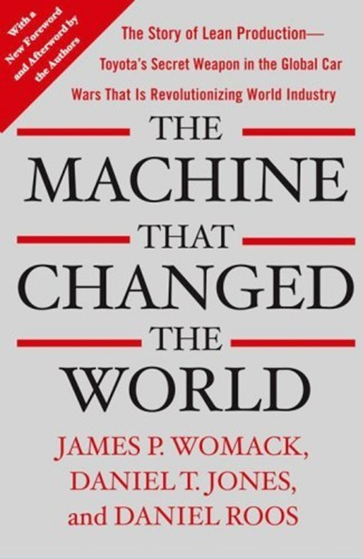
History
Henry Ford
Integrated an entire production process.
1913: Flow Production
Problem: No sort of variety.
Eiji Toyoda &Taiichui Ohno
Reviewed Ford’s concepts
Toyota Production System
“The Machine That Changed the World” 1990
“Lean Thinking” 1996

Slide 4
Literature Review
•
L. N. Pattanaik & B. P. Sharma, "Implementing lean manufacturing with cellular layout:a case study", International Journal of Advance Manufacturing Technology (2009) 42:772-779
An applied methodology of scientific , objective techniques to minimize the non-value adding activities.
•
–
–
–
36% of US based manufacturing companies (2009) Core concept : Pull Production
Driven by demand : Downstream to upstream
•
Cellular Manufacturing System (CMS)
Machines are grouped
Max. Cell independence
Reduces Material Handling, WIP Time, Waiting Time, Bottlenecks
•
A case study on implementing a cellular production layout for a series of intermediate production processes at Franklin Corp., a US manufacturer of upholstered furniture, reported a 36% increas in labor productivity as a result of implementing a lean manufa uring system.

Slide 5
Literature Review
•
Report on Introduction to Lean Manufacturing, Mekong Capital Viet Nam, June 2004
Lean Manufacturing: Set of tools and techniques
•
–
–
To eliminate wastages
Reduce production costs and WIP
•
Objectives:
Defects and Wastage
Reduce defects and unnecessary physical wastage
Unnecessary features
–
Cycle Times
•
Reduce manufacturing lead times
Inventory levels
Labor Productivity
Reducing the idle time of workers
Utilization of equipment and space
–
•
Eliminate bottlenecks and maximize productivity
Flexibility
Output

Slide 6
7 Types of Waste
Waiting Waste
Defects and Rejects Waste
Inventory Waste
Overproduction Waste
Over-Processing Waste
Motion Waste
Transportation Waste

Slide 7
Key Principles of Lean Manufacturing
–
–
–
–
–
–
Recognition of waste Standard Processes Continuous Flow Pull Production Quality at the Source
Continuous Improvement
•
Latech, US Manufacturing Company after implementing LM Model (Compare to Batch Based Production)
Manufacturing space per machine was reduced by 45%;
Defects were reduced by 90%
Production cycle time was reduced from 16 weeks to 14 hours - 5 days
Product delivery lead time was reduced from 4-20 weeks to 1-4 weeks.

Slide 8
Key implications of Lean Manufacturing
Traditional batch manufacturing
Supply driven Orders are pushed
through factory based on production plan/forecast
Lean Manufacturing
Orientation
Customer driven
Orders are pulled through factory based on customer/downstream demand
Little or no work-in- progress between each production stage
Materials handed off directly from one production stage to the next
Planning
Inventory
Buffer of work-in-progress between each production stage
Materials after each stage accumulate into works-in- progress storage areas before being retrieved by next production stage
Longer than actual time
Handoff of works in- progress
Production cycle time
Shorten

Slide 9
Case 1
In the years of reconstruction following the Second World War, Toyota based in Japan faced a major problem.
How to rebuild a shattered manufacturing base without recourse to either the huge market or the economies of scale available to Western (specifically US) companies, and in the face of severe credit restrictions imposed by the occupying forces?

Slide 10
Case Solution and Benefits
•
Taiichi Ohno, the company’s Assembly Shop Manager, took in hand the task of redesigning production.
Ohno redefined production Toyota Production System clearly focusing on getting the best out of limited investment.
•
–
–
–
Build only what is needed
Eliminate anything which does not add value Stop if something goes wrong
•
1970s saw them overturn the dominance of the local industrial giants Ford and GM.
More significantly Toyota and other large Japanese companies expanded in the 1980s to set up new manufacturing centers in Europe and the Americas.
The design and development of a new product takes 12 months for Toyot while the primary American and European competitors need 2-3 years to develop a new model.
•
•

Slide 11
Case 2
•
Poli-film America Inc.- a division of a German owned company manufactures protective masking to prevents abrasion and staining of exposed surfaces during manufacturing and delivery.
•
Problem was an enterprise resource planning system that encompassed an unstable database leading to loopholes in inventory management resulting in inefficiency and resource wastage.

Slide 12
Case Solution and Benefits
•
Chose a new program to implement in later 2003 aiming on lean manufacturing principles
Greatest impact on company’s inventory flow and order distribution
Real time traceability allowed to cut down on the 2 mil lbs. of film and other materials by more than half and maintain a sufficient safety stock for when its time to reorder and restock
•
•
•
•
•
•
•
Time and money has seen dramatic cuts
Instead of 20 min to fill an order, takes less than 5 min currently Allowed company to expand for more regional coverage
Been simplified for reports
Reduce time taken to accomplish certain tasks and add more responsibilities

Slide 13
Techniques of Lean manufacturing
1. The Five S’ Model: Set of Rules to organize each worker’s work area for maximum efficiency
– Sort
•
•
Frequency of usage
Sorting what is needed or what is not. Reduce time.
– Set in order
•
•
Arrange essential things in order for easy access. Reduce Motion
– Scrub (Shine)
•
•
Keep machines and work areas clean Remove Dust through painting
Stabilize (Standardize)
Implement clear procedures for sorting, straightening and scrubbing.
Sustain
Promote, communicate and train

Slide 14
2. Total Productivity Maintenance
Includes basic preventative maintenance work
Inspection, Cleaning, Tightening and Lubricating
Responsibilities given to workers
To Identify, monitor and correct the cause of problem
Training for higher value added or complicated machines
Reduce Machine downtime
Increase Machine output or lifetime

Slide 15
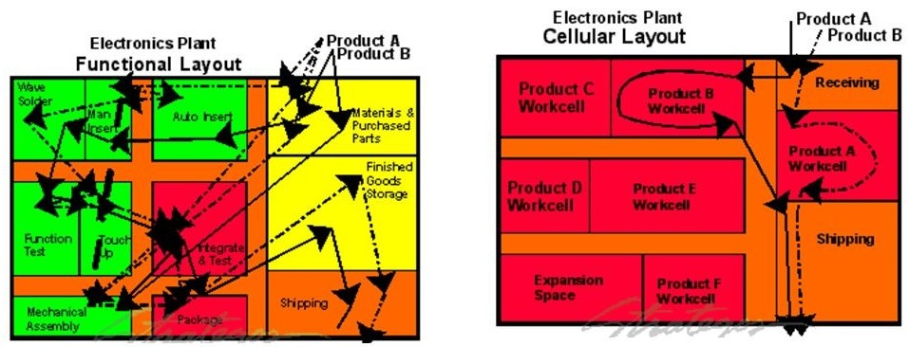
3. Cellular Manufacturing
Production work stations and equipment are arranged in a product-aligned sequence.
Increased production velocity and flexibility
Aims to move products through the manufacturing process one-piece at a time, at a rate determined by customer demand (the pull).

Slide 16
4. Just In Time (JIT)
- Leverages the cellular manufacturing layout to reduce significantly inventory and work-in-process (WIP).
Conditions necessary for the successful:
-
-
-
-
-
small lot sizes
short setup and changeover times efficient and effective quality controls
minimize backups and maximize the efficiency of human and machine labor.

Slide 17
Thank You!

