Slide 1
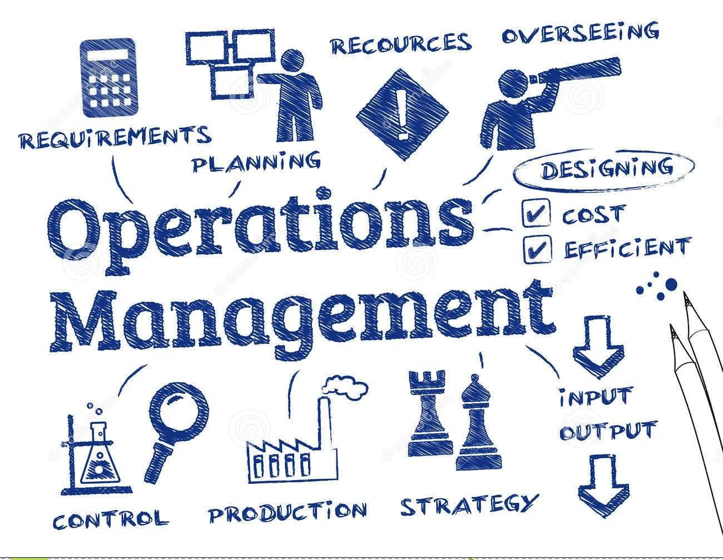
Quality and Competitiveness in a Global
Environment

Slide 2
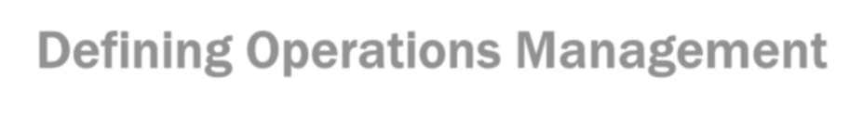
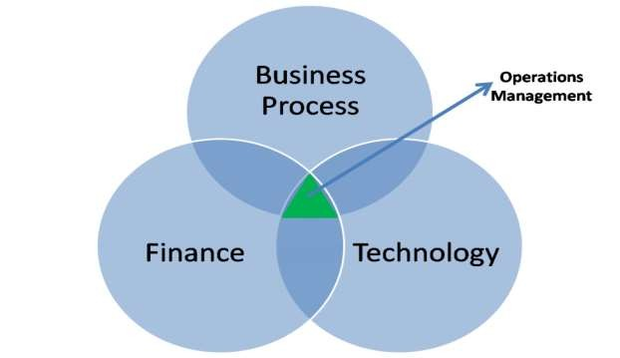
Defining Operations Management
The management of systems or processes
that create goods and/or provide services
Operations management is concerned with converting materials and labour into goods and services as efficiently as possible to maximize the profit of an organization.

Slide 3




The Evolution of Operations Management
One of the oldest management technique
  The Pyramids of Egypt
  The Great Wall of China
  The Roads and the Aqueducts of Rome
Operations Management begin with Industrial Revolution in the 1700s, when Craft Production is converted into factory
When a series of industrial inventions and mechanically powered machines have taken place

Slide 4







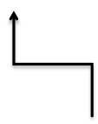


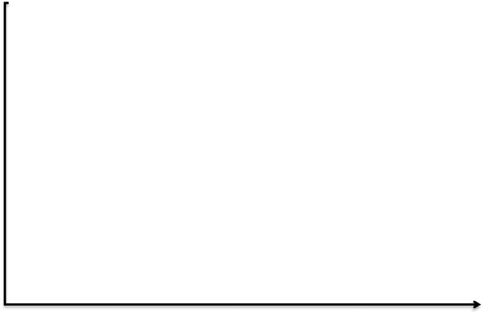







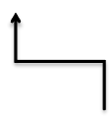


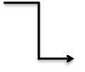







OM
ROADMAP
Quality Management
Product & Services
Global Operations
Quality
Processes, Capacity & Technology
Project Managemen t
Statistical Process Control
Facilities
Human Resources
Supply Chain Management

Slide 5

Learning Includes
Introduction
Planning
Strategy
Supply Chain management
JIT
Quality
Project Management
PERT Diagram & GANTT Chart
Services

Slide 6
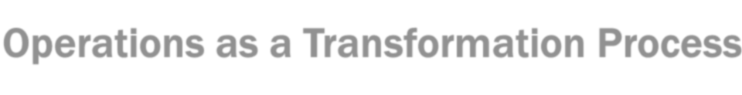





Operations as a Transformation Process
Transformation Process
→Product Design
→Process Planning
→Production Control
→Maintenance
Input
→Man
→Material
→Machine
→Money
→Information
Output
→Product
→Services
Feedback
Continues
→Inventory
→Quantity
→Cost

Slide 7
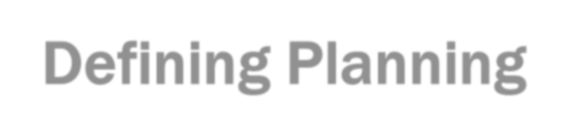
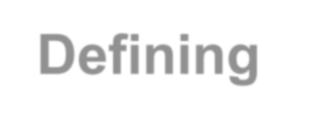
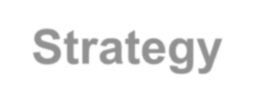
Defining Planning
The process of thinking and organizing the required activities to achieve a desired goal
Plan=Internal → Plan is concrete
Defining
ASptlraan toef agcytion designed to achieve a long- term or overall aim.
Strategy=External → Strategy is abstract

Slide 8
BASIS FOR COMPARISON
PLANNING
STRATEGY
Meaning
Planning is thinking in advance, for the actions which are going to take place in the future.
Best plan opted for achieving the desired outcome.
What is it?
Planning is a road map for accomplishing any task.
Strategy is the path chosen for achieving the objectives.
Related to
Thinking
Action
Basis
Assumptions
Practical considerations
Term
Depending upon the circumstances.
Long Term
Nature
Preventive
Competitive
Part of Management
Functions
Yes
Sub-part of Decision
Making
Sequence
Second
First

Slide 9



Types of Planning
Aggregate Planning
It is an operational activity
DRP
Distribution planning
requirements
(DRP) is a
that does
an aggregate
plan for the production
systematic process to make the delivery of goods more
process, in advance of 6 to 18 months, to give an idea to management as to what quantity of materials and other resources are to be procured and when, so that the total cost of operations of the organization is kept to the minimum over that period.
efficient which
by determining goods,
in what
at what
quantities, and location are
required
to
meet anticipated
demand. is to minimize and
of
The goal
shortages
costs
reduce the
ordering, and holding
transporting, goods.

Slide 10


Types of Strategy
Level Strategy
the company continuously produces goods equal to the average demand for the goods
Chase Strategy
Chase strategy, or Demand Matching Strategy, produce only enough goods to meet or exactly match the demand for goods
Hybrid Strategy
Hybrid strategies as strategies which enable to associate low cost production and differentiation

Slide 11

Supply Chain Management
It is the collaborative effort of multiple channel members to design, implement and manage seamless value added process to meet the real need of end customer
Supply Chain Structure
Responsivenes s
Efficiency
Transportatio n
Inventory
Facilities
Information
Efficiency Responsivenes s
Cost of Holding Availability
Consolidation Speed
Consolidation Dedicated Proximity/Flexi bility
Best Suited for each Objective

Slide 12







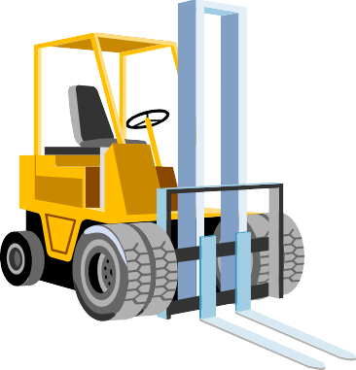
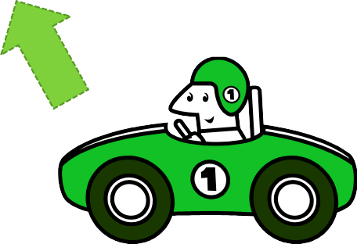

Order placed to EDI
Dealer/Supplier
Value chain of Amazon or any E- tailer
Factory
Customer
Delivery
Distribution
Warehouse

Slide 13

Just In Time (JIT)
Eliminating waste
JIT is an inventory strategy companies employ to increase efficiency and decrease waste by receiving goods only as they are needed in the production process, there by reducing inventory cost
This method requires that producers are able to accurately forecast the demand
JIT concept goes hand in hand with concept such as Kanban, continuous improvement and (TQM)
Technology plays an important role in JIT, an information system such as ERP is required to implement JIT in any organization.

Slide 14







Just In Time (JIT)
Advantages of JIT
Lower on stock holding
Lesser working capital
Avoids buildup of unsold finished products
Lesser time on quality inspection
Disadvantage s
Little room for mistakes
Production is relied on suppliers

Slide 15

JIT can Achieve
Reducing cost
Improving Quality
Improving Performance
Improving Delivery
Adding Flexibility
Increasing Innovation

Slide 16

Quality
Quality is assurance which satisfies the customer’s expectation
QC→ Quality Control
QA→ Quality A
ssurance
 | Six Sigma | Lean Thinking | Theory of Constraint
Views of waste | Variation is waste | Non-value adding in market | Constraint drive waste
Application | Define Measure Analyze Improve Control | Identify value Define value stream Determine the flow Define Pull Improve Process | Identify constraint Exploit Constraint Sub-ordinate Cons Elevate Cons Repeat Cycle
Tools | Math, Stats | Visualize | System thinking
Focus | Problem | Process Flow | Constraint

Slide 17


Project Management
It is temporary endeavor with a defined beginning & end undertaken to meet your need, goals, and objectives, typically to bring about beneficial change or add value
Initiation
Planning & Design
Execution
Monitorin g
Closure
BAU (Business As Usual)
Initiation
Planning &
Design
Monitoring & Controlling
Execution
Closure

Slide 18



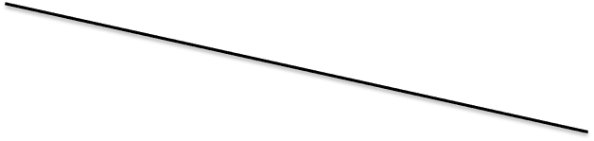
Project Triangle
Quality
Time

Slide 19

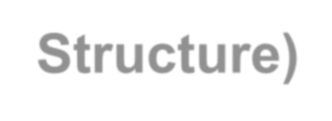
WBS (Work Breakdown
Structure)

Slide 20

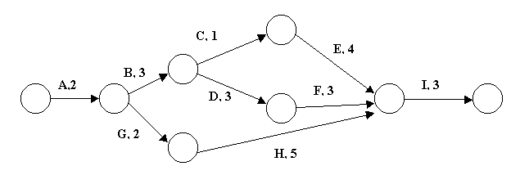
PERT Chart
A PERT chart is a project management tool used to schedule, organize, and coordinate tasks within a project. PERT stands for Program Evaluation Review Technique, a methodology developed by the U.S. Navy in the 1950s to manage the Polaris submarine missile program.

Slide 21

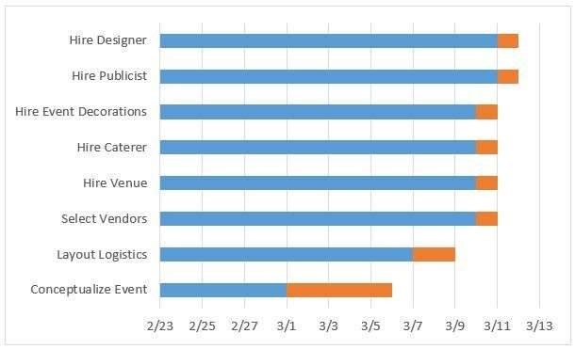
GANTT Chart
A Gantt chart is a horizontal bar chart developed as a production control tool in 1917 by Henry L. Gantt, an American engineer and social scientist. Frequently used in project management, a Gantt chart provides a graphical illustration of a schedule that helps to plan, coordinate, and track specific tasks in a project.

Slide 22


Services
Any activity or benefit that one party can offer to another that is essentially intangible and does not result the ownership of anything. It is production may or may not be tied up to a physical products
Types of services
Pure Service
Product Linked Service
Product Based Service

Slide 23


















 GOODS
SERVICES
  Intangible
  Heterogeneous
  Cannot be stored
  Production, Distribution, and Consumption takes place simultaneously
Tangible
Homogenous
Produced in a factory
Transfer of ownership

Slide 24





Production
The action of making or manufacturing from raw materials, or the process of being so manufactured
TYPES of Production systems
  T-Type
  Y-Type
  Reverse Y-Type
  I-Type

Slide 25


