Slide 1
Preservation of developed prints
Film photography
Digital photography
Print lifts
Cast

Slide 2
Introduction
Preservation of all relevant friction ridge information derived from evidence is mandatory.
With regard to friction ridge detail, methods of preservation include :
Film photography
Digital photography
Latent print lifts
Use of casting material

Slide 3
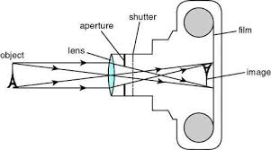
STRUCTURE OF CAMERA
Basic structure of camera. Conventional Camera uses film and digital camera uses sensors.

Slide 4
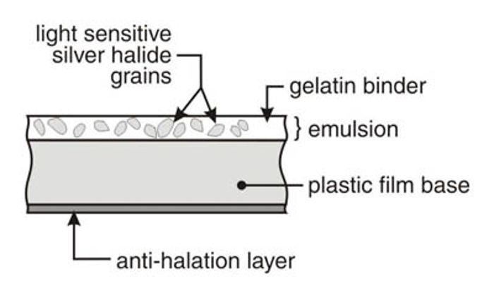
Film Photography
Film is composed of plastic sheets, coated with an emulsion containing silver halide salts bonded by gelatin.
Grain size of silver halide salt determines the sensitivity of the film and resolution.
Smaller grain size : slow film, requires longer exposure but produces a photograph of finer detail.

Slide 5
When silver halide salts are exposed to light, an invisible/ latent image is recorded on the film.
Film-developing chemicals are then applied to the exposed film in order to visualize the latent images.
This process causes the conversion of the silver halide salts to metallic silver. The metallic silver blocks the transmission of light and forms the black portion of a negative.
Development Process

Slide 6
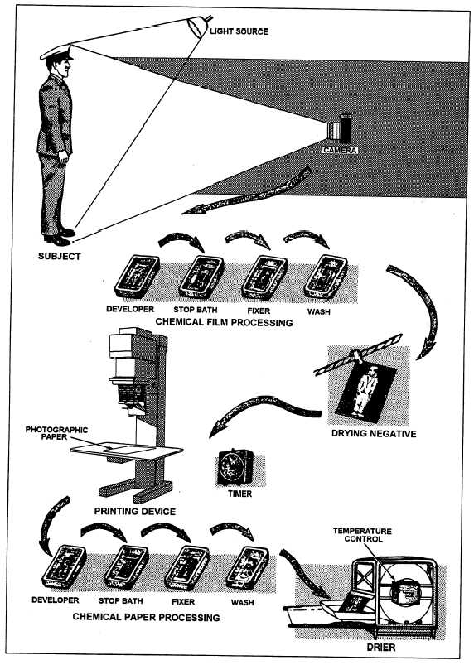

Slide 7
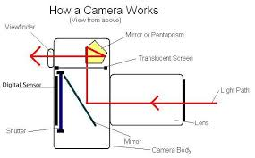
Digital Photography
Digital Camera uses sensors for capturing images/photons.
Sensor : an array of photosensitive diodes called photosites that capture photons . Two types : CCD and CMOS.
The sensor for the digital camera contains millions of CCD cells on a grid. Each CCD records a color and a brightness (tonal) value that is stored as a series of numbers in the camera’s memory.

Slide 8
Working of sensor
Sensor captures photons and converts them to electron
Build up of electron in photosite is converted to voltage
Voltage is converted to digital data as a pixel
Pixels are relayed in consecutive order and stored as an image in camera’s memory
Generally, the greater the number of pixels on the CCD, the sharper the image.
Pixel resolution : number of pixels in an image. For example, a 1000 x 1000 pixel image printed in a one-inch square would have 1000 pixels per inch (PPI).

Slide 9
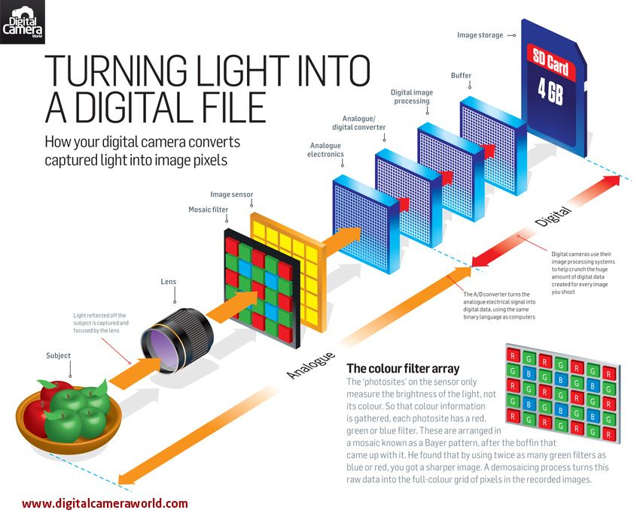

Slide 10
Formats of stored photograph
Two main types of formats: compressed and uncompressed.
Compressed : produce smaller image files that allow for more storage space. Images are reduced in size by the discarding or loosing pixel information. Because of this loss, compression file formats are referred to as lossy. The most common type of lossy compression format is JPEG(Joint Photographic Experts Group).
Uncompressed : Those in which no pixel values are lost and the image can be retrieved in its original. Uncompressed file formats include TIFF (tagged information file format) and RAW formats (i.e., the camera’s native or unprocessed file format).
Require more storage space.
For the purpose of recording friction ridge impressions, the use of TIFF or RAW images in digital photography is valuable to ensure that the integrity of the evidence is preserved

Slide 11
National Institute of Standards and Technology (NIST) established that the minimal resolution of an image taken by a digital camera that is used for latent impression evidence be 1000 PPI at 1:1.
Another key aspect to digital photography in relation to the criminal justice community is the maintenance of the original digital image. The original image must be stored in an unaltered state.
The original images can be stored on the following media: silver-based film negative, write-once compact disk-recordable (CD-R), and digital versatile disk recordable (DVD-R) .
If digital processing is needed, it must be performed on a duplicate image.

Slide 12
lIFTERS and casting
Often the evidence that needs to be processed for latent prints is too large to be removed or is immovable and must be processed in the field.
When this occurs, the impression should be imaged insofar as possible before lifting or casting procedures are used, to retrieve the latent print detail.
The lift or cast can be imaged again for additional preservation.
Prints lifted by the colored silicone will contain a reversed image and the transparent lift would not be a reversed image because the image can be viewed as it was on the surface.

Slide 13
Fingerprint Lifters
Fingerprint lifters are used after the application of fingerprint powders.
lift is usually made with tape or a similar lifting material having the correct amount of adhesive.
Fingerprint lifters come in a variety of types that vary in color, size, flexibility, and tackiness (stickiness).
Types of commercially available fingerprint lifts:
Transparent tape lifters
Hinge lifters
Rubber-gelatin lifters

Slide 14
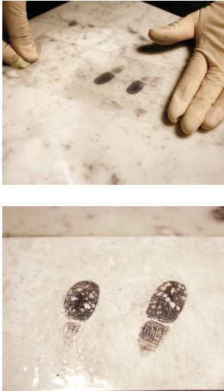
Transparent tape lifters
Transparent tape can be used to lift latent impressions.
Mounted on either a white or black backing card.
Tape should be unrolled in one continuous motion to avoid hesitation marks. Such marks may obscure lifted impressions.
Care should be taken to avoid bubble formation.
Notes:
The tape may be clear or frosted and is dispensed from a roll.
The tape should be unrolled in one continuous motion to the desired length in order to avid any hesitation marks cause these marks can obscure lifted impressions.
Color of the powder that is used determines the color of the backing on which tape is mounted.
When a transparent backing is used, it is up to the photographer to use an appropriately contrasting background. An advantage of using transparent tape lifters is the fact that the latent impressions on the lift will be in the proper viewing position
Photographed using direct lighting or may be digitally recorded using a scanner.
One can also use transmitted light for photographing the prints.
Using transmitted lighting has two benefits :
Improved contrast is achieved.
By using transmitted lighting, the light transmits through the thinner background powder but is not transmitted through the thicker powder adhering to the latent impression

Slide 15
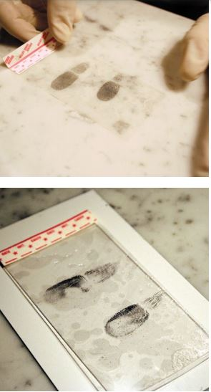
Hinge lifters
Composed of lifting tape and a backing card hinged together on one side.
The adhesive side of the hinge lifter is protected by a plastic cover.
Exposed adhesive is placed on the developed print, lifted off the surface, and then folded back onto the hinged backer.
Notes:
Available in various sizes and contain markings that indicate the correct side for viewing.
Hinge lifters are available with white, black, or transparent backings.

Slide 16
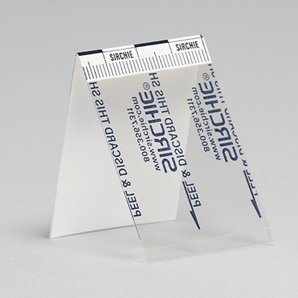
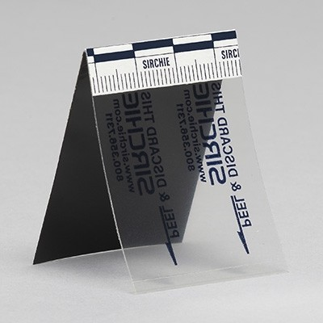

Slide 17
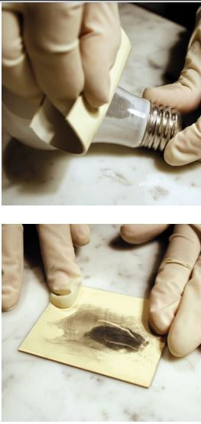
Rubber-gelatin Lifters
Least tacky and most pliable.
Commonly chosen when a latent impression is on a surface that is considered either fragile (peeling paint from a wall) or irregularly shaped (e.G., Doorknob).
Rubber-gelatin lifters include :
A cover sheet,
A low-adhesion gelatin layer
High-quality elastic sheet of rubber
Notes:
Available in various sizes in black, white, or transparent.
Rubber sheet contains adhesive material and is applied to the powdered latent impression. Once it is removed from the surface, the clear and clean plastic covering is reapplied.
Because the latent impression adheres to the rubber and is viewed through the covering, the print will be in reverse position.
Also see : http://www.waproducts.co.uk/pdf/Gel_Lifters.pdf

Slide 18
Casting material
Advantageous when dealing with patent impressions, powdered latent impressions on textured surfaces, or when processing the friction ridges of deceased individuals.
Casting materials (silicone rubber) are available in several colors and have been manufactured to dry quickly and release easily.
In addition to use in photographic recording, casting material can be powdered or inked and then lifted or impressed on lifting sheets.
The resulting image will be a reverse position image of the friction ridges.
Notes:
Casting compound is mixed with hardener and diluant (if needed) and poured over the print developed with fingerprint powder. After the silicone rubber has cured, the fingerprint is lifted.
Depending on the color of the fingerprint powder that was used, white or black silicone rubber is used for contrast.

Slide 20
references
http://www.bvda.com/en/gellifters
https://www.ncjrs.gov/pdffiles1/nij/225328.pdf
https://www.sirchie.com

