Slide 1
SCHEDULING AND SEQUENCING

Slide 2
Scheduling
Scheduling: The allocation of resources over time to accomplish specific tasks.
•
Demand scheduling: A type of scheduling whereby customers are assigned to a definite time for order fulfillment.
•
•
Workforce scheduling: A type of scheduling that determines when employees work.
•
Operations scheduling: A type of scheduling in which jobs are assigned to workstations or employees are assigned to jobs for specified time periods.

Slide 3
Introduction
Operations scheduling is critical to the success of an organization; however, it can be a very complicated task. Effective schedules are needed to meet promised customer delivery dates or inventory targets.
It covers the following areas in particular:
assign job to a particular work center/ machine
time of assignment of job and completion
allocation of resources like manpower and materials
time sequence of operations
feedback and control function to take care of deviations

Slide 4
Work Centre
A work center is an area in a business in which productive resources are organized and work is completed
•
Can be a single machine, a group of machines, or an area where a particular type of work is done
•

Slide 5
Performance Measures
From the manager’s perspective, identifying the performance measures to be used in selecting a schedule is important. If the overall goals of the organization are to be achieved, the schedules should reflect managerially acceptable performance measures. The following list describes the most common performance measures used in operations scheduling.
Job Flow Time: The amount of shop time for the job is called job flow time. It is the sum of the moving time between operations, waiting time for machines or work orders, process time (including setups), and delays resulting from machine breakdowns, component unavailability, and the like.

Slide 6
Performance Measures
Makespan: The total amount of time required to complete a group of jobs is called makespan.
Past Due: The measure past due can be expressed as the amount of time by which a job missed its due date (also referred to as tardiness) or as the percentage of total jobs processed over some period of time that missed their due dates.
Work-in-Process Inventory: Any job in a waiting line, moving from one operation to the next, being delayed for some reason, being processed, or residing in component or subassembly inventories is considered to be work-in-process inventory.

Slide 7
Performance Measures
Total Inventory: The sum of scheduled receipts and on-hand inventories is
the total inventory.
Utilization: The percent of work time productively spent by a machine or worker is called utilization.
These performance measures often are interrelated.
An understanding of the interactions of job flow time, makespan, past due, WIP inventory, total inventory, and utilization can make scheduling easier.

Slide 8
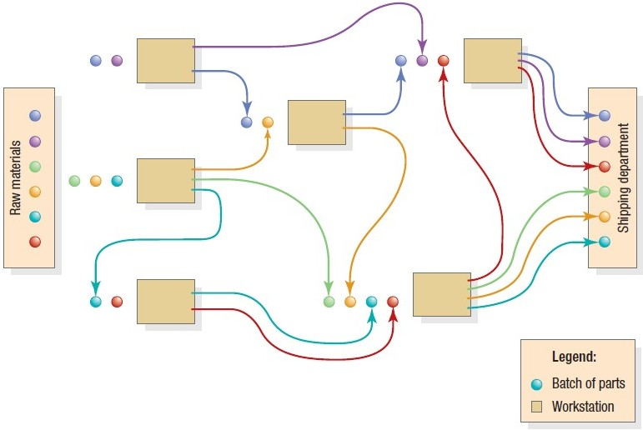
Manufacturing Process

Slide 9
Objectives of Operations Scheduling
•
Making efficient use of the labour.
•
Making best possible use of the equipments that are available for the use.
•
Increasing the profit.
•
Increasing the output.
•
Improving the service level.

Slide 10
Objectives of Operations Scheduling
•
Maximizing the delivery performance i.e. meeting the delivery dates.
•
Minimizing the inventory.
•
Reducing the manufacturing time.
•
Minimizing the production costs.
•
Minimizing the worker costs.

Slide 11
Functions of Operations Scheduling
•
Allocation of the resources.
•
Shop floor control.
•
Making maximum use of the plant at minimum possible cost.
•
Ensure that the needs of the manpower are optimum.
•
Determination of the sequence of the jobs.

Slide 12
Functions of Operations Scheduling
•
Specifying the start and the end time for each job (actively scheduled).
•
Getting quick feedback from the shops regarding the delays and the various interruptions.
•
Possess up – to – date information for the availability of the materials, expected delivery dates etc.
•
Possess up – to – date data on the machine regarding its breakdown, servicing etc.

Slide 13
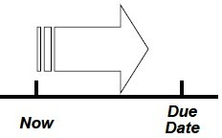
Types of Scheduling
Types of Operations Scheduling are as follows:
1. Forward operations scheduling –
•
•
Classified on the basis of the time.
All the activities are scheduled from the date of the planned order release.
First task of the job is scheduled.
Its subsequent task is scheduled on the scheduled completion of the first task.
Like this, accordingly all the tasks of the job are scheduled.
•
•
•

Slide 14
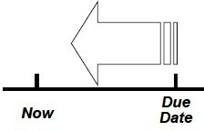
Types of Scheduling
2. Backward operations scheduling –
•
Also classified on the basis of the time.
•
Activities are scheduled from the date or the planned receipt date.
•
The last activity is scheduled first.
•
Time of the start of the last task is considered as the time for the start of the previous activity.

Slide 15
Shop Floor Control (SFC)
Schedule and monitor day-to-day job shop production • Also called production control and production activity control (PAC) • Performed by production control department
Loading - check availability of material, machines, and labor
Sequencing - release work orders to shop and issue dispatch lists for individual machines
Monitoring - maintain progress reports on each job until it is complete

Slide 16
Loading
Process of assigning work to limited resources
Perform work with most efficient resources
Use assignment method of linear programming allocation
to determine

Slide 17
Sequencing
Prioritize jobs assigned to a resource
If no order specified use first-come first-served (FCFS)
Other Sequencing Rules
FCFS - first-come, first-served
LCFS - last come, first served • DDATE - earliest due date
CUSTPR - highest customer priority • SETUP - similar required setups
SLACK - smallest slack • CR - smallest critical ratio
SPT - shortest processing time • LPT - longest processing time

Slide 18
Sequencing Jobs
Operations schedules are short-term plans designed to implement the sales and operations plan
An operation with divergent flows is often called a job shop
Low-to medium-volume production
Utilizes job or batch processes
The front office would be the equivalent for a service provider
Difficult to schedule because of the variability in job routings and the continual introduction of new jobs to be processed

Slide 19
Sequencing Jobs
•
An operation with line flow is often called a flow shop
–
–
–
Medium- to high-volume production Utilizes line or continuous flow processes
The back office would be the equivalent for a service provider
Tasks are easier to schedule because the jobs have a common flow pattern through the system
–

Slide 20
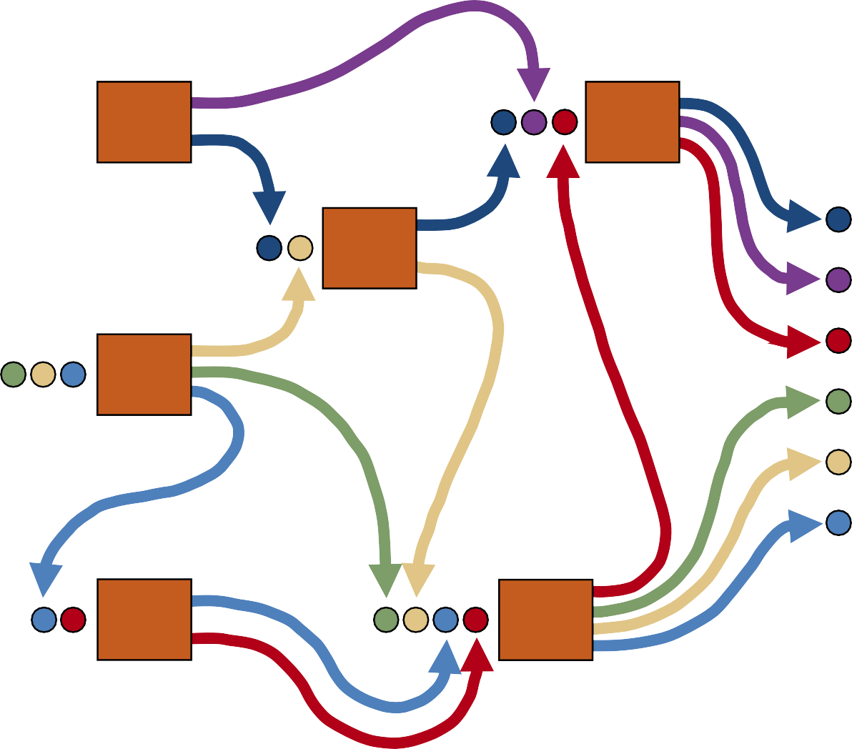
Job Shop Sequencing
Raw Materials
Shipping Department
Legend:
Batch of parts Workstation
^{Copyr}F^{ig}i^{h}g^{t}u©re²⁰J¹.⁰1^{P}–^{ea}D^{rso}ia^{n}gram of a Manufacturing Job Shop Process
Education, Inc. Publishing as
Prentice Hall.

Slide 21
Priority Sequencing Rules
First-come, first-served (FCFS)
Earliest due date (EDD)
Critical ratio (CR)
(Due date) – (Today’s date)
CR =
Total shop time remaining
◆
A ratio less than 1.0 implies that the job is behind schedule
A ratio greater than 1.0 implies the job is ahead of schedule
The job with the lowest CR is scheduled next
◆
◆
Copyright © 2010 Pearson Education, Inc. Publishing as Prentice Hall.

Slide 22
Priority Sequencing Rules
Shortest processing time (SPT)
Slack per remaining operations (S/RO)
Due Today’s date – date
_{– ti} Total shop me remaining
S/RO =
Number of operations remaining
◆
The job with the lowest S/RO is scheduled next
Copyright © 2010 Pearson Education, Inc. Publishing as Prentice Hall.

Slide 23
Sequencing One Workstation
Single-dimension rules
A job’s priority assignment based only on information waiting for processing at the individual workstation (e.g., FCFS, EDD, and SPT)
Copyright © 2010 Pearson Education, Inc. Publishing as Prentice Hall.

Slide 24
Multiple-Dimension Rules
The priority rules CR and S/RO incorporate information about the remaining workstations
● S/RO is better than EDD with respect to the percentage of jobs past due but usually worse than SPT and EDD with respect to average job flow times
● CR results in longer job flow times than SPT, but CR also results in less variance in the distribution of past due hours
● No choice is clearly best; each rule should be tested in the environment for which it is intended
Copyright © 2010 Pearson Education, Inc. Publishing as Prentice Hall.

Slide 25
Multiple Workstations
•
Identifying the best priority rule to use at a particular operation in a process is a complex problem because the output from one operation becomes the input to another
Computer simulation models are effective tools to determine which priority rules work best in a given situation
•
Copyright © 2010 Pearson Education, Inc. Publishing as Prentice Hall.

Slide 26
Scheduling a Two-Station Flow Shop
•
In single-workstation scheduling, the makespan is the same regardless of the priority rule chosen
In the scheduling of two or more workstations in a flow shop, the makespan varies according to the sequence chosen
Determining a production sequence for a group of jobs to minimize the makespan has two advantages
•
•
–
–
The group of jobs is completed in minimum time
The utilization of the two-station flow shop is maximized
Copyright © 2010 Pearson Education, Inc. Publishing as Prentice Hall.

Slide 27
Scheduling Jobs for Multiple Workstations
•
Priority sequencing rules can be used to schedule more than one operation. Each operation is treated independently.
Identifying the best priority rule to use at a particular operation in a process is a complex problem because the output from one process becomes the input for another.
Computer simulation models are effective tools to determine which priority rules work best in a given situation.
When a workstation becomes idle, the priority rule is applied to the jobs waiting for that operation, and the job with the highest priority is selected.
When that operation is finished, the job is moved to the next operation in its routing, where it waits until it again has the highest priority.
•
•
•
•

Slide 28
Scheduling Problems
One machine, many jobs
Two machines, many jobs
Three machines, many jobs
Many machines, many jobs

Slide 29
One machine, many jobs
Total time is independent of sequence
SPT minimizes average flow time
Examples- Mumbai airport

Slide 30
Two machines, many jobs
All Jobs follow same sequence – Johnson’s Rule
Jobs have different sequence – Jackson’s Rule
Johnson’s 3 machine rule

Slide 31
Johnson’s Rule
•
Minimizes makespan when scheduling a group of jobs on two workstations
Step 1: Scan the processing time at each workstation and find the shortest processing time among the jobs not yet scheduled. If two or more jobs are tied, choose one job arbitrarily.
Step 2: If the shortest processing time is on workstation 1, schedule the corresponding job as early as possible. If the shortest processing time is on workstation 2, schedule the corresponding job as late as possible.
Step 3: Eliminate the last job scheduled from further consideration. Repeat steps 1 and 2 until all jobs have been scheduled.
Copyright © 2010 Pearson Education, Inc. Publishing as Prentice Hall.

Slide 32
Gantt Progress Chart
Gantt Progress Chart for an Auto Parts Company
Start activity Finish activity
Nonproductive time
Scheduled activity time Actual progress
Current date
Job
4/17
4/18
4/19
4/20
4/21
4/22
4/23
4/24
4/25
4/26
Ford
Plymouth
Pontiac

Slide 33
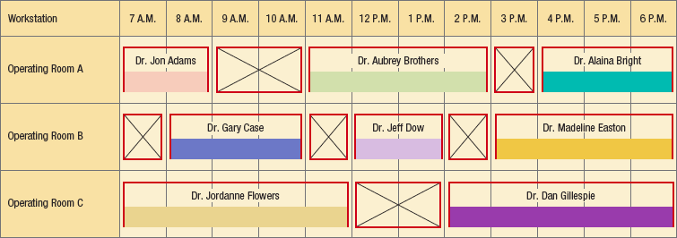
Gantt Workstation Chart
Gantt Workstation Chart for Hospital Operating Rooms

Slide 34
Thank You

