Slide 1
Value Chain Analysis

Slide 2
Introduction:
The idea of a value chain was first suggested by Michael Porter (1985) to depict how customer value accumulates along a chain of activities that lead to an end product or service. Porter describes the value chain as the internal processes or an activity a company performs “to design, produce, market, deliver and support its product.”

Slide 3
Definition:
“Value chain analysis (VCA) is a process where a firm identifies its primary and support activities that add value to its final product and then analyse these activities to reduce costs or increase differentiation.”
“Value chain represents the internal activities a firm engages in when transforming inputs into outputs.”

Slide 4
The value chain contains two types of activities:
Primary activities : Where most of the value for customers is created.
Support activities: That facilitate performance of the primary activities

Slide 6
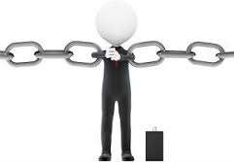
Primary Activities:
Inbound logistics: Material handling and warehousing.
Operations: Transforming inputs into the final product.
Outbound logistics: Order processing and distribution.
Marketing and sales: Communication, pricing and channel management
Service: Installation, repair and parts.

Slide 7
Support activities
Procurement: Purchasing of raw materials, supplies and other consumable items as well as assets.
Technology development: Know-how, procedures and technological inputs needed in every value chain activity.
Human resource management: Selection, promotion and placement, appraisal, rewards management development and labour or employee relations.
Firm infrastructure: General management, planning, finance, accounting, legal, government affairs and quality management.

Slide 8
Objective value chain analysis:
The objective is to analyse competitive disintegrating an organisation into discrete
advantage by activities or
processes and examine how each activity contributes to the organisation’s relative cost position or the customer’s comparative willingness to pay.

Slide 9
Value Chain
Activities for a Hotel Chain
Primary Activities
Site selection and construction
Reservations
Operation of hotel properties
Managing lineup of hotel locations
Support Activities
Accounting
Hiring and training
Advertising
Building a brand and reputation
General administration

Slide 10
Cost Advantage and the Value Chain:
A firm may create a cost advantage either by reducing the cost of individual value chain activities or by reconfiguring the value chain. It include,
Economies of scale
Learning
Capacity utilization
Linkages among activities
Interrelationships among business units
Degree of vertical integration
Timing of market entry
Firm's policy of cost or differentiation
Geographic location
Institutional factors (regulation, union activity, taxes, etc.)

Slide 11
Differentiation and the Value Chain:
A differentiation advantage can arise from any part of the value chain. It may,
Policies and decisions
Linkages among activities
Timing
Location
Interrelationships
Learning
Integration
Scale (e.g. better service as a result of large scale)
Institutional factors
Many of these also serve as cost drivers. Differentiation often results in greater costs, resulting in trade-offs between cost and differentiation

Slide 12
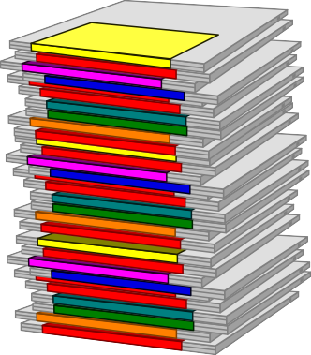
Example: Value Chain Activities
Computer Software Industry
Programming Disk loading Marketing Distribution

Slide 13
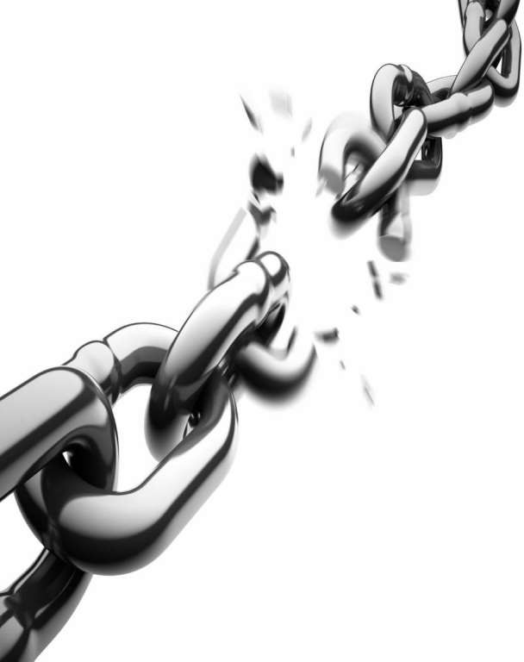
Limitations of Value Chain Analysis :
Difficulty in implementation and interpretation
Problem of
Traditional Accounting system
Difficulty in decision making

Slide 14
