Slide 1
Advantages
and
Disadvantages of Cloud Computing

Slide 2
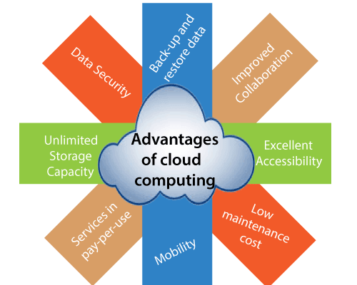
Advantages of Cloud Computing
As we all know that Cloud computing is trending technology.
Almost every company switched their services on the cloud to rise the company growth.
Here, we are going to discuss some important advantages of Cloud Computing-

Slide 3
a) Back-up and restore data
Once the data is stored in the cloud, it is easier to get back-up and restore that data using the cloud.
b) Improved collaboration
Cloud applications improve collaboration by allowing groups of people to quickly and easily share information in the cloud via shared storage.
c) Excellent accessibility
Cloud allows us to quickly and easily access store information anywhere, anytime in the whole world, using an internet connection. An internet cloud infrastructure increases organization productivity and efficiency by ensuring that our data is always accessible.

Slide 4
d) Low maintenance Cost
Cloud computing reduces both hardware and software maintenance costs for organizations.
e) Mobility
Cloud computing allows us to easily access all cloud data via mobile.
f) Services in the pay per use model
Cloud computing offers Application Programming Interfaces (APIs) to the users for access services on the cloud and pays the charges as per the usage of service.

Slide 5
g) Unlimited storage capacity
Cloud offers us a huge amount of storing capacity for storing our important data such as documents, images, audio, video, etc. in one place.
h) Data security
Data security is one of the biggest advantages of cloud computing. Cloud offers many advanced features related to security and ensures that data is securely stored and handled.

Slide 6
Disadvantages of Cloud Computing
A list of the disadvantage of cloud computing is given below –
Internet Connectivity
As you know, in cloud computing, every data (image, audio, video, etc.) is stored on the cloud, and we access these data through the cloud by using the internet connection. If you do not have good internet connectivity, you cannot access.
b) Vendor lock-in
Vendor lock-in is the biggest disadvantage of cloud computing. Organizations may face problems when transferring their services from one vendor to another. As different vendors provide different platforms, that can cause difficulty moving from one cloud to another.

Slide 7
c) Limited Control
As we know, cloud infrastructure is completely owned, managed, and monitored by the service provider, so the cloud users have less control over the function and execution of services within a cloud infrastructure.
d) Security
Although cloud service providers implement the best security standards to store important information. But, before adopting cloud technology, you should be aware that you will be sending all your organization's sensitive information to a third party, i.e., a cloud computing service provider. While sending the data on the cloud, there may be a chance that your organization's information is hacked by Hackers.

Slide 8
Difference between
Cloud Computing
and
Grid Computing

Slide 9
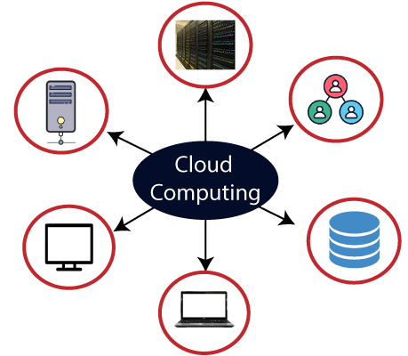
Cloud Computing
Cloud computing uses a client-server
architecture to deliver computing resources such as
servers, storage, databases, and software over the
cloud (Internet) with pay-as-you-go pricing.
Cloud computing becomes a very popular option
for organizations by providing various advantages,
including cost-saving, increased productivity, efficiency,
performance, data back-ups, disaster recovery,
and security.

Slide 10
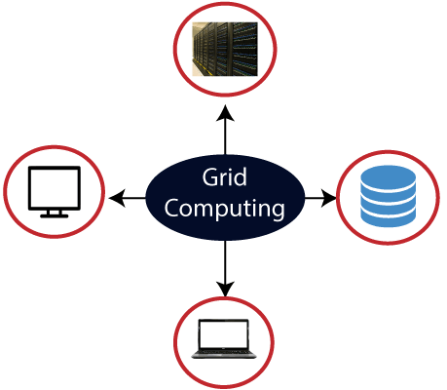
Grid Computing
Grid computing is also called as "distributed computing." It links multiple computing resources (PC's, workstations, servers, and storage elements) together and provides a mechanism to access them.
The main advantages of grid computing are that it increases user productivity by providing transparent access to resources, and work can be completed more quickly.

Slide 11
Let’s understand the difference between cloud computing and grid computing.
Cloud Computing | Grid Computing
Cloud Computing follows client-server computing architecture. | Grid computing follows a distributed computing architecture.
Scalability is high. | Scalability is normal.
Cloud Computing is more flexible than grid computing. | Grid Computing is less flexible than cloud computing.
Cloud operates as a centralized management system. | Grid operates as a decentralized management system.
In cloud computing, cloud servers are owned by infrastructure providers. | In Grid computing, grids are owned and managed by the organization.
Cloud computing uses services like Iaas, PaaS, and SaaS. | Grid computing uses systems like distributed computing, distributed information, and distributed pervasive.
Cloud Computing is Service-oriented. | Grid Computing is Application-oriented.
It is accessible through standard web protocols. | It is accessible through grid middleware.

Slide 12
Thank You

