Slide 1
Center for Smart Agriculture Protected cultivation of vegetable crops
Module 8: Plant Protection
Session 19: Identification, damage symptoms and control methods of different diseases

Slide 2
DISEASES OF TOMATO
Early blight
Bacterial wilt
Fusarium wilt

Slide 3
Early Blight:
Alternaria solani
Symptoms
This is a common disease of tomato occurring on the foliage at any stage of the growth.
The fungus attacks the foliage causing characteristic leaf spots and blight. Early blight is first observed on the plants as small, black lesions mostly on the older foliage.
Spots enlarge, and by the time they are one-fourth inch in diameter or larger, concentric rings in a bull's eye pattern can be seen in the center of the diseased area.

Slide 4
Tissue surrounding the spots may turn yellow. If high temperature and humidity occur at this time, much of the foliage is killed.
Lesions on the stems are similar to those on leaves, sometimes girdling the plant if they occur near the soil line.
Transplants showing infection by the late blight fungus often die when set in the field. The fungus also infects the fruit, generally through the calyx or stem attachment.
Lesions attain considerable size, usually involving nearly the entire fruit; concentric rings are also present on the fruit.

Slide 5
Management
Removal and destruction of crop debris.
Practicing crop rotation helps to minimize the disease incidence.
Spray the crop with Mancozeb 0.2 % for effective disease control.

Slide 6
Bacterial wilt :
Burkholderia solanacearum
Symptom
This is one of the most serious diseases of tomato crop. Relatively high soil moisture and soil temperature favour disease development.
Characteristic symptoms of bacterial wilt are the rapid and complete wilting of normal grown up plants.
Lower leaves may drop before wilting. Pathogen is mostly confined to vascular region; in advantage cases, it may invade the cortex and pith and cause yellowbrown discolouration of tissues.

Slide 7
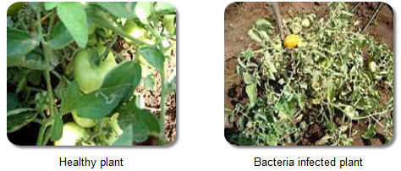
Infected plant parts when cut and immersed in clear water, a white streak of bacterial ooze is seen coming out from cut ends.
The spreads through wounds, soil and implements.
Avoid damage to seedling while transplanting
Apply bleaching powder @ 10kg/ha and inrate.

Slide 8
Management
Crop rotations, viz.,
cowpea-maize-cabbage,
okra-cowpea-maize,
maize- cowpea-maize and
finger millet-egg plant
These are reported effective in reducing bacterial wilt of tomato.

Slide 9
Fusarium Wilt :
Fusarium oxysporum f. sp. lycopersici
Symptom
The first symptom of the disease is clearing of the veinlets and chlorosis of the leaves.
The younger leaves may die in succession and the entire may wilt and die in a course of few days. Soon the petiole and the leaves droop and wilt.
In young plants, symptom consists of clearing of veinlet and dropping of petioles. In field, yellowing of the lower leaves first and affected leaflets wilt and die.
The symptoms continue in subsequent leaves. At later stage, browning of vascular system occurs. Plants become stunted and die.

Slide 10
Management
The affected plants should be removed and destroyed.
Spot drench with Carbendazim (0.1%)
Crop rotation with a non-host crop such as cereals.

Slide 11
Disorders

Slide 12
Blossom End Rot (BER)
Due to deficiency of calcium in the fruit The symptoms are disintegration of the cell membranes and increased ion permeability.
It is due to soil water deft, high salinity or high NH4 + activity,
A higher susceptibility to various stresses due to an increase in physiologically active gibberellins and a resulting decrease In calcium, causing the enhanced permeability of cell membranes
This results in a brown-black discoloration at the affected site.
To control -always ensure adequate calcium supply to the crop root zone
Do not over water the tomato crop.
Maintain steady fruit and plant growth. Maintain the proper RH in the greenhouse

Slide 13
Symptoms of Blossom End Rot (BER)
Regular irrigation. Application of calcium in fertigation or spray with 0.5% CaSO0.5% CaSO4 4 solutionsolution

Slide 14
RUSSETTING
Inability of the fruit skin to expand with fruit growth. This results in fine hair like cracks on the fruit shoulders.
Cracks visible under certain light conditions.
Ensure proper plant nutrient balance in greenhouse cultivation of tomato by way of plant architecture.
Rate of' growth and water regimes can minimize this problem.

Slide 15
BLOTCHY RIPENING
A light color (yellow orange) on the shoulder.
This fruit ripening disorder caused by lack of adequate potassium absorption.
Reduces the quality and grade of the greenhouse fruits.
Proper nutrition and make sure there is adequate foliage to shade the fruit.

Slide 16
DISEASES OF CUCUMBER
Powdery mildew
Downy mildew

Slide 17
Powdery mildew
(Budida Tegulu)
(Erysiphe cichoracearum)
A white powdery growth appears on the leaf surface mostly confined to the upper surface but also found on the lower surface and the stem.
In severe infections the leaves and stem dryoff and further growth of the plant is arrested.

Slide 19
Control
Spray Dinocap @ 1 ml/lit. or Tridemorph @ 1 ml/lit. or Sulfex 0.2% or Calixin 0.1% or Karathane 0.2% or Bavistin @ 1g/lit of water 2-3 times at 10 days interval.

Slide 20
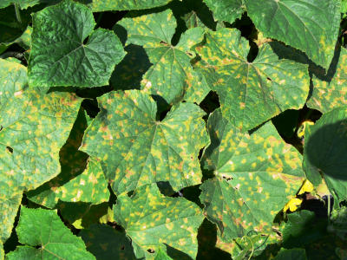
Downy mildew
(Pseudoperonospora cubensis)
Purple spots appear on lower surface and yellow spots on upper surface of leaves.
Fruits do not mature.

Slide 21
Control
Spray Mancozeb @ 2.5 g/lit. or Metalaxyl M.Z @ 2g/lit. or Dithane Z-78 0.2% i.e. 2g/lit of water at 8-10 days interval.

