Slide 1
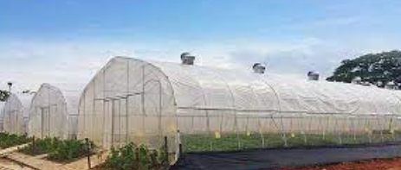
Center for Smart Agriculture Protected cultivation of vegetable crops
Module 3: Control of Light
Session 7: Importance of light for crop growth

Slide 2
Light
In intensive horticultural cultivation natural light levels often limit crop production during several periods.
Light has to be optimised together with all other growth factors like temperature, humidity and CO₂.
For a sustainable greenhouse production the use of freely available sunlight has to be preferred.

Slide 3
Transparent GH covering materials - Diffuse light
Temperature has a direct impact on the physiological development phases
Different metabolic responses are influenced by temperature.
Temperature of climate area plays a large role in designing structures and control systems.

Slide 4
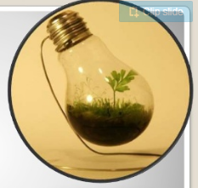
Light is the part of the electromagnetic spectrum having wavelengths visible to the human eye.
The light intensity is measured by the international unit known as Lux.
It is direct illumination on the surrounding surface that is one meter from a uniform point source of 1 international candle.

Slide 5
It is direct illumination on the surrounding surface that is one meter from a uniform point source of 1 international candle.
GH crops LI varying from 129.6klux on clear summer days to 3.2 Klux on cloudy winter days.
Photosynthesis does not increase at light intensities higher than 32.2klux

Slide 6
Importance of Light for Plants
Photosynthesis:
Light energy, carbon dioxide (CO2) and water all enter in to the process of photosynthesis through which carbohydrates are formed.
The production of carbohydrates from carbon dioxide and water in the presence of chlorophyll, using light energy is responsible for plant growth and reproduction.

Slide 7
Photosynthesis reaction :
light intensity is diminished, photosynthesis slows down , Etilation Symptoms
Excessive light – Generates oxygen radicals, Photoinhibition

Slide 8
Photomorphogensis:
It is defined as the ability of light to regulate vegetable crops growth and development, independent of photosynthesis.
Plant process that appear to be photomorphogensis include: Flowering, Internode elongation, Lateral bud out growth, Root and shoot growth, Chlorophyll development.

Slide 9
Principal characteristics of light:
Quantity of light:
Light quantity refers to the intensity. The term photosynthesis refers to the reaction between carbon dioxide and water in the presence of light to produce carbohydrates and oxygen.
The rate of this process is highly dependent on the light quantity; the photosynthesis rate is higher as the Photosynthetic Active Radiation (PAR) increases.

Slide 10
Each plant species starts the process of photosynthesis at different light energy levels, which is called the light compensation point.
This point starts when light energy is sufficient for photosynthetic activity to produce more oxygen than is required by the plant for respiration.

Slide 11
Likewise, the release of carbon dioxide through respiration by the plant must be less than the total carbon dioxide used by the plant for photosynthesis
Net Photosynthesis = Gross Photosynthesis – Respiration
Light saturation point

Slide 12
Light quality:
Light quality refers to the colour or wavelength reaching the plant surface.
Light is classified according to its wave length in nanometers (nm)
Terrestrial sunlight is considered to consist of ultraviolet (UV), visible (light) and infra-red light.

Slide 13
The wavelengths of UV radiation (UVR) lie in the range of 100–400 nm.
Visible Light (400 – 700 nm)
In the blue and red bands, the photosynthesis activity is higher, when the blue light (shorter wavelength) alone is supplied to plants, the growth is retarded, and the plant becomes hard and dark in colour.

Slide 14
When the plants are grown under red light (longer wavelength), growth is soft and internodes are long, resulting in tall plants.
Ultraviolet Light: Harmful
Blue Light: Blue light is responsible for vegetative growth
Red Light: Phytochrome (a photoreceptor) within the leaves is more sensitive to and responds to red light.

Slide 15
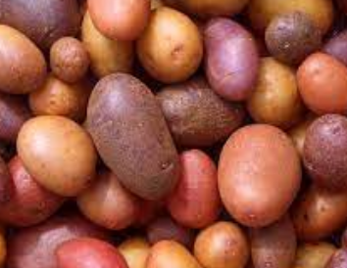
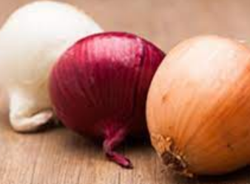
Duration: Light duration or Photoperiodism refers to the amount of time that a plant is exposed to sunlight. Based on response to light period, plants may be classified into:
Long day plants (12-14 hours) : Examples- Potato, Onion, Lettuce, Cabbage

Slide 16
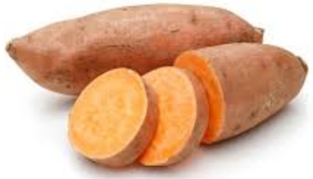
Short day plants (8-10 hours) : Examples- sweet potato, winged bean, cluster bean

Slide 17
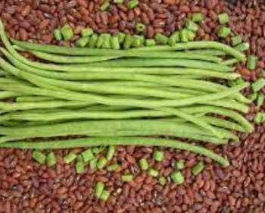
Day neutral plants (Photo-insensitive):
Examples- tomato, cowpea, cucurbitaceous vegetable crops

Slide 18
Thank You ….

