Slide 1
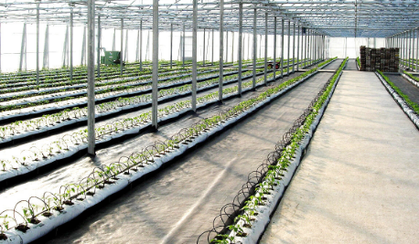
Center for Smart Agriculture Protected cultivation of vegetable crops
Module 5: Nutrient management
Session 11: Fertigation system and forms of inorganic fertilizers

Slide 2
Fertigation: Fertigation is the application of required fertilisers/plant nutrients (water soluble) with the irrigation water at a slow and controlled rate to meet the nutritional requirements at different stages of crop growth.
In fertigation system an automatic mixing and dispensing unit is installed which consists of three systems pump and a supplying device.
The fertilizers are dissolved separately in tanks and are mixed in a given ratio and supplied to the plants through drippers.

Slide 3
Fertilizer dosage has to be dependent on growing media.
Soilless mixes - more frequent fertilizer application.
pH range of 5.5 to 6.5.
Micro elements- lower pH ranges
Macro elements - at pH 6 and higher.

Slide 4
FERTIGATION
Advantages:
Relatively uniform fertilizer applications
Flexibility in timing of applications
Less fertilizers used
Reduced costs

Slide 5
Disadvantages:
Potential contamination hazard from equipment malfunctions
Backflow prevention devices required
Careful handling of liquid fertilizers required

Slide 7
Forms of inorganic fertilizers
Dry fertilizers
Slow release fertilizer
Liquid fertilizer

Slide 8
Slow release fertilizer :
They release the nutrient into the medium over a period of several months.
These fertilizer granules are coated with porous plastic.
They released slowly into the root medium.
Heating melts the plastic coating

Slide 9
Liquid fertilizer:
These are 100 per cent water soluble.
These comes in powdered form.
This can be either single nutrient or complete fertilizer.
They have to be dissolved in warm water.

Slide 10
Thank you…

