Slide 1
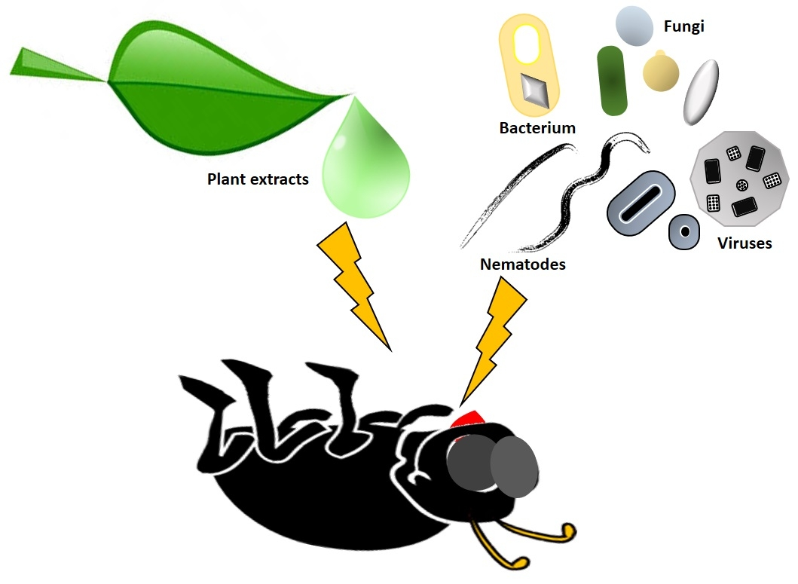
Center for Smart Agriculture
Bio fertilizer and Bio pesticide Production Technology
Module 1:
Session1: Isolation and purification of important bio pesticides

Slide 2
Pest: A pest is an organism, living and growing where they are not wanted and can cause an economical damage to plants, humans, structures, and other creatures, including crops that are grown for food.
Pesticide: Pesticides are chemical substances that are meant to kill pests.
Bio pesticide: A naturally occurring or derived substance or an organism or its part that controls pests.

Slide 3
Most commonly used microorganisms for the preparation of bio pesticides are:
1. Trichoderma
2. Pseudomonas
3. Bacillus
4. Metarhyzium
All these microbes are present in the natural environment. For their utilization, we have to isolate them from their natural habitat

Slide 4
Trichoderma as biopesticide
Several strains of Trichoderma have been developed as biocontrol agents against fungal diseases of plants.
The various mechanisms include antibiosis, parasitism, inducing host-plant resistance, and competition.
Most biocontrol agents are from the species T. asperellum, T. harzianum, T. viride and T. hamatum. The biocontrol agent generally grows in its natural habitat on the root surface, and so affects root disease in particular, but can also be effective against foliar diseases.

Slide 5
Isolation and Purification of Trichoderma
Trichoderma is a genus of fungi in the family Hypocreaceae, that is present in all soils, and they are the most prevalent culturable fungi.
Many species in this genus can be characterized as opportunistic avirulent plant symbionts.
This refers to the ability of several Trichoderma species to form mutualistic endophytic relationships with several plant species.

Slide 6
Kingdom : Fungi
Division : Ascomycota
Class : Sordariomycetes
Order : Hypocreales
Family : Hypocreaceae
Genus : Trichoderma

Slide 7
Cultural characteristics of Trichoderma
Cultures are typically fast growing at 25–30°C, but some species of Trichoderma grows at 45°C. Colonies are seen transparent or white on potato dextrose agar (PDA) medium. A yellow pigment may be secreted into the agar, especially on PDA. Some species produce a characteristic sweet or 'coconut' odor.
Fig 1: Initial and final mycelial growth of Trichoderma

Slide 8
Method for isolation of Trichoderma
Several methods are available for the isolation of Trichoderma, however, one of the common and easy method is serial dilution method.
Materials needed
Soil sample from which isolation has to be done
Conical flasks of 50 ml volume
Distilled water
Micropipette of 1 ml volume
Test tubes
Nonabsorbent cotton
Petri plates
Para film tape
Trichoderma Specific media

Slide 9
Trichoderma Specific media:
Ingredients gm/liter
Magnesium sulphate heptahydrate 0.20
Dipotassium hydrogen phosphate 0.90
Ammonium nitrate 1.00
Potassium chloride 0.15
Glucose(Dextrose) 3.00
Rose Bengal 0.15
Agar 20.00
Magnesium sulphate heptahydrate 0.20
Rose Bengal should be added to medium after sterilization and before transferring to plates.

Slide 10
Procedure:
1. Soil samples are collected, air dried, and ground into powder.
2. Stock solution of sample is prepared by dissolving 10 g of powdered soil sample into 90 mL of distilled water.
3. Serial dilution of samples prepared as 10⁻¹, 10⁻²…10⁻⁵ in distilled water.
4. One milliliter of each of the prepared dilution is spread evenly on a suitable autoclaved medium on autoclaved petri dish at 28 ± 1°C for 7 days.
5. After growth of fungus, pure culture of the microbe should be done in test tube slants with suitable autoclaved media.
Note: All the glasswares and media used should be autoclaved and the work should be done in aseptic condition of laminar air flow after wearing of gloves and masks.

Slide 12
Harmful Trichoderma
T. aggressivum or T. harzianum biotype 4 is the causal agent of green mold, a disease of cultivated button mushrooms. T. viride is the causal agent of green mold rot of onion and causes die back disease of Pinus nigra seedlings.

Slide 13
Pseudomonas as bio pesticide:
Pseudomonads belong to Plant Growth Promoting Rhizobacteria (PGPR), the important group of bacteria that play a major role in the plant growth promotion, induced systemic resistance (ISR), biological control of pathogens etc.
Many species of Pseudomonas are known to enhance plant growth promotion and reduce severity of various diseases. Pseudomonads are common Gram-negative, rod-shaped bacterium, belongs to the Pseudomonas genus.

Slide 14
Domain : Bacteria
Phylum : Proteobacteria
Class : Gammaproteobacteria
Order : Pseudomonadales
Family : Pseudomonadaceae
Genus : Pseudomonas

Slide 15
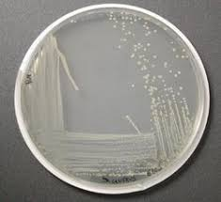
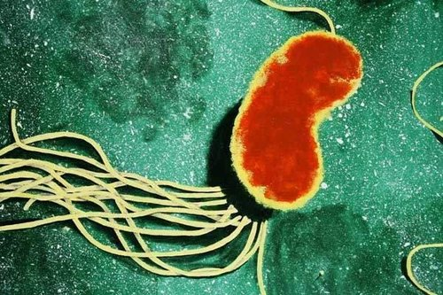
General characteristics of Pseudomonas
Pseudomonas has multiple flagella. It has an extremely versatile metabolism, and can be found in the soil and in water. It is an obligate aerobe, but certain strains are capable of using nitrate instead of oxygen as a final electron acceptor during cellular respiration. Optimal temperatures for growth is 25–30° C.
Fig. 2: Colony of Pseudomonas and flagella as seen under microscope

Slide 16
Materials needed and procedure for isolation of
Pseudomonas is same as that of Trichoderma,
but the serial dilution for Pseudomonas goes up
to 7-8 times and the medium used is Pseudomonas specific media and rest all the protocols are similar to that of Trichoderma.
Pseudomonas Specific media:
Ingredients | gm/liter
Peptone | 20.00
Magnesium chloride | 1.40
Potassium sulphate | 10.00
Triclosan (Irgasan) | 0.025
Agar | 13.60
Final pH ( at 25°C) | 7.0±0.2

Slide 17
General characteristics of Bacillus
Bacillus is a genus of Gram-positive, rod-shaped bacteria. The term is also used to describe the shape (rod) of certain bacteria; and the plural Bacilli is the name of the class of bacteria to which this genus belongs. Bacillus species can be either obligate aerobes, oxygen dependent or facultative anaerobes, having the ability to continue living in the absence of oxygen.

Slide 18
Domain : Bacteria
Phylum : Firmicutes
Class : Bacilli
Order : Bacillales
Family : Baciilaceae
Genus : Bacillus

Slide 19
Materials needed and procedure for isolation
of Bacillus is same as that of Trichoderma,
but the serial dilution for Bacillus goes up to
7-8 times and the medium used is Bacillus
specific media and rest all the
protocols are similar to that of Trichoderma.
Bacillus Specific media:
Ingredients | gm/liter
L-Glutamic acid | 4.00
Citric acid | 2.00
Dipotassium hydrogen phosphate | 0.50
Ferric ammonium citrate | 0.50
Magnesium sulphate | 0.50
Final pH ( at 25°C) | 7.4±0.2

Slide 20
General Characteristics of Metarhizium:
In the 1990s, the LUBILOSA research programme proved that M. acridum in its spore form was effective in killing locusts and other members of the Acrididea families with no deleterious effects found in field trials on any non-target species except for the domesticated silk worm Bombyx mori. Metarhizium is a genus of entomopathogenic fungi in the Clavicipitaceae family.

Slide 21
Kingdom | : | Fungi
Division | : | Ascomycota
Class | : | Sordariomycetes
Sub class | : | Hypocreomycetidaae
Order | : | Hypocreales
Family | : | Clavicipitaceae
Genus | : | Metarhizium

Slide 22
Materials needed and procedure for isolation of
Metarhizium is same as that of Trichoderma, but the
medium used is Metarhizium specific media and rest
all the protocols are similar to
that of Trichoderma.
Metarhizium Specific media:
Ingredients | gm/liter
Potassium dihydrogen Phosphate | 0.50
Dipotassium hydrogen phosphate | 0.50
Peptone | 0.50
Magnesium sulphate | 0.50
Dextrose | 10.00
Yeast extraxt | 0.50
Rose Bengal | 0.05
Streptomycin sulphate | 0.03
Rose Bengal and streptomycin sulphate should be added to medium after sterilization and before transferring to plates

