Slide 1
Improvised Explosive Devices

Slide 2
What is an IED
Today bombs are popularly known as Improvised explosive devices. Then how is it different ???
  It could be in any shape and size
  May be operated electrically or mechanically
    Designed to explode while handling or
    by use of delay mechanism or
    ambient condition or
    By remote control devices

Slide 3
Component of IED or bomb mechanism
An standard IED or bomb mechanism consists of
  Explosive
  Detonators
  Power Sources
  Switches

Slide 4
EXPLOSIVE TRAIN
FLAME PRODUCER
FLAME CARRIER
CONVERTING FLAME INTO DETONATION
DETONATION WAVE CARRIER
BOOSTER
MAIN CHARGE

Slide 5
Power source
+
-
Switch
Detonator
Explosive

Slide 6
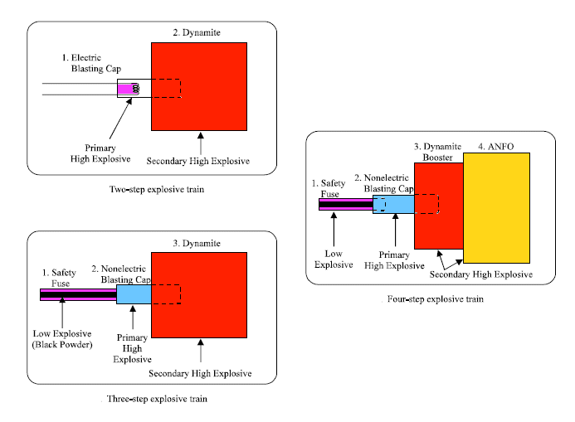

Slide 7
Switches :
  Anti handling –
  pressure
  pressure release
  pull
  tilt
  vibration
  mercury switches etc.

Slide 8
Switches :
  Delayed switch
  Mechanical -
  clock work,
  thermal
  chemical
  electrochemical
  Electronic

Slide 9
Ambient Condition
  smoke or gas.
  sound
  proximity
Remote Control
  radio control
  wire control
  FM control

Slide 10
Clock work delay IED Circuit
Clock
Detonator
Explosive
Battery

Slide 11
Aim of designing of an IED
  designed,
  Manufactured by terrorist
  Planted
  with an aim of
  creating panic to General Public
  Kill VIPs
  cause extensive damage to Govt./ private property
  cause extensive damage to economic installations etc
  To hide any other crime

Slide 12
Types of IEDs
Some of the IED’s
  Brief-case
  Gift packet
  Perfume bottle
  Thermos flask
  Soap case
  Cigarette packet
  Ghee tin/Milk tin
  Letter and Book
  Telephone etc.

Slide 13
  Petrol bomb
  Human bomb
  Jute bomb
  Car/scooter bomb
  Tiffin box bomb
  Soft drink can bomb
  Cycle bomb
  Television/radio bomb
  Aero model bomb etc.

Slide 14
The Explosive Act
The INDIAN Explosive Act 1884
(Indian Word omitted w.e.f 2-3-1983)
“Explosive” means gunpowder, nitroglycerine, nitroglycol,
guncotton, DNT, TNT, picric acid, dinitrophenol, styphnic
acid, RDX, PETN, tetryl, lead azide ect etc includes fire
works, detonators, ammunition of all descriptions etc.

Slide 15
Explosive Substance Act 1908
The expression “Explosive substance” include any materials for making any explosive substance, also any apparatus, machine, implement or material used, or intended to be used, or adapted for causing, or aiding in causing, any explosion in or with any explosive substances; also any part of any such apparatus, machine or implement.
(b) The expression “special category explosive substace”
includes TNT, RDX, PETN, HMX Tetryl, CE, PEK, or any
combination thereof and remote control devices etc.

Slide 16
Delay mechanism
Clock work delay
Chemical delay
Material fatigue
Cigarette & Matchbox delay
Electronic delay(8min 32sec to 194days 4 hour 20 min)

Slide 17
Ambient Condition Switches
Gas/Smoke Sensitive
Metal Sensitive
X-Ray sensitive
Light Sensors

Slide 18
Remote Control switches
Radio Control
Command Wire
Infrared

Slide 20
EXPLOSION SIGNATURES
PERMANENT DISTORTION OF OBJECT
a) Plastic deformation
b) Dishing of metal plates
c) Fractures
FRAGMENT ATTACK
DISPLACEMENT OF OBJECTS
FLAME & HEAT MARK
EFFECTS ON PRESSURE

Slide 21
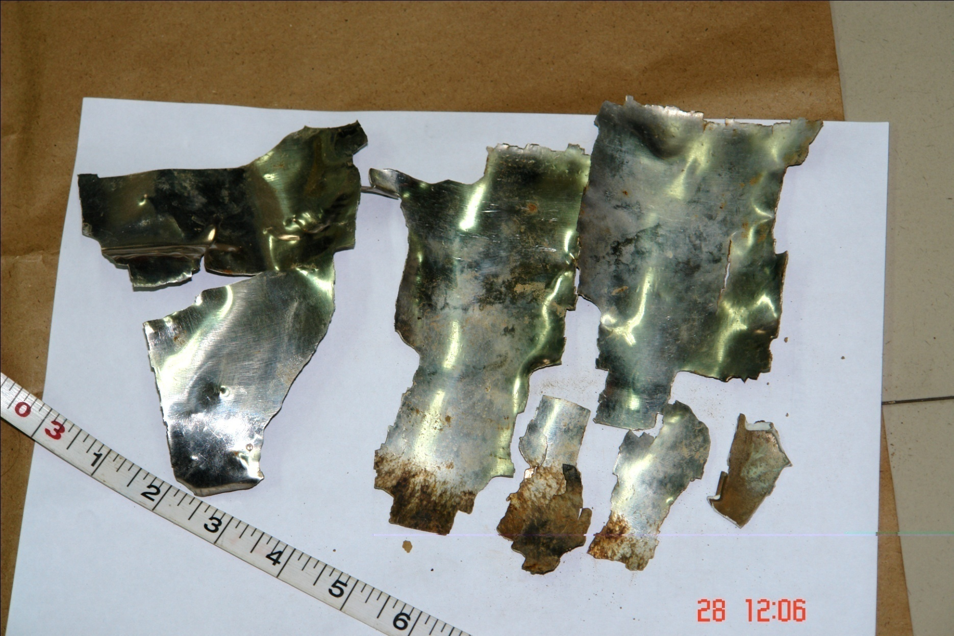

Slide 22
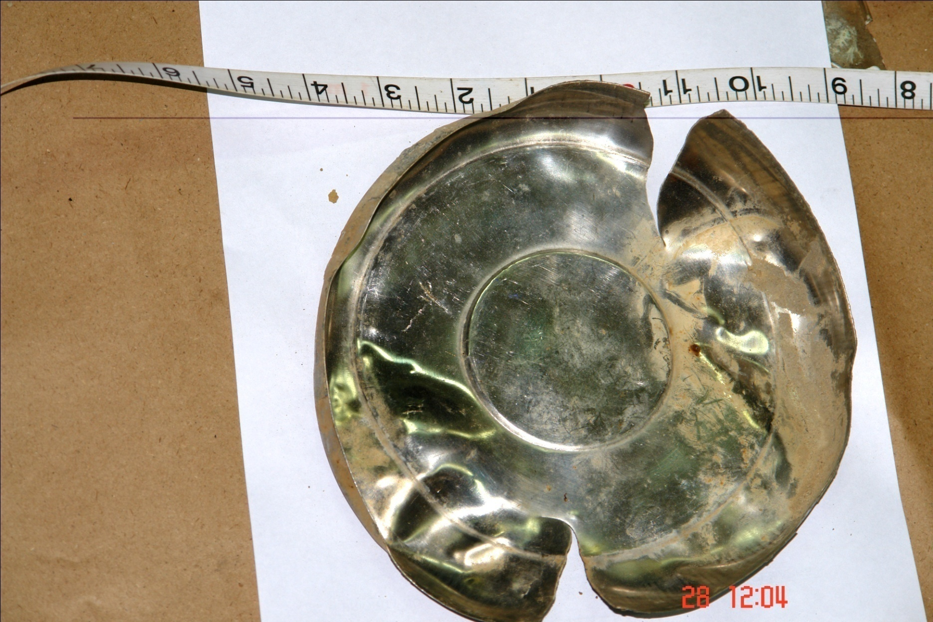

Slide 23
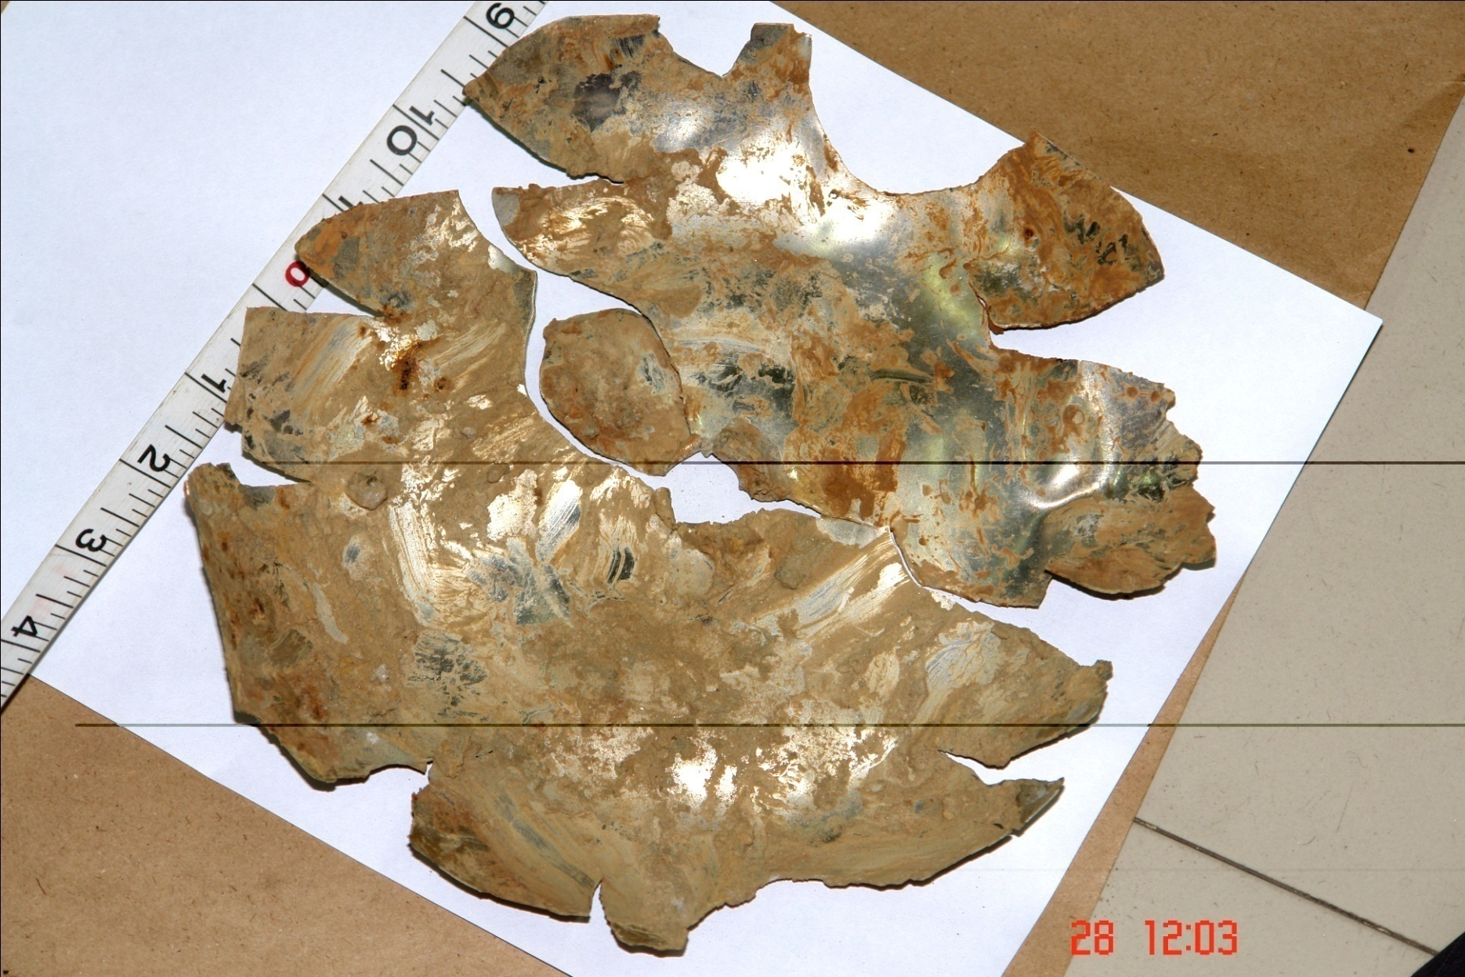

Slide 24
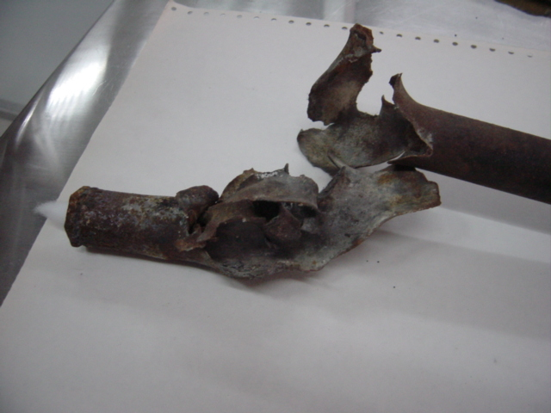
Deformed pipe bomb

Slide 25
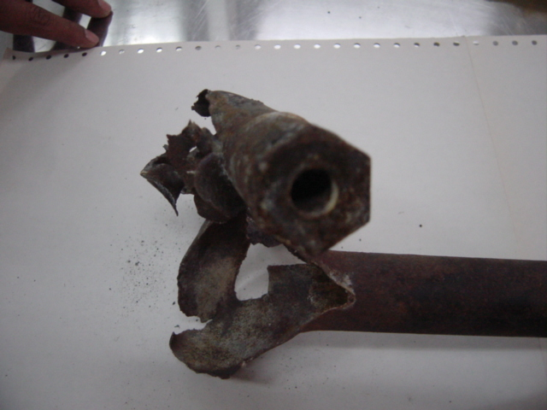
Parts of Pipe bomb

Slide 26
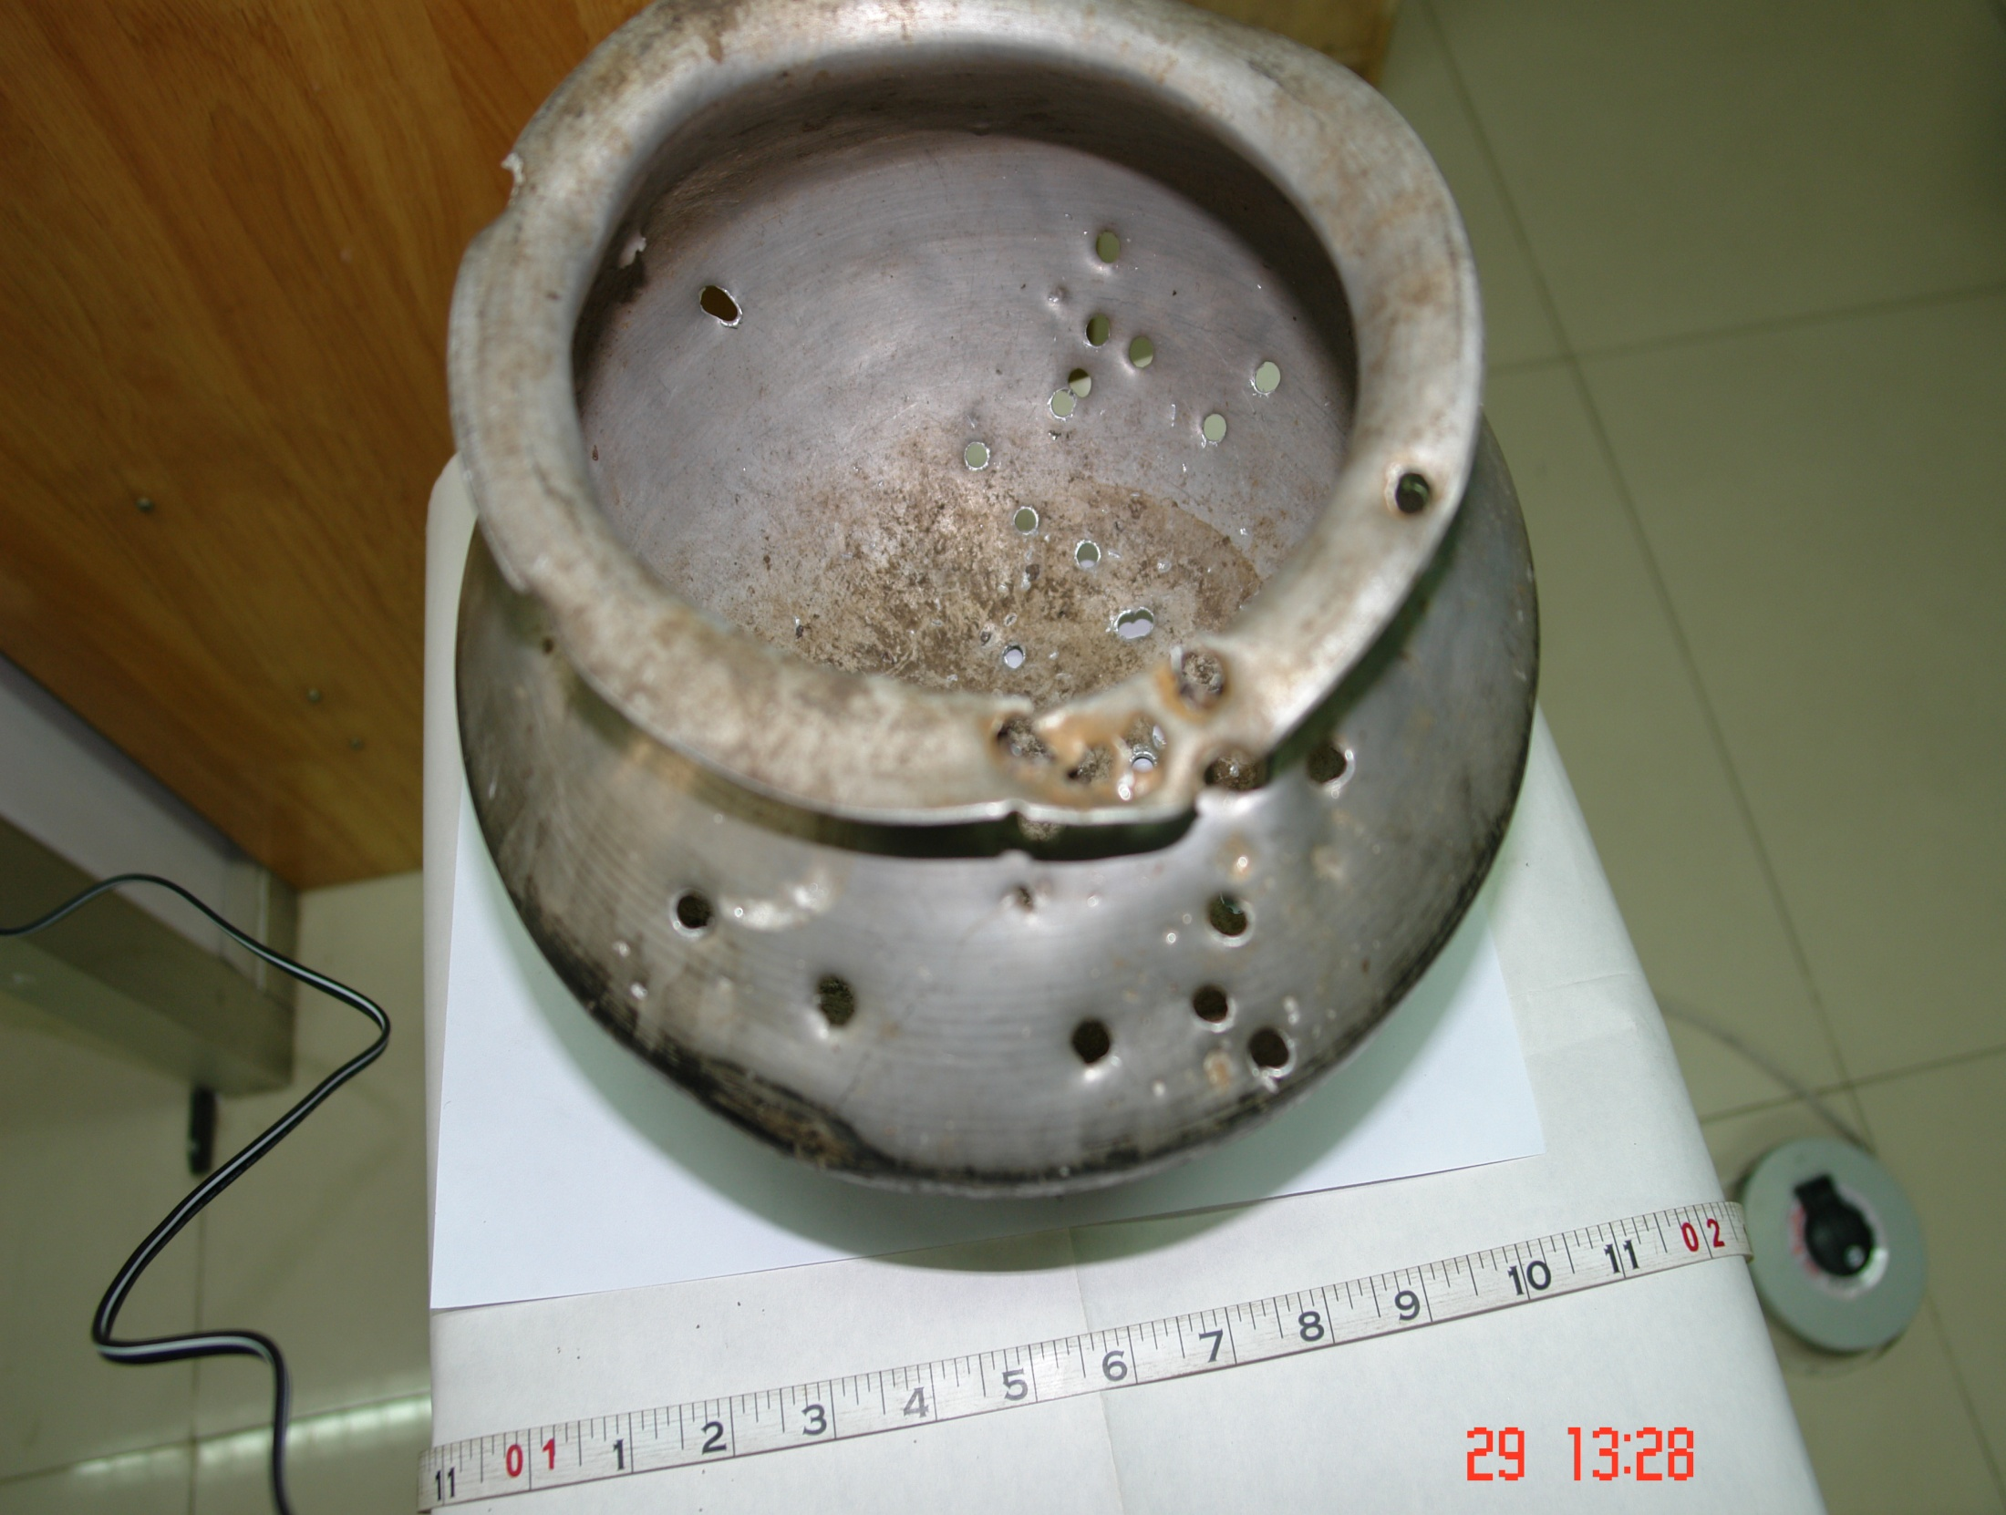

Slide 27
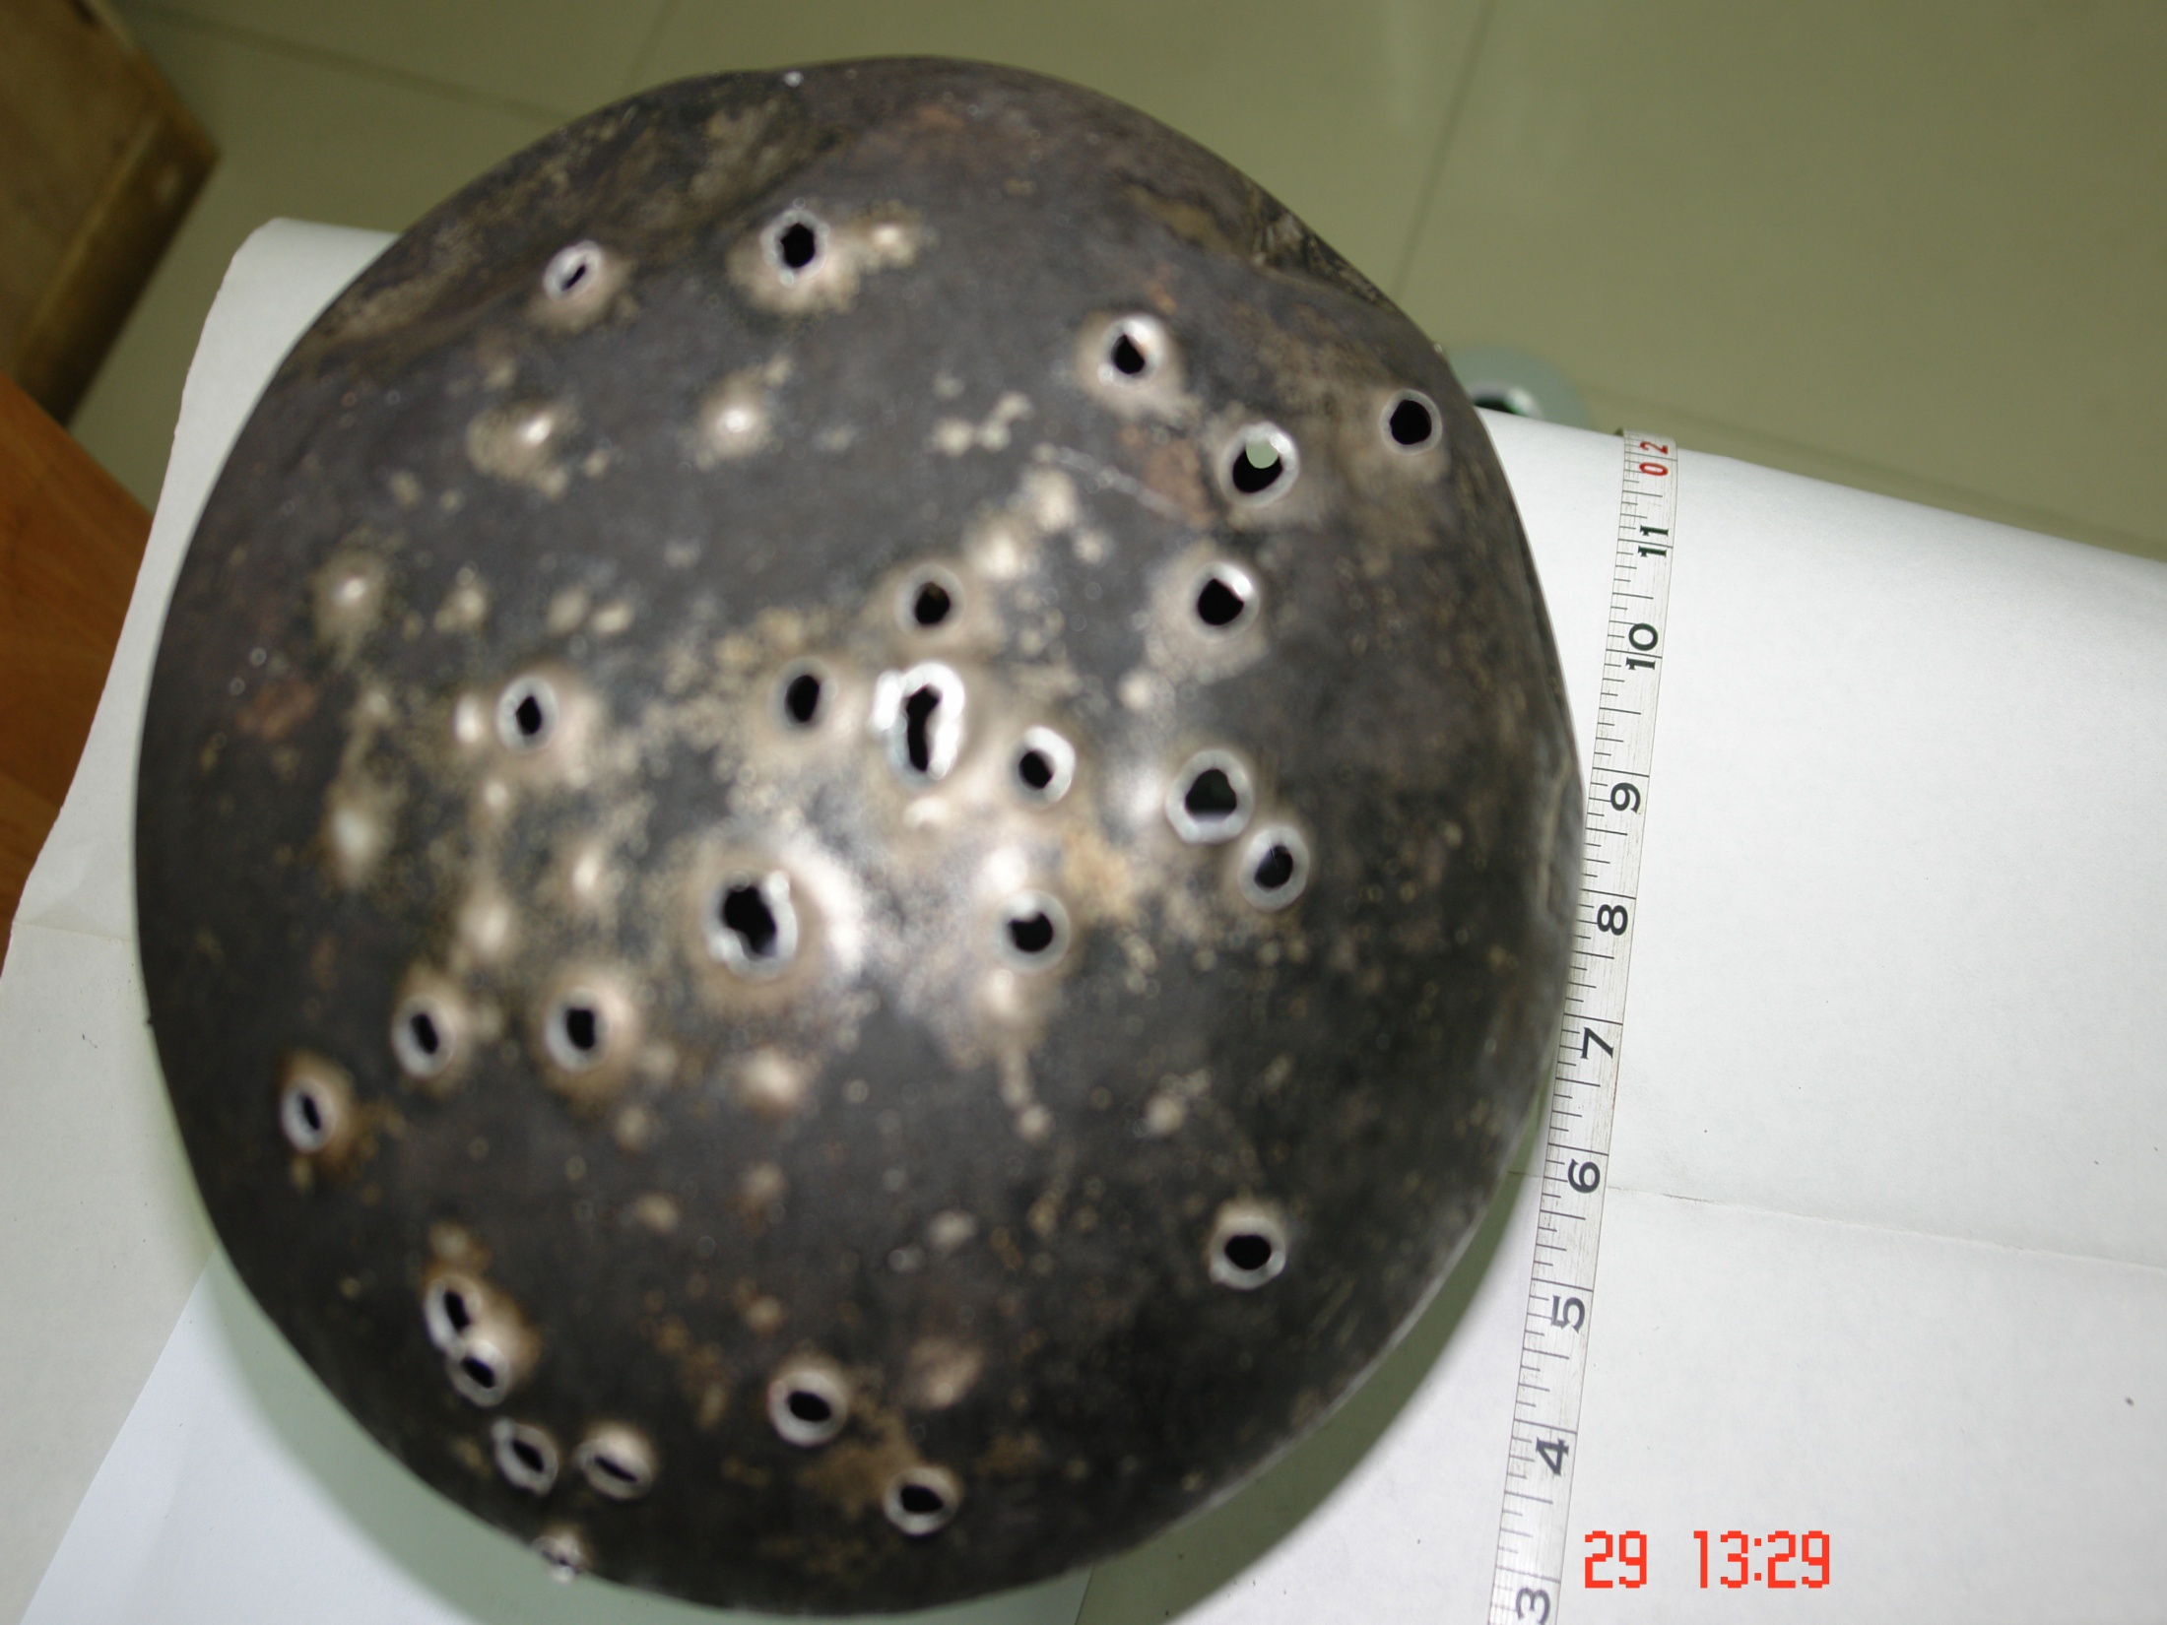

Slide 28
INJURY TO PERSONS
Blast pressure wave
Fragments injury
Burn injury

Slide 29
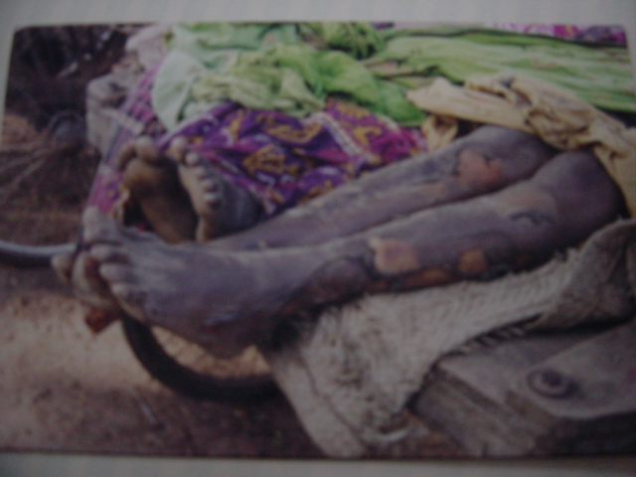
Burn injury in an low explosive explosion case

Slide 30
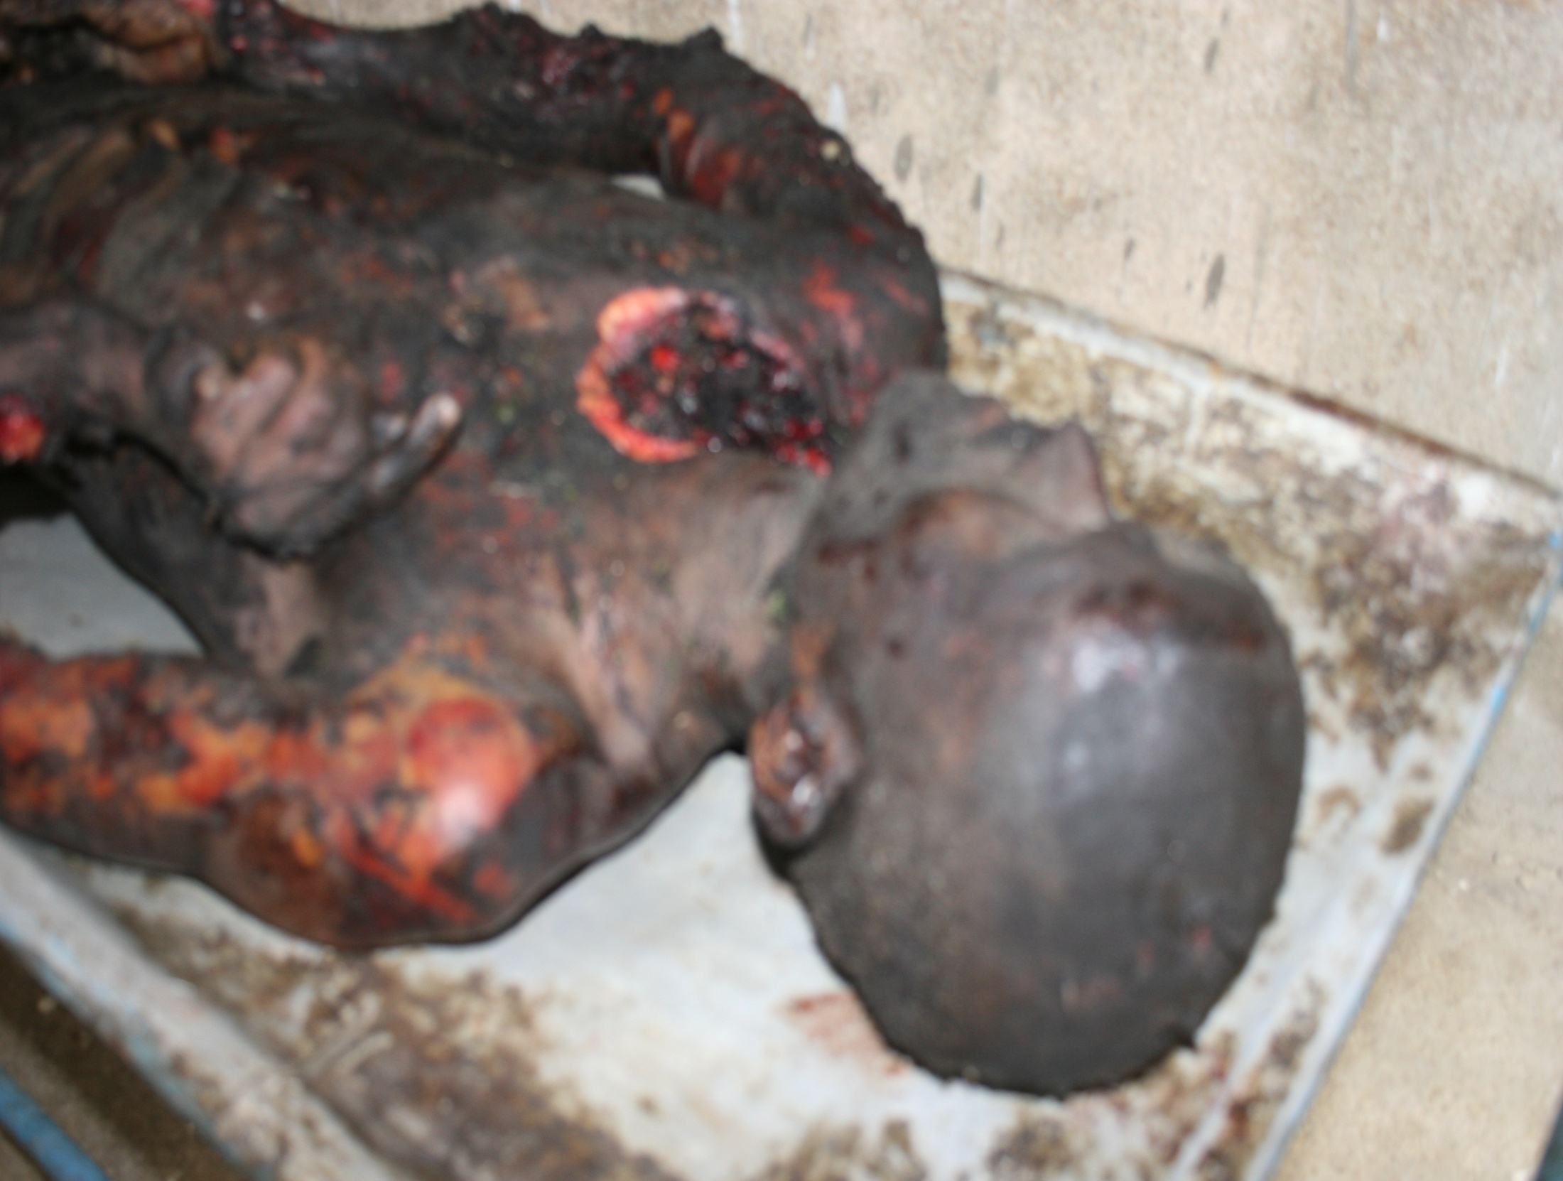

Slide 31
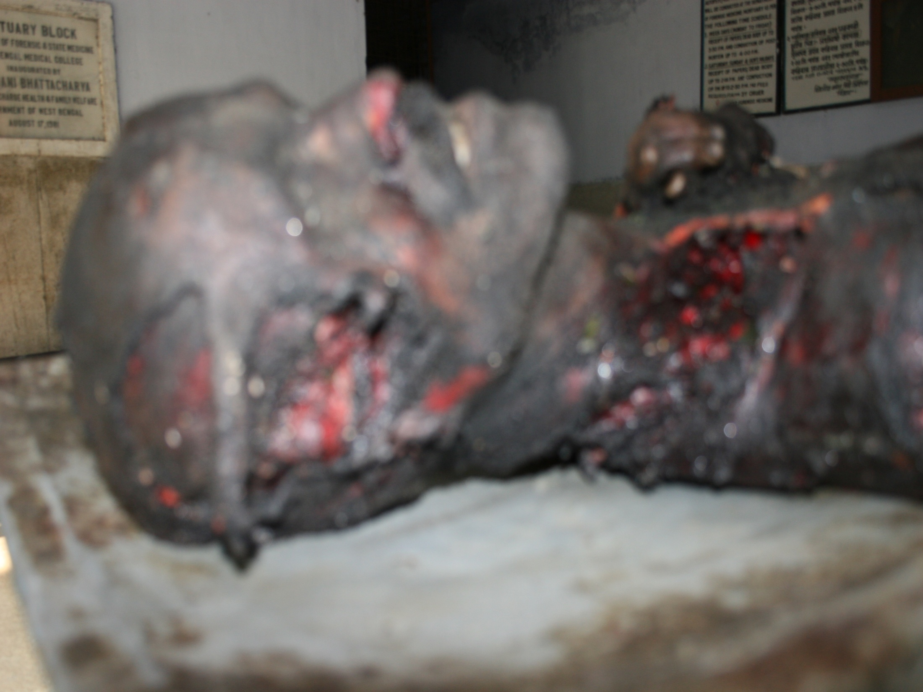

Slide 32
SEAT OF EXPLOSION
IDENTIFICATION OF SEAT OF EXPLOSION

Slide 33
CRATER
D³=16W
D =METER,W=KG

Slide 34
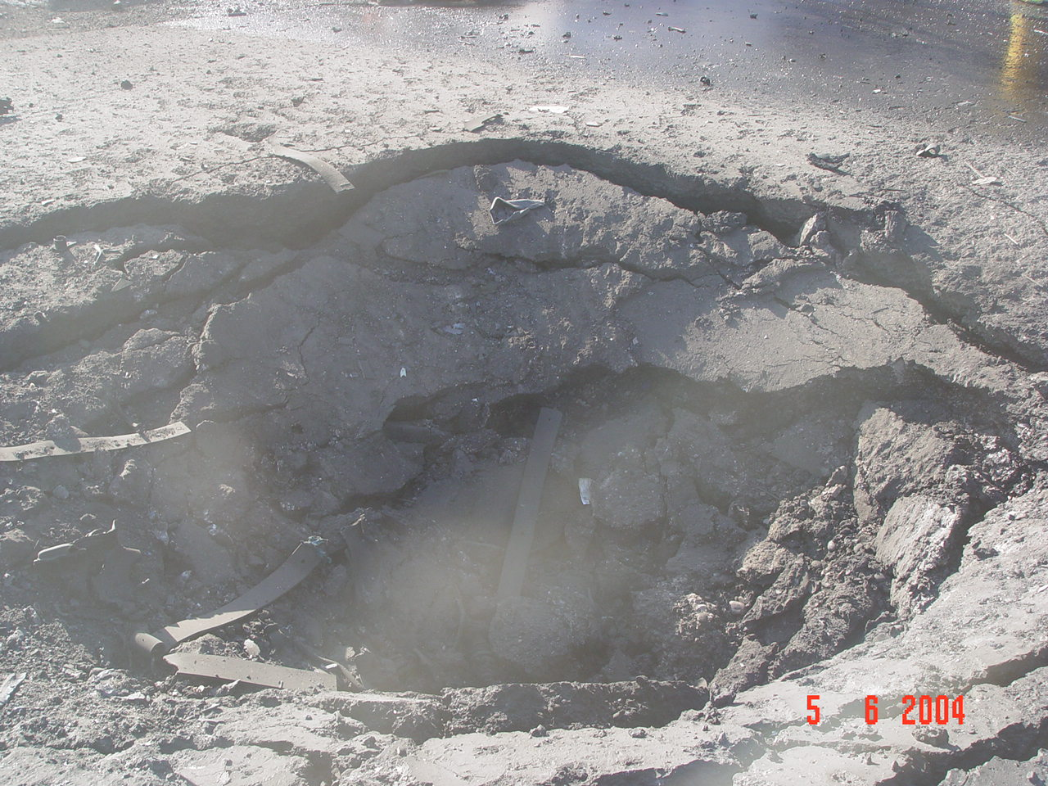

Slide 35
PRIMARY FRAGMENTS
CASING OF DEVICE
MARKING
PAINTS
MATERIAL
INITIATING MECHANISM FRAGMENT
FRAGMENTS FROM SWITCHES
FRAGMENTS FROM POWER SOURCES

Slide 36
High Low
Shattering No shattering
Detonation Deflagration
Small diameter but wide diameter
deeper crater
4. Small fragments bigger fragments
5. Cutting effect bending effect
Confinement Confinement
Independent dependent

Slide 37
DIFFERENCE BETWEEN LOW AND HIGH EXPLOSIVE
LOW | HIGH
LESS SHATTERING EFFECT WIDE DIAMETER CRATER GRADUAL SLOPING BIGGER FRAGMENTS INTENSE HEAT EFFECT, LITTLE OR MODERATE BLAST EFFECT DEPENDENT ON CONFINEMENT BENDING EFFECT | MORE SHATTERING EFFECT SMALL DIAMETER BUT DEEPER SLOPE VERY STEEP SMALLER FRAGMENTS SEVERE BLAST EFFECT INDEPENDENT OF CONFINEMENT CUTTING EFFECT

Slide 38
FREQUENTLY ASKED QUESTIONS
WHAT KIND OF EXPLOSIVE
HOW MUCH EXPLOSIVES ARE USED
WHAT COULD BE THE TRIGGERING MECHANISM

Slide 39
POST EXPLOSION ANALYSIS
EXTRACTION
CHEMICAL TEST
INSTRUMENTAL ANALYSIS
THIN LAYER CHROMATOGRAPHY
HIGH PERFORMANCE THIN LAYER
CHROMATOGRAPHY
H.P.L.C.
I.R.
G.C.
G.C. MASS
I.C.

Slide 40
Do’s and Don’ts if an IED found

Slide 41
Don'ts
1. Do not touch or remove packet unless duty bound.
2. Do not open the package with hands.
3. Do not puncture the package. .
4. Do not submerge the package In water.
5. Do not cut or pullout the strings or wire.
6. Do not pass the metallic object over the package.
7.Do not accept the identification marks on the package on the face value.
8.Do not bring a bomb or suspected object in police station or security control room.
9.Do not use radio in the vicinity of bomb.

Slide 42
10. Do not transport the suspected object through congested area.
11.Do not transport the suspected object . Do not transport the suspected object .
11. 12.Evacuate the people to safe distance. Always evacuate the people and NOT the BOMB.
12. 13.Do not direct a flash light on the bomb.
13. 14.Do not cover the object.
14. 15.Do not permit re-entry of people until objects are removed.
15. 16.Do not be a DEAD HERO. You can construct a building or house but you can not make dead man alive.

Slide 43
Do’s
Do evacuate men immediately to a safe distance.
Open all windows and doors.
Place sand bags around the suspected object.
Inform Bomb Disposal Squad.
Inform Fire Brigade, Hospital and Ambulance.
Do handle the package alone if you are duty bound to handle.
7. Remove all inflammable items.

Slide 44
Dos
Actions before bomb call
1. Selection/nomination of persons
2. Training
3. Equip them
4. Prepare contingency plan
5. Prepare search plan
6. Prepare evacuation plan
Educate officers and staff on telephone threats
Rehearsals

Slide 45
Golden rules of Handling
Use rubber gloves- Do not touch anything with bare hands
Avoid the temptation of picking up an article immediately on
seeing it.
Carefully examine the article externally before touching it and then handle it accordingly.
After the preliminary examination (before touching the article) make a record in writing of the exact spot where it was found.
Handling should be as minimum as possible and should be done in such a way as to leave the article as nearly as possible in its original condition.

Slide 46
Handling should be a little bit abnormal, i.e., hold the article only by such parts as are unlikely to have been touched by the previous users whose finger impressions may be on them
Use forceps to pick up a small article
Main attention to be paid to see that your handling should not disturb or obliterate any trace which may subsequently prove to be of great importance.

Slide 47
Packing and Labeling
1.Each article should be separately packed and labeled indicating the serial number of the item.
2.Two or more items should never be packed together.
3.The labels should numbered consecutively and should bear the signature of the forwarding officer and the case number and date of his letter of advice .
4 So far as possible , all such packets belonging to one case should be enclosed one box or outer covering to for a parcel.
5.Packets of articles belonging to different cases should never be enclosed in one parcel.
6.Soil and other stiff loose materials are best stored in plastic bag or metallic container.
7. Sharp edged objects should not be allowed to pierce the sides of the plastic bag.
8. Pack the initiating device or the detonators separately with cotton wrapping.

Slide 48
Sealing
All parcels should be carefully sealed by the despatching officers and packed in such a manner that they cannot be opened without destroying the seals.
In one case, the same seal should be used throughout.
The specimen seal should be the same with the seals of the packets.

Slide 49
Forwarding
A letter of advice should be separately forwarded to the examiner concerned.
Forwarding letter should contain the following particulars:
a) report number
b) case reference
c) brief history of the case
d) description of articles in each packet
e) Nature of examination required
f) forwarding note of the officer through whom the articles are forwarded
g) name of the investigating officer
h) specimen seal used on the parcel
i) certificate of authority to examine

Slide 50
Chain of custody
The continuity or chain of custody of the exhibits must be insured in order to maintain its integrity.
there should be record of the names of the persons through whom the exhibits passed and to whom they were delivered together with the time and date

Slide 51
DESPATCH
Only by special messenger all sealed materials should be sent to forensic laboratory with proper specimen seal, authority letter.
Don’t send materials by postal means or by goods train.
If unexploded explosive materials and its initiating mechanism (detonator) are found then detonator must be packed with sufficient cotton and packing materials and kept in different containers .
Send only representative sample of the explosives and not the whole bulk.
Inform the station master that the explosives are being carried in the train.

Slide 52
Action on receipt of call
1. Inform Police/NSG/ Any BD Unit
2. Inform Superior Officers & IB
3. Inform Fire Station
4. Inform neighbouring premises
5. Detail Guides
6. Evacuate if need be
7. Assist Police and Bomb Squad
8. Start search as per plan
9. Keep Telephone free for incoming calls and man it.

Slide 53
Actions on locating the bomb
1. Isolate the bomb
2. Remove essential/important items
3. Inform Bomb Squad
4. Inform Superior Officers
5. Protective Works like use of sand bags/bomb blanket
6. Evacuate if not done earlier
7. Inform police/'Fire Service/Hospital
8. Post Guides
9. Assist Police / BD Squad

