Slide 1
FACTORS AFFECTING CULTIVATION

Slide 2
FACTORS AFFECTINGCULTIVATION
CLIMATIC CONDITIONS [A]ALTITUDE [B]TEMPERATURE [C]RAIN FALL
[D]TYPE OF SOIL [E]FERTILIZERS [F]PEST CONTROL

Slide 3
CULTIVATION DETAILS
TYPE OF PROPAGATION
TIME OF CULTIVATION
DURATION OF CROP
PREPARATION OF LAND
NURSERY BED
TRANSPLANTATION
IRRIGATION
FERTILIZERS
INTERCROPS
HARVESTING
YIELD
USE
STORAGE

Slide 4
ALTITUDE
EXAMPLES
TEA
CINCHONA
COFFEE
CLOVE
CARDAMOM
1000-1500m
1000-2000m
1500-2000m UPTO-900m 600-1600m

Slide 5
TEMPERATURE
EXAMPLES
CINCHONA
COFFEE
TEA
CARDAMOM
60-75F
55-70F
70-90F
50-100F

Slide 6
RAIN FALL OR IRRIGATION
EXCEPT THE XEROPHYTIC PLANTS LIKE ALOE, ACACIA AND FEW OTHERS, MOST OF THE PLANTS NEED EITHER PROPER ARRANGEMENTS FOR IRRIGATION OR SUFFICIENT RAINFALL FOR THEIR FAVOURABLE DEVELOPMENT.
IN FEW CASES, WELL DISTRIBUTED RAINFALL THROUHOUT THE YEAR IS DESIRED.

Slide 7
METHODS OF IRRIGATION
HAND WATERING
FLOOD WATERING
BOOM WATERING
DRIP IRRIGATION
SPRINKLER IRRIGATION

Slide 8


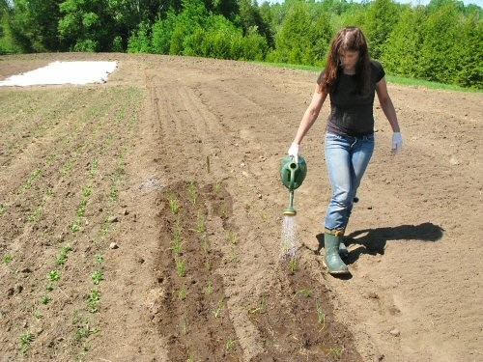
HAND WATERING

Slide 9
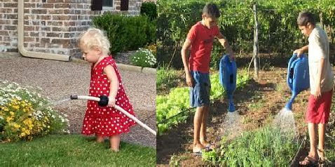
HAND WATERING

Slide 10
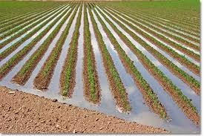
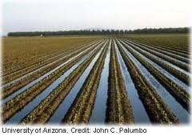
FLOOD WATERING

Slide 11
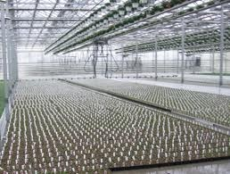
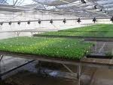
BOOM WATERING

Slide 12
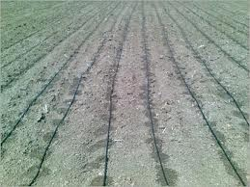
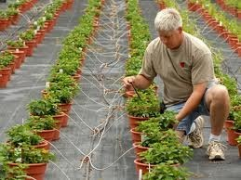
DRIP IRRIGATION

Slide 13
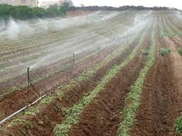
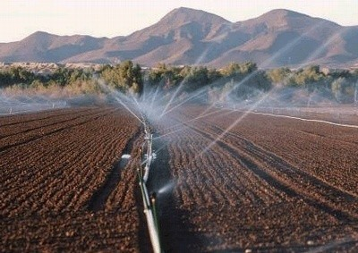
SPRINKLER
IRRIGATION

Slide 14
SOIL
DEPENDING UPON THE SIZE OF THE MINERAL MATTER.
PARTICLE SIZE
Less than 0.002mm
0.002-0.02mm
0.02-0.2mm
0.2-2.00mm
TYPE OF SOIL
fine clay
coarse clay(or)slit fine sand
coarse sand

Slide 15
DEPENDING UPON THE
PERCENTAGE COVERED BY CLAY
TYPE OF SOIL
Clay
Loamy
Silt loam
Sandy loam
Sandy soil
Cal carious soil
PERCENTAGE COVERED
more than 50% of clay 30 to 50%clay
20 to 30% of clay 10 to 20%of clay
more than 70% sand more than 20% of lime

Slide 16
SOIL FERTILITY
IT IS THE CAPACITY OF THE SOIL TO PROVIDE NUTRIENT IN ADEQUATE AMOUNTS AND IN BALANCED PROPORTION TO PLANTS.
SOIL FERTILITY CAN BE MAINTAINED BY ADDITION OF ANIMAL MANURES , NITROGEN- FIXING BACTERIA OR BY APPLICATION OF CHEMICAL FERTILIZERS.

Slide 17
FERTILIZERS
CHEMICAL FERTILIZERS
PRIMARY NUTRIENTS
N, P, K.
SECONDARY NUTIENTS
Copper, manganese, iron, boron etc.

Slide 18
MANNURES
FYM/COMPOST
CASTOR SEED CAKE
NEEM CAKES
VERMI COMPOST etc.

Slide 19
BIO FERTILIZERS
RHIZOBIUM
AZOTOBACTOR
AZOSPERILLIUM
BLUE GREEN ALGAE

Slide 20
PEST AND PEST CONTROL
TYPES
FUNGI
VIRUSES
INSECTS
WEEDS
NON-INSECT PESTS

Slide 21
METHODS OF PEST CONTROL
MECHANICAL
AGRICULTURAL
BIOLOGICAL
CHEMICAL
FUNGICIDES
HERBICIDES

Slide 22
MECHANICAL METHOD
THE SIMPLE TECHNIQUES USED ARE HAND- PICKING, PRUNING, TRAPPING OF PEST.
A
PROPER APPROACH IS MADE FOR
COLLECTION AND DESTRUCTION OF EGGS, LARVAE, PUPAE, ADULTS OF INSECTS.

Slide 23
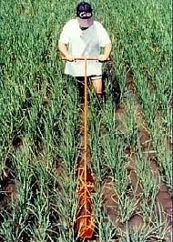
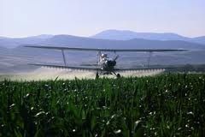
MECHANICAL
METHOD

Slide 24
AGRICULTURAL METHOD
IT COVERS ADVANCED PLANT BREEDING TECHNIQUES CAPABLE OF INDUCING GENETIC MANUPULATION RESULTING IN PRODUCTION OF PEST-RESISTANT SPECIES.
IT HAS PRODUCING RESISTANT ATTACK .
ACHIVED MUCH HYBRID VARIETIES
SUCCESS IN WHICH ARE
TO FUNGAL AND
BACTERIAL

Slide 25
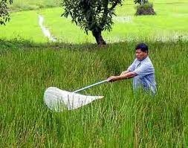
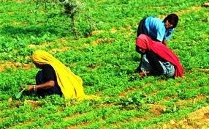
AGRICULTURAL
METHOD

Slide 26
BIOLLOGICAL METHOD
THIS METHOD IS PRACTISED BY THE PESTS, MOSTLY THE INSECTS LIVING ORGANISMS .
COMBATING WITH OTHER
IT MAY EMERGE AS AN EFFECTIVE SAFE AND ECONOMIC METHOD OF PEST CONTROL..

Slide 27
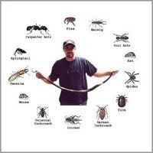
BIOLLOGICAL METHOD

Slide 28
COLLECTION OF MEDICINAL
PLANTS
HARVESTING
DRYING
NATURAL DRYING
ARTIFICIAL DRYING
TRAY DRYERS
VACCUM DRYERS
SPRAY DRYERS
PACKING
STORAGE & PRESERVATION OF CRUDE DRUGS.

Slide 29
HARVESTING
HARVESTING CAN BE DONE EFFICIENTLY IN EVWRY RESPECT BY THE SKILLED WORKERS..

Slide 30
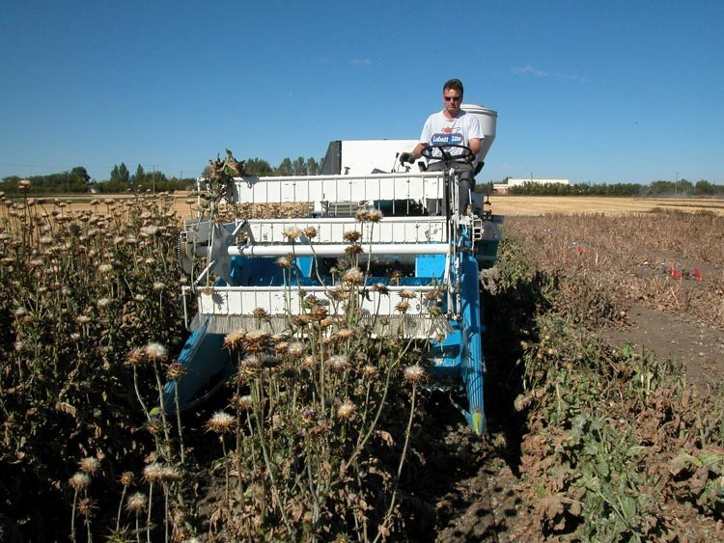
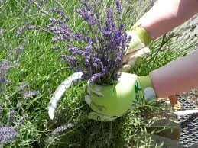
HARVESTING METHODS

Slide 31
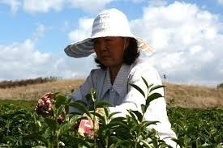
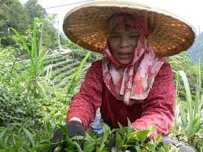
Leaf harvesting

Slide 32
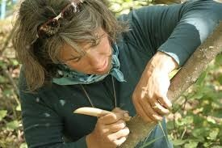
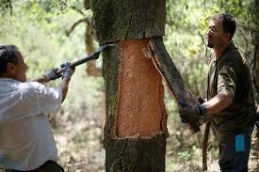
Bark harvesting

Slide 33
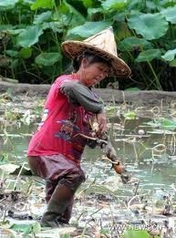
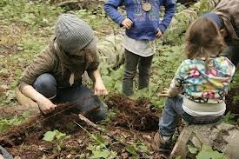
Root harvesting

Slide 34
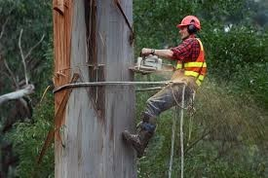
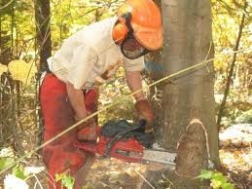
Wood harvesting

Slide 35
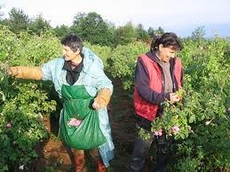
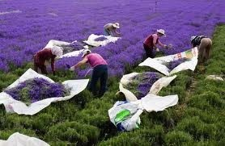
Flower harvesting

Slide 36
DRYING
DRYING CONSISTS OF
REMOVAL MOISTURE
OF SUFFICIENT
CONTENT OF CRUDE DRUG.
SO, AS TO IMPROVE ITS QUALITY AND MAKE IT RESISTANT TO THE GROWTH OF MICROORGANISMS.

Slide 37
NATURAL DRYING
IN CASE OF NATURAL DRYING IT MAY BE EITHER DIERCT SUN- DRYING OR IN THE SHED .
IF THE NATURAL COLOUR OF THE DRUG(DIGITALIS, CLOVE, SENNA) AND THE VOLATILE PRINCIPLE OF THE DRUG (PEPPERMINT)…

Slide 38
TRAY DRYERS
IN THIS THE
PROCESS
, HOT AIR OF
IS
DESIRED
TEMPERATURE
CIRCULATED
THROUGH
THE
DRYERS AND THIS THE REMOVEL OF
FACILITATES
WATER
CONTENT OF THE DRUG.

Slide 39
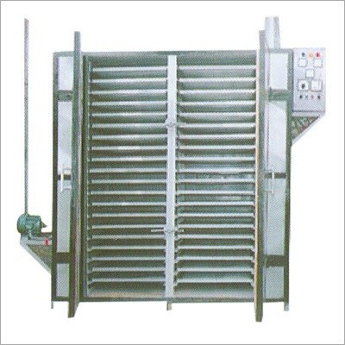
A. TRAY DRYERS

Slide 40
VACCUM DRYERS
THE DRUG WHICH ARE SENSITIVE TO HIGHER TEMPERATURE ARE DRIED BY THIS PROCESS
EX: TANNIC ACID, DIGITALIS LEAVES.

Slide 41
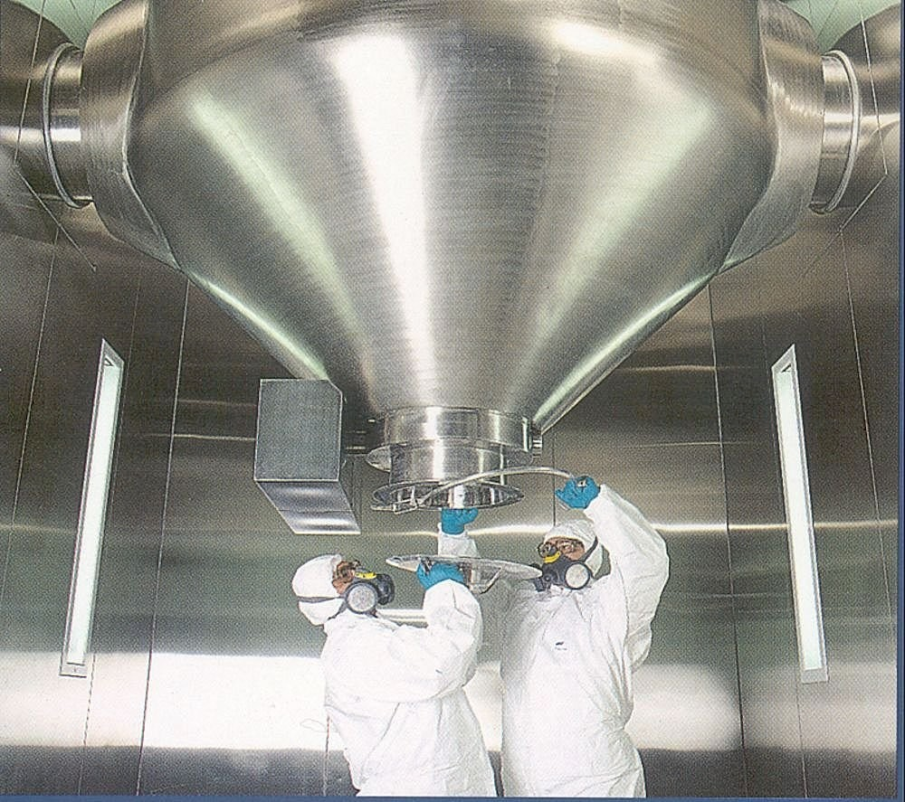
B.VACCUM DRYERS

Slide 42
SPRAY DRYERS
THE TECHNIQUE IS FOLLOWED FOR QUICK
DRYING
OF
ECONOMICALLY IMPORTANT PLANT OR ANIMAL CONSTITUENTS, RATHER THAN THE CRUDE DRUGS.

Slide 43
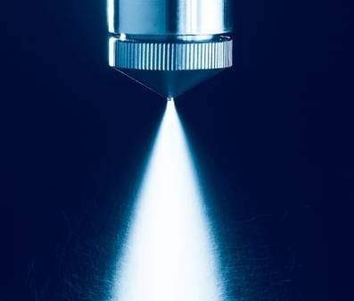
SPRAY DRYERS

Slide 44
GARBLING(DRESSING)
The next step in preparation of crude drug for market after drying is garbling.
This process is desired when sand, dirt & foreign organic parts of the same plant, not constituting drug are required to be removed.

Slide 45
PACKING
The morphological & chemical nature of drug, its ultimate use & effects of climatic conditions during transportation & storage should be taken into consideration while packing the drugs.
Aloe is packed in goat skin.
Colophony & balsam of tolu are packed in kerosene tins.
While asafoetida is stored in well closed containers to prevent loss of volatile oil.
The leaf drugs are stored in plastic bags.
The crude drugs like roots, barks, seed are packed in gunny bags.

Slide 46
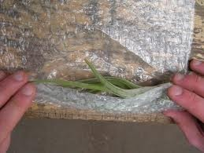
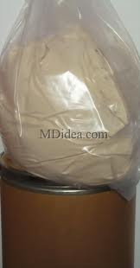

Slide 47
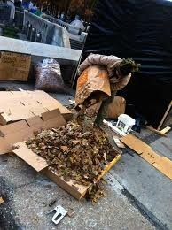
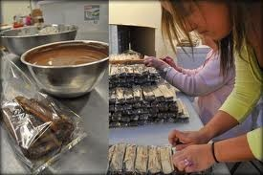

Slide 48
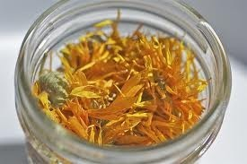
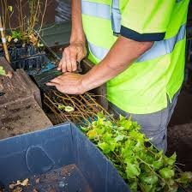

Slide 49
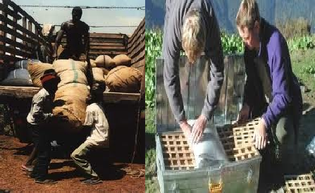

Slide 50
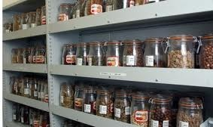

Slide 51
Storage & preservation o f
crude drugs:
Preservation of crude drugs needs should knowledge of their physical & chemical properties.
All the drugs should be preserved in well closed and possibly in the filled containers.
They should be stored in the premises which are water- proof, fire proof and rodent proof.
A number of drugs absorb moisture during their storage and become susceptible to the microbial growth.
Apart from protection against adverse physical and
or
chemical changes, the preservation against insect
mould attacks is also important.

Slide 52


