Slide 1
Plant Tissue Culture and their techniques
PREPARED BY :
LADI ALIK KUMAR
ASST PROFESSOR

Slide 2
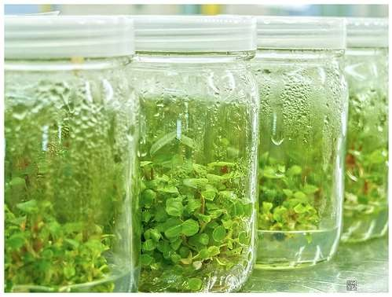
Plant Tissue Culture and their techniques

Slide 3
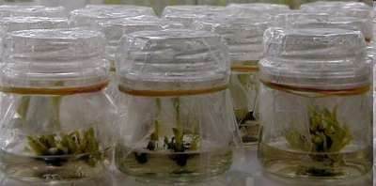
What is plant tissue culture?
Plant tissue culture is a technique of growing plant cells, tissues, organs, seeds or other plant parts in a sterile environment on a nutrient medium

Slide 5
Fundamental principles:
PTC depends upon
Totipotency :- It is the ability of plant cells to regenerate into a whole plant
Plasticity :- It is the ability of plants to alter their metabolism, growth and development to best suit their environment

Slide 6
Explant
Plant tissue cultures are generally initiated from multicellular tissue fragments, called explants, obtained from living plants. Explants may originate from a wide range of plant tissues, such as…
leaf, stem, root, petiole, hypocotyl, cotyledon, embryo, or meristem

Slide 7
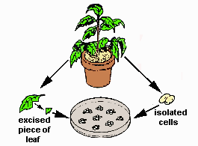
Selection of explant
The explant is selected it is either haploid or diploid explant
The plant growth can be achieved in two ways: 1.shoots directly by appropriate media
2.By somatic embryogenesis

Slide 8
Sterilization
 Sterilization Methods Used in Tissue CultureLaboratory - All thematerials, e.g., vessels, instruments, medium, plantmaterial, etc., used in culture work must be freedfrom microbes

Slide 9
STERILIZATION TECHNIQUES
sterilization is achieved by one of the following approaches:
(i) dry heat treatment
(ii) flame sterilization
(iii) autoclaving
(iv) filter sterilization
(v) wiping with 70% ethanol
(vi) surface sterilization.

Slide 10
Culture media
Explants are then usually placed on the surface of a solid culture medium, but are sometimes placed directly into a liquid medium, when cell suspension cultures are desired.
Culture media are generally composed of inorganic salts plus a few organic nutrients, vitamins and plant hormones.

Slide 11
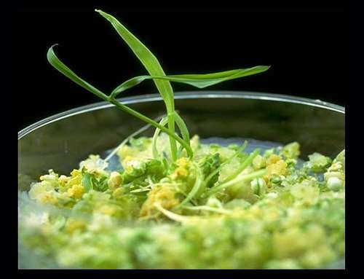
 As cultures grow, pieces are typically sliced off and transferred to new media (subcultured) to allow for growth or to alter the morphology of the culture.

Slide 12
MAJOR TYPES OF MEDIA
White’s medium - is one of the earliest plant tissue culture media
MS medium - formulated by Murashige and
Skoog (MS) is most widely used for many types of culture systems
B5 medium - developed by Gamborg for cell
suspension and callus cultures and at present it’s modified form used for protoplast culture
N6 medium - formulated by Chu and used for
cereal anther culture
-Nitsch’s medium developed by Nitsch and Nitsch and used for anther culture

Slide 16
Factors Affecting Tissue Culture Efficiency
Plant regeneration from tissue culture varies with the following parameters:
plant species,
genotype within the species,
source of the cultured tissue,
age and health of the donor plant,
nutrient medium, other factor

Slide 17
Plant Tissue Culture Applications
The commercial production of plants used as potting, landscape, and florist subjects
To conserve rare or endangered plant species.
To screen cells rather than plants for advantageous characters, e.g. herbicide resistance/tolerance.
Large-scale growth of plant cells in liquid culture
in bioreactors for production of valuable compounds, like plant-derived secondary metabolites and recombinant proteins used as biopharmaceuticals.

Slide 18
Plant Tissue Culture Applications
To cross distantly related species by protoplast fusion and regeneration of the novel hybrid.
To produce clean plant material from stock infected by viruses or other pathogens.
Production of identical sterile hybrid species can be obtained

Slide 19
Difference in PTC& Animal culture
It grow on at specific temperature i.e. normal temperature for human is 37°c.
Carbon dioxide is also require.
It needed proper change in media otherwise cells will not grow properly.
Animal cells needed protein and hormones for proper development

