Slide 1

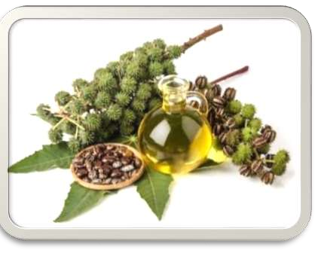
CASTOR OIL

Slide 2
SYNONYMS :
RICINUS OIL, OLEUM RICINI.
BIOLOGICAL SOURCE :
CASTOR OIL IS A FIXED OIL OBTAINED BY COLD EXPRESSION OF THE SEEDS OF RICINUS COMMUNIS FAMILY EUPHORBIACEAE.
GEOGRAPHICAL SOURCE :
CASTOR SEEDS ARE PRODUCED IN ALL TROPICAL AND SUBTROPICAL COUNTRIES.
BRAZIL, U.S.S.R., THAILAND, U.S.A., ROMANIA, INDIA. IN

Slide 3
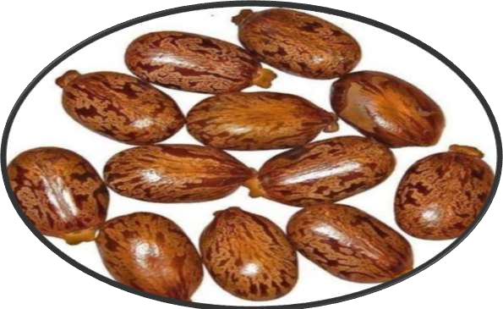
COMPOSITION OF SEEDS :
CASTOR OIL IS FIXED OIL OF THERAPEUTIC IMPORTANCE AND PURGATIVE IN ACTION, IT CANNOT BE CONSUMED FREELY.
SEEDS CONTAINS TOXIC SUBSTANCES.
SEEDS CONSIST OF 75% KERNEL AND 25% OF HULL.
SEEDS WEIGH FROM 0.1 TO 1GM.

Slide 4
DESCRIPTION :
COLOUR : PALE YELLOW OR COLOURLESS LIQUID.
ODOUR : SLIGHT AND CHARACTERISTIC
TASTE : BLAND THEN SLIGHTLY ACRID & NAUSEATING
IT IS VISCOUS AND TRANSPARENT LIQUID
IT IS SOLUBLE IN ALCOHOL. INSOLUBLE IN MINERAL OIL. MISCIBLE IN CHLOROFORM, SOLVENT ETHER, GLACIAL ACETIC ACID AND PETROLEUM ETHER.

Slide 5
STANDARDS :
WEIGHT PER ML : 0.945 TO 965 GM
ACID VALUE : NOT MORE THAN 2
IODINE VALUE : 80 TO 90
SAPONIFICATION VALUE : 176 TO 187
ACETYL VALUE : NOT LESS THAN 143
OPTICAL ROTATION : +3.5° TO +6.0°
SOLIDIFYING POINT : -10 TO -18°C
VISCOSITY : 6 TO 8 POISES

Slide 6
CHEMICAL CONSTITUENTS :
CASTOR OIL CONTAINS TRIGLYCERIDE OF RICINOLEIC ACID 80%.
THE VISCOSITY OF CASTOR OIL IS DUE TO RICINOLEIC ACID.
OTHER GLYCERIDES ARE ISORICINOLEIC, LINOLEIC, STEARIC AND ISOSTEARIC ACID.
IT CONTAINS HEPTALDEHYDE. UNDECENOIC ACID & SEBACIC ACID.
RICINOLEIC ACID : CH₃ (CH₂)₆ CHOHCH₂CH = CH (CH₂)₇COPY.

Slide 7

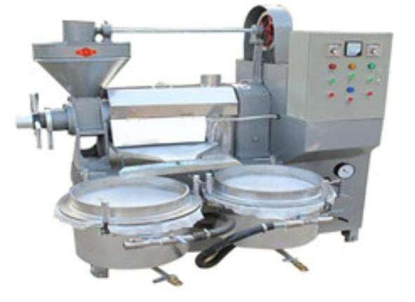
PREPARATION OFPREPAREAL CASTOR OIL :
CASTOR OIL IS PREPARED-
BY CRUSHING THE SEEDS IN HYDRAULIC PRESS AND
IN GHANI CONSISTS OF SCREW PRESS. THE OIL IS PRODUCED IS NON-MEDICINAL CASTOR OIL.

Slide 8
CONTI...
SEEDS ARE GRADED, IMPURITIES ARE REMOVED.
HULLS ARE REMOVED AND DECORTICATED, WHICH HELP IN CONTROLLING ACID VALUE AND IMPROVES THE COLOUR OF THE OIL.
THE CASTOR CAKE WITH HULLS INCREASE THE MANORIAL VALUE.
DECOR TICATED SEEDS ARE PRESSED UNDER HYDRAULIC PRESS WITH A PRESSURE OF 2 TONNES PER SQUARE INCH, IT HELPS IN EXTRACTING OUT 30% OF THE OIL PRESENT IN THE SEEDS AT ROOM

Slide 9
CONTI...
OIL IS KNOWN AS COLD DROWN OIL.
REST OF THE OIL IS REMOVED BY INCREASING THE PRESSURE, HOT PRESSING, OR SOLVENT EXTRACTION PROCESS.
THIS OIL IS NOT SUITABLE FOR MEDICAL PURPOSE.
THE COLD DROWN OIL IS STEAMED AT 80°C, TO DESTROY THE ENZYME LIPASE AND RECIN, THEN BLEACHED, DEACIDIFIED WITH SODIUM CARBONATE TO REMOVE FREE FATTY ACID.
IF NECESSARY, OIL IS WASHED WITH HOT WATER BEFORE STEAMING TO REMOVE THE MUCILAGINOUS

Slide 10

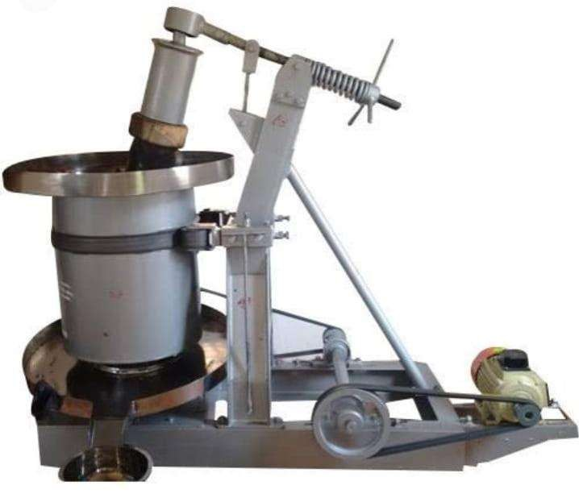
CONTI...
FINALLY IT IS TREATED WITH ACTIVATED EARTH OR ANIMAL CHARCOAL TO REMOVE THE IMPURITIES BY ADSORPTION AND FILLED INTO CONTAINERS.

Slide 11

CHEMICAL TEST :
Test | Observation | Inference
Castor oil + petroleum ether | Completely soluble in petroleum ether | Castor oil is present
Castor oil + equal volume of alcohol | Clear liquid at cool at 0°c for (3 hours) | Castor oil is present

Slide 12
USES :
CASTOR OIL IS CATHARTIC.
IT IS USED AS LUBRICANT, IN PAINTS, ENAMEL, VARNISH, GREASE, POLISH, PRINTING INK, HYDRAULIC AND BRAKE SPIRIT, AROMATIC CASTOR OIL, OR IN THE FORM OF CAPSULES, ABORTIFACIENT PASTE, RICINOLEIC ACID IS USED IN CREAMS, JELLIES, LIP- STICKS, PERFUMED HAIR OIL, SOAP ETC. PURGATIVE.
CASTOR SEED CAKE IS USED AS MANURE, ENZYME LIPASE ETC.
DEHYDRATED CASTOR OIL (DCO), HYDROGENATED

Slide 13
