Slide 1
VEHICLE COLLISION MODEL

Slide 2
CONTENT
COLLISION
PARTS OF COLLISION
TYPES OF COLLISION
CAUSES OF COLLISION
COLLISION DIAGRAM
REFERENCE

Slide 3
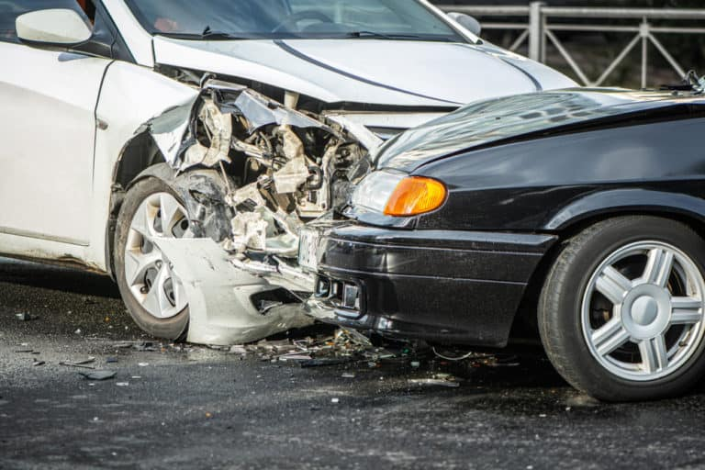
COLLISION
collision is any event in which two or more bodies exert forces on each other in a relatively short time.

Slide 4
1. VEHICLE COLLISION
PARTS OF COLLISION
The first collision is when a vehicle strikes another object, generally linked to a car crash. When the vehicle impacts, it rapidly decelerates as it crashes due to the force of the collision. While most modern vehicles are equipped to absorb much of the kinetic energy associated with a crash, humans are not totally protected from harm and injury during a vehicle collision.
Back and head injuries
Neck injuries

Slide 5
2. HUMAN COLLISION
The second collision is the human collision when the human body that was traveling at the same speed as the vehicle hits an object that causes the forward motion of the human to stop.
This might be a seatbelt that catches you and absorbs much of the motion, which can still lead to soft tissue damage, broken bones, and internal injury.

Slide 6
3. INTERNAL COLLISION
There is more going on than cars hitting cars and humans hitting the interior of cars in an accident, as there is also motion happening inside your body.
Your internal organs and brain will move with the same momentum and come to a sudden stop, which can cause internal injuries like ruptured organs, brain injury, internal hemorrhaging, or broken ribs.

Slide 7
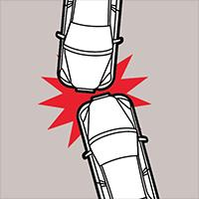
TYPES OF COLLISION
FRONT TYPE COLLISION
Front-impact collisions—when the front end of a vehicle hits another vehicle or something on the side of the road, like a tree or telephone pole

Slide 8
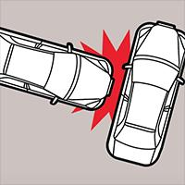
SIDE IMPACT COLLISION
Side-impact collisions can be either a classic “T-bone” or a sideswipe. The former often occurs at intersections, usually as the result of some sort of confusion regarding which vehicle has the right of way.

Slide 9
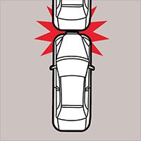
REAR END COLLISION
Motorists are prone to rear-end collisions in heavy commuter traffic on highways and thoroughfares. The most common causes are driving too fast or too aggressively, or failing to leave sufficient space between you and the vehicle in front of you.

Slide 10
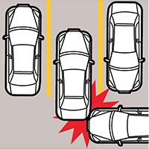
PARKING LOT COLLISION
Dented bumpers are all too common in busy parking lots. They may happen when a car is backing out of a parking spot or where there are multiple cars moving in different directions.

Slide 11
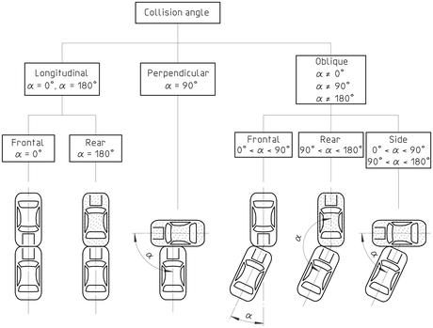
COLLISION ANGLE BETWEEN TWO VEHICLES
α angle measured between the two vertical longitudinal zero planes of the vehicles involved

Slide 12
CAUSES OF COLLISION
Driver
Pedestrian
Passengers
Vehicle
Road conditions
Weather conditions

Slide 13
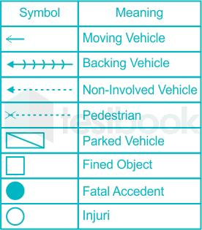
COLLISION DIAGRAM
Collision diagrams are used to display and identify similar accident patterns.
They provide information on the type and number of accidents; including conditions such as time of day, day of week, climatic conditions, pavement conditions, and other information critical to determining the causes of safety problems.

Slide 14
REFERENCE
https://living.geico.com/driving/auto/car-safety-insurance/common-collisions/
https://testbook.com/question-answer/in-a-collision-diagram-the-symbolsnb--61bae651f4b29aaaf69a607b#:~:text=Collision%20diagrams%20are,of%20safety%20problems

