Slide 1
PCB Design steps
Subrat Kumar Pradhan
Asst. Prof.
Dept of ECE

Slide 2
Steps in Designing a PCB
Decide what functionality you need
Break that functionality into small modules
Sense motion -> IMU
Communicate with phone -> Bluetooth module
Research components for each module
Always read the datasheets
Check to make sure footprints are solderable
Choose a CPU that can interface with your modules and meets other requirements
Try not to pick something overly complicated

Slide 3
Steps in Designing a PCB
Make the system schematic
Confirm every part has a schematic symbol and footprint
If it doesn’t then make your own
Place all parts on the schematic and wire
Remember to add lots of bypass caps
Check errors to make sure everything is properly connected
Make PCB
Check design rules
Place parts in reasonable location (minimize rats nest)
Use polygon pours for power and ground
Route remaining traces (use larger width for high current)
Check DRC

Slide 4
Interacting with Schematic Parts
All parts have a crosshair that can be interacted with
Kind of goofy for some parts like frame
When selecting multiple objects, some commands like move require right clicking to affect the whole group

Slide 5
Wiring it Up
Use net tool to make connections
Don’t always need to make a physical connection
Create a partial net
Use the name tool to give it a proper name
Use the label tool to place that name right on the net
Repeat for other pins you want to connect
Always do an ERC when finished to find any mistakes.

Slide 6
PCB Layout
Use File -> switch to schematic to create a PCB for your schematic
First set up your grid, usually want a slightly large grid and a much smaller alt grid
Next, use DRC to set up design rules according to PCB manufacturer requirements
Can download and import Osh Park DRU
When moving parts, everything snaps to grid, can hold ALT key to get more fine grained control
Try to arrange parts to minimize the rat’s nest

Slide 7
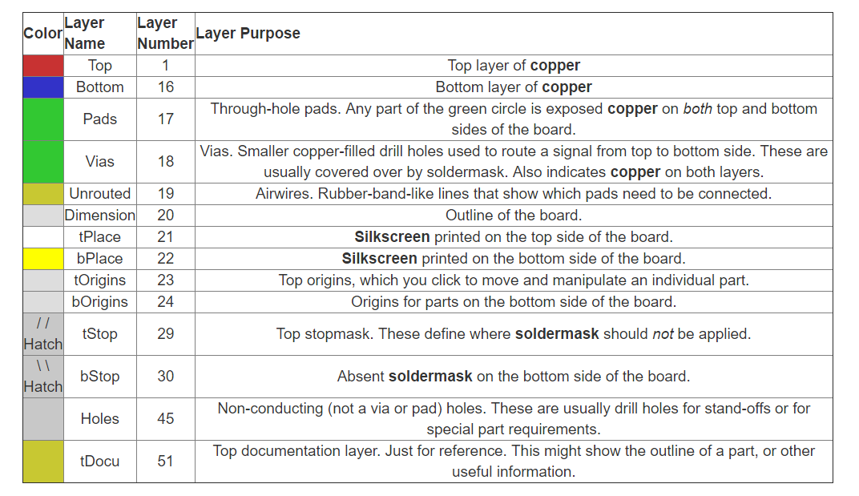
PCB Layers

Slide 8
Routing
Current operating layer shown in upper left
Click middle mouse button to switch
Focus on one trace at a time
Use middle click to place a via
Right click to change wire style
For tight boards, try to keep top layer horizontal and bottom layer vertical
Use bigger traces for power and ground if possible
When finished, use rats nest to check if anything missed
Always do a DRC

Slide 9
Advanced Routing
Good idea to use polygon pours for Power and Ground
Provides good capacitance to reduce noise
Makes routing easier
Looks cool
Use polygon pour tool to trace outline
Press ratsnest to fill in.
Can still route through the pour or hide with ripup on the edge
Also fun to write on the board by editing the silkscreen
Choose tPlace or bPlace layer then use drawing or text tools
Wont affect circuit, purely visual

Slide 10
Finishing Up
Need to convert schematic to format a PCB manufacturer can parse
Standard to use Gerber files
Need one Gerber file for each layer of the board
Press the Cam tool button
Open job, choose the sparkfun job file
Process job
Zip the cam files up and submit to Osh Park

Slide 11
Creating Custom Parts
From the Control Panel go to File -> New -> Library
Library -> Symbol, name it and accept
This opens an editor similar to a schematic
Use shapes to draw a box
Use the add pins tool to place pins on the box
Name the pins
Good idea to add >NAME and >VALUE text to part to allow more customization down the line, make sure to set these to Names and Values layer respectively
Save and then go to Library -> Create -> Package

Slide 12
Creating Custom Footprints
Start by using the SMD or pad tool to place pads
Can change to metric units using grid
Set size of pads with info tool
The grid is your friend
Set the grid distance to be the distance between pads for quick and easy placement
Hold control while moving to have pads center on grid
Can also use info to explicitly choose center
Use tPlace layer to draw shape of chip body (optional)
Add >NAME and >VALUE text in tName and tValue layers

Slide 13
Associate Symbol and Package
Library -> Device -> New
Name it the same thing as the Symbol and Package
Use add to place the symbol for the part
In the right side, press new and add the Package
Note the yellow exclamation, this means pins have not been associated
Double click on the package name to associate
Set prefix (default is U)
Match left and right sides then press connect
Save and you’re done!
Find your library in the control panel, right click and use

