Slide 1
Shell scripting
A shell script is a computer program designed to be run by the Unix/Linux shell which could be one of the following:
The Bourne Shell
The C Shell
The Korn Shell
The GNU Bourne-Again Shell
A shell is a command-line interpreter and typical operations performed by shell scripts include file manipulation, program execution, and printing text.

Slide 2
The shell sits in between the user and the operating system ,acting as a command interpreter.
It reads your terminal input and translates the commands into actions taken by the system.

Slide 3
A Shell provides you with an interface to the Unix system. It gathers input from you and executes programs based on that input. When a program finishes executing, it displays that program's output.
Shell is an environment in which we can run our commands, programs, and shell scripts. There are different flavors of a shell, just as there are different flavors of operating systems. Each flavor of shell has its own set of recognized commands and functions.

Slide 4
system memory(RAM)
KERNEL SPACE
CPU
HHARDDISK
USER SPACE

Slide 5
A process is a program under execution. A program is a passive entity that resides on a disk where as a process is an active entity residing in the RAM.
A program consists of 3 segments
Text segment:
It includes the sequence of instruction and is never modified by the process
Data segment
It contains global and static variables and can be modified by the process during execution
Stack segment
It holds temporary variable like local variable of functions, function parameters and corresponding function return addresses

Slide 6
New: The process is being created
Ready: The process is waiting for the CPU to execute it.
Running: Instructions are being executed.
Waiting: The process is waiting for some event (I/O operation) to occur.
Terminated: The process has finished execution.

Slide 7
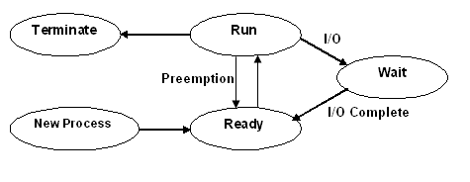

Slide 8
The newly created process information is internally stored in a data structure named as process control block (PCB). Some of the basic information stored on the PCB are
Process ID
Process state
This Field will hold the current state of a process.
Register save area
All hardware registers like IR, Accumulator and PC etc will be updated from this field.
Accounting Information
Amount of CPU usage and I/O usage will be accounted in this field
List of open files.
CPU scheduling information Process scheduling related information’s like Process priority etc

Slide 9
The newly created process will be moved to ready state (internally managed as a queue called ready queue). From the ready state, one particular process is picked and given to the CPU by the short term scheduler or CPU scheduler.
In case, the process encounters an I/O request, it will be moved from run state to wait state. On completion of I/O, the process will be moved back to ready state. When the process is in run state, if a high priority process arrives or if the time slice is over, the process will be forcefully moved out of CPU and will be placed back in ready state. This is technically termed as preemption. Once the execution is over, the process gets terminated. A process can get terminated either normally or abnormally. A process executing its last instruction and calling exit instruction can be considered as terminating normally.

