Slide 1
Introduction
What is the Diagnostic Communication Manager (DCM)?
The Diagnostic Communication Manager (DCM) is a vital component of the Autosar (AUTomotive Open System ARchitecture) framework.
It enables diagnostic communication between the vehicle's Electronic Control Units (ECUs) and external diagnostic tools.
Purpose of the Diagnostic Communication Manager (DCM)
Facilitate diagnostic services, allowing communication with ECUs for diagnostic purposes.
Support standardized diagnostic protocols for efficient and accurate fault diagnosis and troubleshooting.

Slide 2
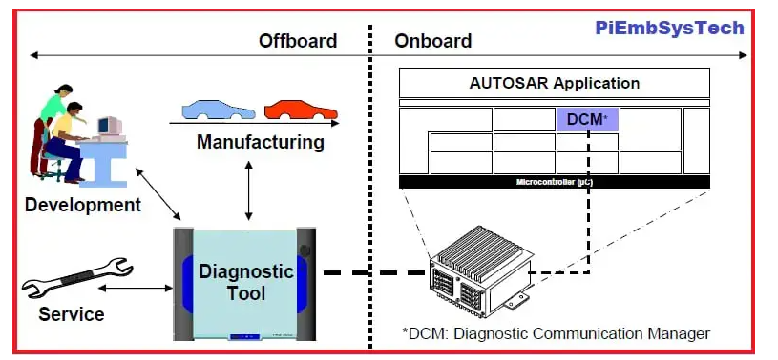

Slide 3
Diagnostic Services
1. Read Data by Identifier (RDBI)
Retrieves diagnostic data from the ECU based on specified identifiers.
Enables access to various parameters, sensor values, and diagnostic information.
2. Write Data by Identifier (WDBI)
Allows the diagnostic tool to write data to the ECU's memory or configuration parameters.
Useful for calibration or reprogramming of ECUs.

Slide 5
Diagnostic Services (contd.)
3. Control DTC Setting (CDTC)
Controls the activation and deactivation of Diagnostic Trouble Codes (DTCs) or fault codes.
Enables clearing or setting of DTCs based on specific conditions.
4. Routine Control (RC)
Initiates predefined routines or sequences in the ECU.
Used for functions like actuator tests, self-tests, or system
initialization.

Slide 6
Diagnostic Protocols
1. Unified Diagnostic Services (UDS)
Most widely used diagnostic protocol in the automotive industry.
Defines a set of standardized diagnostic services and communication procedures.
Supports various diagnostic functionalities, including fault code retrieval, data reading/writing, and control operations.
2. Keyword Protocol 2000 (KWP2000)
Legacy diagnostic protocol commonly used in older vehicles.
Provides diagnostic services and communication mechanisms for ECUs.
Primarily used for diagnostics and ECU reprogramming.
3. On-Board Diagnostics (OBD)
A protocol used for emission-related diagnostics in vehicles.
Monitors the vehicle's emission control systems and detects faults or malfunctions.
Supports standardized diagnostic trouble codes (DTCs) and emission-related parameters.

Slide 7
Benefits of DCM
1. Standardization
DCM ensures standardized diagnostic communication across different ECUs and diagnostic tools.
Allows seamless integration of diagnostic functionalities from multiple suppliers.
2. Efficiency and Accuracy
Diagnostic services and protocols provided by DCM enhance the efficiency and accuracy of fault diagnosis and troubleshooting.
Enables quick identification and resolution of issues in the vehicle.

Slide 8
Conclusion
The Diagnostic Communication Manager (DCM) is a crucial component in Autosar, enabling efficient and standardized diagnostic communication between ECUs and external diagnostic tools.
The DCM supports various diagnostic services and protocols such as UDS, KWP2000, and OBD, enabling effective fault diagnosis and troubleshooting in vehicles.

