Slide 1

ENGINE COMPONENTS THEIR CONSTRUCTION, OPERATING PRINCIPLES AND FUNCTIONS
IC ENGINE

Slide 2
Engine Components
Cylinder
Cylinder block
Cylinder head
Cylinder liner or sleeve: Dry liner, wet liner
Piston: Piston head, piston skirt
Piston Ring: Compression ring, oil ring
Piston pin or Gudgeon pin
Connecting rod
Crankshaft
Fly wheel
Cam shaft
Timing gear
Inlet manifold
Exhaust manifold

Slide 3
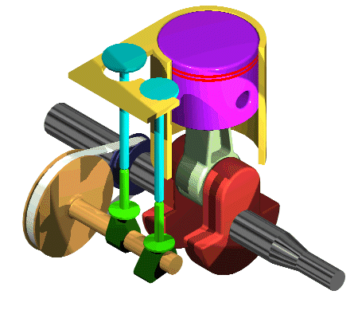
Working of IC Engine
A mixture of fuel with correct amount of air compressed in an enclosed cylinder is ignited by means of spark. As a result of explosion, the volume of the gas increases resulting in tremendous pressure on the top of the piston. This force causes the piston to move in down ward direction. The movement of the piston is transmitted to the crankshaft by means of connecting rod.

Slide 4
WORKING
https://www.youtube.com/watch?v=fTAUq6G9apg&t=10s
https://www.youtube.com/watch?v=Sk74-CfhCkE
https://www.youtube.com/watch?v=OGj8OneMjek

Slide 5
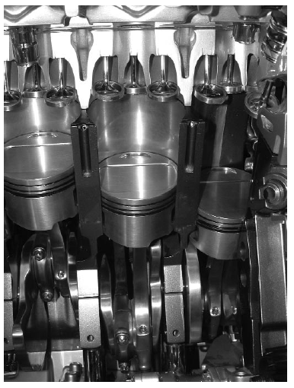

Slide 7
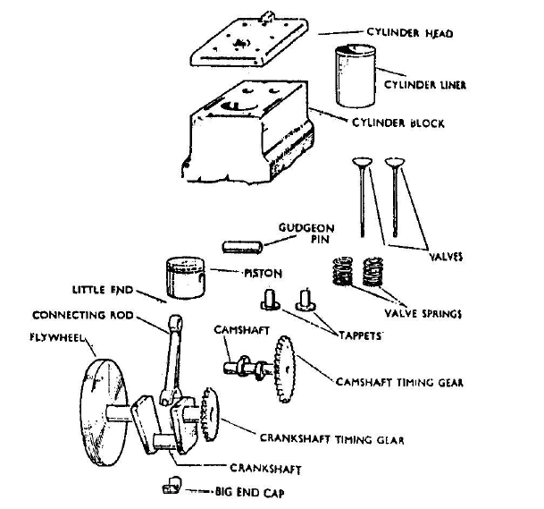
Engine Components

Slide 8
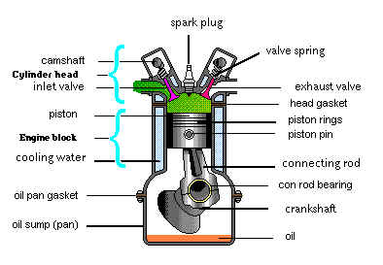
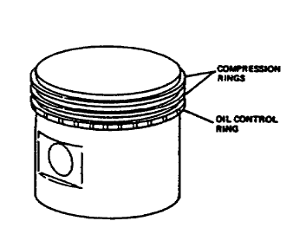

Slide 9
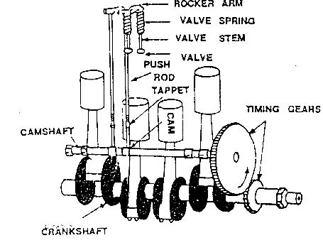

Slide 10
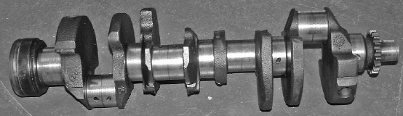
Crank shaft and cam shaft

Slide 11
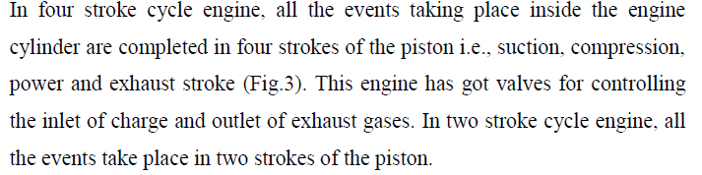
Four Stroke Cycle Engine

Slide 12
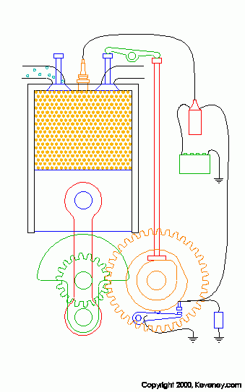

Slide 13
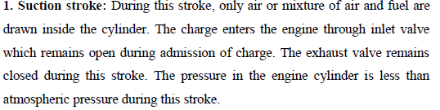
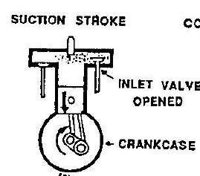
Four Stroke Cycle Engine

Slide 14
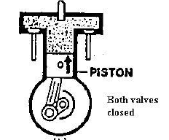
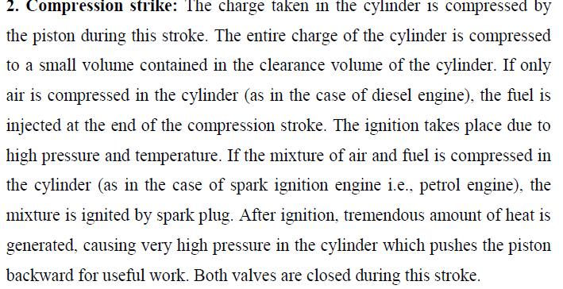
Four Stroke Cycle Engine

Slide 15
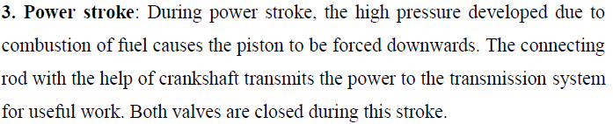
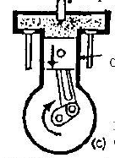
Four Stroke Cycle Engine

Slide 16
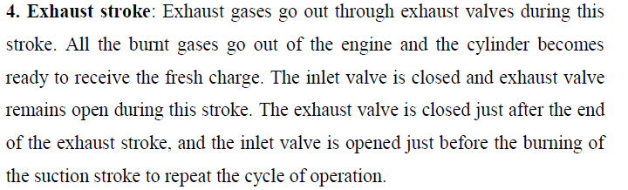
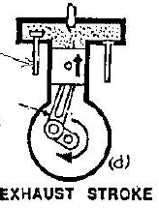
Four Stroke Cycle Engine

Slide 17
https://www.youtube.com/watch?v=XKcRf2R5h4o&t=78s

Slide 18
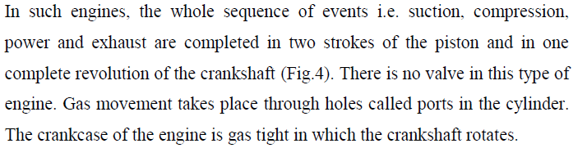
Two Stroke Cycle Engine

Slide 19
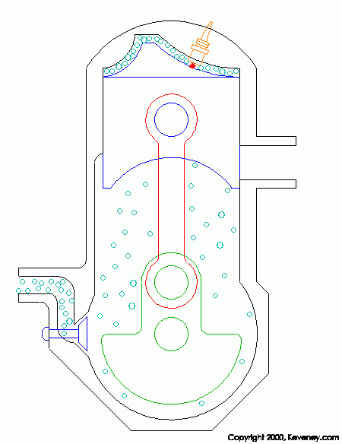

Slide 20
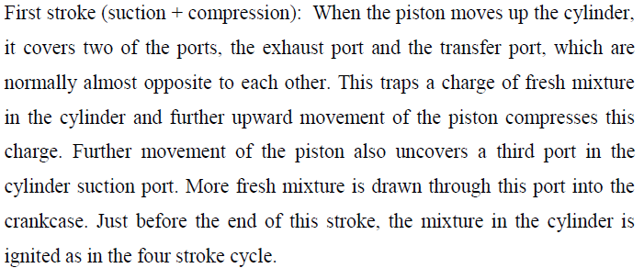
First Stroke

Slide 21
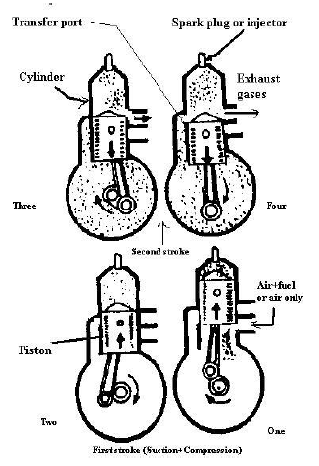

Slide 22
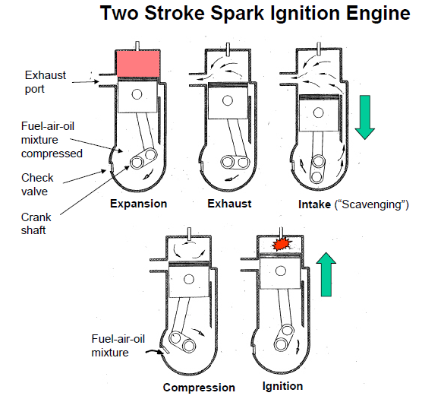

Slide 23
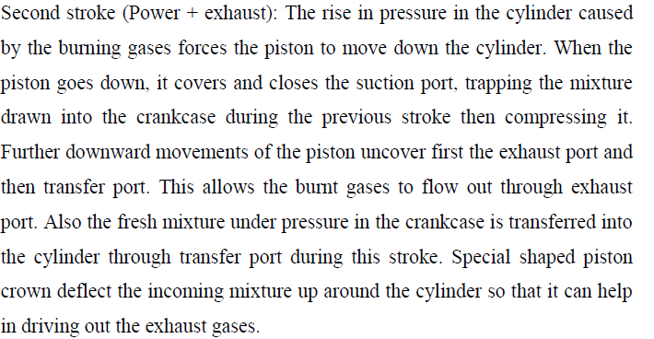

Slide 24
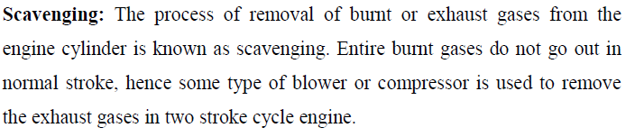

Slide 25
DIFFERENCE BETWEEN TWO STROKE AND FOUR STROKE ENGINE

Slide 26
