Slide 1
FUEL SYSTEM OF DIESEL ENGINE

Slide 2
During engine operation, the fuel is supplied by gravity from fuel tank to the primary filter where coarse impurities are removed.
From the primary filter, the fuel is drawn by fuel transfer pump and is delivered to fuel injection pump through second fuel filter.
The fuel injection pump supplies fuel under high pressure to the injectors through high pressure pipes.
The injectors atomize the fuel and inject it into the combustion chamber of the engine.
The fuel injection pump is fed with fuel in abundance. The excess fuel is by-passed to the intake side of the fuel transfer pump through a relief valve.

Slide 3
COMPONENTS-
The main components of the fuel system in diesel engine are:
(1) fuel filter
(2) fuel lift pump
(3) fuel injection pump
(4) atomizers
(5) high pressure pipe.

Slide 4
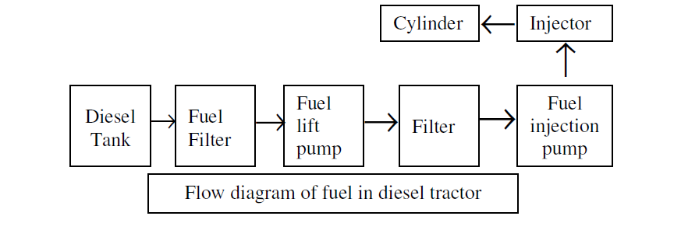

Slide 5
Two conditions are essential for efficient operation of fuel system:
(i) The fuel oil should be clean, free from water, suspended dirt, sand or other foreign matter.
(ii) The fuel injection pump should create proper pressure, so that diesel fuel may be perfectly atomized by injectors and be injected in proper time and in proper quantity in the engine cylinder.
Fuel should be filtered before filling the tank also.
If these precautions are followed, ninety per cent of diesel engine troubles are eliminated.

Slide 6
FUEL LIFT PUMP (FEED PUMP OR TRANSFER PUMP)
It is a pump, which transfers fuel from the fuel line to the fuel injection pump. It is mounted on the body of fuel injection pump. It delivers adequate amount of fuel to the injection pump.
The pump consists of:
(I)body (2) piston (3) inlet valve and (4) pressure valve.
The valves are tightly pressed against their seats by springs.
The piston is free to slide in the bore.
The fuel contained in the space below the piston is forced to flow through secondary fuel filter to the injection pump.
At the same time downward movement of the piston creates a depression in the space above the piston which, causes the fuel to be drawn in the transfer pump from the fuel tank through the inlet valve and the primary filter.

Slide 7
FUEL INJECTING PUMP
It is a pump, which delivers metered quantity of fuel to each cylinder at appropriate time under high pressure.
Tractor engines may use two types of fuel injection pump:
(i) Multi-element pump and
(ii) Distributor (Rotary) type pump.

Slide 8
Fuel Injector:
It is the component, which delivers finely atomized fuel under high pressure to the combustion chamber of the engine.
Modern tractor engines use fuel injectors, which have multiple holes.
Main parts of injector are: nozzle body and needle valve.
The nozzle body and needle valve are fabricated from alloy steel.
The needle valve is pressed to deliver the fuel.

Slide 9
FUEL INJECTION SYSTEM
Diesel fuel is injected in diesel engine through injectors with the help of fuel injection pump. The system using injectors, fuel injection pump, fuel filter, and fuel lines is called fuel injection system.
The main functions of fuel injection system are:
(i) To measure the correct amount of fuel required by engine speed and load,
(ii) To maintain correct timing for beginning and end of injection,
(iii) To inject the fuel into the combustion space against high compression pressure.
(iv) To atomize the fuel for quick ignition.

Slide 10
Process of fuel injection in diesel engine is of two types: (i) Air injection (ii) Solid injection.
Air injection: In this process, the engine uses compressed air to force the fuel into the cylinder.
It is a bulky system and hence it is not considered very suitable for vehicles and tractors.
It is mostly used on heavy-duty stationary engines.
Solid injection: A high-pressure pump is used for forcing the fuel into the combustion chamber

Slide 11
FUEL FILTER
It is a device to remove dirt from fuel oil.
Solid particles and dust in diesel fuel are very harmful for giving a fine degree of filtration.
Fuel injection equipment in diesel engines is extremely sensitive to dirt and solid particles present in fuel.
A filter is used to remove the dirt and solid particles from the fuel to ensure trouble free fuel supply.
It consists of a hollow cylindrical element contained in a shell, an annular space being left between the shell and the element.
The filtering element consists of metal gauge in conjunction with various media such as packed fibers, woven cloth, felt, paper etc.
These filters are replaced at certain intervals, specified by the manufacturer. Usually there are two filters in diesel engine:
(1) Primary filter and
(2) Secondary filter.
The primary filter removes water and coarse particle of dirt from the fuel. The secondary filter removes fine sediments from the fuel.

Slide 12
