Slide 1
Biochemical Changes During Ripening
Centurion University Of Technology And Management
Prepared by:-
190804130006- Kaushik ku. Ghosh
190804130032- Pritam Kumar Charchi
190804130037- Sri Charan sai
190804130056- Satya
Submitted to:-
Dr. Anant Tamang
Asst. Professor

Slide 2
INTRODUCTION
Ripening is the process by which fruits attain their desirable flavor, quality, color, palatable nature and other textural properties.
Ripening is a phase of qualitative change which occurs in fruits particularly, after completion of maturation, during which the fruit becomes acceptable for consumption in terms of taste and flavour.
Ripening occur during the later stages of maturation and is the first stage of senescence.

Slide 3
Summary of changes during ripening:
Increase in rate of respiration.
Hormonal changes – Ethylene.
Change in chlorophyll content.
Synthesis of carotenoids, anthocyanin, xanthophyll.
Increase in activity of enzymes.
Synthesis of volatile compounds.
Conversion of starch to sugar.
Change in colour and texture. (Softness)
Change in aroma ,taste and flavour.

Slide 4
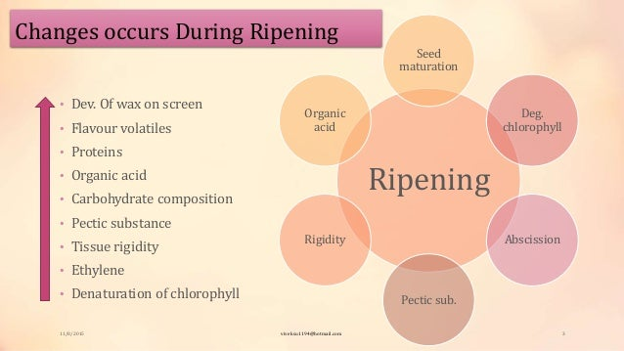

Slide 5
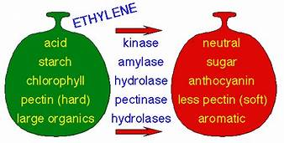
Hormonal changes – Ethylene
Ethylene is a natural plant hormone released by all plant tissues and microorganisms.
Ethylene is a naturally occurring ripening hormone.
Even at minute quantities it stimulates ripening activity, induces ripening.
Promotes its own biosynthesis in ripening climacteric fruits.
This process is not reversed.
This process is accompanied by an increase in oxygen uptake.

Slide 6
Ethylene Biosynthesis

Slide 7
Respiration
One of the major physiological and biochemical change which occur in fruits and vegetables is a change in the pattern of respiration.
If the respiration rate of a fruit or vegetable is measured as their O2 consumed or CO2 evolved during the course of the development, maturation, ripening and senescent period, a characteristic respiratory pattern is observed. And during ripening there is an increase in respiration.
Respiration is a process in which stored organic materials (carbohydrates, protein, and fat) are broken down into simple end products with release of energy. Oxygen is used in this process and carbon dioxide is produced.
The respiratory pattern also impacts the pattern of evolution of ethylene. Based on this pattern, fruits can be classified into ‘climacteric’ and ‘non-climacteric.

Slide 8
Factors responsible for the respiration
Temperature
Relative Humidity
Gas composition in the ambient and in the cell
Moisture content of the tissue
Wounding or injury
Type of the plant parts
Stage of development of tissue
Surface area to volume of the produce
Pre-harvest treatments and PH methods
Chemical composition of tissue
Size of the produce
Presence of natural coating on the surface

Slide 9
Change in chlorophyll content.
The loss of green colour during maturation and ripening is mainly due to degradation of chlorophyll molecules which is mediated by chlorophyllase enzyme (Hydrolase), pH changes (leakage of organic acids from vacuoles), oxidative stress and synthesis of secondary metabolites, such as carotenoids, anthocyanins and other pigments that mask the expression of chlorophyll pigment.

Slide 10
Change in colour
Colour change is one of the most common harvesting index practically utilized in many fruits and vegetables.
With the onset of maturity, the colour of fruits and vegetables changes due to the accumulation of various pigments viz.
ß- carotene - (mango, peach, plum, carrot),
Anthocyanin - light red to blue (apple, strawberry, pomegranate,),
Lycopene - (tomato, watermelon,)
Xanthophyll - (papaya),

Slide 11
Organic Acid
Generally fruits are acidic in nature and vegetables are alkaline in nature (with exception of tomato and rhubarb), as fruits contain greater amounts of organic acids.
The total acid content among fruits varies from 0.2 to 0.8 per cent approximately in pear juice and lime, respectively.
The major organic acids profoundly found in fruits include citric acid (mango, guava, pineapple, citrus except sweet lime, pear, tomato), malic acid (apple, banana, cherry, watermelon), tartaric acid (grape, tamarind), quinic acid (kiwifruit, blueberry) and ellagic acid (strawberry, jamun).
After reaching maturity, the organic acid content of fruits decline gradually towards the fruit ripening phase (Kinase) except in banana and pineapple where the acid content remains high even after ripening.
The fall in organic acid content after fruit maturity might be due to their reduced acid synthesizing ability, sugar translocation and dilution effect with increase in fruit volume.

Slide 12
Ascorbic acid
Ascorbic acid (Vitamin C) is the naturally occurring acid in fruits. Ascorbic acid has important antioxidant and metabolic functions in plants and animals in the form of vitamin C.
A gradual rise in ascorbic acid content with fruit growth has been observed and the levels decline with the advancement of maturity and onset of fruit ripening and postharvest handling.
The increase in vitamin C content during the ripening is due to increase in the synthesis of some metabolic intermediates that promote synthesis of precursors for vitamin C

Slide 13
Starch
Based on the type of fruit and its place of ripening (on/off the plant), their inner sugar levels tend to raise, attributing to their importation from the parent plant or mobilization of starch within the fruit.
As maturity progresses, the starch reserves get hydrolysed into sugars (glucose, fructose or sucrose) (Amylase) and this is considered as a distinctive event during fruit ripening.
Further the complex sugars viz. sucrose is broken down into simple sugars viz. glucose and fructose with the catalytic action of enzyme invertase.
In pea, the higher sucrose content is noticed in fresh immature stage and gets converted into starch with the attainment of maturity.
Starch content decreases progressively throughout the post climacteric ripening stages in banana fruit which is accompanied by progressive increase in soluble sugars.

Slide 14
Increase in activity of enzymes

Slide 16


