Slide 1

Canopy Management and Rejuvenation in Fruit Crops
Course:- Production Technology of Fruits and Plantation crops
DR. Prashant Kalal
Assistant Professor,
Department of Horticulture, mSSSoA
CUTM, Paralakhemundi, ODISHA

Slide 2
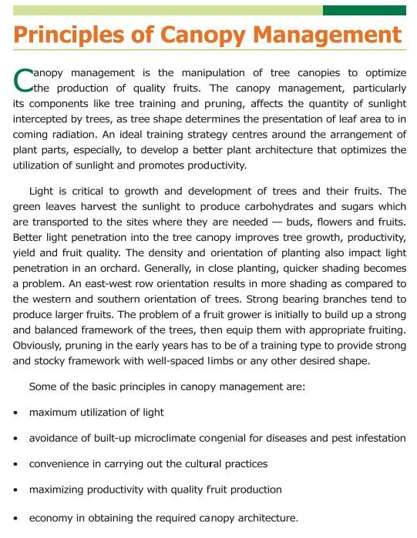

Slide 3
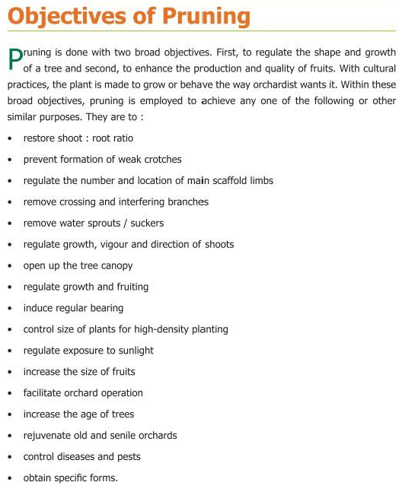

Slide 4
Canopy Management in Mango

Slide 5
Topics to be covered
Basic information on plant canopy management
Approaches for canopy architecture
Canopy and Light interception
Physiology of flowering

Slide 6
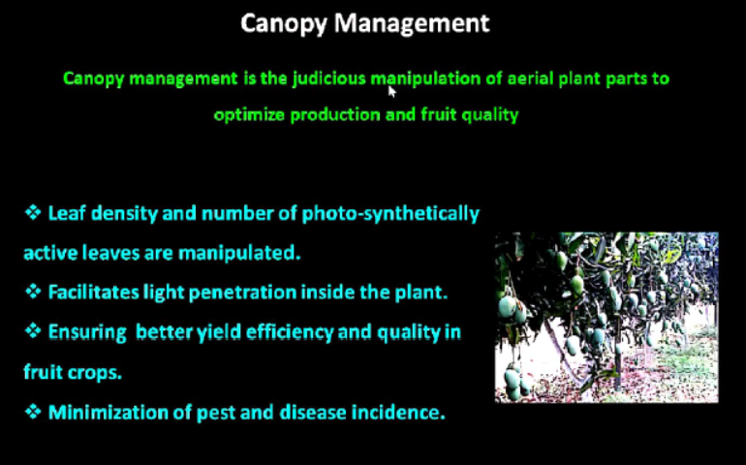

Slide 7
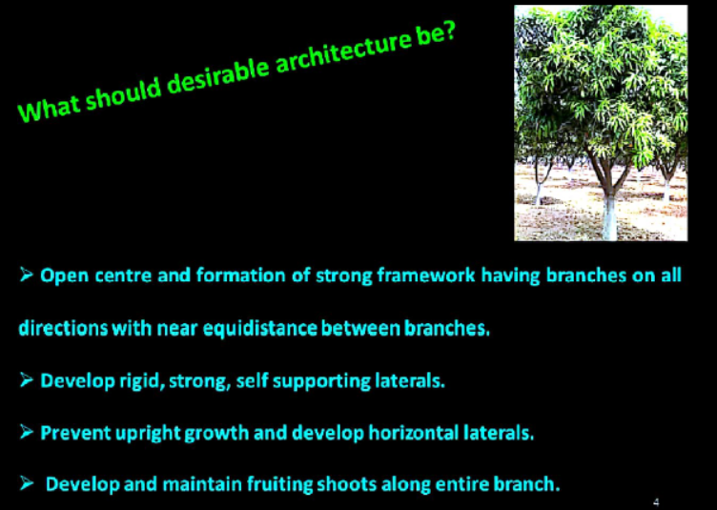

Slide 8
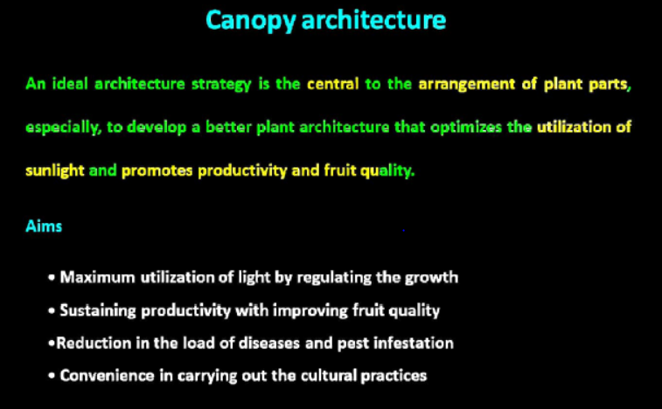

Slide 9
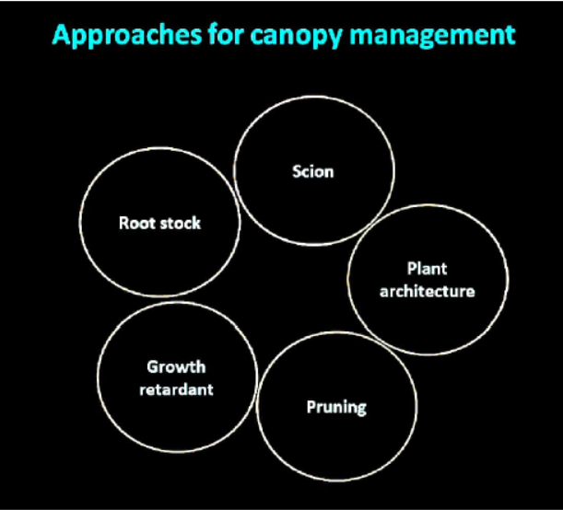

Slide 10
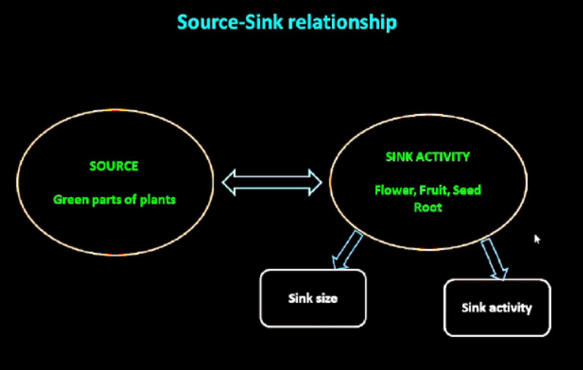

Slide 11
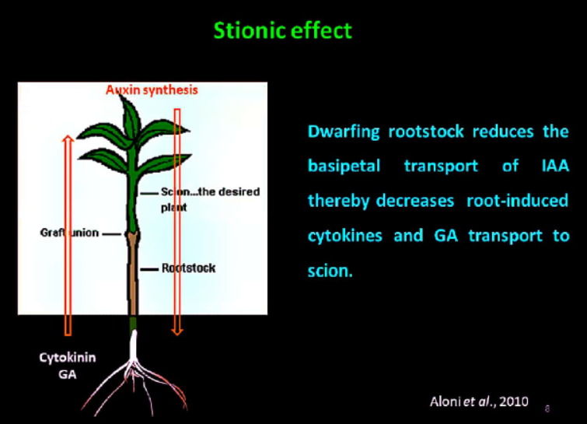

Slide 12
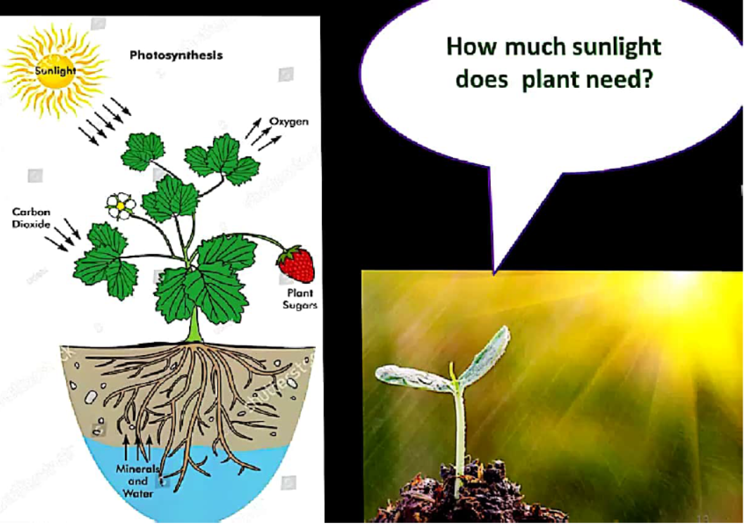

Slide 13
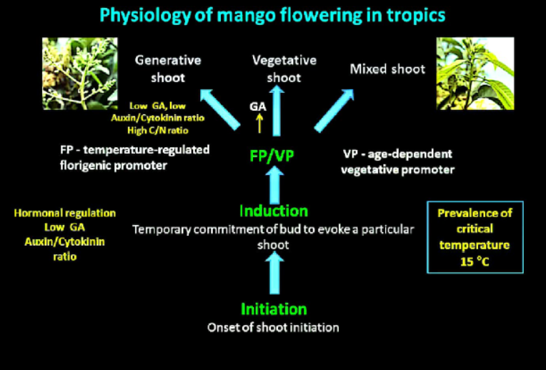
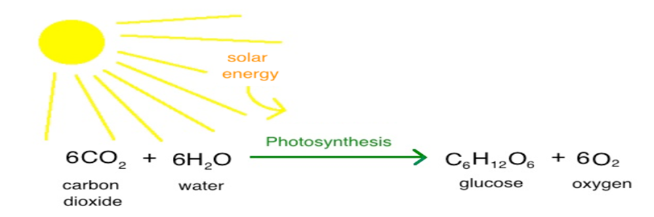
Davenport, 2007

Slide 14
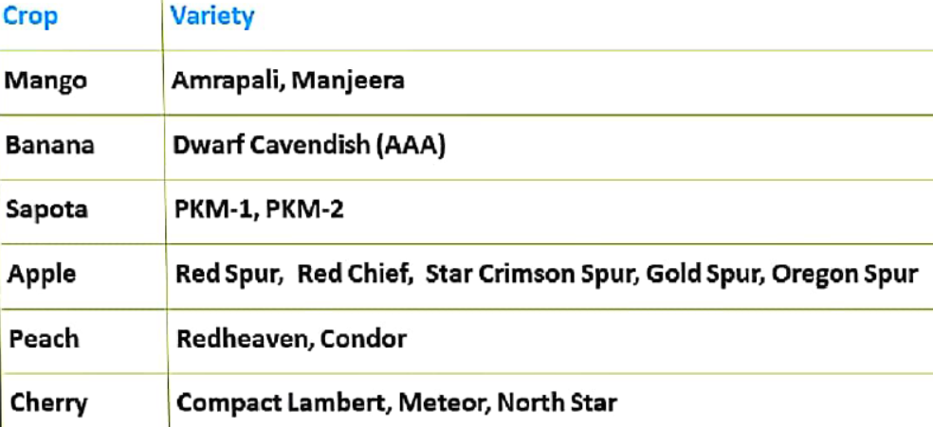
Commercial Scion varieties of different fruit crops

Slide 15
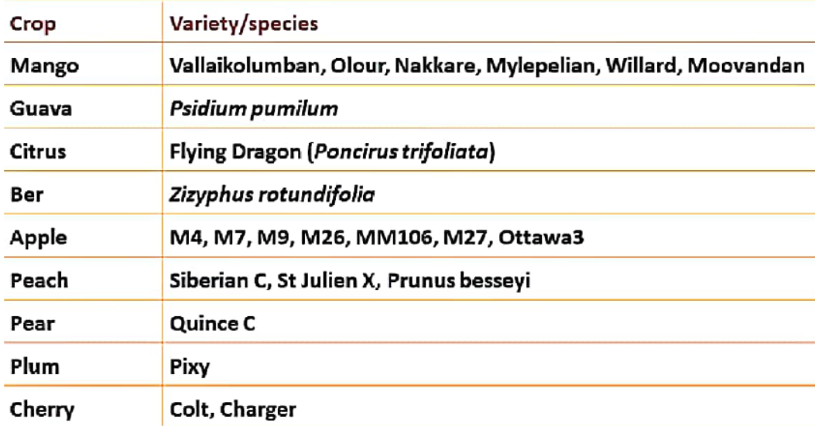
Rootstocks
Size controlling rootstocks are economically important for high-density planting
that may produce more yield per unit area and better fruit quality

Slide 16
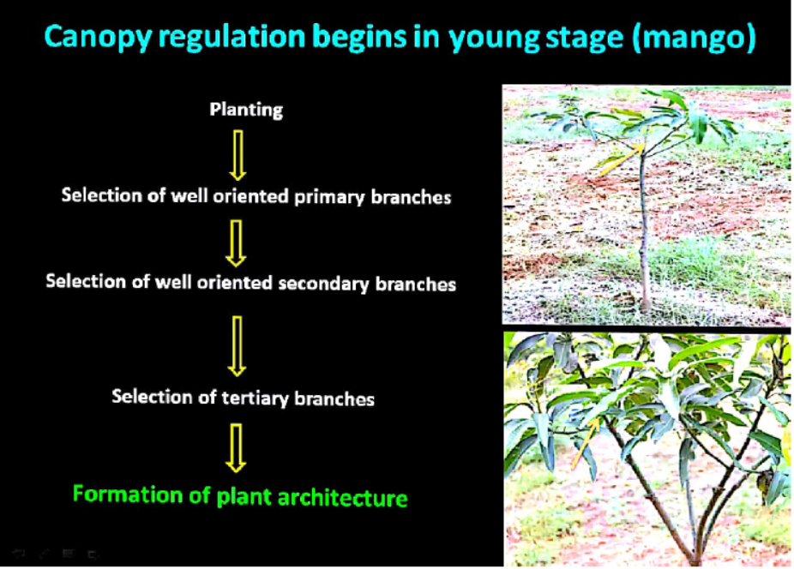

Slide 17
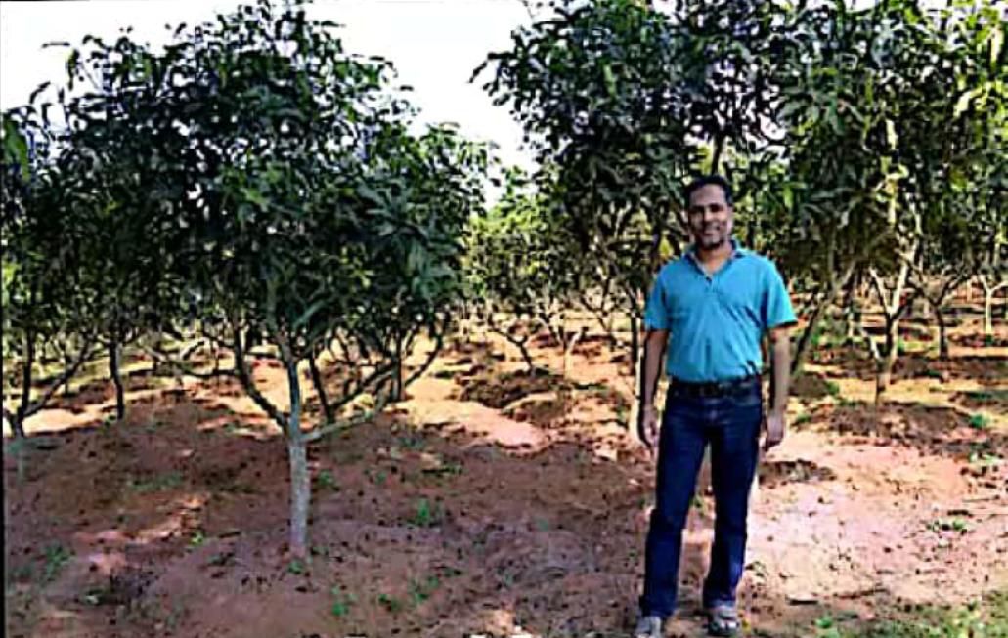
2.5m X 2.5m Square system

Slide 18
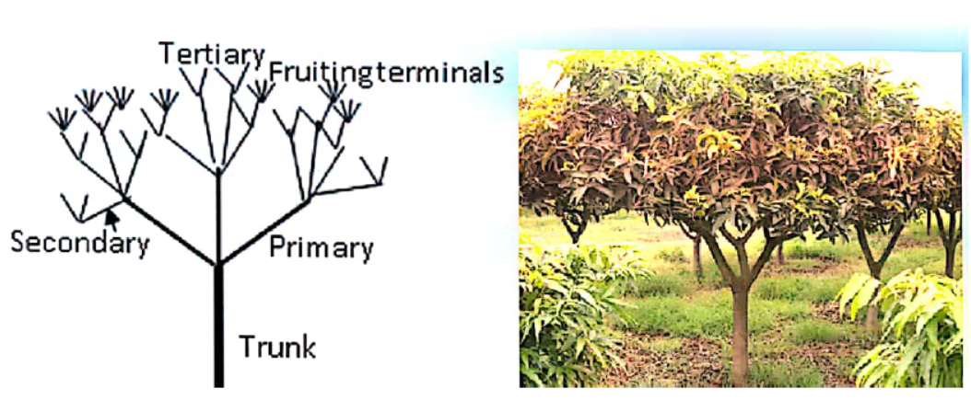
Open center system

Slide 19
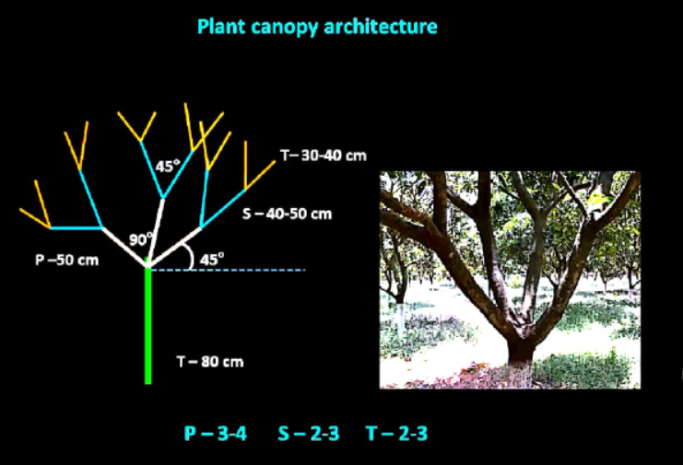
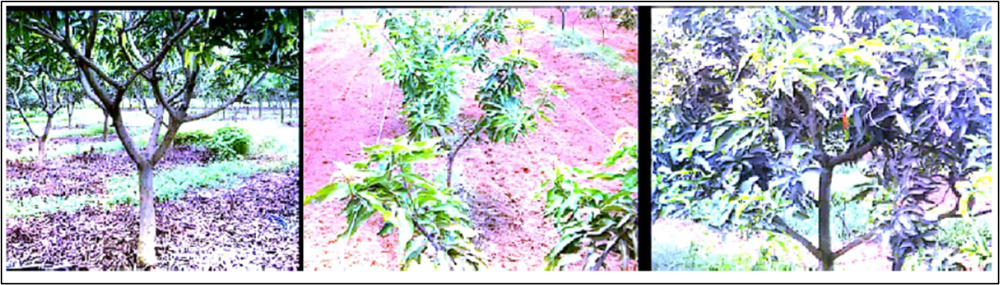
P- 3-4 S – 2-3 T – 2-3

Slide 21
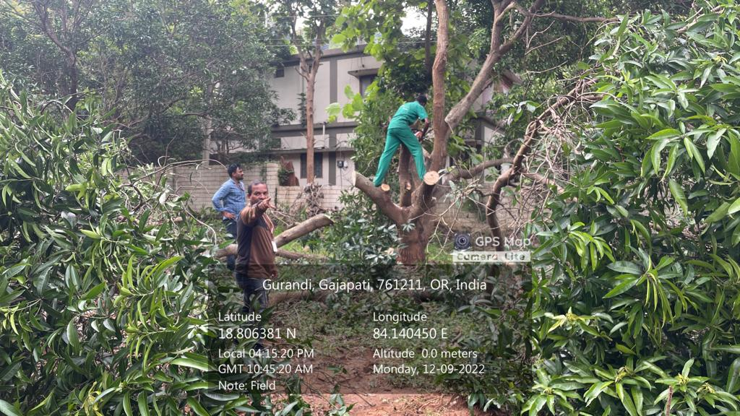
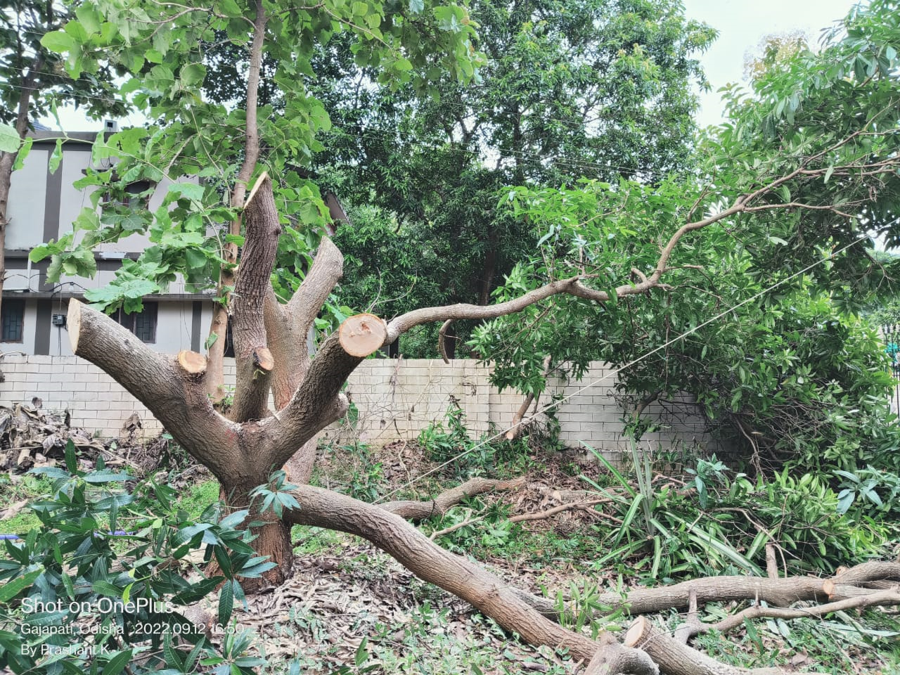
Rejuvenation
Mango old trees rejuvenation
@ CUTM, paralakhemundi campus

Slide 22
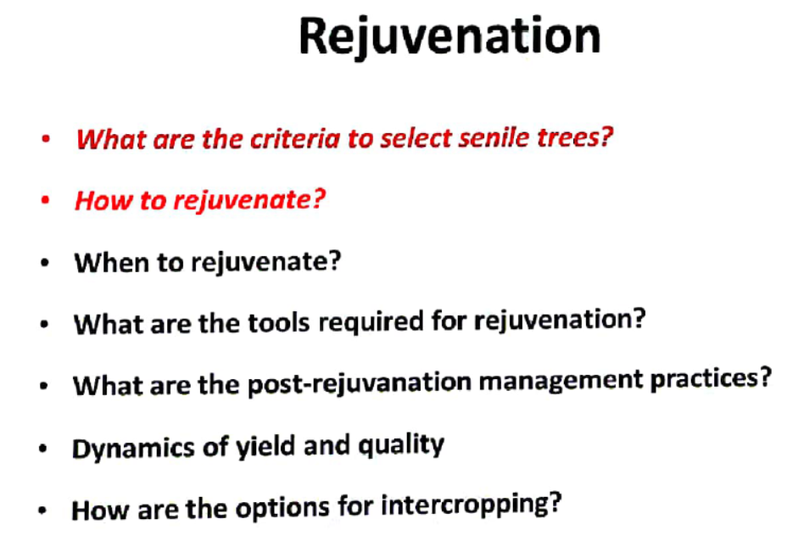

Slide 23
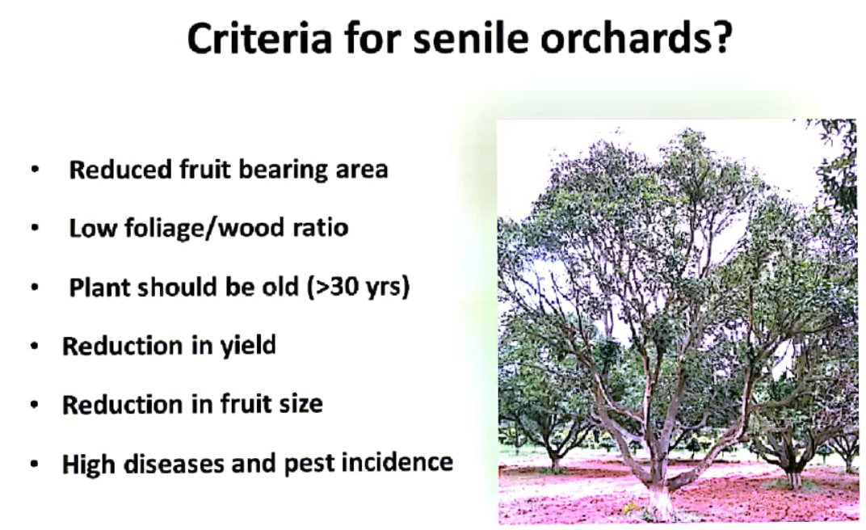

Slide 24
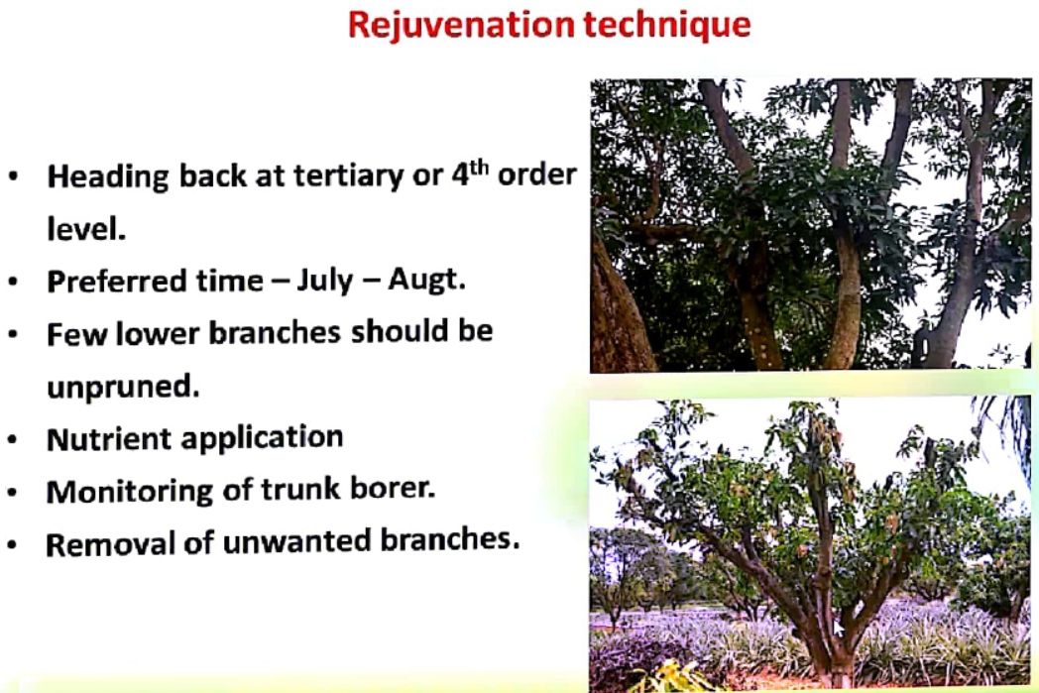

Slide 25
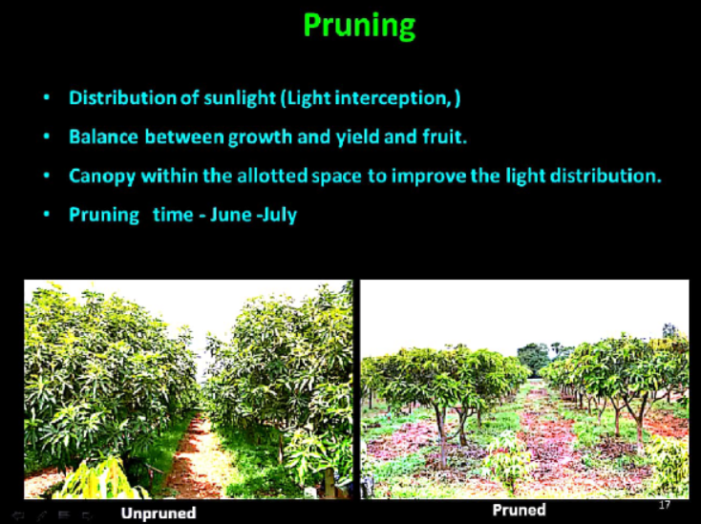

Slide 26
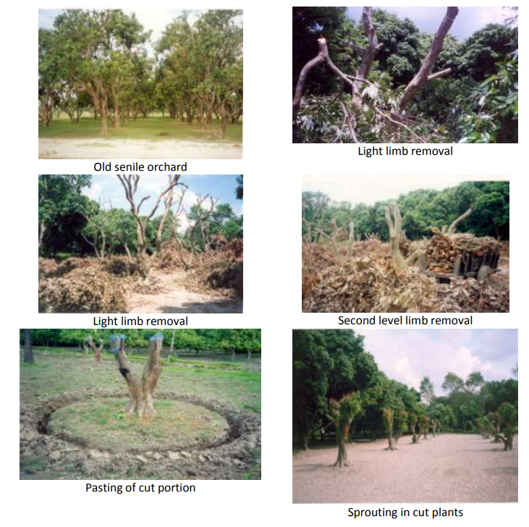
Rejuvenation of mango old orchard

Slide 27
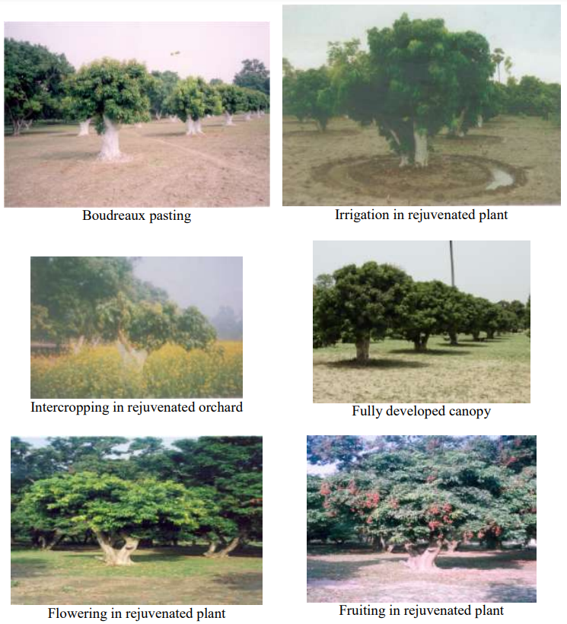

Slide 28
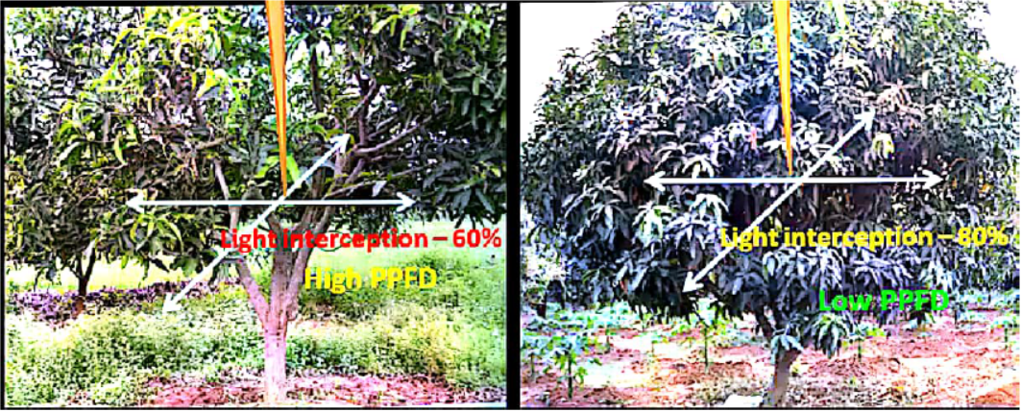
After rejuvenation
Cut end of the branches should be pasted with Bordeaux paste
(1:1:10) 1kg CuSO4 + 1kg hydrated acid lime CaO + 10 litres of water and maintain pH neutral 6.5 to 7.5
Nutrition: FYM and recommended fertilizer application in the ring basin.
Irrigation: flood or Drip method @ 2 weeks interval
Mulching: wheat or rice straw or plastic mulch

Slide 29
Fertilizer application
Application of 25kg FYM to young plants and bearing trees
Apply RDF to young plants
1 year old plant = 73g: 18g: 68g (Urea:SSP:MOP)
2year old plant = double the quantity each year
10th year onwards: 730g:180g:680g
Apply a Recommended Dose of Fertilizer (RDF) for old rejuvenated trees: 730g Urea: 180g SSP: 680g MOP.
Well decomposed FYM = 75-100kg per tree
Micronutrient spray during fruit development
Application of FYM which is enriched with biofertilizer Trichoderma viridae, Pseudomonas fluorescence, and Pacealomyces lilacinus.
Apply Vermicompost @ 2 to 3 kg per tree

Slide 30
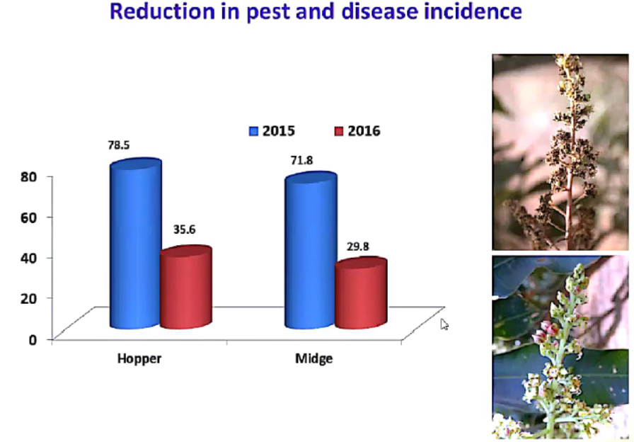

Slide 31
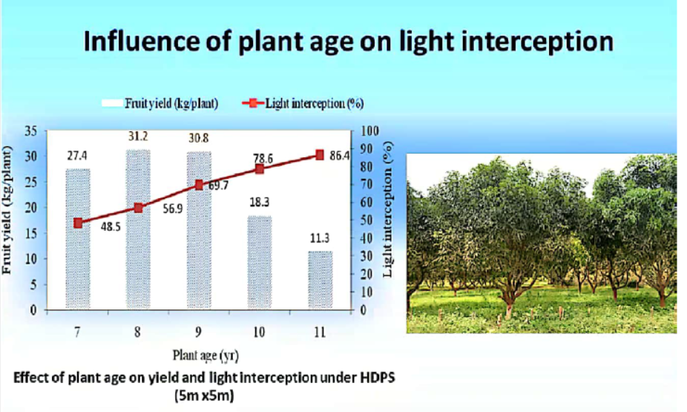

Slide 32
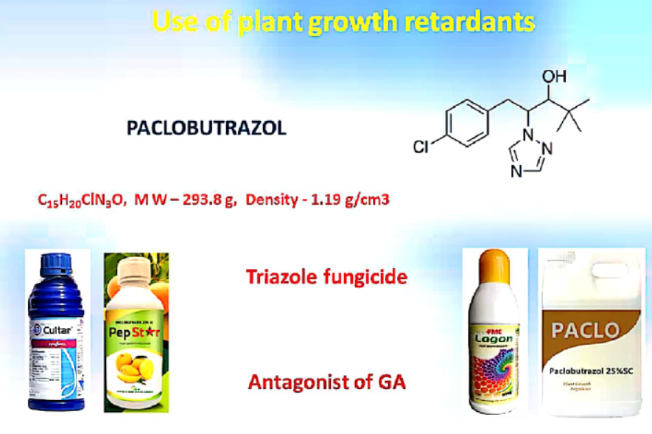

Slide 33
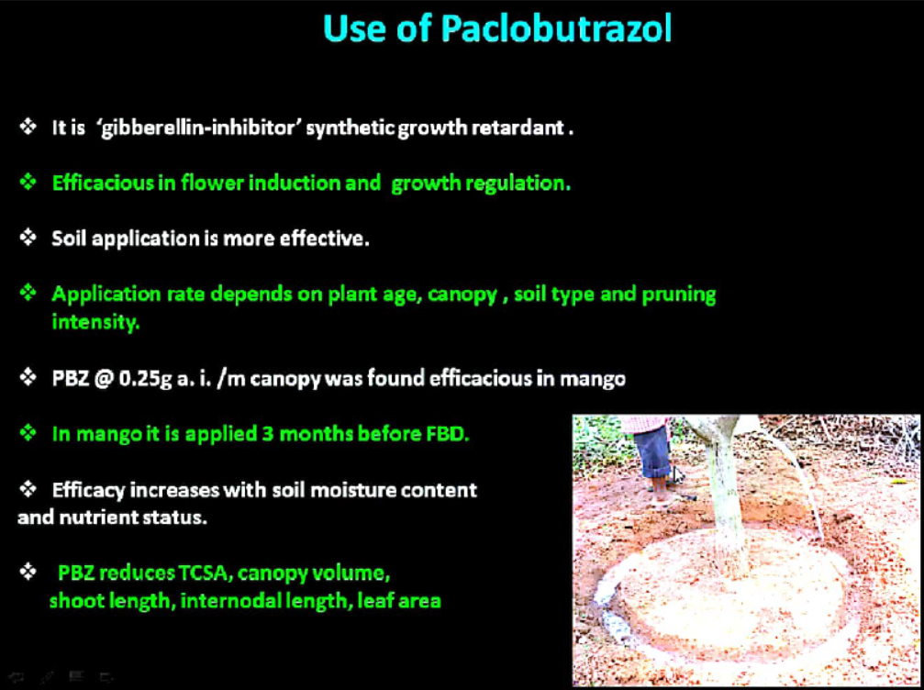

Slide 34
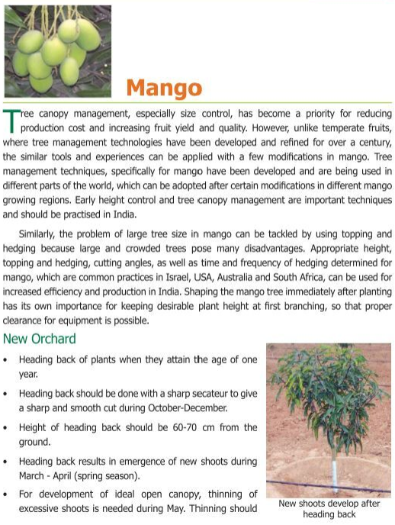

Slide 35
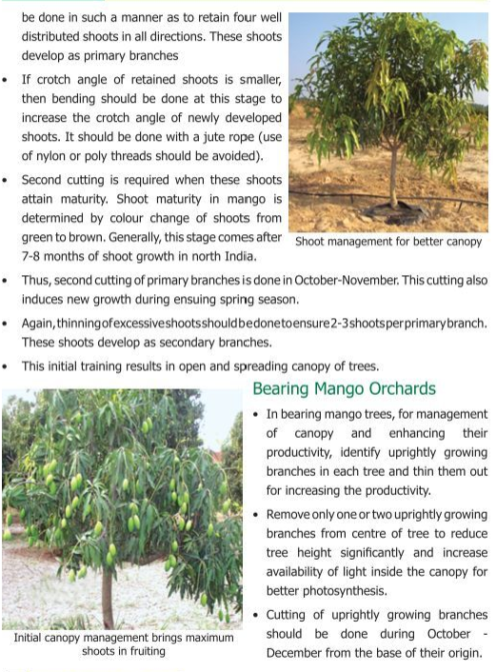

Slide 36
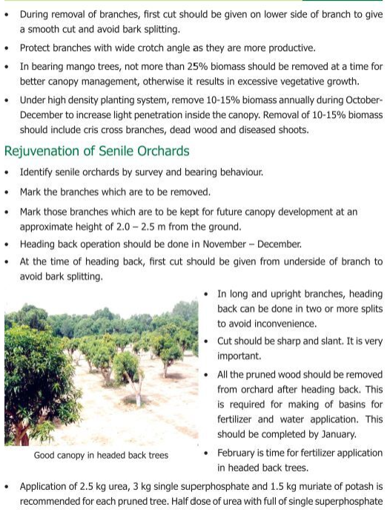

Slide 37
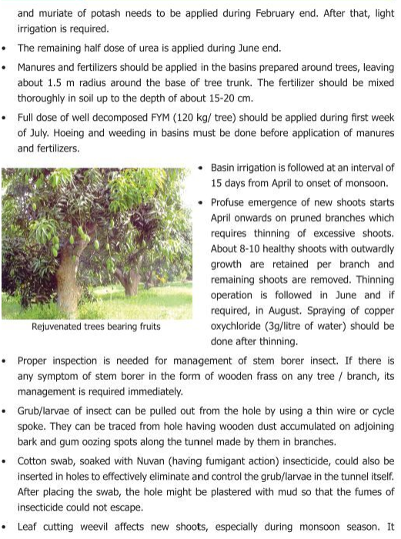

Slide 38
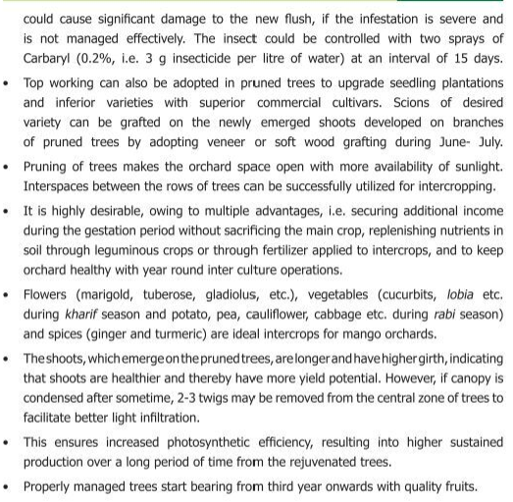

Slide 39
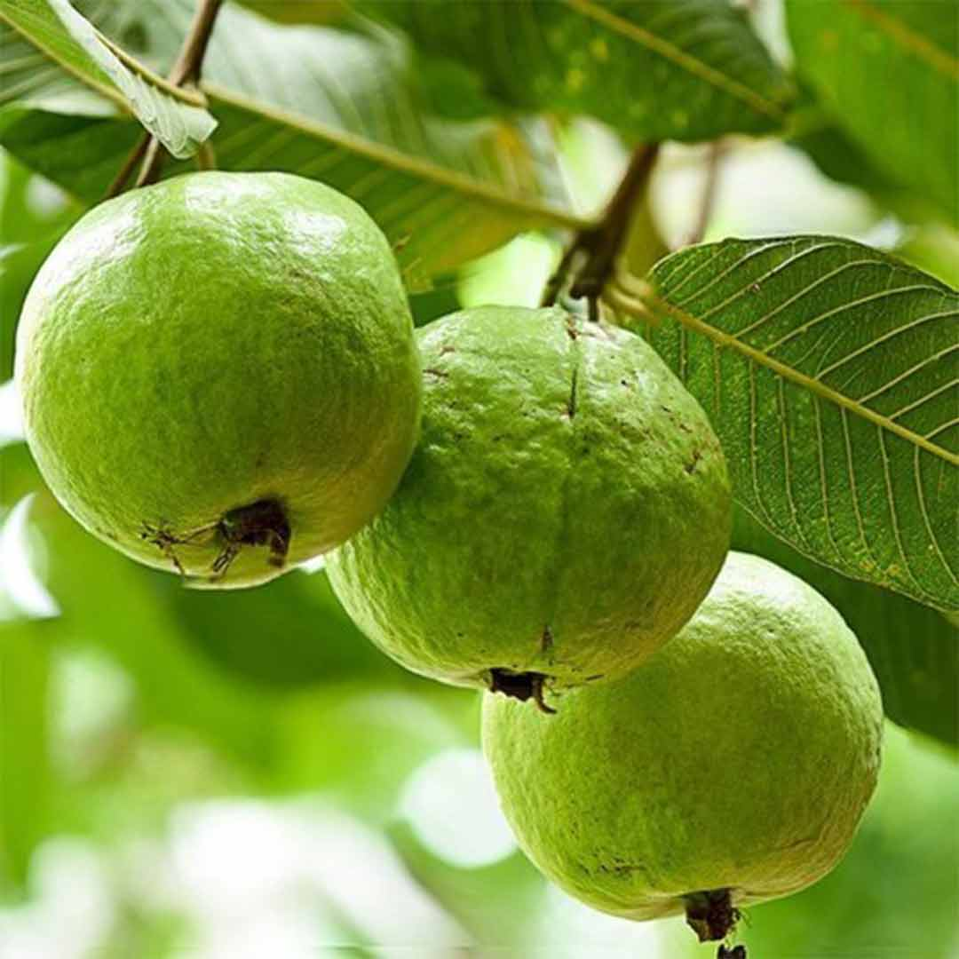
Canopy Management in Guava
Psidium guajava
Family: Myrtaceae
Origin: Peru

Slide 40
Suitable variety: Allahabad Safeda, Lalit, Lucknow-49 (Sardar Guava)
Rootstock: Pusa Srijan
High-density planting in guava
3.0m (row to row) x 1.5m (plant to plant) accommodating2222 plants/ha
3.0m (row to row) x 3.0m (plant to plant) accommodating 1111 plants/ha
6.0m (row to row) x 3.0m (plant to plant) accommodating 555 plants/ha
Ultra-High-density/ Meadow orcharding in guava
2.0m (row to row) x 1.0m (plant to plant) accommodating 5000 plants/ha

Slide 41
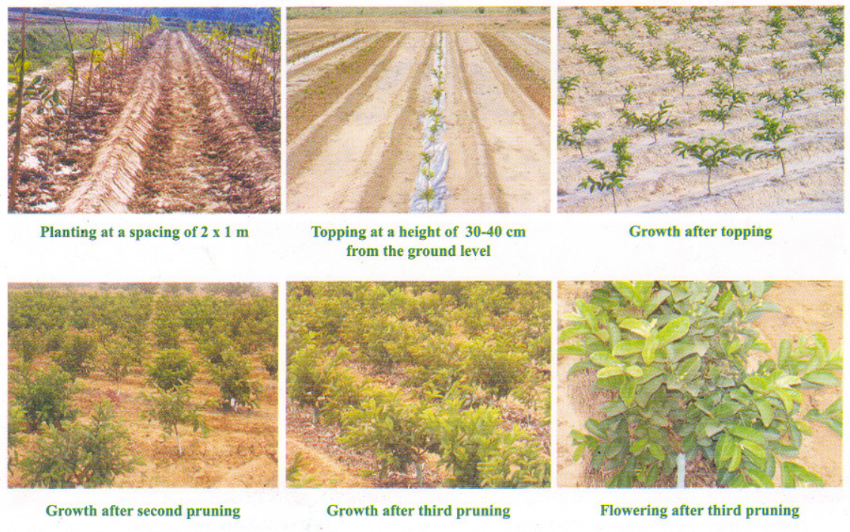

Slide 42
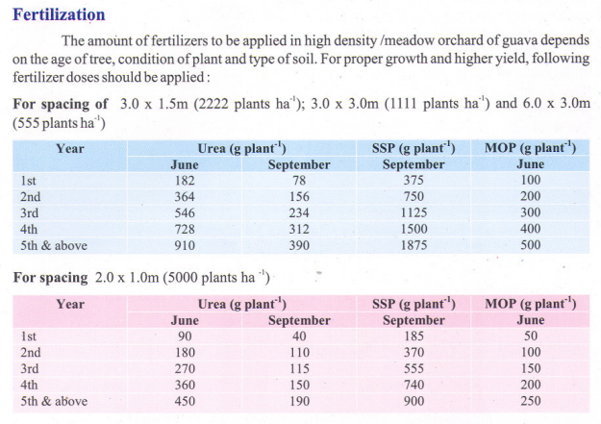
Irrigation: The drip method
Mulching: Straw or plastic

Slide 43
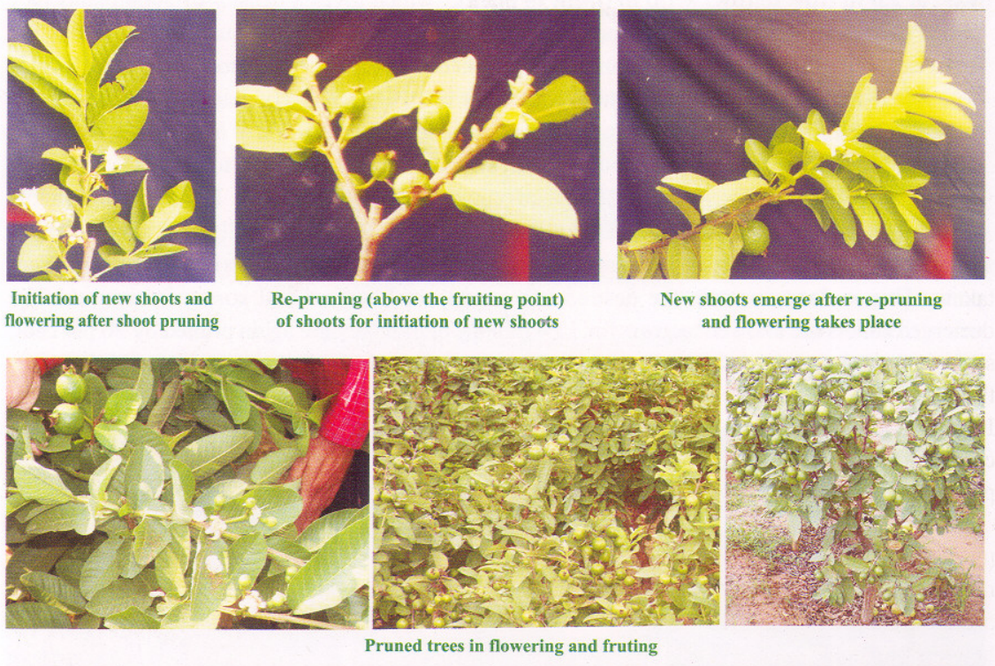

Slide 44
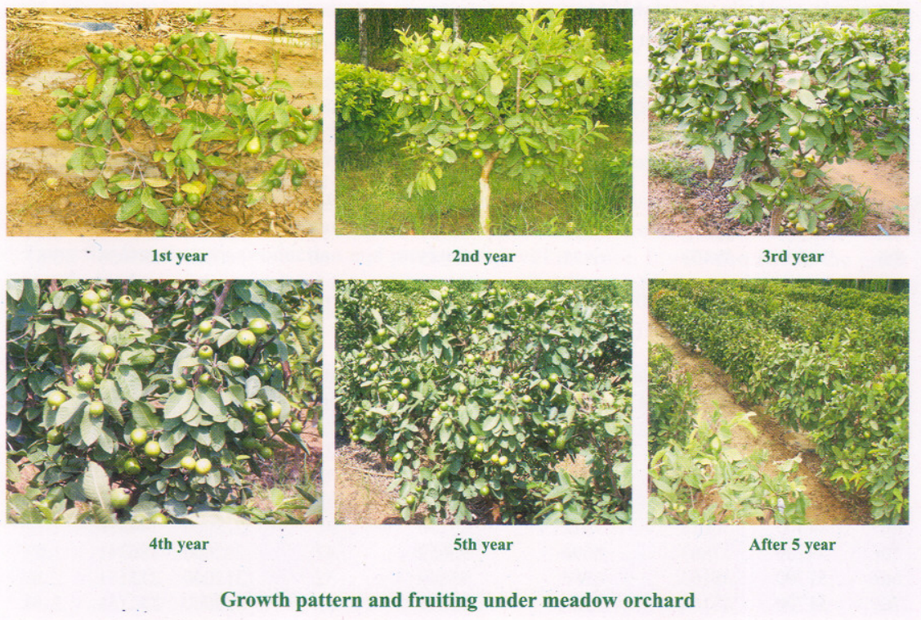
Spacing: 2m x 1m, Total 5000 plants/hectare
Source: CISH, Lucknow

Slide 45
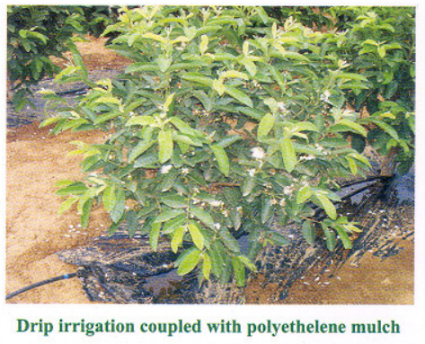
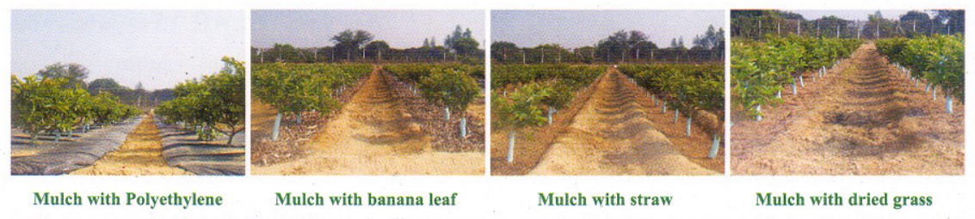

Slide 46
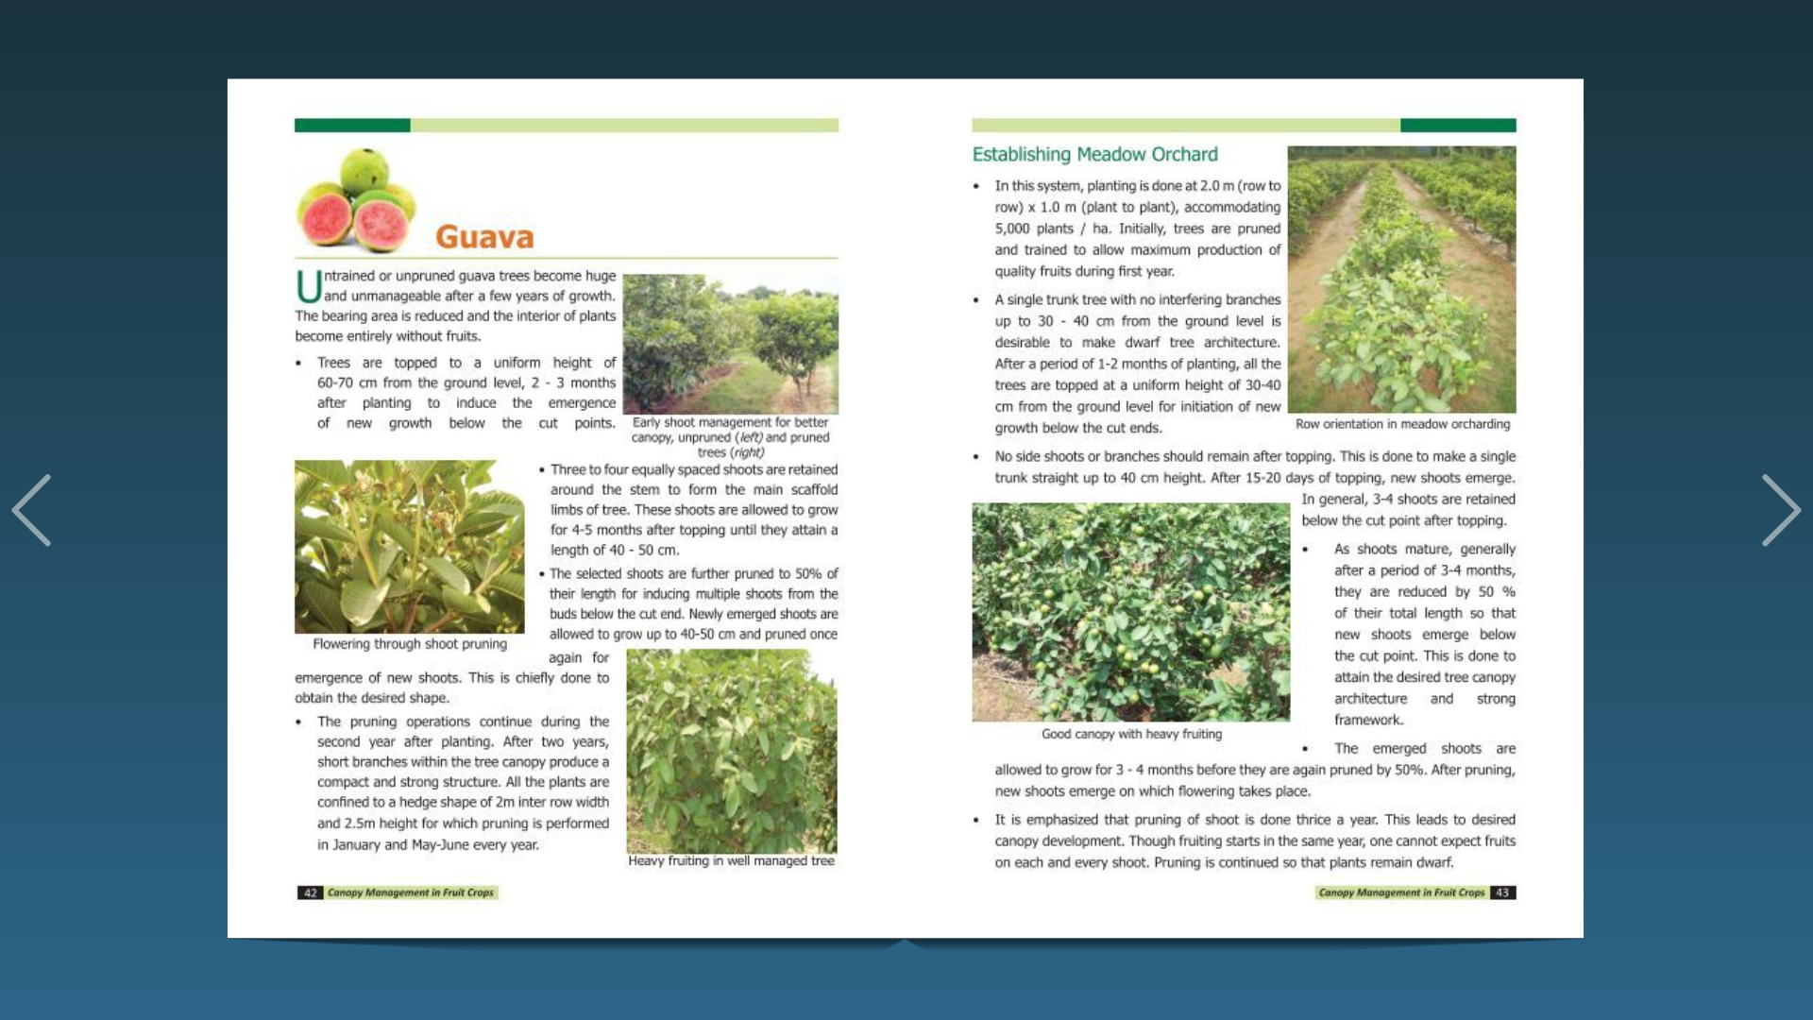
Canopy Management in Guava

Slide 47
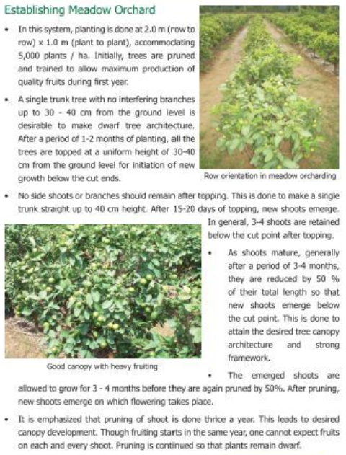

Slide 48
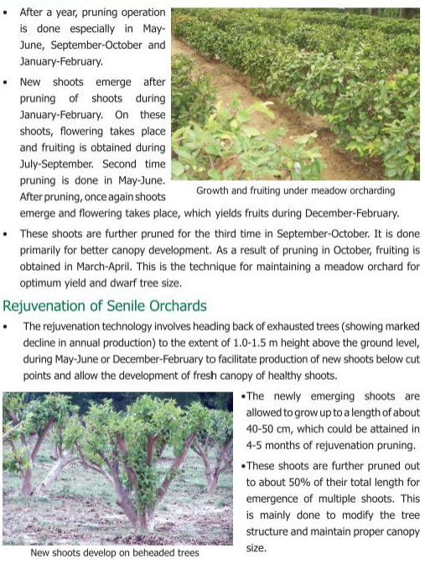

Slide 49
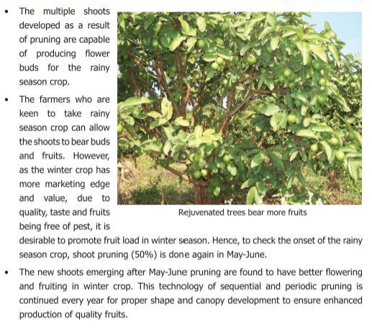

Slide 50
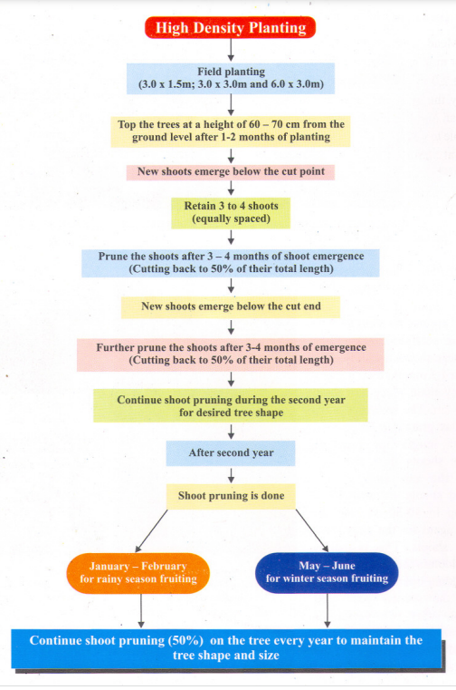

Slide 51
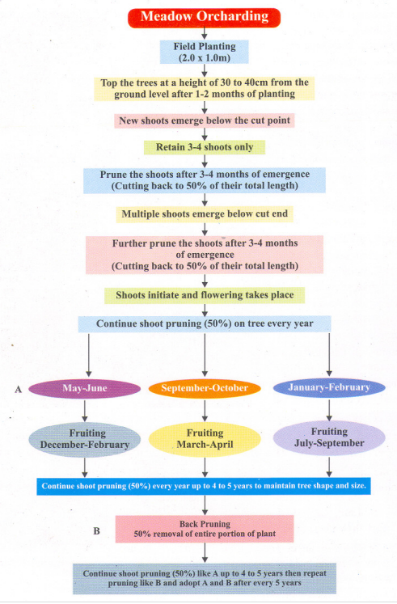

Slide 52
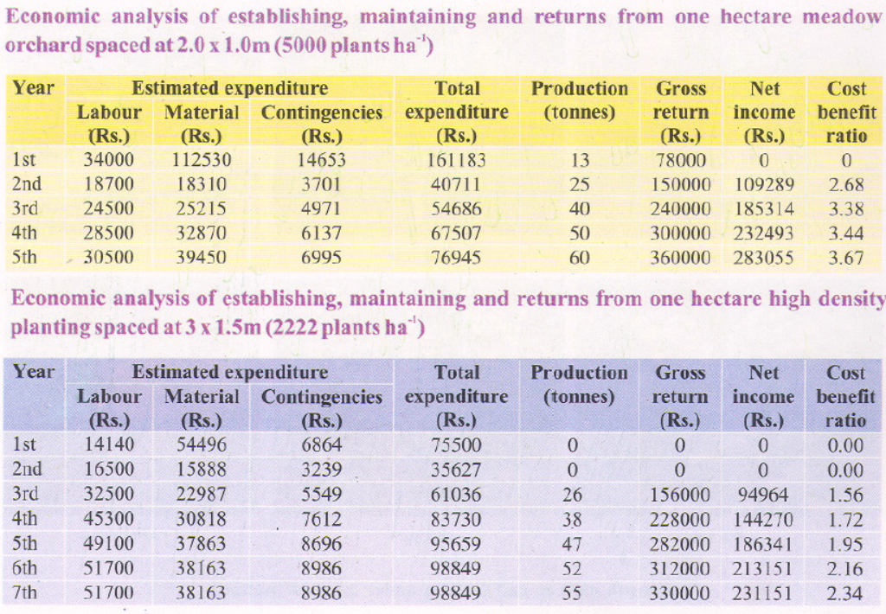
Yield and net income from HDP and Meadow orcharding
Source: CISH, Lucknow

Slide 53
Canopy Management in Citrus
Canopy management in young trees, bearing trees, and old trees
Grapefruit
Lime
Lemon
Mandarin
Sweet Orange

Slide 54

Citrus fruits

Slide 55


Slide 56


Slide 57


Slide 58


Slide 59


Slide 60


Slide 61
Planting and Propagation
It can be done before or after rains during the rainy season depending upon the amount of rainfall. Spacing should be 4-6 m for limes and 6-8m for lemons. Pits can be of 1 m cube and filled with a mixture of soil and manure.
Acid lime is propagated by seeds selecting the nucellar seedlings. But budding on Rangpur lime is preferable. Sweet limes can be propagated by sub-terminal stem cuttings or layering or budding. Lemons by budding on trifoliate orange or Rangpur lime (Citrus limonica).
Irrigation
Limes require more water; irrigation may be given if top 25cm soil becomes dry.
Check bund system is best as it will not allow the contact of water with the stem.
Drip irrigation improves yield.

Slide 62
Weed Control
In citrus orchards weed control is carried out by 2 or3 cross ploughing. While resorting to manual weeding tillage should not be deeper than 10 to 15 cm. Deep tillage once or twice in a year is more harmful than regular deep tillage.
Diuron at 3 kg/a.i. /ha or Simazine (4kg a. i./ha) when sprayed during end of May controls dicot and monocot weeds in the orchard. The application may be repeated at 120 days for complete control of the weeds.
Intercropping
The interspaces between the rows can be utilized in the initial 3 - 4 years for growing short-term crops like Mung, Black gram, groundnut, soybean, and vegetable crops. During the rainy season, green manuring crops are grown and plowed into the soil before flowering. The choice of intercrop depends on local conditions and climate. However indiscriminate cultivation of exhaustive intercrop should be avoided. Intercropping in Nagpur mandarin plantations should be avoided as it increases pest and disease incidences and even micronutrient deficiencies.

Slide 63
Crop regulation or Bahar treatment
Under south and central Indian conditions, mandarin produces 3 flowerings in a year during Feb (Ambe bahar), June (Mrig bahar), and October (Hasta bahar) of which Mrig bahar is preferred.
So, flower regulation is done by withholding water a month or two before flowering till the plants wither and drop some of their leaves.
Then they are manured and irrigated which results in profuse flowering.
Important practices to induce flowering in fruits
Witholdinng irrigation (30 to 40 days before flowering)
Partial exposing the roots to sunlight
Training and Pruning of branches
Application of ethrel and growth retardant (Cycocel, paclobutrazol)
(Note: indirectly to enhance C: N ratio. Increased carbon content induces flowering in the tree. If Nitrogen content increases then the tree continues vegetative growth)

Slide 64

Thank you all

