Slide 1
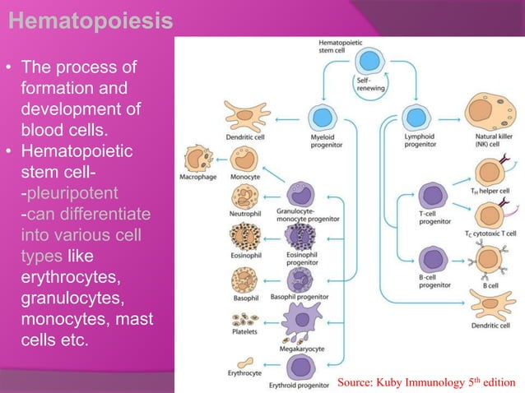

Slide 2
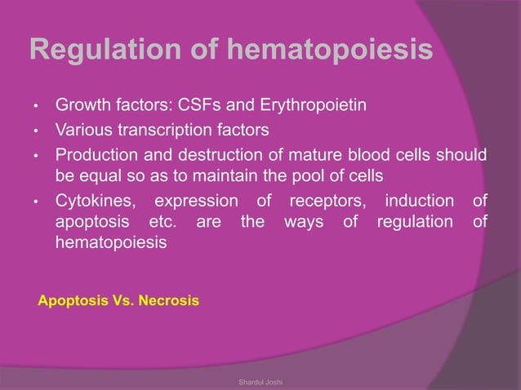

Slide 3
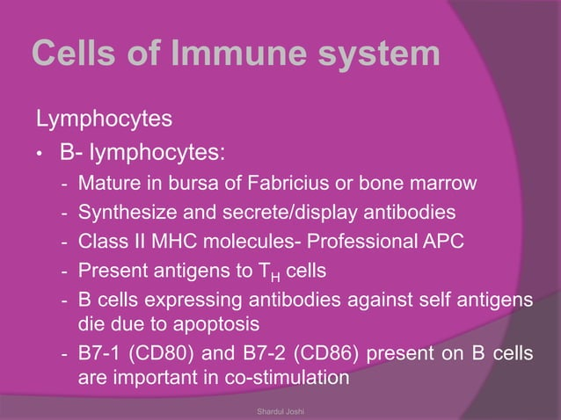

Slide 4
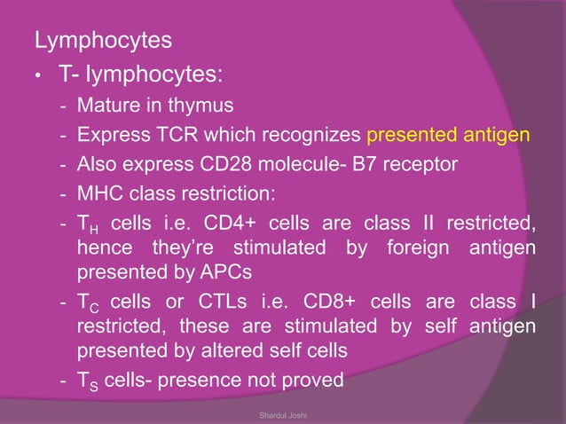

Slide 5
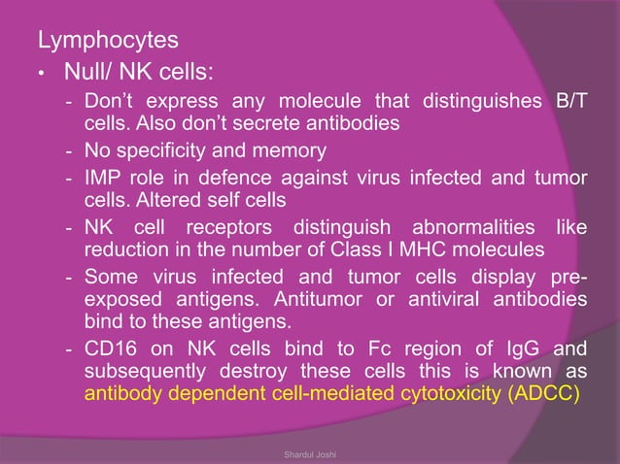

Slide 6
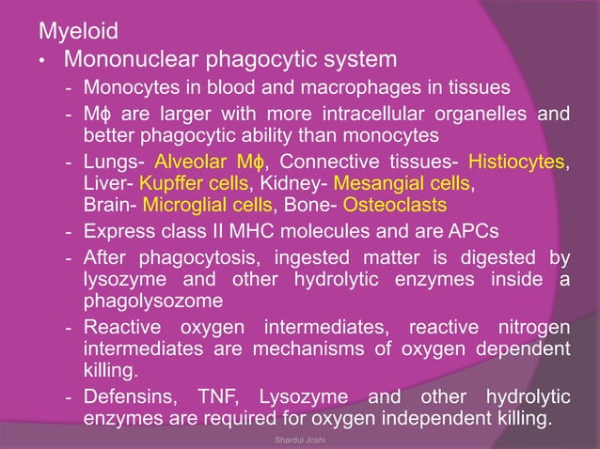

Slide 7
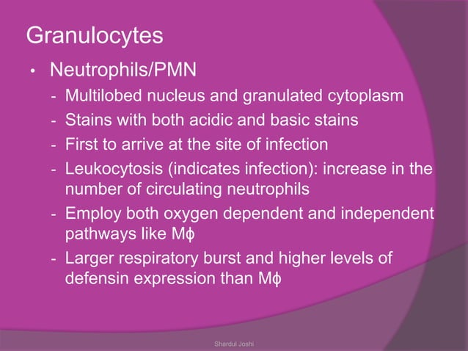

Slide 8
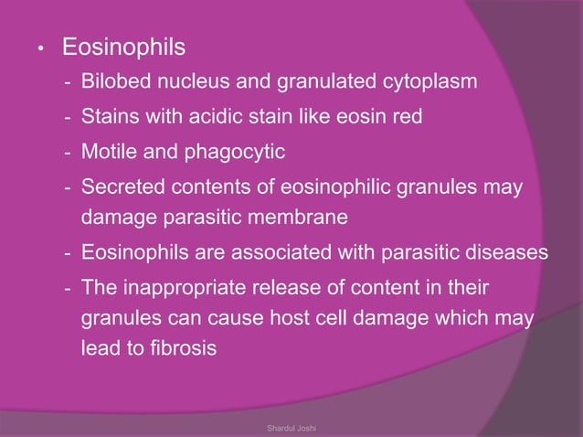

Slide 9
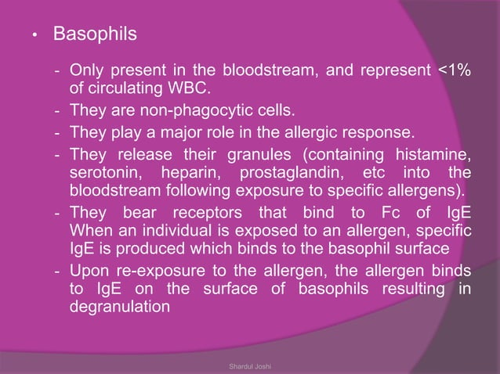

Slide 10
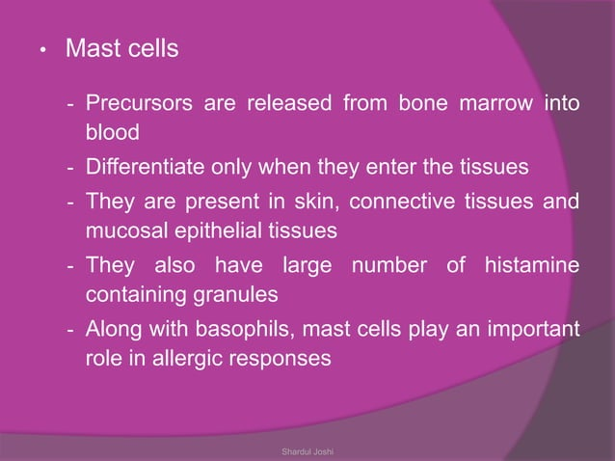

Slide 11
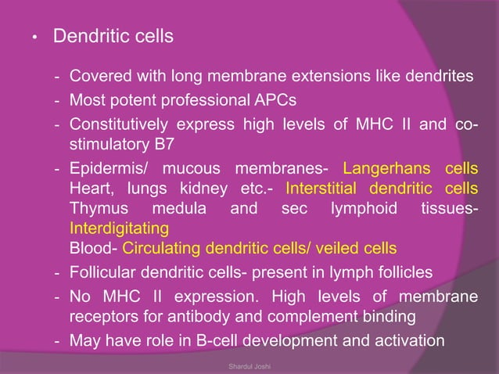

Slide 12
LYMPHOID organs OF FINFISHES
In all modern fish including both chondrichthyes and oestichthyes, thymus, spleen and somewhat develop gut lymphoid aggregates appear
Lymphoid organ system of finfishes contains lymphoid organs and their functions
Lymphoid system of finfishes is mainly grouped into two groups
  The primary lymphoid organs: Thymus and Anterior kidney
  The secondary lymphoid organs: Kidney, spleen, epigonal organs and mucosa associated lymphoid tissue
  Besides these organs, liver, skin, intestine and heart are also important organs take part in the defense

Slide 13
THE THYMUS
-The thymus plays a pivotal role in the development of the adaptive immune system
-It is a paired organ situated in the dorsolateral region of the gill chamber close to the opercular cavity
-the histology of thymus varies within the species
-may start developing as early as 24 hrs after fertilization
-as development starts the cells gradually differentiate into thymocytes and epithelial cell
-the major site of T-cell development

Slide 14
-unlike mammals, the outer cortex and inner medulla is poorly separated in many fish species
-covered by the modified stratified epithelium of the gill chamber
-the thymocytes are separated by single layer of epithelial cells from the water environment
-first organ to be lymphoid during histogenesis and aquires mature lymphocytes
-thymocytes appear in carp on day 4 post fertilization
-by day 5, immature and intermediate stage lymphocytes are found
-on day 10, B and T lymphocytes appear during organogenesis

Slide 15
-in rainbow trout, thymus appears before hatching and becomes fully lymphoid at the time of hatching
-In marine fishes - head kidney, spleen, and thymus
-small lymphocytes appear first in thymus and later in head kidney & spleen
-seems to originate from haematopoietic stem cells migrating from the head region of the kidney

Slide 16
Anterior Kidney
Like other vertebrates, the kidney is situated retroperitoneally and exterior to the dorsal wall or body cavity
Anatomy varies from species to species
Broadly classified into two parts :
•head or anterior kidney or pronephros
•posterior or trunk kidney or opisthonephros
The anterior kidney losses its excretory role once the fish matures
It contains only haematopoietic tissue

Slide 17
Predominantly a lympho-myeloid compartment
Lymphoid precursor tissue and mostly the generation and maturation of B lymphocytes occur in this tissue
Act as both primary as well as secondary lymphoid organs
Serves as a lymph node analogue, important in the induction and elaboration of immune responses
Indicate the importance of innate immune system during early stage of development
plays important role in non-specific immunity and the clearance of debris and damaged cells

Slide 18
  THE SECONDARY LYMPHOID ORGANS
  Provide structural organization for trapping and processing them in suitable ways for the cell that are capable of reacting to them
  Include spleen, Gut Associated Lymphoid Tissue (GALT) and mucosal
  immune system (MIS), epigonal organs in elashmobranch
  SPLEEN:
  The major peripheral lymphoid organ of all gnathostomus vertebrates
  Last organ to develop during histeogenesis of the lymphoid organs of teleost
  Has a fibrous capsule and small tubercles extend into the parenchyma- divide spleen into red and white pulp
  White pulp poorly developed & contains melano-macrophages
  Plays role in both haematopoiesis and immune reactivity

Slide 19
When the filtration happen, the foreign substances are retained in the ellipsoidal wall and subsequently taken up by macrophages surrounding the vessels
These cells then migrate into melano-macrophage centres
Melano-macrophage centres (MMCs)-
large nodule of macrophage aggregates
MMCs also found in intestinal submucosa, thymus, gill, brain and gonads but mostly in liver tissue
It has been described that immunological maturity of fish is attained after development of MMCs

Slide 20
FUNCTIONS OF MMCs:
Trapping of immune complex and production of high level of antibodies
Processing of antigens and prolonged retention of antigens
As bactericidal activity by the pigments such as lipofuscin, haemociderin and ceroid and melanin
Deposition of parasitic spores ad resistant bacterial pathogens

Slide 21
Gut Associated Lymphoid Tissue (GALT)
All vertebrates contain lymphoid cell isolates in the lamina propria and the intestinal epithelium-
Consists of nonencapsulated lymphoid accumulations
In all teleosts, diffuse accumulation of lymphoid tissue appear along the gut
Associated with specific innate immune activities
IgM has been identified in the gut mucus and bile of both chondrichthyes and oestichthyes

Slide 22
MUCOSA-ASSOCIATED LYMPHOID TISSUES (MALT)
The mucosal surface of gut, gills and skin are protected by both humoral and cellular defense mechanisms
Mucus contains several humoral factors and play role in defense mechanism
The wall of the organs is also infiltrated with lymphocytes and other leukocytes

Slide 23
OTHER TISSUES OF IMMUNOLOGICAL IMPORTANCE
Liver:
minor role in the defense mechanism
reticuloendothelial system- poorly developed- scavenging role
Kuffer cells: the liver macrophages
Heart:
endothelial cells have the capacity to take up foreign particle
transformed into macrophages

Slide 24
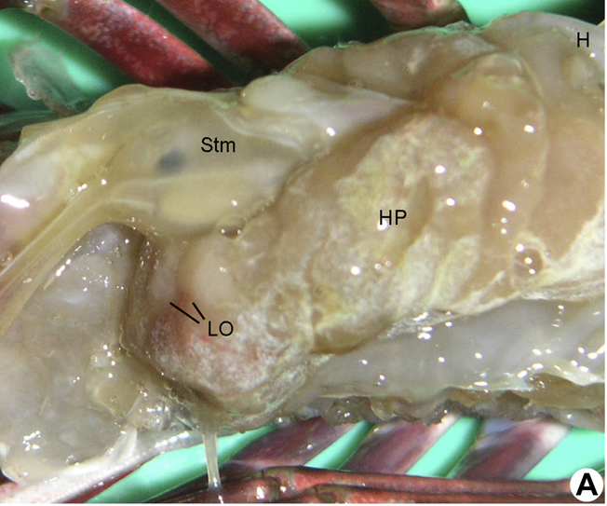
Lymphoid organ in crustaceans
Introduction
Also called as Oka organ
First described in
Penaeus orientalis by Oka
Identified only in
penaeid spp.

Slide 25
Location and Structure
Consists of two lobes situated ventero-anterior to hepatopancreas.
Lobes are similar and are surrounded by connective tissue capsules.
These are connected directly to heart by subgastric artery which supplies hemolymph to them.

Slide 26
Each lobe consists of tubules and the spaces in between which are occupied by hemal sinuses.
Lymphoid tubules (LT) consist of central lumen lined with flattened endothelial cells.
Next to endothelial lining there are two types of stromal cells.

Slide 27
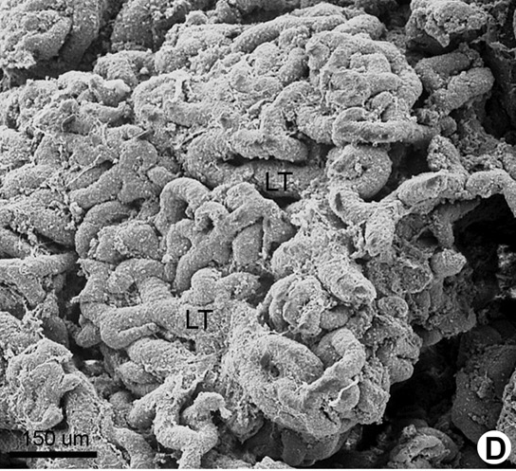
Tubules are encircled with connective tissue fiber.

Slide 28
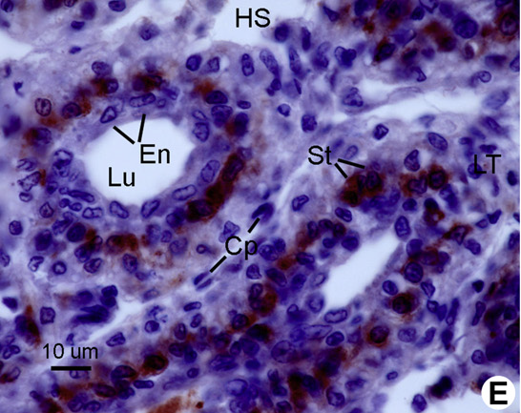

Slide 29
Functions
Involved in immunodefence against foreign materials.
Major phagocytic organ in penaeid shrimps.
Exerts bacteriostatic effect.
Has trapping ability to immobilise foreign material from hemolymph before this material enters the open circulatory system.
Major site for viral degradation by forming spheroid cells.

Slide 30


