Slide 1
CHROMOSOME MANIPULATION IN DISTANT HYBRIDIZATION
DEPARTMENT OF PLANT BREEDING AND GENETICS

Slide 2
INTRODUCTION
Chromosome manipulation - The term chromosome manipulation or chromosome engineering describes process or technologies in which chromosomes are manipulated to change their mode of genetic inheritance.
Distant hybridization - a cross of two individuals belonging to different species (interspecific hybridization) or genera , it is called as intergeneric hybridization

Slide 3
TECHIQUES OF DISTANT HYBRIDIZATION
Embryo Rescue
Alien Addition lines
Alien substitution lines
EMBRYO RESCUE :
When embryos fails to develop due to endosperm degeneration, embryo culture is used to recover hybrid plants

Slide 4
TYPES OF CHROMOSOMES MANIPULATION
Incorporation of a single or fragments of chromosome from a wild into the existing crops to enhance the genetic diversity
Incorporation of an alien chromosome by chromosomes doubling in order to produce amphidiploids
Elimination of an alien chromosome in order to induce haploids.

Slide 5
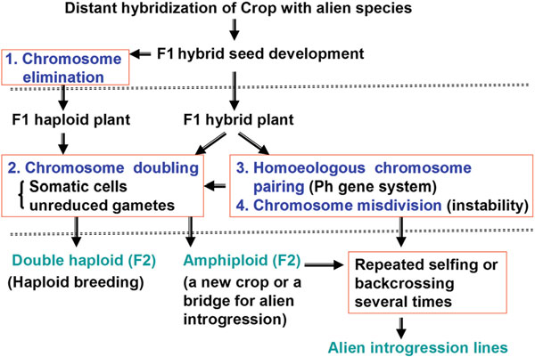
Fig. 1. Chromosome manipulation based on chromosome behaviors in F 1 hybrids.

Slide 6
CHROMOSOMES MANIPULATION IN CROP IMPROVEMENT
Chromosomes elimination and haploid crops
Chromosome elimination is the degeration of one parental chromosomes in F1 hybrid due to inactivation of kinetochore function.
production of doubled haploids
Chromosomes doubling and amphidiploids
Chromosome doubling can be carried out through the treatment with antimicrotubule drugs, Colchicine (originally extracted from autumn crocus ( Colchicum autumnale ).

Slide 7
Amphihaploid chromosomes of interspecific and intergeneric hybridizzation can be doubled by colchicine treatment.
Homeologous chromosomes pairing
The manipulation of Ph1 gene can relieve the restriction of homoeologous chromosome pairing and thus improve the efficiency of alien translocation development.

Slide 8
Advantages of chromosomes manipulation
Increase genetic diversity
Produce variability and varieties
Production of gene introgression lines
Overcoming barriers of distant hybridization
Limitation
Limited knowledge on process of gene expression and intremediary metabolism
Complex nature of DNA

Slide 9
Table 1: Seed development percentages (embryo formation in parenthesis) in bread wheat, durum wheat and hexaploid triticale crossed with pearlmillet and maize
Genotypes | pearlmillet |  |  | Maize |  | Mean
 | LGD-1-10-B | H-77/833-2P5 | 843B | NEC-7006 | CML-246XCML-242
Bread wheat
Norin 61 | 72.8(0.3) | 82.4(9.0) | 77.6(18.0) | 73.2(29.6) | 72.5(17.0) | 75.9a(20.6a)
Attila | 3.0(0.7) | 83.9(0.6) | 94.5(28.2) | 85.6(10.9) | 81.0(14.9) | 83.6a(11.0b)
Durum wheat
Sora/plata-12 | 3.0(0.7) | 48.9(14.1) | 16.7(8.5) | 20.0(4.5) | 29.794.3) | 23.7b(6.4bc)
Altar-84 | 0.0(0.0) | 25.6(8.1) | 2.7(0.4) | 7.6(2.0) | 0.3(0.0) | 7.2c(2.1de)

Slide 10
Cont..
Genotype | pearlmillet |  |  | Maize |  | Mean
 | LGD-1-10-B | H-77/833-2P5 | 843B | NEC-7006 | CML-246XCML-242
Hexaploid triticale
Anoas-3/ tatu-4 | 18.4(0.0) | 41.0(1.4) | 10.3(5.5) | 18.0(5.2) | 15.5(1.2) | 20.6b(2.7cd)
Jilotecpec-96 | 0.0(0.0) | 1.4(0.4) | 0.0(0.0) | 0.0(0.0) | 0.0(0.0) | 0.3c(0.1e)
Mean | 28.0(5.1b) | 47.2a(5.6b) | 33.6ab(10a) | 34.1a(8.7a) | 33.2a(6.2ab)
Ref: Inagaki and Hash; Plant Breeding 117, 485—487 (1998)

Slide 11
Table 2. Frequencies of haploid formation following crossing between wheat x job`s tears and maize
Cross | No. of crossed embryo | No. of formed embryo (%) | No. of haploids plants (%)
Wheat x Job`s tear | 218 | 23 | 6 (28)
Wheat x Maize | 1196 | 125 | 33(28)
The generated F1 plants from the cross of wheat x job`s tears carries 21 chromosomes indicating the complete elimination of chromosomes of job`s tears .
Colchicine treated F1 plants showed to carries 42 chromosomes i.e. the normal chromosomes of common wheat.
Job`s tears can be used as a suitable pollen donar plant for haploid wheat production.
(Ref.: K. Mochida and H. Tsujimoto. Production of wheat double haploid by pollination with job`s tears. Journal of heredity 2001.92(1)-82)

Slide 12
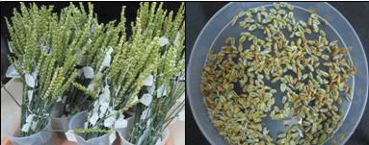
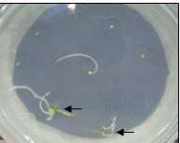
.
Fig. 1: Steps involved in wheat x maize system to develop haploid lines in wheat :
a) Spikes collected from the field b)Caryopses removed from the collected spikes c) Cultured embryos on half strength MS media (without growth regulator).
a.
b.
c.
Ref. : Bhattacharya et al. An insight into wheat haploid production using wheat x maize hybridization. J. App.Biol. Biotech.3 (05): 2015: 45

Slide 13
Table 3: Details of wheat x maize wide hybridization technique used to develop haploid lines in wheat
Wheat Genotype No. of Spikes (Pollination) No. of Caryopsis obtained No. of Haploid MW-1 51 150 -
MW-2 54 200 07 (3.5%)
MW-3 58 200 20 (10.0%)
MW-4 4 25 -
MW-5 58 - -
MW-6 71 - -
Total 296 575 27 (4.69%)
Average 49.33 143.75 13.5
SEM 9.49 40.00 3.30
Source : Bhattacharya et al. An insight into wheat haploid production using wheat x maize hybridization. J. App. Biol. Biotech.3 (05):2015:45

Slide 14
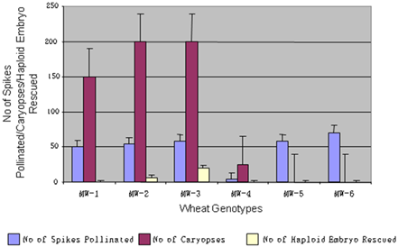
Ref. : Bhattacharya et al. J. App. Biol. Biotech.3 (05);2015:046

Slide 15
Inference
Higher percentage of embryo formation (3.5-10.0%) was observed on half strength MS media without growth regulators.
This technology may be used to reduce the time for release of new wheat varieties.
Wheat x maize system of double haploid development could be the method of choice for wheat breeding programs.
(Bhattacharya et al. J. App. Biol. Biotech. 3 (05): 2015)

Slide 16
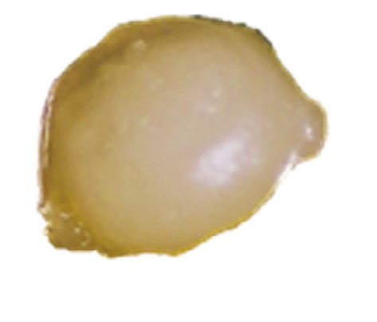
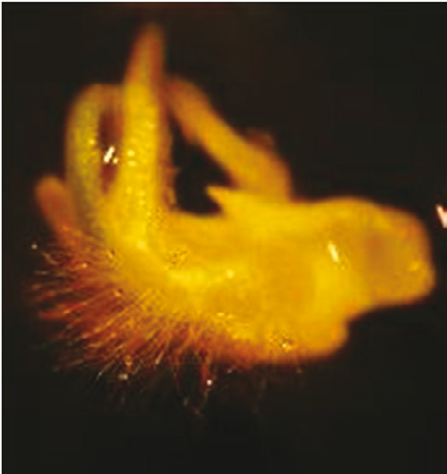
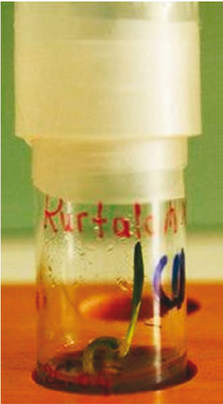
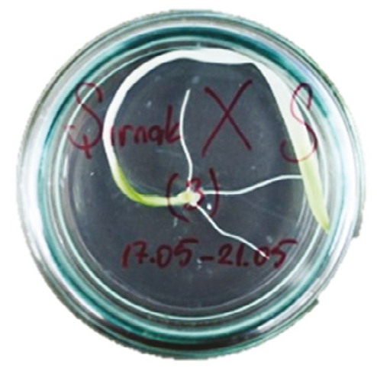
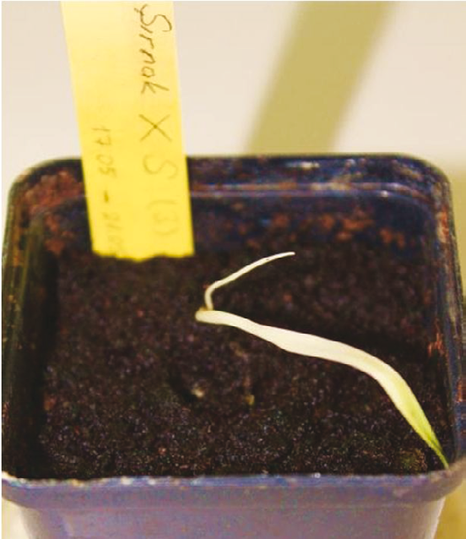
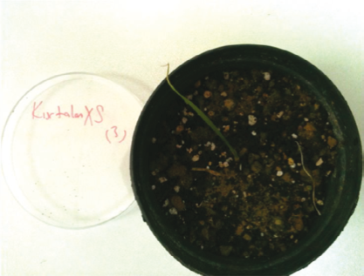
Fig. 2. Durum wheat × I. cylindrica derived dihaploid embryo formation and plant regeneration:
a) isolated embryo 14–16 days after hybridization; b) dihaploid embryo regeneration in MS medium (20 days after incubation);
c, d) the rooted regenerants (30 days after incubation);
e, f) the plantlets in acclimatization.
a.
b.
c
d
e
f
Ref. Celiktas et al. Production of dihaploids in durum wheat using Imperata cylindrica L. mediated chromosome elimination. Turk. J. Agric. For (2015) 39: pg.50

Slide 17
Table 4. The efficiency of I. cylindrica mediated chromosome elimination technique with respect to seed setting % in crosses with durum wheat.
wheat genotypes | Seed setting % Alahan Antakya samandag
Sirnak | 14.6 0.0 20.0
Havrani | 2.5 0.0 2.7
Karadere | 4.5 0.0 11.1
Kurtalan | 7.1 0.0 31.1
Menceki | 4.4 8.6 3.4
Devedesi | 6.8 0.0 8.6
Minnaret | 8.3 0.0 12.6
Hacihalil | 13.4 0.0 8.2
Bagicak | 3.2 0.0 7.6
Karakilcik | 4.6 6.8 10.0
Diyabakir-81 | 12.7 0.0 24.3
Mean | 7.5 1.4 12.7
# Celiktas et al. / Turk J Agric For(2015): 39 pg. 51

Slide 18
Table 5. The efficiency of I. cylindrica mediated chromosome elimination technique with respect to embryo formation % in crosses with durum wheat
wheat genotypes | Embryo formation %
 | Alahan | Antakya | samandag
Sirnak | 9.1 | 0.0 | 15.5
Havrani | 3.8 | 0.0 | 1.1
Karadere | 4.9 | 0.0 | 8.6
Kurtalan | 4.2 | 0.0 | 13.1
Menceki | 2.3 | 6.3 | 2.7
Devedesi | 4.2 | 0.0 | 4.1
Minnaret | 6.8 | 0.0 | 5.2
Hacihalil | 4.7 | 0.0 | 5.8
Bagicak | 3.8 | 0.0 | 3.7
Karakilcik | 1.5 | 3.2 | 7.7
Diyabakir-81 | 6.9 | 0.0 | 13.3
Mean | 4.7 | 0.9 | 7.3
# Celiktas et al. / Turk J Agric For (2015): 39 pg. 51

Slide 19
Table 6. The efficiency of I. cylindrica mediated chromosome elimination technique with respect to regeneration % in crosses with durum wheat genotypes.
wheat genotypes | No. pollinated florret | Regeneration %
 |  | Alahan | Antakya | Samandag
Sirnak | 276 | 0.0 | 0.0 | 6.1
Havrani | 96 | 0.0 | 0.0 | 0.0
Karadere | 139 | 0.0 | 0.0 | 2.5
Kurtalan | 338 | 4.6 | 0.0 | 11.5
Menceki | 142 | 0.0 | 0.0 | 4.6
Devedesi | 64 | 0.0 | 0.0 | 0.0
Minnaret | 148 | 0.0 | 0.0 | 0.0
Hacihalil | 64 | 0.0 | 0.0 | 0.0
Bagicak | 102 | 0.0 | 0.0 | 0.0
Karakilcik | 112 | 0.0 | 0.0 | 0.0
Diyabakir-81 | 248 | 4.6 | 0.0 | 3.1
Mean |  | 0.8 | 0.0 | 2.5
# Celiktas et al. / Turk J Agric For (2015): 39 pg. 51

Slide 20
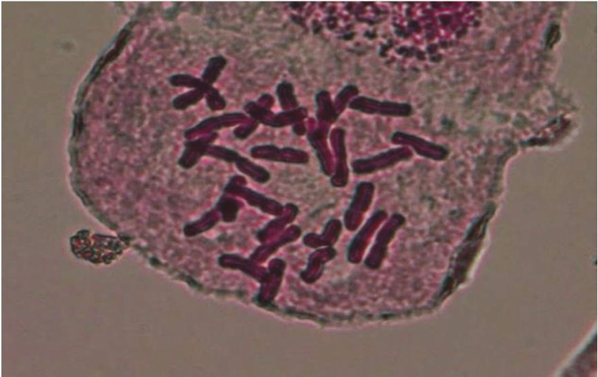
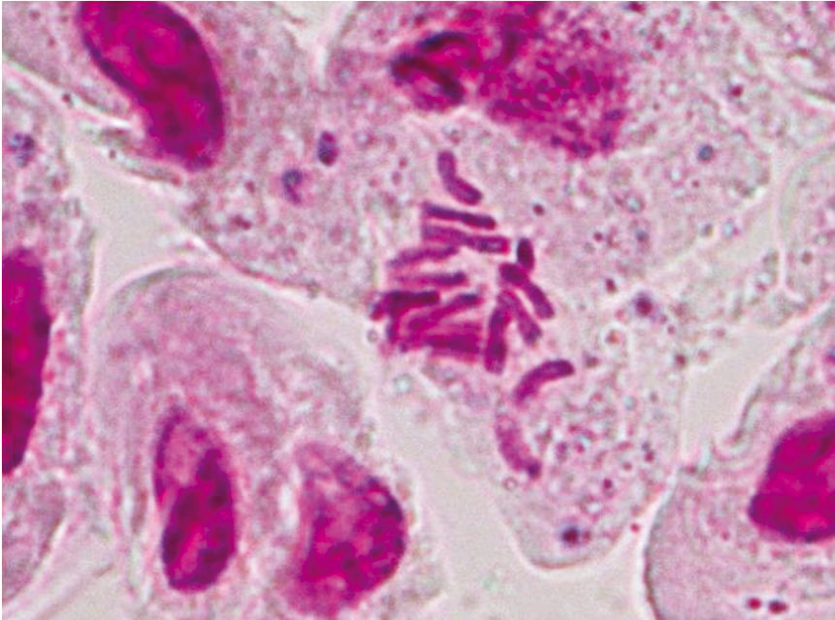
Fig. 3. Cytological investigations of the maternal tetraploid durum wheat (genotype Kurtalan) (2n = 4x = 28) (a) and regenerated doubled haploid plantlets (genotype Kurtalan) (2n = 2x =14) (b) obtained from the interspecific hybridization of wheat × I. cylindrica derived embryos.
a.
b.
Ref.: Celiktas et al. Production of dihaploids in durum wheat using Imperata cylindrica L. mediated chromosome elimination. Turk. J. Agric. For (2015) 39: pg.52

Slide 21
Inference
Chromosomes elimination mediated techniques are the method choice for haploids production in cereals.
Interspecific hybridization with Imperata cylindrica results in production of maternal haploid( complete loss of parental chromosomes).
Effective in the production of wheat haploids for large scale production and for gene mapping and other breeding studies.
(Celiktas et al. Turk. J. Agric. For (2015) 39: 48-54)

Slide 22
CONCLUSION
Chromosomes manipulation techniques manipulated the chromosomes change their mode of genetic inheritance.
It is useful in the development of various varieties and lines of crops with desireable traits (transfer from wild to cultivated crops).
It is an important technique to create genetic diversity in crops species( which is the basic for crop improvement and breeding).

Slide 23
THANK YOU

