Slide 1
introduction
The Communication Stack (COM) is an integral part of the Autosar (AUTomotive Open System ARchitecture) framework.
It facilitates communication between different software components within Electronic Control Units (ECUs) and between ECUs in a vehicle.
Purpose of the Communication Stack
Enable seamless and standardized inter-ECU communication.
Provide a consistent interface for software components to exchange data.
Ensure efficient and reliable communication across various automotive networks.

Slide 2
Communication Stack Components
1. Communication Services
Responsible for managing communication services and protocol handling.
Implement communication protocols such as CAN, LIN, FlexRay, Ethernet, etc.
Ensure data transmission and reception between ECUs.
2. Service Interface
Defines a set of standardized methods that software components use to access communication services.
Provides an abstraction layer, enabling components to remain independent of the underlying communication protocols.

Slide 3
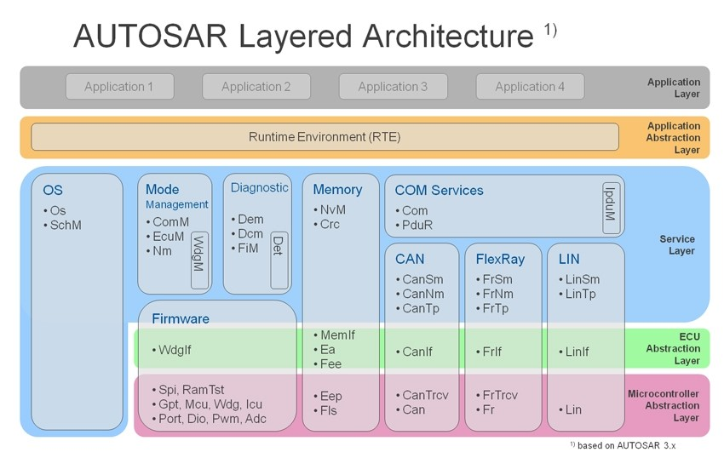
Communication Stack Architecture
The Communication Stack is divided into several layers, each with specific responsibilities.
Higher layers interact with application software, while lower layers interact with communication hardware.

Slide 4
Communication Stack Layers
1. Application Layer
Topmost layer interacts with application software.
Comprises software components and application interfaces.
Requests for data transmission/reception are initiated from this layer.
2. RTE (Run-Time Environment) Layer
Handles the exchange of information between the Application Layer and the Communication Layer.
Encapsulates data and prepares it for communication.
3. Communication Layer
Manages communication services and protocols.
Ensures efficient data transfer between ECUs using the specified communication protocol (e.g., CAN, FlexRay).
4. Bus-specific Interface Layer
Serves as an interface between the Communication Layer and the bus-specific drivers.
Adapts the data to the specific requirements of the communication bus (e.g., CAN driver).

Slide 5
Communication Stack Benefits
1. Standardization
Autosar-compliant Communication Stack ensures interoperability among various ECUs and communication hardware from different suppliers.
2. Scalability
Adaptable to different vehicle architectures and communication requirements.
Supports both small and large-scale automotive systems.

Slide 6
Conclusion
The Communication Stack (COM) is a crucial component of Autosar, enabling standardized communication between ECUs in modern vehicles.
It provides a robust and flexible solution for inter-ECU communication, contributing to the overall efficiency, safety, and reliability of automotive systems

