Slide 1
Introduction
What is the AUTOSAR Runtime Environment (RTE)?
The AUTOSAR Runtime Environment (RTE) is a crucial component of the AUTOSAR (AUTomotive Open System ARchitecture) framework.
It acts as an intermediary between the application software and the underlying software platform, facilitating their interaction.
Purpose of the AUTOSAR Runtime Environment
Provide an abstraction layer between application software and the software platform.
Enable efficient communication and coordination among software components.
Ensure the proper execution and synchronization of tasks in a distributed system.

Slide 2
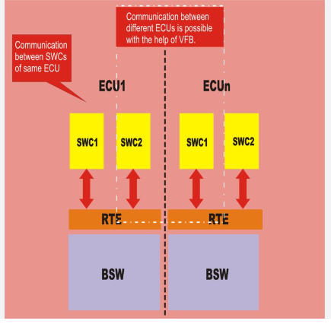

Slide 3
Key Features of the AUTOSAR Runtime Environment (RTE)
1. Inter-Software Component Communication
RTE facilitates communication between different software components in the system.
It manages the exchange of data, signals, and events among components.
2. Run-Time Management
RTE manages the execution and scheduling of software components at run-time.
It ensures proper sequencing and synchronization of tasks according to their priorities and timing requirements.
3. Memory Management
RTE handles memory management for software components.
It provides mechanisms for memory allocation and deallocation within the system.
4. Diagnostic Event Management
RTE supports the handling and reporting of diagnostic events.
It enables the monitoring and reporting of system and component-level diagnostic information.

Slide 4
AUTOSAR RTE Architecture
The AUTOSAR RTE consists of several layers, each serving specific functions.
These layers work together to provide the necessary runtime environment for the software components.

Slide 5
AUTOSAR RTE Layers
1. Application Software Layer
Topmost layer containing the application software components.
Components interact with each other through RTE services and APIs.
2. RTE Layer
Acts as the core layer of the RTE, providing run-time management and communication services.
It handles task scheduling, inter-component communication, and event handling.
3. ECU Abstraction Layer (EAL)
Provides an abstraction of the underlying hardware and software platform.
Handles platform-specific details such as I/O access, timers, and interrupts.
4. Basic Software Layer (BSW)
Lowest layer of the RTE, consisting of the AUTOSAR basic software modules.
BSW modules provide foundational services such as memory management, communication drivers, and diagnostic functionalities.

Slide 6
Benefits of AUTOSAR RTE
1. Modularity and Reusability
AUTOSAR RTE enables the development of modular and reusable software components.
Components can be easily integrated into different vehicle platforms.
2. Efficient Communication and Coordination
RTE provides efficient inter-component communication and task coordination mechanisms.
Enables seamless interaction and cooperation among software components.

Slide 7
Conclusion:
The AUTOSAR Runtime Environment (RTE) is a vital component of the AUTOSAR framework, facilitating efficient communication and coordination among software components.
The RTE provides an abstraction layer between application software and the software platform, ensuring proper execution and synchronization of tasks.

