Slide 1
RTE Configuration and Code Generation

Slide 2
Introduction
RTE (Run-Time Environment) Configuration and Code Generation are crucial steps in the development of embedded systems software. The RTE provides the necessary infrastructure for the execution of software components in an embedded system, and its configuration involves defining the communication and synchronization mechanisms between these components. Code generation, on the other hand, refers to the process of generating source code or binary code from a higher-level representation, such as a model or a configuration.

Slide 3
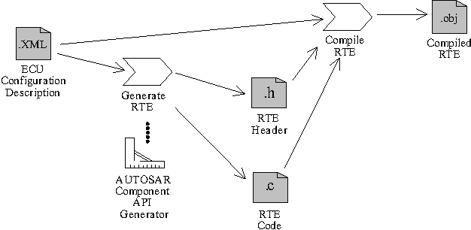

Slide 4
Process
Software Component Design: Before configuring the RTE, the software components and their interfaces need to be designed. This involves breaking down the system functionality into smaller components and defining the inputs, outputs, and dependencies of each component.
RTE Configuration: The RTE configuration involves defining the communication and synchronization mechanisms between the software components. This typically includes configuring inter-component communication channels, such as message queues, event queues, or shared memory, and specifying the timing and scheduling requirements for the components.

Slide 5
To Be contd..
RTE Code Generation: Once the RTE is configured, code generation tools or frameworks can be used to generate the source code or binary code for the software components and the RTE infrastructure. The code generation process typically takes into account the defined interfaces, communication mechanisms, and timing requirements to produce the necessary code.
Integration and Compilation: After code generation, the generated code needs to be integrated with the rest of the system and compiled. This involves combining the generated code with any existing code or libraries, resolving dependencies, and compiling the entire system into executable form.

Slide 6
To becontibued..
Deployment and Execution: The compiled software is then deployed onto the target hardware platform. This can involve flashing the code onto microcontrollers, installing the software on embedded systems, or deploying it on other appropriate hardware. Once deployed, the software can be executed within the embedded system, utilizing the RTE infrastructure for communication and synchronization between components.

Slide 7
Key Points for code generation
Key points about code generation:Automation: Code generation reduces manual coding efforts by automatically generating code from higher-level representations.
Consistency: It ensures consistency between the system design and the resulting code, reducing the chances of errors or inconsistencies.
Efficiency: Code generation tools can optimize the generated code for performance, memory usage, or other constraints.
Portability: Generated code can be platform-independent or tailored for specific hardware platforms, facilitating portability.

Slide 8
Conclusion
It's important to note that the specific tools, frameworks, and methodologies used for RTE configuration and code generation can vary depending on the embedded system development environment and the programming language being used. Different industries and domains may also have their own specialized tools and standards for these processes.

