Slide 1
Software Component Template (SWC)

Slide 2
Introduction
A Software Component Template (SWC) is a predefined structure or blueprint used for designing and implementing software components in embedded systems. It provides a standardized format for organizing the code, interfaces, and behavior of the component. SWCs are commonly used in methodologies like AUTOSAR (AUTomotive Open System ARchitecture) in the automotive industry.

Slide 3
Structure of SWC
It includes:
Component Identifier: A unique name or identifier assigned to the software component for identification and referencing purposes.
Interfaces: SWCs define a set of interfaces that enable communication and interaction with other components or the runtime environment. These interfaces can be categorized as provided interfaces (exposed by the SWC) and required interfaces (used by the SWC to communicate with other components or services).

Slide 4
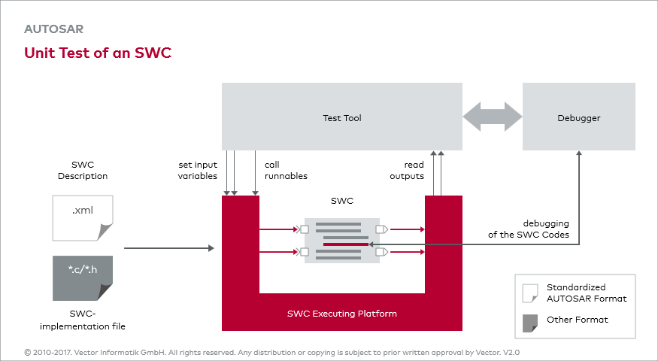

Slide 5
Data Elements: SWCs define data elements representing inputs, outputs, or internal variables required for the component's operation. These data elements have specific data types and properties, such as read/write access, initialization values, or ranges.
Runnable Entities: SWCs can contain one or more runnable entities, which represent units of code execution within the component. Each runnable entity corresponds to a specific behavior or functionality and is associated with a particular execution context or trigger condition.
Internal Behavior: SWCs define the internal behavior or logic that governs the component's operation. This includes the implementation of runnable entities, state machines, control algorithms, or any other logic necessary for the component's functionality.

Slide 6
Configuration Parameters: SWCs may include configurable parameters that allow customization of the component's behavior or properties. These parameters can be set during the configuration phase of embedded system development, enabling flexibility without modifying the underlying code.
Initialization and Shutdown Hooks: SWCs can define initialization and shutdown hooks, which are code sections executed when the component is started or stopped. These hooks handle necessary initialization or cleanup tasks required by the component.
Timing and Scheduling: SWCs may specify timing and scheduling requirements, such as execution periods, deadlines, or priorities, to ensure proper integration and coordination within the overall system.

Slide 7
Conclusion
It's important to note that the structure and terminology of SWCs can vary depending on the specific development methodology, industry standards, or tools used. The SWC structure outlined here provides a general understanding of the common elements found in SWC templates.

