Slide 1
Error Handling in AutoSAR: Diagnostic Event Manager (DEM) and Error Tracer (DET)

Slide 2
Introduction
Error handling is crucial in developing reliable automotive software.
AUTOSAR provides components for effective error handling.
Diagnostic Event Manager (DEM) and Error Tracer (DET) are key components in AUTOSAR error handling.

Slide 3
Diagnostic Event Manager (DEM)]
Manages and reports diagnostic events and errors.
Functions:
Event Reporting: Collects diagnostic events from software components.
Event Classification and Aggregation: Groups events based on severity or priority.
Diagnostic Status Management: Tracks event status and lifecycle.
Error Reporting: Generates error reports for external diagnostic systems.
Failure Memory Management: Stores critical event information.

Slide 4
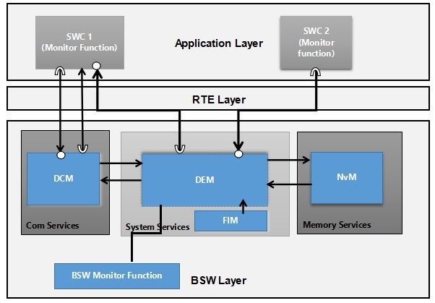

Slide 5
Error Tracer (DET)
Provides additional capabilities for error handling within DEM.
Functions:
Error Detection and Reporting: Identifies runtime errors and generates diagnostic events.
Error Propagation: Communicates error information to higher-level components.
Error Recovery: Triggers recovery or mitigation actions.
Error Memory: Stores recent error information for troubleshooting.

Slide 6
Error Handling Benefits
Standardized error handling framework.
Fault detection and diagnosis.
Centralized error reporting and management.
Error recovery and mitigation.
Troubleshooting and root cause analysis.

Slide 7
Error Handling Process
Diagnostic Event Generation:
Components detect errors or abnormal conditions.
Generate diagnostic events.
Diagnostic Event Manager (DEM):
Collects and aggregates events.
Manages event lifecycle and status.
Generates error reports.

Slide 8
Error Tracer (DET):
Monitors component execution.
Detects runtime errors.
Propagates errors and triggers recovery.
Error Reporting and Analysis:
Error reports communicated to diagnostic systems.
Troubleshooting and root cause analysis using error memory.

Slide 9
Conclusion
DEM and DET are key components in AUTOSAR error handling.
Enable effective management, reporting, and recovery of diagnostic events.
Enhance reliability, maintainability, and diagnostics of automotive software

