Slide 1
Topic – 3
AutoSAR Architecture: Layered architecture and software components

Slide 2
Introduction
AutoSAR (Automotive Open System Architecture) is a standardized automotive software architecture framework.
It provides a common platform for developing reusable and interoperable software components in the automotive industry.
The AutoSAR architecture follows a layered structure and comprises various software components.

Slide 3
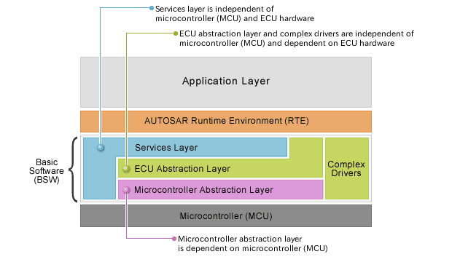
Layered Architecture
AutoSAR follows a layered architecture, consisting of four main layers: Application Layer, RTE Layer, Basic Software Layer, and Microcontroller Abstraction Layer (MCAL).
Each layer has its specific functionality and interacts with the layers above and below it.

Slide 4
Application Layer
The Application Layer is the topmost layer in the AutoSAR architecture.
It includes the application-specific software components, such as functions for vehicle control, diagnostics, and communication.
The Application Layer communicates with the RTE Layer using standardized interfaces and services.

Slide 5
RTE Layer
RTE stands for Run-Time Environment.
The RTE Layer acts as a mediator between the Application Layer and the lower layers.
It provides inter-task communication, manages data exchange, and handles the scheduling and timing requirements of the software components.
The RTE Layer ensures the decoupling of application-specific software components from the underlying hardware.

Slide 6
Basic Software Layer
The Basic Software Layer provides the fundamental services and functions required by the software components.
It includes modules for services like communication, memory management, diagnostics, and operating system (OS) abstraction.
The Basic Software Layer abstracts the hardware-specific details and provides a standardized interface for the upper layers.

Slide 7
Conclusion
The AutoSAR architecture provides a structured framework for automotive software development.
The layered architecture and software components ensure modularity, interoperability, and scalability.
AutoSAR facilitates the development of reliable and standardized software systems in the automotive industry.

